Slide 1




Analytics Employee Attrition & Performance
IBM HR
Kinga Klejne
Katarzyna Hewelt
Piotr Nowicki
Dariusz Starosta

Slide 2


Slide 3
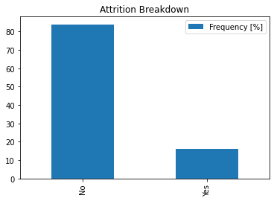
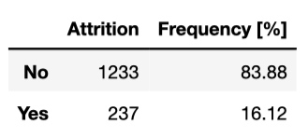
Attrition

Slide 4
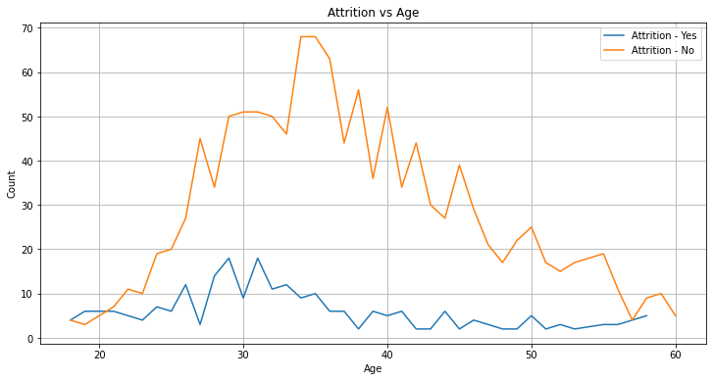
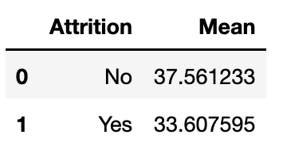
Age

Slide 5
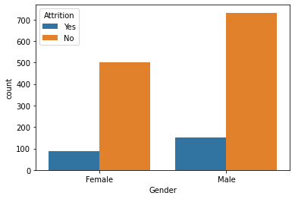
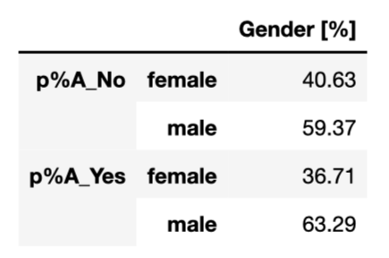
Gender

Slide 6
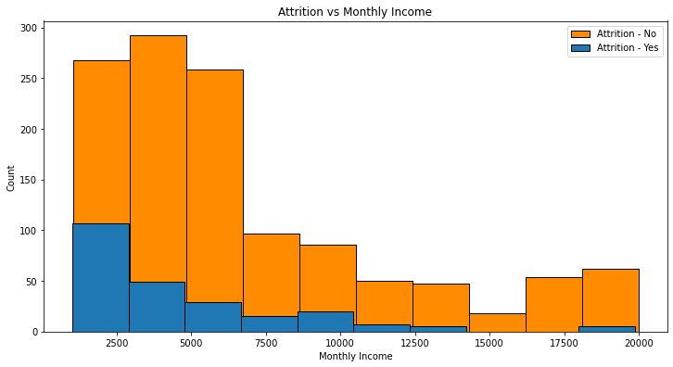
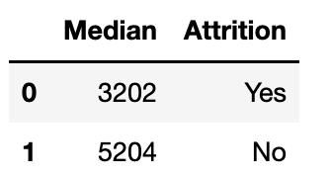
Monthly Income
With the higher salary rate - it is more likely that the employee will stay at the company.

Slide 7
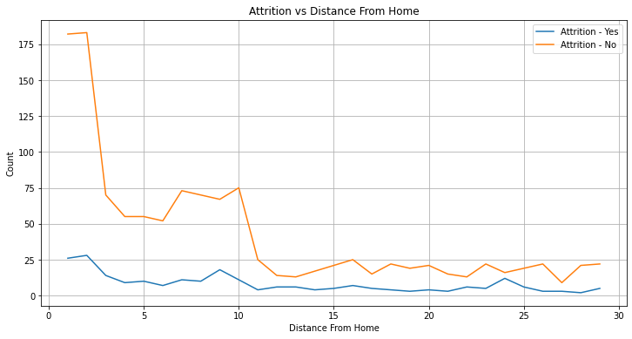
Distance From Home
Employees who live closer to the workplace - tend to stay at the company.

Slide 8
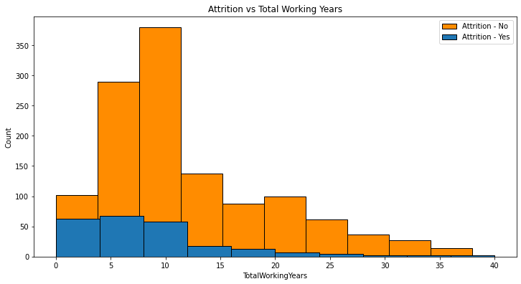
Overall work experience
Employees who started their career with the company- or have switched to the company in the initial years of their career, have a higher chances of leaving the organization to a different company. People who have gained much experience tend to stay in the company.

Slide 9
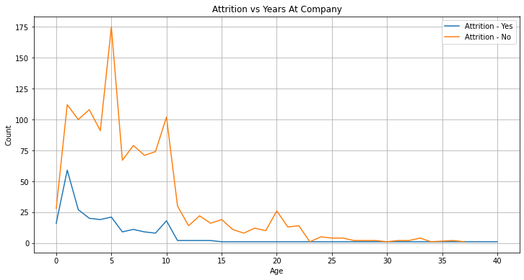
Current Work Experience
People with lower experience at the company are more likely to quit. First year is the most crucial.

Slide 10


