Slide 1


< Docker for developers
– tips and tricks >
Piotr Zalewski / TomTom PU AD

Slide 2

We will not talk about ...
Not about production use of Docker
Not about tests environments

Slide 3
We will not talk about ...
Not about production use of Docker
Not about tests environments
We will talk about using Docker for developers tools on your laptop/workstations.

Slide 4
“Why we want use Docker on our laptops???”
Sebastian sorry !

Slide 5
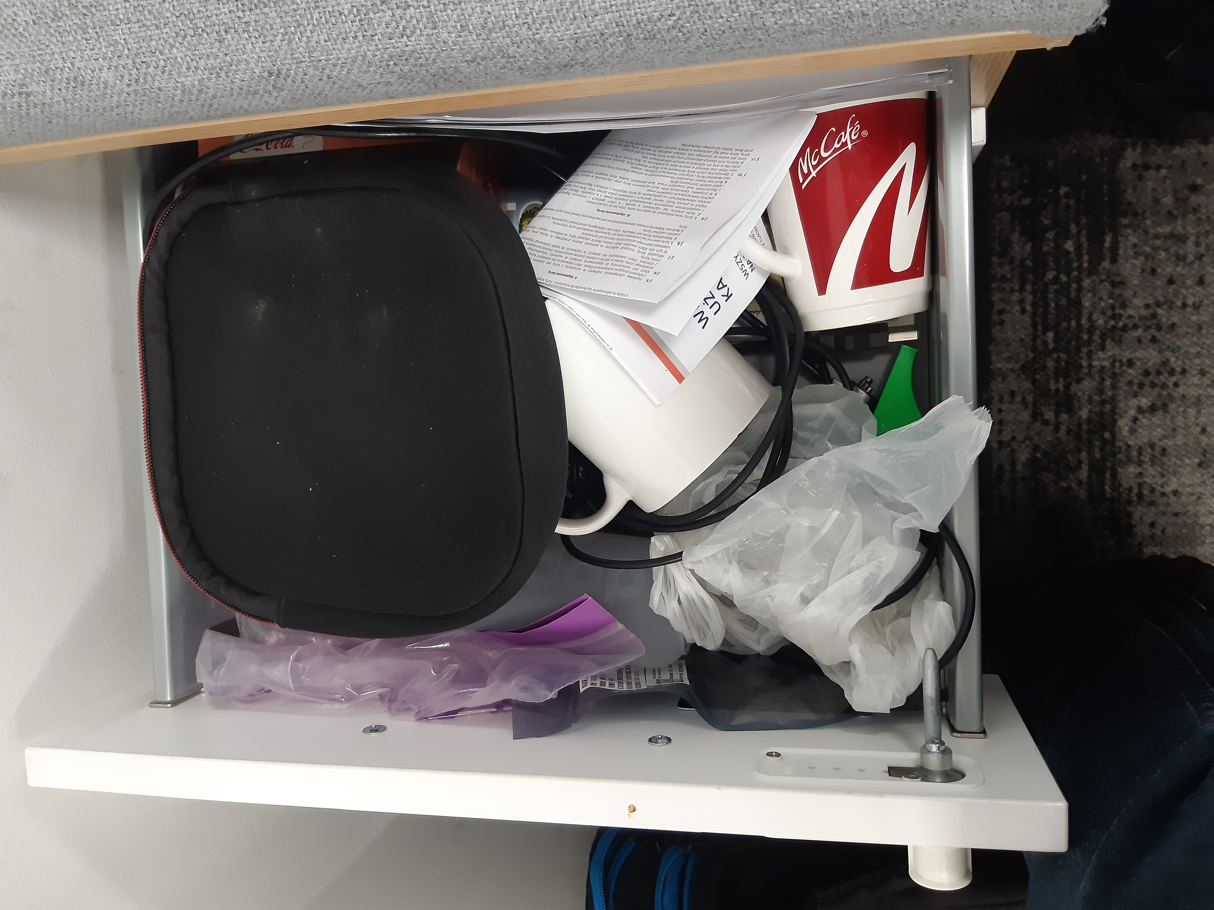

Slide 6
WhY ???
Isolation
Experience with docker

Slide 7
Using ready images
There is about 3 milions ready
images on hub.docker.com
Tool name | Count
mysql | 18.163
postgresql | 4.137
java | 21.419
consul | 2.988

Slide 8
Testing sql query
Pg9.6
Select smth from ...
Pg11

Slide 9
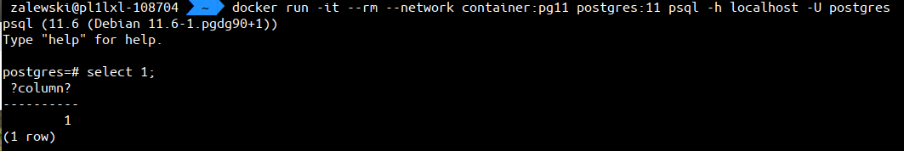
Testing sql query
docker run -d --name pg9.6 -e POSTGRES_PASSWORD=mysecret
postgres:9.6
docker run -d --name pg11 -e POSTGRES_PASSWORD=mysecret
postgres:11

Slide 10
VSCode

Slide 11
VSCode
docker run -it -p 8080:8080
-v "$(pwd):/home/coder/project"
codercom/code-server --auth none

Slide 12
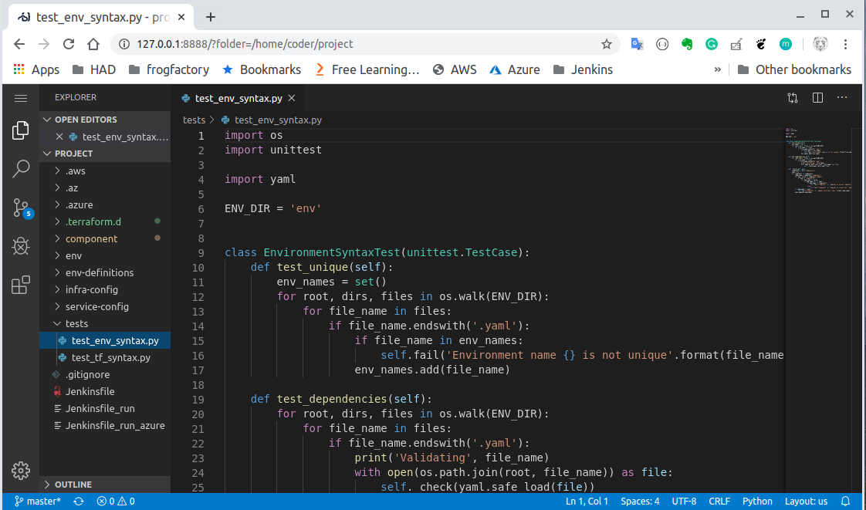

Slide 13
Cloud utils
aws, az, kubectl – diffrent versions

Slide 14
Cloud utils
docker run -it --rm
-e AWS_SECRET_KEY = XXXSSDSXSXXXX
-e AWS_ACCESS_KEY = XSwewedfwewee
pzalews/awscli
aws rds describe-db-instances --output table

Slide 15
Cloud utils
docker run -it –rm
-v ~/.aws:/aws/.aws:ro
pzalews/awscli
aws rds describe-db-instances --output table

Slide 16
Cloud utils
alias awsd=
'docker run -it --rm
-v "$(pwd):/aws"
-v ~/.aws:/aws/.aws:ro
-e AWS_PROFILE=had-dev
pzalews/awscli aws'

Slide 18
Consul
How to run some tools on my local netowork interface?

Slide 19
Consul
How to run some tools on my local netowork interface?
alias consul=
'docker run -d --rm
-e CONSUL_BIND_INTERFACE=enxa44cc8d6bc80
--net=host
consul'

Slide 20
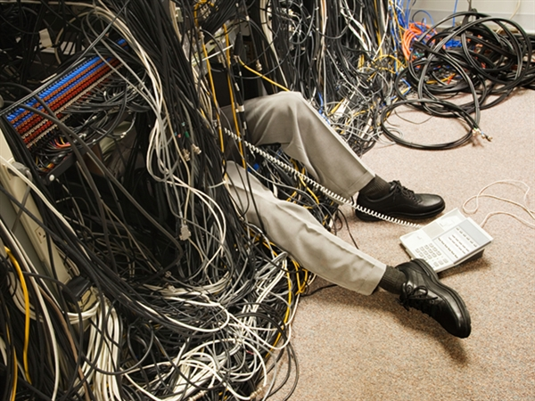
Debug network trafic

Slide 21
Debug network trafic
Run our main service
docker run --name ubuntu -it ubuntu /bin/bash

Slide 22
Debug network trafic
docker run --name ubuntu -it ubuntu /bin/bash
docker run --net=container:ubuntu
-v $(pwd)/temp:/dump
corfr/tcpdump -s 65535 -w /dump/test.dump

Slide 23
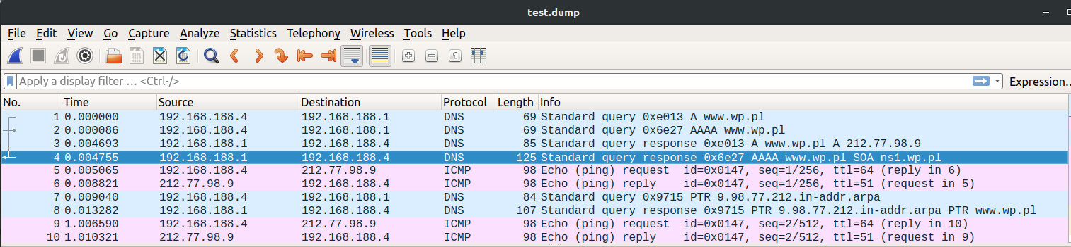

Slide 24
More docker, more...
X

Slide 25
More docker, more...
X→Vnc

Slide 26
More docker, more...
X→Vnc
Http client for vnc

Slide 27
More docker, more...
docker run -d -p 6080:6080
lukaszlach/kali-desktop:xfce-top10

Slide 28
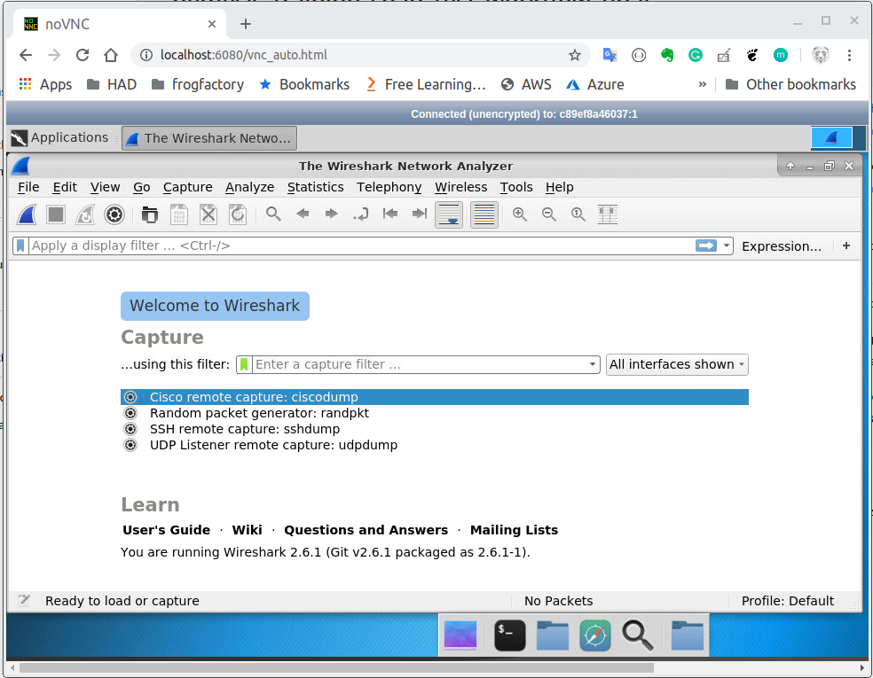

Slide 29
Dockerizing your tools

Slide 30
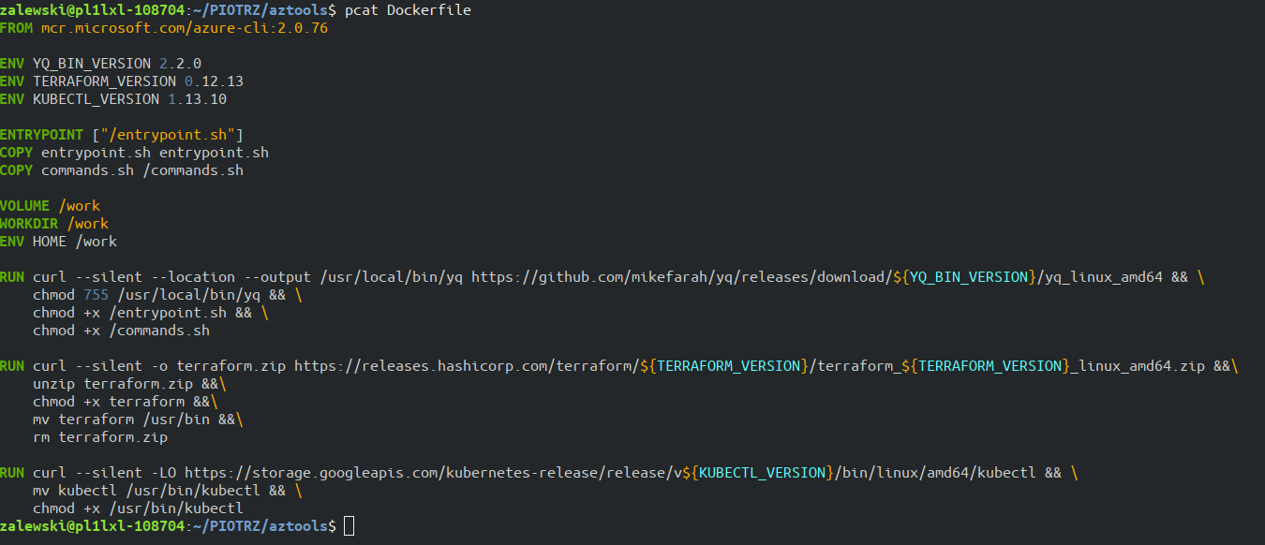
Dockerfile

Slide 31
Docker build
docker build -t imagename .

Slide 32
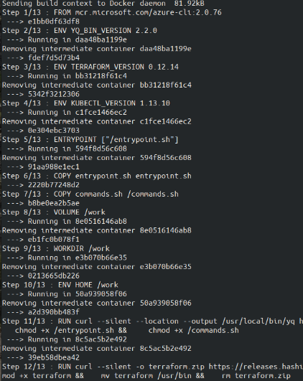

Slide 33
Docker buildkit
export DOCKER_BUILDKIT=1
(starting from Docker 18.09)
New tty output
Better caching
Mounting folders for build time only
Adding secrets for build time only
Parrallel build

Slide 34
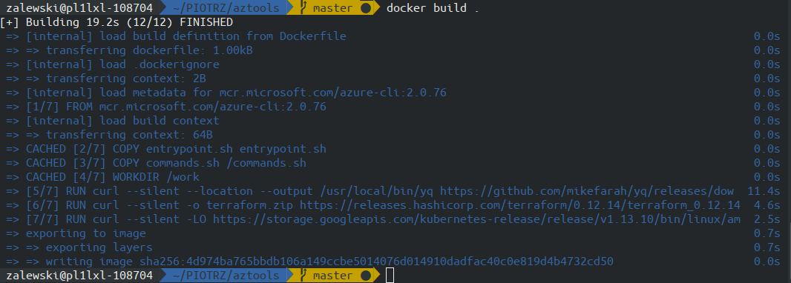

Slide 35
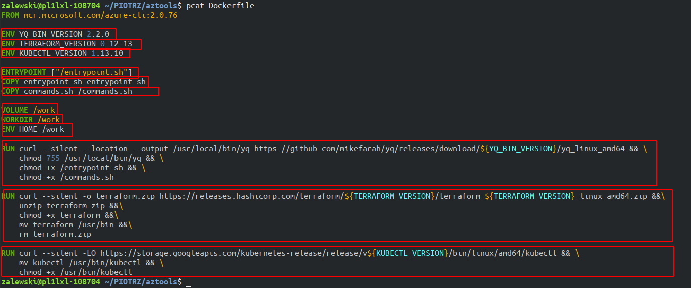
Layers

Slide 36
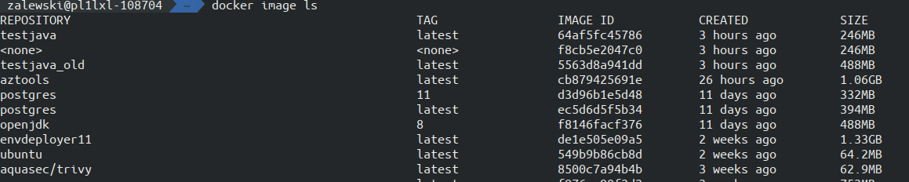
Image size
What is eating my space ?
docker image ls

Slide 37
Image size
docker image history imagename

Slide 38
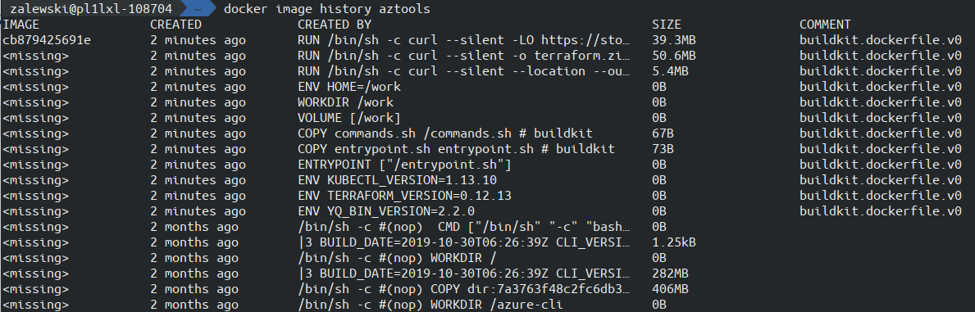

Slide 39
Docker build context
One of first steps in build process is sending build context to docker daemon.
Default build contect is whole directory with all subfolders.
Tip: The rule of thumb is not adding files to the build context, if you do not need them in your Docker image.
The Docker context should be minimal and secret-free.
Use wisely .dockerignore

Slide 40
Docker build context
docker build -f- out/ < Dockerfile

Slide 41
Layers

Slide 42
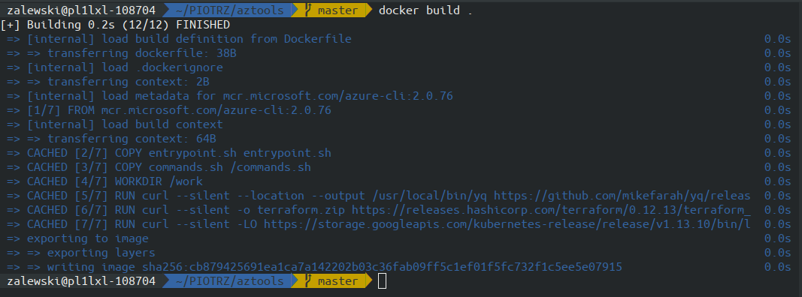

Slide 44
Lint for Dockerfile
docker run --rm -i hadolint/hadolint < Dockerfile

Slide 46
Cleaning after work

Slide 47
Logs
docker run -it
--log-opt max-size=10m
alpine ping 127.0.0.1

Slide 48
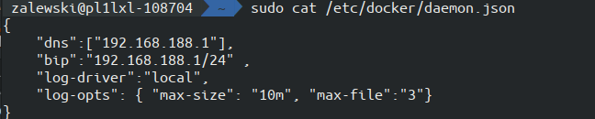
Logs
add “log-opts”: { “max-size”: “10m”, “max-file”:“3”}

Slide 49
System prune
docker system prune -f
This doesn’t clean by default:
Running containers
Tagged images
Volumes

Slide 50
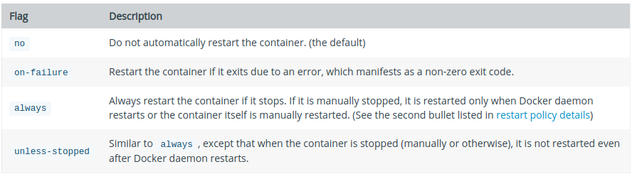
Restart options

Slide 51
Crontab by docker
docker run -d --restart=unless-stopped --name cleanup
-v /var/run/docker.sock:/var/run/docker.sock
docker
/bin/sh -c "while true; do docker system prune -f && date ; sleep 24h; done"

Slide 52
Multistage build
Show time

Slide 53
Thank you!

