Slide 1

SVD Based Face Recognition
Computational Numerical Methods (IT -509)
Presented by :
ALOKENDU MAZUMDER (201916003)
PIOUS PRADHAN (201916010)

Slide 2
Abstract
Identifying face of a person with varied facial expressions, facial obstacles and under different lighting conditions by highlighting features of a person using Singular Value Decomposition. The algorithm highlights the features in form of Eigenvectors computed using SVD, which is used for identifying if a person’s face is present in the dataset.

Slide 3
Data Preprocessing
To reduce the pixel matrix of training images, we used neighbourhood interpolation method. In such methods, we choose a particular neighbourhood of a pixel and fit a function around it and estimate the final pixel value by putting the coordinate of the previous one into the function. Hence getting an updated pixel value.

Slide 4
Data Preprocessing II
We then flatten the modified pixel matrix of each image into column vector and stack them column wise to form final Data Matrix.
The Data matrix we got has certain mean, one can imagine it as a signal set along its mean value. We subtract the mean from the Data Matrix and make it a Zero Mean Matrix. Generally, the removal of DC values from signals are done in order to level shift them along the origin to conserve linearity and superposition.
Subtracting mean makes the image less sensitive to different background and lightning conditions.

Slide 5
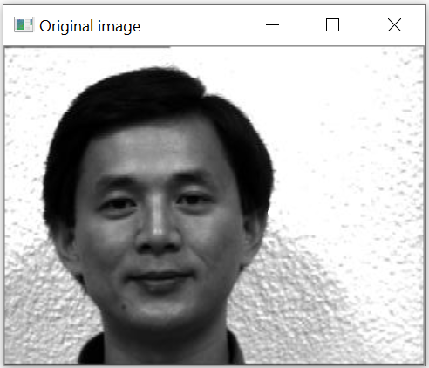
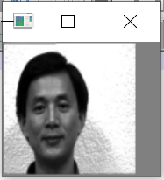
Comparing Original & Resized Dimensional Image
Original Dimensions : (243, 320)
Resized Dimensions : (100, 100)

Slide 6
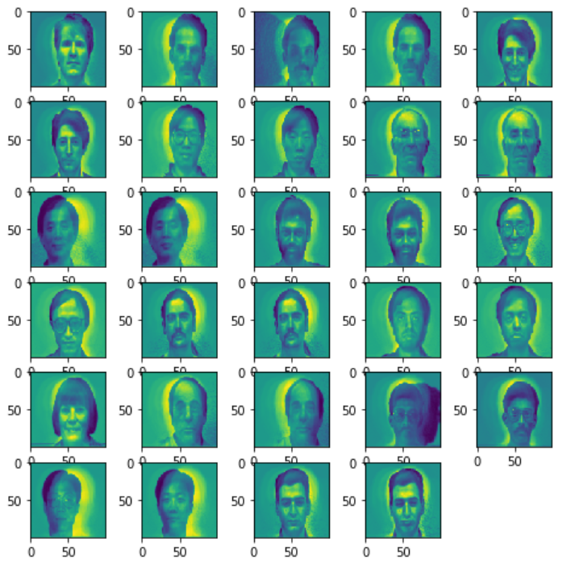

Slide 7
SVD & Hadamard Product
Main aim of performing SVD is to extract the Eigenvectors of the Data Matrix.
The main purpose to find the Eigenvectors of the Data Matrix is to extract the characteristics/features of each training image in form of numerics.
Eigen Face is a generic term that is used to denote the set of Eigenvectors i,e U Matrix, in problems related with Face Recognition.
The images of the same person tend to cluster in the eigenface space, making this a useful transformation for facial recognition
Followed by SVD, we’ve performed the elementwise product of each Eigenvector with all the Pixel vectors in Data Matrix. This operation ensures the amount of characteristic that has to extracted from each pixel value of each Pixel vector.

Slide 8
Euclidean Norm
In a similar fashion as described earlier, the testing image pixel vector is also multiplied all the eigenvectors.
They are stacked in column form, and then we performed difference between the modified testing vector and all columns of the modified Data Matrix. We took the euclidean norm of the resultant and retrieve the image which has the lowest norm index value.
The euclidean norm computes the distance between the testing vector and all the training image vector, the lowest distance training image is then retrieved.

Slide 9
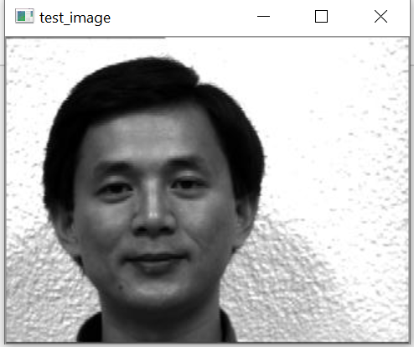
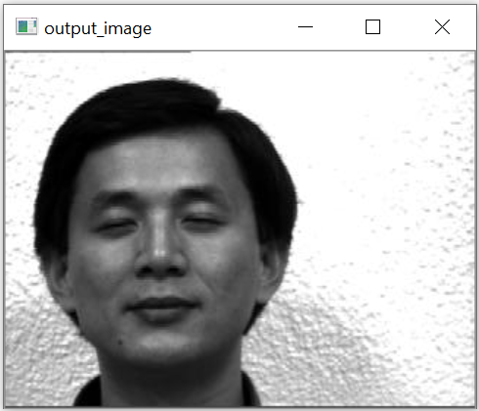
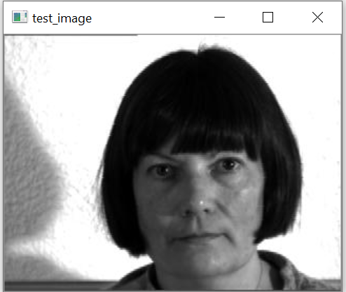
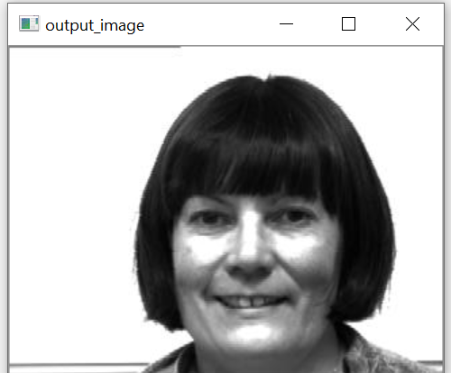
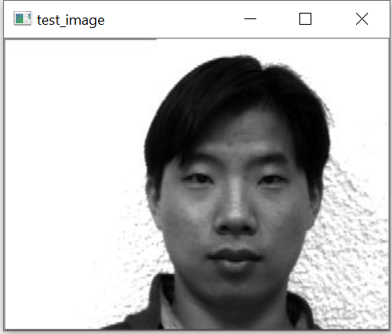
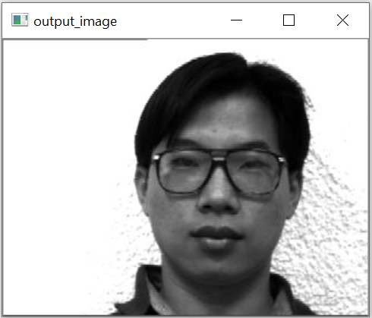
Output
Images

Slide 10
Dataset Used : Yale Face Database

Slide 11
THANK YOU !

