Slide 1
Using Neural Networks to Analyze LIBS Data
J.R. Powers-Luhn

Slide 2
Outline
Introduction
The data set
Benchmark
Classification
Regression
Moving forward

Slide 3
Introduction

Slide 4
Introduction
We have a recipe for urban melt glass
Want to measure homogeneity
Further application: handheld LIBS
GOAL: given a LIBS spectrum, determine what quantity of each analyte is present

Slide 5
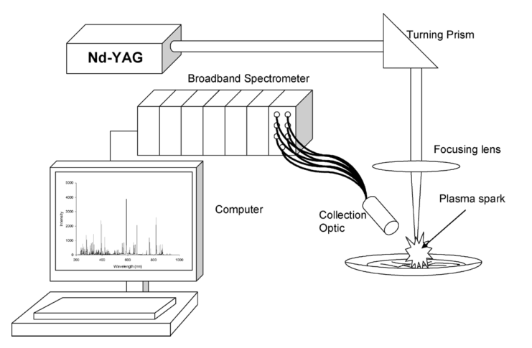
What is LIBS?
LASER Induced Breakdown Spectroscopy
Handheld devices
Notes:
A short (ns or fs) laser pulse ablates the surface of a sample, forms a plasma. The elements/constituents of this plasma form larger compounds, emitting light as they do. This light is collected and turned into a spectrograph. It depends on laser power and the delay between ablation and collection of the signal

Slide 6
The Dataset
11 samples
20 spectra per sample
11725 channels
Notes:
Made 11 Samples
All samples had SiO2 (sand), Fe2O3 (rust), and NaO (to make it stick together)
10 samples had an additional analyte of interest from our urban meltglass
Al2O3, CaO, KOH, MgO, S, BaO, MnO, Ca3(PO4)2, TiO
No Uranium! ☹
Each sample shot 20 times at slightly different location on puck

Slide 7
Classify Sample by Analyte
First Task:

Slide 8
Simple RBF
Average the samples in the training set
Use RBF to measure deviation of each spectrum from this average
Choose the one with the highest value
Notes:
“spread” set to the standard deviation of each classified sample – sample mean

Slide 9
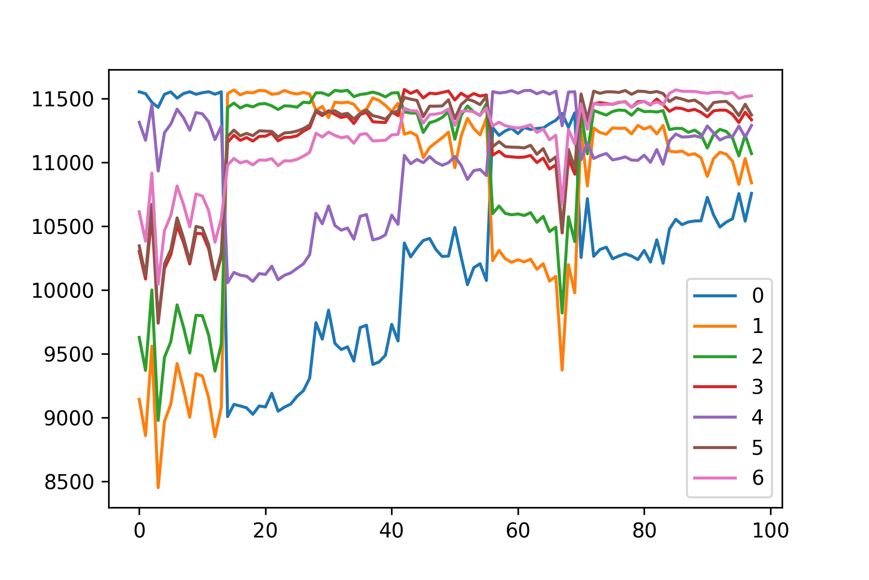
Results

Slide 10
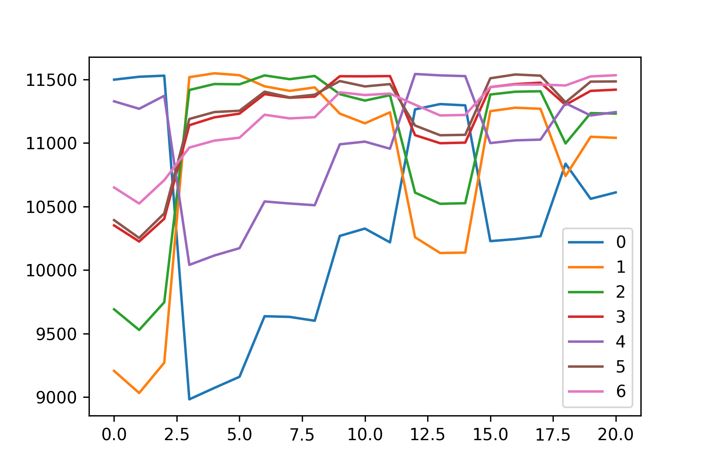
Validation set…
Notes:
Wrong about 20% of the time

Slide 11
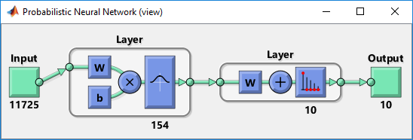
Probabilistic Neural Network
RBF neuron for each training sample
Orthonormal output

Slide 12
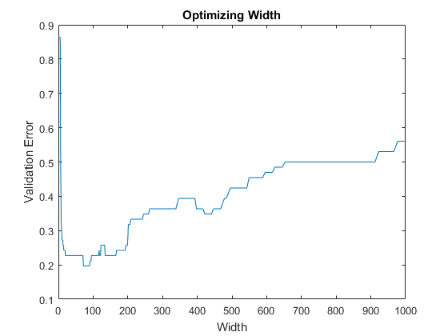
Optimizing Width
~Global minimum around 80
Local minima around 150 and 450
Resists gradient descent
Notes:
Error just measured as confusion—fraction of samples mischaracterized. This was ~21% at best

Slide 13
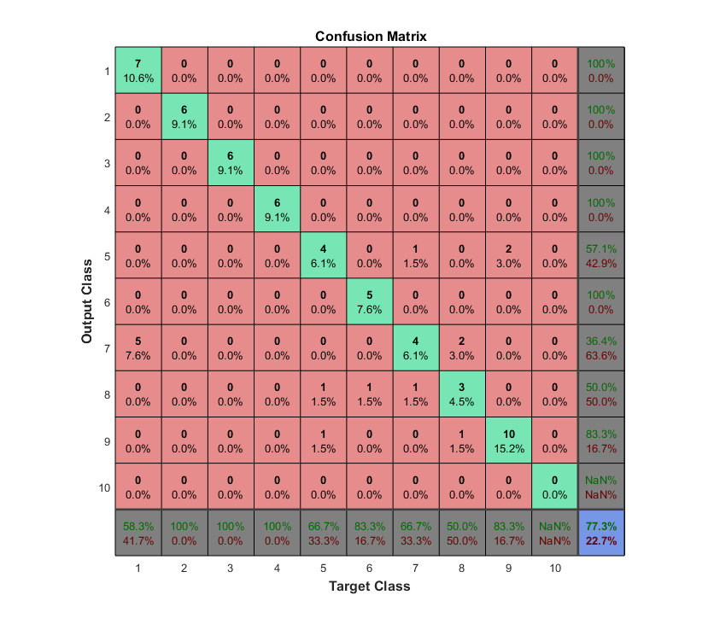
Result

Slide 14
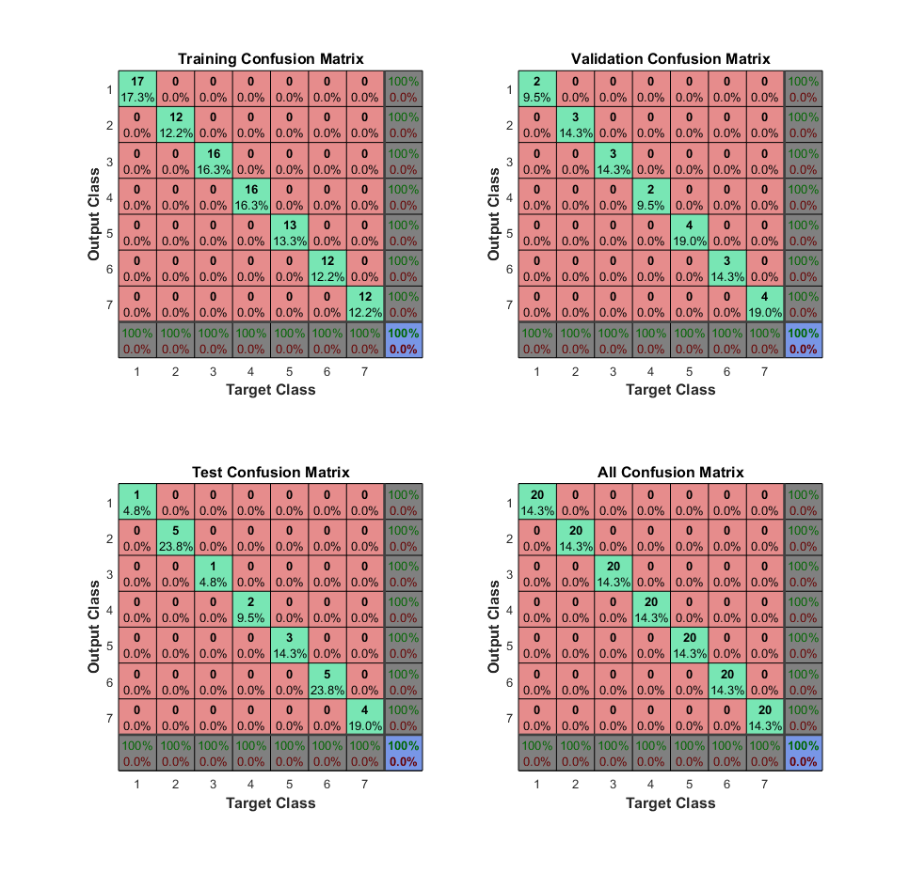
PatternNet

Slide 15
Quantify the Constituent Elements
Second Task

Slide 16
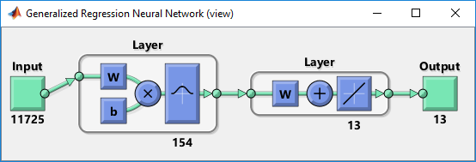
Generalized Regression Neural Network
Try to fit a surface using data points from the surface
Impact of bad data minimized
If all samples equally representative, weights should come out to be equal
Notes:
This matches what we see in the trained network…almost all weights in the 0.13-0.14 range. A couple are weighted to 0

Slide 17
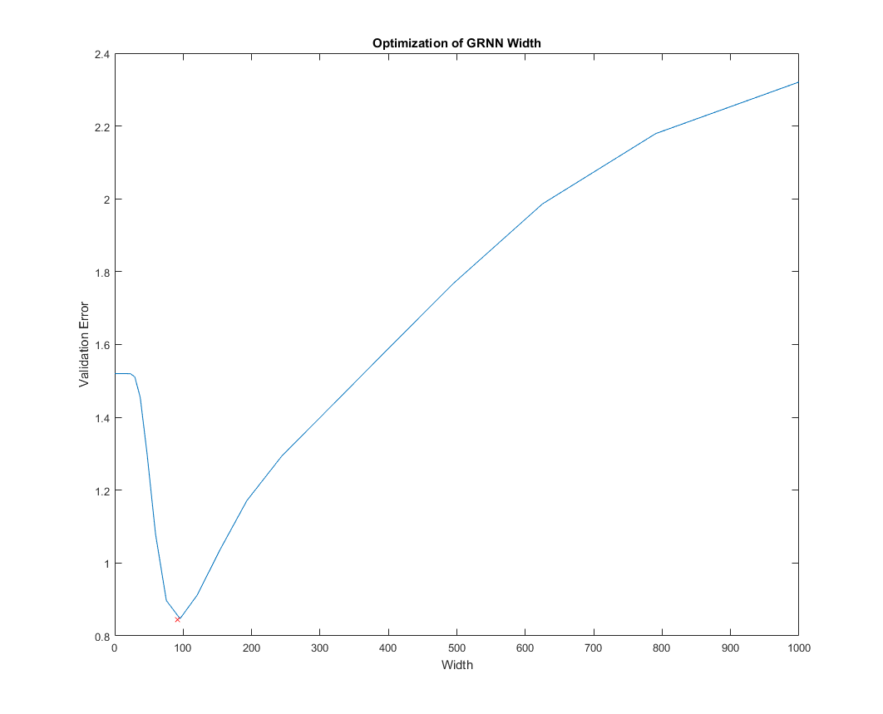
Optimizing width
Want to avoid overfitting
Cross-validation method

Slide 18
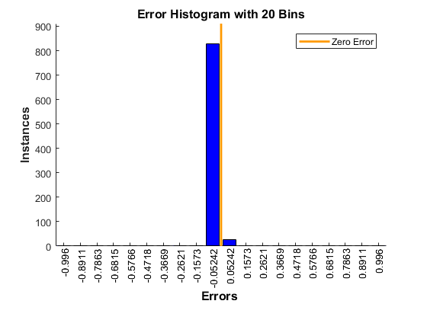
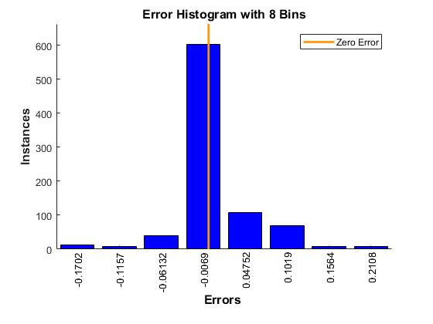
Comparison with PatternNet
RBF
FitNet
Error (val): 0.8454
Error (val): 1.5201

Slide 19
Future Work
Improved samples
Normalize for sample composition
Better tuning of GRNN
Convolutional neural network—harden against offsets
Classification network with confidence

Slide 20
Conclusions
PNN did not out perform the “out of the box” PatternNet
GRNN performance good for regression on samples
Space not well populated--not enough variety in the samples

Slide 21
References
DeLucia, F. C., Samuels, A. C., Harmon, R. S., Walters, R. A., McNesby, K. L., LaPointe, A., … Miziolek, A. W. (2005). Laser-induced breakdown spectroscopy (LIBS): a promising versatile chemical sensor technology for hazardous material detection. IEEE Sensors Journal, 5(4), 681–689. https://doi.org/10.1109/JSEN.2005.848151
Musavi, M. T., Ahmed, W., Chan, K. H., Faris, K. B., & Hummels, D. M. (1992). On the training of radial basis function classifiers. Neural Networks, 5(4), 595–603. https://doi.org/10.1016/S0893-6080(05)80038-3
McCormick, C. (n.d.). Radial Basis Function Network (RBFN) Tutorial · Chris McCormick. Retrieved August 8, 2017, from http://mccormickml.com/2013/08/15/radial-basis-function-network-rbfn-tutorial/

Slide 22
Questions

