Slide 1
Using Neural Networks to Analyze LIBS Data

Slide 2
Outline
Introduction
The data set
Benchmark
Classification
Patternnet
Probabilistic Neural Network
Regression
Moving forward

Slide 3
Introduction

Slide 4
Introduction
We have a recipe for urban melt glass
Want to measure homogeneity
Further application: handheld LIBS
GOAL: given a LIBS spectrum, determine what quantity of each analyte is present

Slide 5
What is LIBS?
LASER Induced Breakdown Spectroscopy
Handheld devices
Notes:
A short (ns or fs) laser pulse ablates the surface of a sample, forms a plasma. The elements/constituents of this plasma form larger compounds, emitting light as they do. This light is collected and turned into a spectrograph. It depends on laser power and the delay between ablation and collection of the signal

Slide 6
The Dataset
11 samples
20 spectra per sample
11725 channels
Notes:
Made 11 Samples
All samples had SiO2 (sand), Fe2O3 (rust), and NaO (to make it stick together)
10 samples had an additional analyte of interest from our urban meltglass
Al2O3, CaO, KOH, MgO, S, BaO, MnO, Ca3(PO4)2, TiO
No Uranium! ☹
Each sample shot 20 times at slightly different location on puck

Slide 7
Classify Sample by Analyte
First Task:

Slide 8
Simple RBF
Average the samples in the training set
Use RBF to measure deviation of each spectrum from this average
Choose the one with the highest value

Slide 9
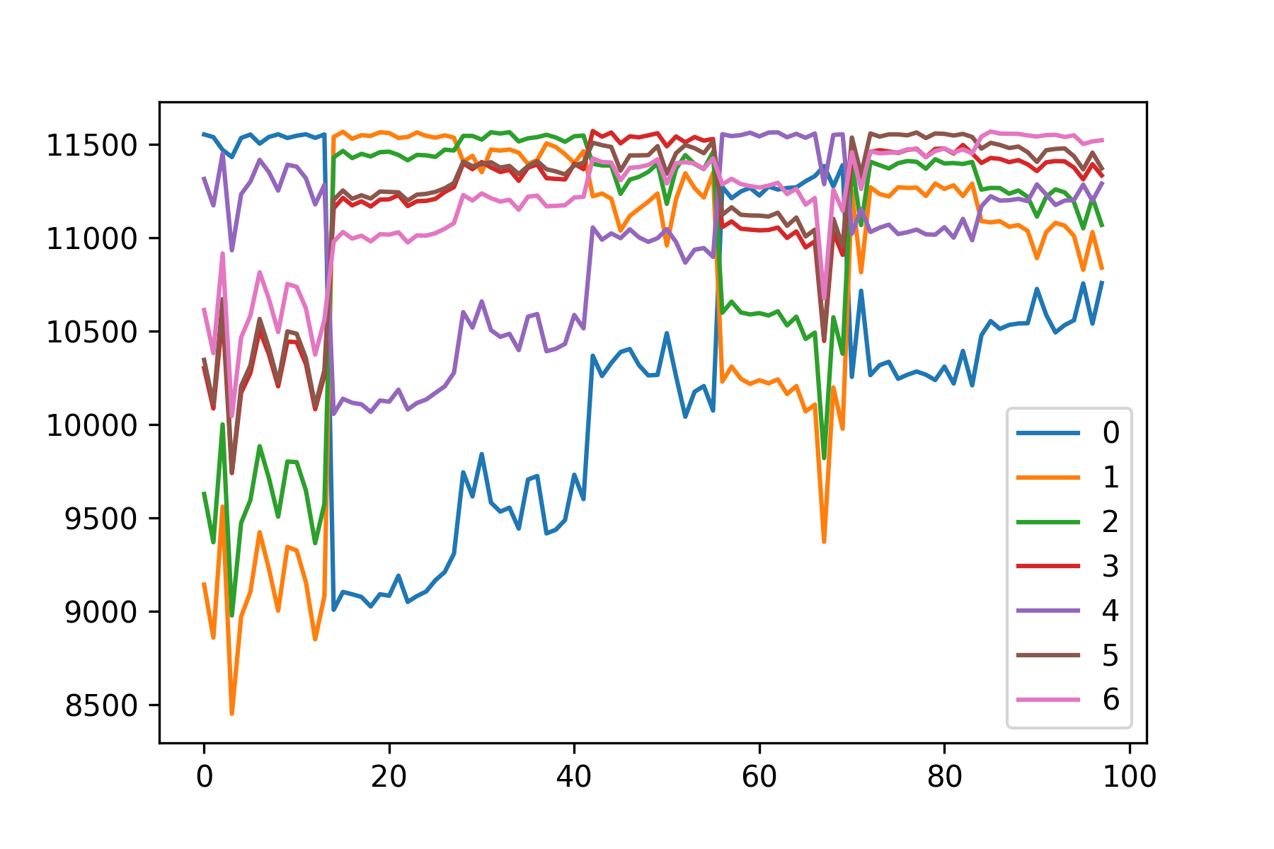
Results

Slide 10
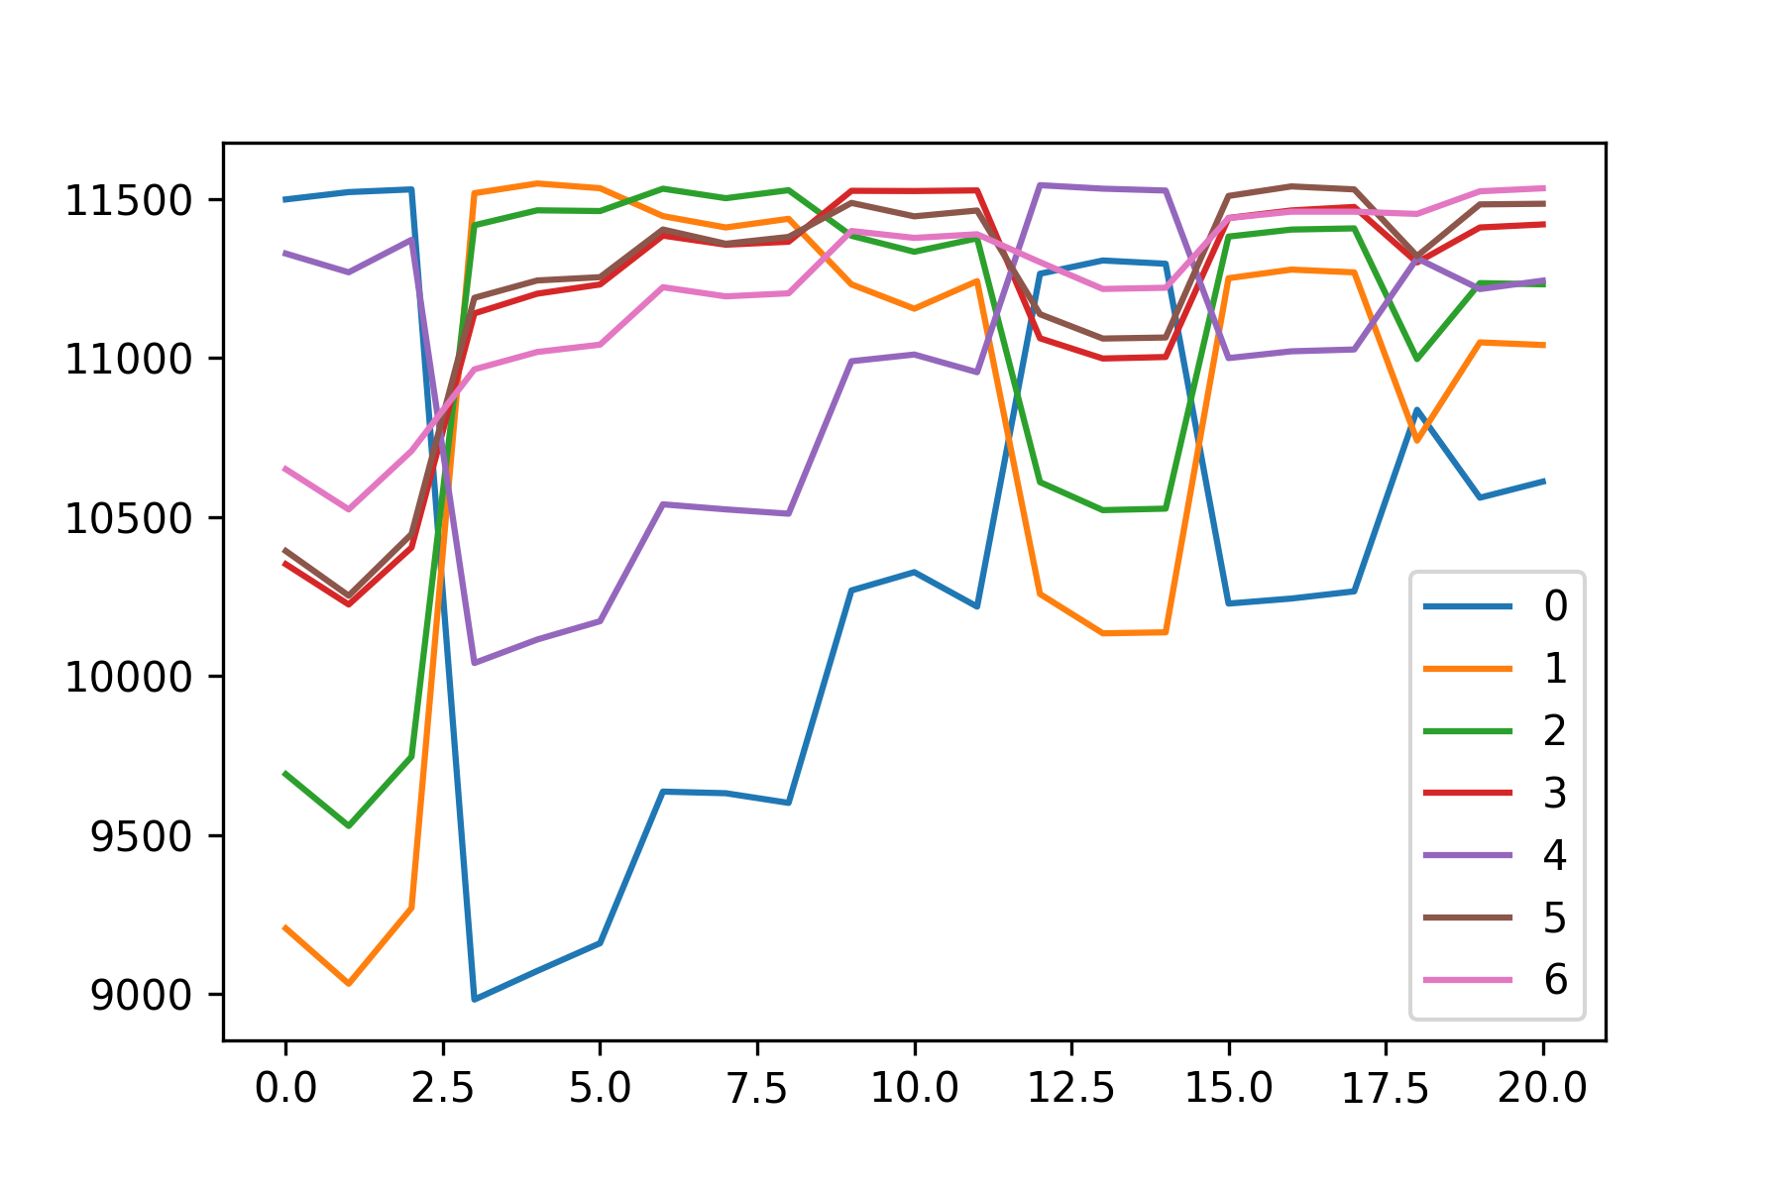
Test set…

Slide 11
Probabilistic Neural Network
RBF neuron for each training sample

Slide 12
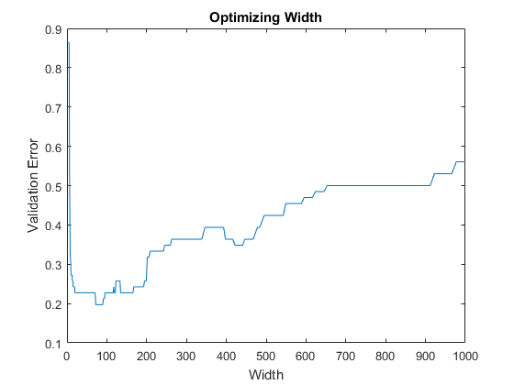
Optimizing Width
~Global minimum around 80
Local minima around 150 and 450
Resists gradient descent

Slide 13
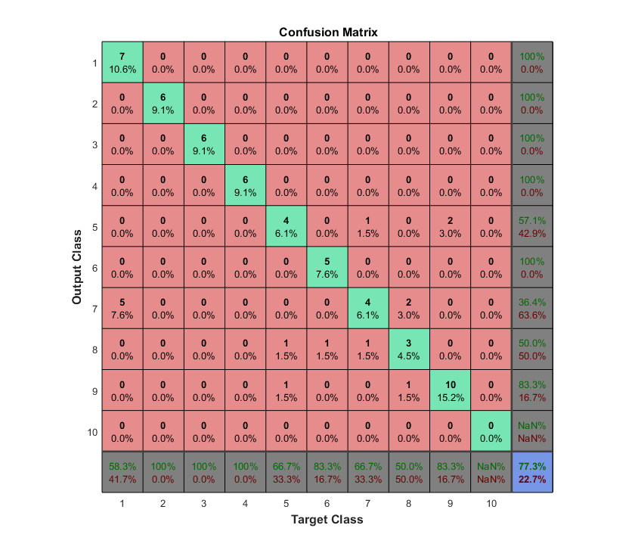

Slide 14
Quantify the Constituent Elements
Second Task

Slide 15
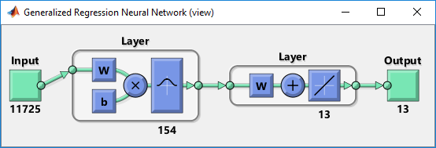
Generalized Regression Neural Network
Lorem
Ipsum
Dolor
Simet

Slide 16
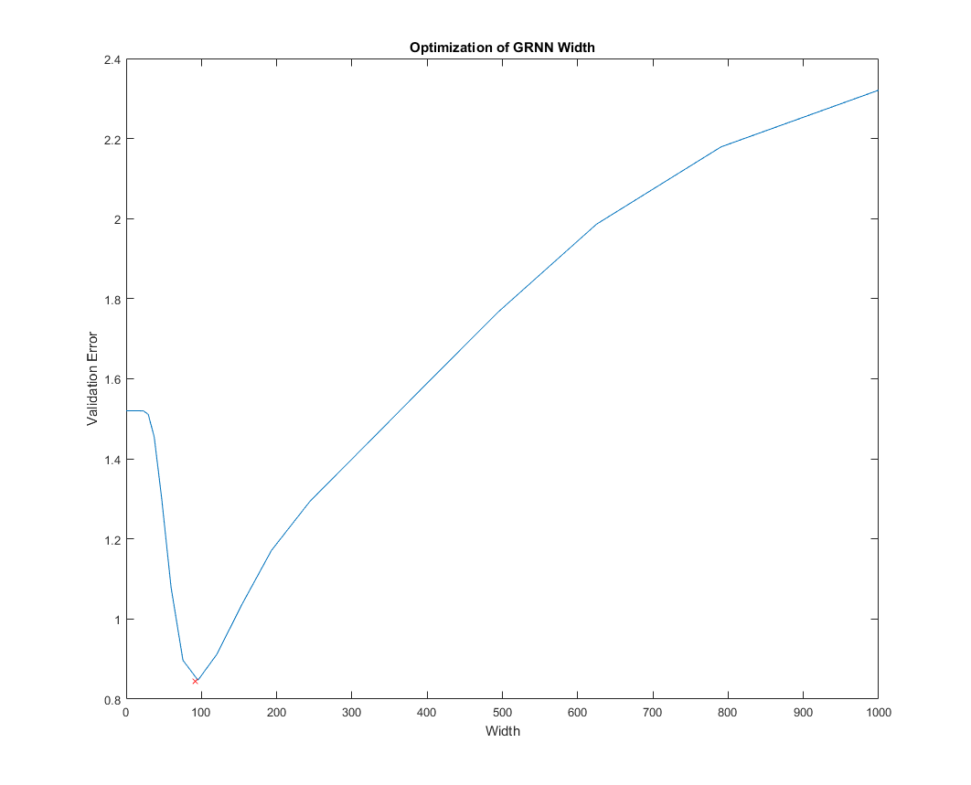
Optimizing width
Want to avoid overfitting
Cross-validation method

Slide 17
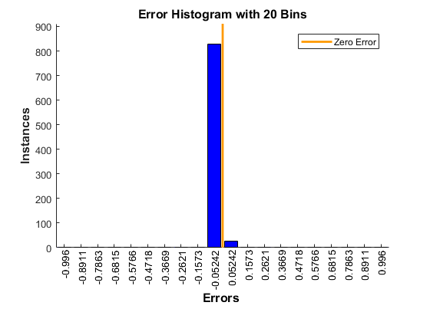
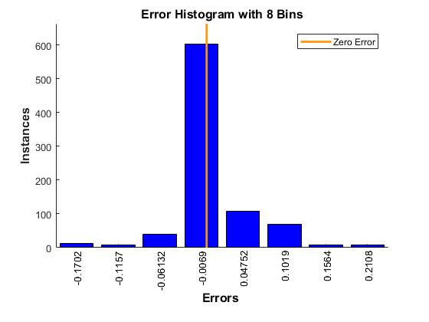
Comparison with PatternNet
RBF
PatternNet
Error (val): 1.5201
Error (val): 0.0056

