Slide 1
Lesson 1 Objectives
Objectives of Course
Go over syllabus
Go over course
Overview of Course
The Transport Equation
  Assumptions
  Definition of basic elements
  Scattering cross sections
  Use of Legendre expansions of angular distribution
  Fission neutron distribution

Slide 2
Objectives of Course
User setup should be:
  Materials and geometry
    Material makeup (isotopics)
    Material energy interactions with particles
    Material spatial distribution
  Source description
    Source particles
    Source energy distribution
    Source spatial distribution
  “Detector” response
    Detector particle sensitivity
    Detector energy sensitivity (response function)
    Detector spatial location
  Why are any other questions asked?

Slide 3
Objectives of Course (2)
Answer: Boltzmann gave us an exact equation, but we cannot solve it exactly.
We must simplify the equation:
  Space: Replace continuous space with homogeneous blocks (“cells”) of material
  Energy: Replace continuous energy with energy “groups”
  Direction: Constrain particles to only travel in certain directions
  Time: Deal with the vastly different time scales
Result: The deterministic discrete ordinates equation, discretized for computer solution.

Slide 4
Objectives of Course (3)
“Deterministic codes give you exact solutions to approximate models. Monte Carlo codes give you approximate solutions to exact models.”
This situation puts an extra burden on you, the user.
You are required to supply computer code input that is NOT related to the description of your problem, but is related to how you want the computer to simplify the model.
My goal: Help you understand what is being asked of you

Slide 5
Overview of Course
First five chapters of:
  Lewis, E. E., and Miller, W. F., Jr.; Computational Methods of Neutron Transport, American Nuclear Society, La Grange Park, IL, 1993.
General flow of the course will be:
  Derivation of the continuous-energy Boltzmann Equation (L&M, 1)
    Derivation of the forward equation
    Differences in approach for source vs. eigenvalue problems
    Derivation and use of adjoint form of equation

Slide 6
Overview of Course (2)
General flow of the course (cont’d):
  Energy and time discretization (L&M, 2)
    Multigroup approximation in energy
    Fixed source solution strategies in energy
    Eigenvalue problem solution strategies in energy
    Time-dependent considerations
  1D discrete ordinates methods (L&M, 3)
    Angular approximation
    Spatial differencing
    Curvilinear coordinates
    Acceleration techniques

Slide 7
Overview of Course (3)
General flow of the course (cont’d):
  2D and 3D discrete ordinates (L&M, 4)
    Angular quadrature
    Cartesian treatments
    Curvilinear treatments
    Ray effects
  Miscellaneous
    Integral transport theory (L&M, 5)
    Diffusion theory derivation
    Time dependence

Slide 8
The Transport Equation
Introduction
Particle Interaction
Particle Streaming
Transport with Secondary Particles
The Time-Independent Transport equation
The Adjoint Transport Equation

Slide 9
The basic physical assumptions
Particles are points
Particles travel in straight lines, unaccelerated until they interact
Particles don’t hit other particles
Collisions are resolved instantaneously
Material properties are the same no matte what direction a particle approaches
Composition, configuration, and material properties are known and constant in time
Only the expected (mean) values of reaction rates are needed
You will think about these more deeply in HW problem 1-1.

Slide 10
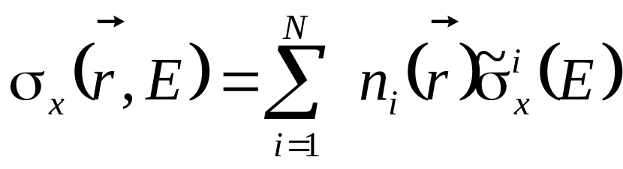
Definition of basic elements
Material cross sections: Particle/matter interaction probabilities
We will use small sigma, σ, for for microscopic AND macroscopic cross sections:
  =Probability of an interaction of type x per unit path length

Slide 11
Definition of basic elements (2)
where x=
‘c’ for capture=particle loss
‘f’ for fission
‘a’ for absorption=fission + capture
‘s’ for scattering=particle change of energy and direction
For neutrons, the primary scattering mechanisms are elastic scattering, inelastic scattering, and (n,2n)
For photons, the scattering mechanisms are Compton scattering and pair production
For coupled neutron/gamma problems, neutron reactions that produce gammas are “scatter”
Unit of macroscopic cross section is cm⁻¹

Slide 12
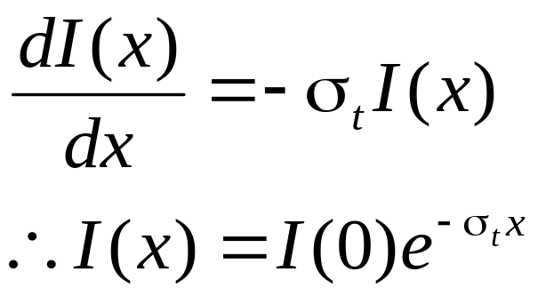
Definition of basic elements (3)
Denoting the intensity of the flow of a beam of particles as I(x), we have:
This is the familiar exponential attenuation
In the book, the total cross section is sometimes denoted by σ (no subscript)

Slide 13
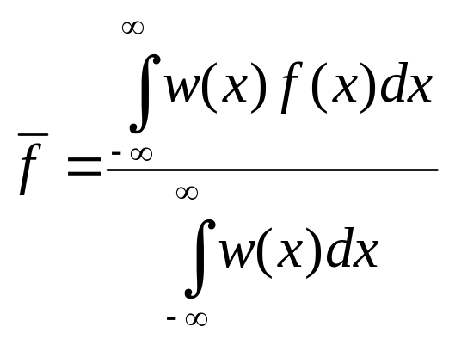
Definition of basic elements (4)
Background: A “weighted average” of a function of x is defined as:
The most common variations we see in NE are:
  Unweighted average: w(x)=1 (over finite domain of x)
  Mean (or expected) value of x: w(x)=Pr(x) (probability of x being chosen). Denominator will be zero.
  Nth Legendre moment: w(x)=1/2 P_{n}(x), -1<x<1
    P_{n}(x) is the nth order Legendre polynomial

Slide 14
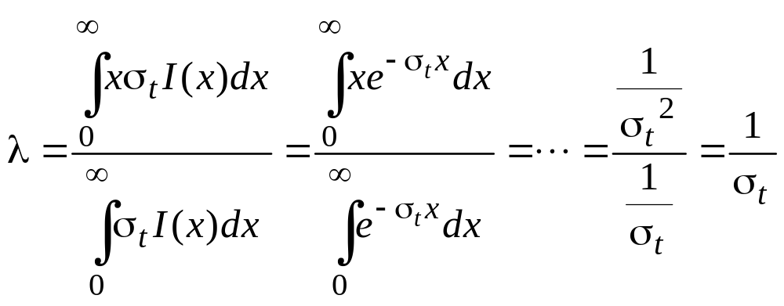
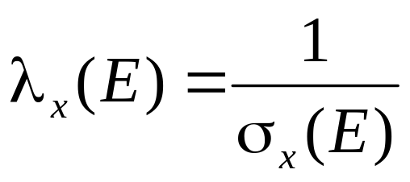
Definition of basic elements (4a)
The mean free path, λ, is defined as the average distance traveled before a collision:
Work this out (Prob. 1-2)
For reaction rate x, we have:

Slide 15
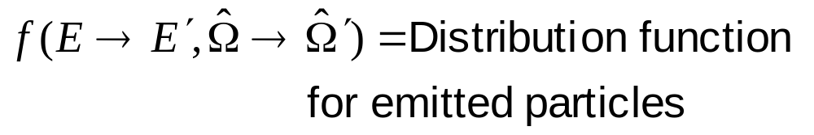
Scattering cross sections
For scattering reactions, we must consider the post-collision properties as well as the probability of interaction:
where:

Slide 16
Scattering cross sections (2)
Based on Assumption #5, the angular dependence is dependent on the deflection angle between the two directions:
where:
Note that there is no azimuthal angular dependence

Slide 17
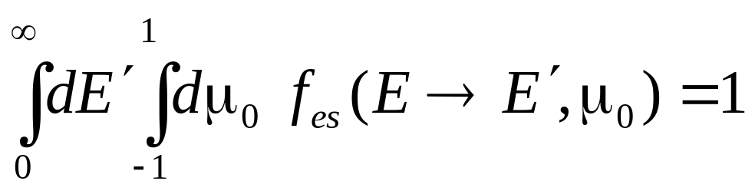
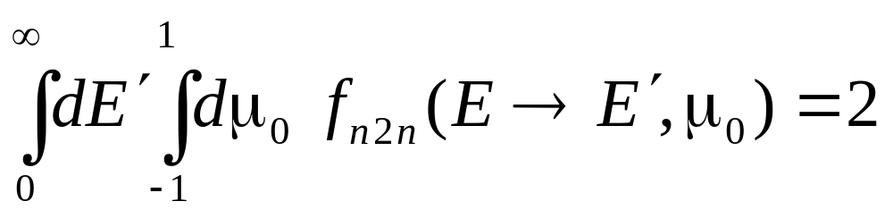
Scattering cross sections (3)
The distribution function is normalized to integrate to the number of particles that are emitted by the reaction. For example, normal (n,n’) scattering has:
whereas for (n,2n) we have:

Slide 18
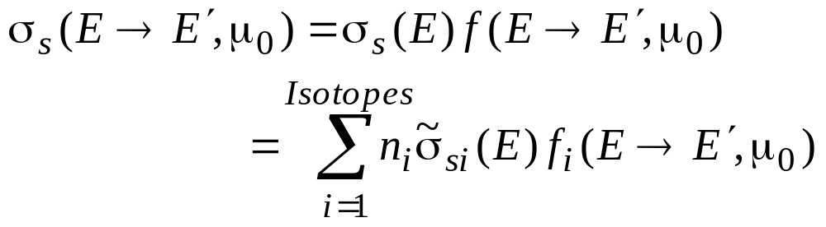
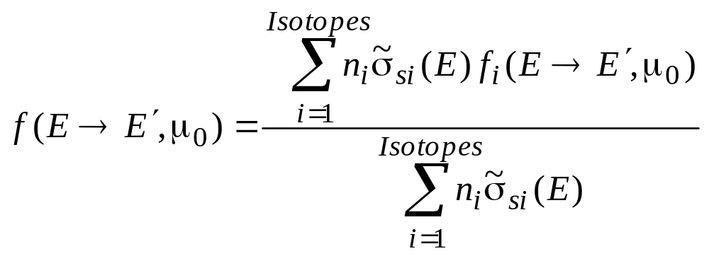
Scattering cross sections (4)
Note that since we combine cross sections linearly, the relationship between the macroscopic and microscopic distribution functions is given by:

Slide 19
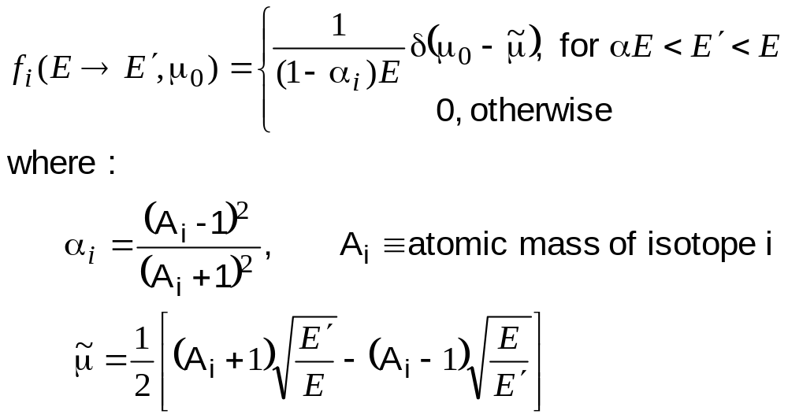
Scattering cross sections (5)
The most familiar distribution is the elastic scattering distribution (from kinematics):

Slide 20
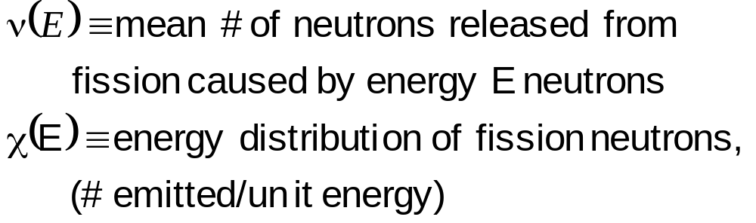
Fission neutron distribution
Two data variables you need to know are:
The first is a function; the second is a distribution

Slide 21
Homework 1-1
For each of the assumptions listed on slide 1-9, give a physical situation for which the assumption may not be a good one.

Slide 22
Homework 1-2
Use integration by parts and l’Hopital’s rule to show that:

