Slide 1
Lesson 5 Objectives
Finishing up Chapter 1
Development of adjoint B.E.
Mathematical elements of adjoints
Application to the terms of the B.E.
Use of adjoint in source/detector problems

Slide 2


Slide 3
Mathematical terms we will use
“Function”=converts scalar to another scalar
“Functional”=converts function to scalar
“Operator”=converts function to another function
Inner product (cf. Bra-ket) notation=simple(r) notation for integration. For us:
Definition of L*, the operator adjoint to L:

Slide 4
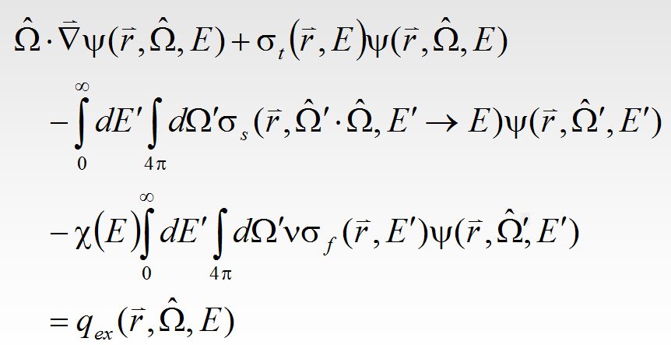

Our operator
Becomes for us:

Slide 5
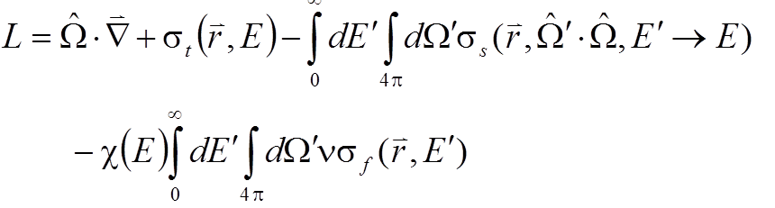
Our operator (2)
where:
We are going to find the operator L* that is adjoint to L.
Why would we want to do this?

Slide 6
Why? Why? Why?
We can get a detector response two ways:

Slide 7
Use of Adjoint in Source/Detector
There are several uses of adjoint B.E.
We will examine it in a Source/Detector problem:
Volume V
Source
Detector
Surface S

Slide 8
Traditional Forward Solution
In the typical forward solution, one uses a computer code to solve operator relation:
in Volume V
Once is known, we “fold” the flux into the detector response function to get the detector response, R, using functional:

Slide 9
Equivalent Adjoint Analysis
Alternatively, the analyst can use a computer code (usually the same one) to solve:
in Volume V
Once is known, we “fold” the adjoint flux into the SOURCE distribution to get the SAME detector response, R:

Slide 10
A little more abstract
A FORWARD calculation involves DEDUCING the consequences of the presence of a SOURCE. It results in a particle flux distribution that can be used to make a DOSE MAP.
On the other hand, an ADJOINT calculation involves deducing the consequences of the placement of a DETECTOR. It results in a adjoint flux distribution that can be translated into a DETECTOR SENSITIVITY MAP. (i.e., a map of what source locations a detector can “see”).

Slide 11
Adjoint or forward?
Q: If either way gives the same answer, how do you choose between the forward and adjoint modes?
A: Both methods involve two steps:
Solve for forward or adjoint flux (expensive)
Integrate flux over response function or source (cheap)
Therefore, you should choose the mode that minimizes expense:
FORWARD if you have 1 source, many detectors
ADJOINT if you have 1 detector, many sources

Slide 12
Development of Adjoint B.E.
We will be developing the Adjoint form of the Boltzmann Equation with the following steps:
Mathematical elements of adjoints
Introduction of special notation
Discussion of WHAT an adjoint operator is
Application to the terms of the B.E.
Use of a “cookbook” approach to (tediously) translate each term of the B.E. into adjoint
Physical derivation of adjoint
WHAT the adjoint flux means
Use of adjoint in source/detector problems

Slide 13
Special mathematical notation
Operator notation:

Slide 14
Special mathematical notation (2)
Inner product (cf. Bra-ket) notation:
Definition of L*, the operator adjoint to L:
We will use this definition both to convert each of the four “sub-terms” of the B.E. into the adjoint form and to demonstrate the usefulness of the adjoint B.E.

Slide 15
Converting to adjoint form
Our conversion of the four subterms will follow the following procedure:
Form the “left-hand-side” for the sub-term:
Reverse the positions of a and b inside the resulting equation.
Rearrange (if necessary) the integrals into the form:
Isolate the new operator term,

Slide 16
Interaction term, L₂
Form the “left-hand-side” for the sub-term:
Reverse the positions of a and b inside the resulting equation.
Rearranging (if necessary) the integrals into the form:
Isolate the new operator term,

Slide 17
Interaction term, L₂ (2)
Rearranging (if necessary) the integrals into the form:
Isolate the new operator term:
with:
So, the first term is so-called “self-adjoint”

Slide 18
Scattering term, L₃
Form the “left-hand-side” for the sub-term:
Reversing the positions of a and b inside the resulting equation (after moving a inside)

Slide 19
Scattering term, L₃ (2)
Rearranging the integrals into the form:
Exchange primed and unprimed:

Slide 20
Scattering term, L₃ (3)
Isolate the new operator term:
Note that the energy direction of scatter has been reversed

Slide 21
Fission term, L₄
Form the “left-hand-side” for the sub-term
Reversing the positions of a and b:

Slide 22
Fission term (2)
Rearranging the integrals into the form:
Exchange primed and unprimed:

Slide 23
Fission term (3)
Isolate the new operator term:
Note the interesting swap of the roles of the cross sections and chi function.

Slide 24
Leakage term, L₁
Form the “left-hand-side” for the sub-term:
Reversing the positions of a and b inside the resulting equation.
This is more difficult because of the divergence operator
We must use the vector product rule:

Slide 25
Leakage term, L₁ (2)
Rearranging this to:
Substituting this gives us

Slide 26
Leakage term, L₁ (3)
Isolate the new operator term
We are only partially successful.
The operator can be identified as:
but only if we can guarantee that:
If we cannot set this term to 0, then it will have to be dealt with in some way.

Slide 27
Final form of the Adjoint B.E.
Putting the terms together, we get:

Slide 28
Solution of the Adjoint Equation using a “Forward” code
Although we have not yet studied how the forward equation is solved in modern computer codes, let us assume that such codes can written.
A term-by-term comparison of the forward and adjoint operators indicates that we can “fool” a forward code into solving the adjoint problem with a little data manipulation:
Reversing the scattering cross sections: Make upscatter into downscatter and vice versa
Reverse the roles of
Interpret directions backwards: adjoint fluxes are turned around 180 degrees
Reverse the roles of the source and response function
Steps 1 & 2 are cross section manipulations, implemented i practice by having “forward” and “adjoint” cross section libraries
Steps 3 & 4 are left to the user to implement in the problem setup and answer interpretation

Slide 29
A little legalism
Remember that we REALLY came up short in our development of the adjoint, arriving at:
If you remember (or even if you don’t), we have a divergence theorem that tells us:

Slide 30
A little legalism (2)
Therefore the “troublesome” term can be written as a surface integral:
And a careful examination of the boundary conditions of the forward and adjoint problems will convince you that this term must be 0 (ψ=0 on the surface for INCOMING directions, ψ*=0 for OUTGOING directions)

Slide 31
Adjoints and boundary sources
An important class of shielding problems do not fit the source/detector geometry we have been using, but instead involve boundary fluxes serving as sources:
Volume V
Boundary flux
as a surface
source
Detector
Surface S

Slide 32
Adjoints/boundary sources (2)
For this situation, the derivation becomes a little different and involves the SURFACE term that we previously eliminated:

Slide 33
Adjoints/boundary sources (3)
The resulting choice that the analyst has is to either solve:
and use the flux to get the detector response the “normal” way:
OR

Slide 34
Adjoints/boundary sources (4)
Solve the “normal” adjoint problem:
and use the adjoint flux and boundary fluxes to get the detector response using:
The adjoint path is especially useful in “do-it-yourself” response function creation: Run an adjoint on a “detector” object you define (e.g., human phantom, battle tank) and then subsequently use the surface adjoint flux as a response function for the object.

Slide 35
Surface scoring
This “surface source” methodology can even be applied to “normal” source/detector problems by partitioning the problem into a “source side” (V₁) and a “detector side” (V₂) :
Volume V₁
Volume V₂
Source
Detector
Partitioning surface PS
Surface S

Slide 36
Surface scoring (2)
The detector response is given by the surface integral:
where the integral need only be taken over the Partitioning Surface PS because (like before) the external boundary conditions guarantee that the product ψ∗ψ is 0 on all external surfaces.
Note that the partitioning surface can be ANY surface that completely separates the source and detector

Slide 37
Uses of adjoint
Uses of the adjoint in shielding applications:
Alternative way of performing shielding problems
Efficient way to partition a complex problem
Way to convert a physical detector (e.g., person) into an “equivalent” response function
As a graphical tool for illustrating the important particle paths in a shielding analysis (i.e., the product ψ∗ψ is the so-called “contributon” flux, the distribution of particles that are “destined” to be detected).
Importance function for emerging particles in a Monte Carlo calculation (NE582)

