Slide 1
Lesson 9 Objectives
Spatial treatment in 1D Slab Discrete Ordinates
Discretizing in space by cell balance
Auxiliary equations
Solution strategies
Boundary conditions

Slide 2
Application of SN quadrature to direction
We will now apply the Gaussian quadrature to our direction variable
As engineers, we are seldom interested in the angular flux itself. We are much more interested in REACTION RATES, which are determined from the scalar flux (using unit :

Slide 3
Applic. of SN quadrature to direct’n (2)
This approach also fits well with our definition of the angular source, for which we use flux moments:

Slide 4
1D Slab D.O. Equation
Our current status: For each energy group we calculate the angular flux ONLY IN PARTICULAR DIRECTIONS (“discrete ordinates”):

Slide 5
Space: The Final Frontier
We begin dealing with space by dividing the spatial domain into homogeneous cells:
We denote the MIDPOINTS of cell i as x_{i}
By convention, the left and right edges are denoted as x_{i-1/2} and x_{i+1/2}, respectively, with similar spatial notation for the angular fluxes at these points:
x₁
x₂
x₃
x₄
x₅
x₆
x₇
x₈
x₉
x₁₀
x
x
x
x
x
x
x
x
x
x
xright
xleft
x_{i-1/2}
x_{i}
x_{i+1/2}
Cell i

Slide 6
Spatial treatment
The second step of our spatial treatment is the integrate the balance equation of the volume of each cell:
which gives us:
where:

Slide 7
Spatial treatment (2)
This equation has three unknowns:
so we need three equations (i.e., two more)
One of these will be found from the SWEEP strategy: We will calculate the cells in a certain order:
We begin at the incoming boundary for the direction (i.e., left boundary for directions to the right, right boundary for directions to the left)
The entering flux is found from boundary conditions, so the 1st cell’s equation has only 2 unknowns: average and outgoing fluxes
For the 2nd cell, the incoming flux is set to the outgoing flux of 1st cell.
For the 3rd cell, the incoming flux is set to the outgoing flux of 2nd cell, etc.
NOTE: Positive μ directions are left-to-right; negative μ are swept right-to-left

Slide 8
Spatial treatment (3)
To complete the set of equations, we must come up with a 3rd equation relating the 3 unknowns
This third relationship is called the “auxiliary equation”
Several have been postulated and used:
Step
Diamond Difference
Weighted diamond difference
Characteristic
We will examine each of these for accuracy, stability, and ease of use

Slide 9
Auxiliary equation #1: Step
For the auxiliary equations, we use plausible relations between the fluxes that we expect to be true in the limit as
The first is not very accurate, but is extremely stable, the STEP condition:
NOTE: I will describe them as if we are going left-to-right (positive μ). For negative μ, we would use :
That is, the flux on the “outgoing” side is set equal to the average flux.

Slide 10
Step Auxiliary equation (2)
Substituting this into the balance equation gives:
Note that we use the auxiliary equation to get the average flux:

Slide 11
Step Auxiliary equation (3)
Notice that if the source and incoming fluxes are positive, the outgoing and average fluxes are guaranteed to be positive. This is physically appealing.
Once we get the cell angular fluxes, we convert them into cell flux moments:
which we need to get subsequent scattering source moments.

Slide 12
Aux. equation #2: Diamond Difference
Although guaranteed positive, the step relation tends to not be very accurate.
A more accurate relationship would be to let the cell average flux be an AVERAGE of the incoming and outgoing fluxes. This is called the “Diamond Difference” relationship:

Slide 13
Diamond Difference (2)
Substituting this one gives:
Notice the minus sign: This one is NOT guaranteed to be positive

Slide 14
Diamond Difference (3)
We can even quantify the risk of going negative.
The risk exists IFF the term in the numerator can go negative, i.e., if for some n and i we have:
That is, we run the risk of negative fluxes if the cell is more than 2μ mean free paths wide
What is wrong with negative fluxes?
One solution=“negative flux fixup”=If the outgoing flux is negative, revert to STEP

Slide 15
Aux. #3: Weighted Diamond Difference
Once you have two methods, someone is bound to suggest a HYBRID of the two
Introduce a factor α:
Obviously,
so we probably want

Slide 16
Weighted Diamond Difference (2)
Substituting this one gives:
Notice that a proper choice of α can keep the troublesome term in the numerator positive.

Slide 17
Weighted Diamond Difference (3)
Therefore, we can guarantee positive fluxes if:
Notice that the terms in brackets are the two terms we compared in DD: The bracketed term is < 1 if DD is at risk of going negative.

Slide 18
Auxiliary #4: Characteristic methods
Characteristic methods are based on analytical solutions of the equation in a cell:
has the solution (for positive μ):
or (in our notation):

Slide 19
Auxiliary #4: Characteristic methods (2)
Characteristic methods can be shown to be a special case of Weighted Diamond Difference with α chosen to be:
Note that α goes to 1 (STEP) as τ goes to infinity and α goes to 0.5 (D-D) as τ goes to 0
It would be expected that characteristic methods would be the most accurate, since they use the most geometric information about the cell
In practice, they are less accurate than DD!

Slide 20
Solution strategies
For each direction, we “sweep” the cells in the direction of particle travel, beginning at the (known) incoming boundary flux, calculate the cells in order across the geometry to the outgoing side
We combine the discrete angular fluxes into scalar flux moments and save the outgoing fluxes by direction in case we need them in implementing boundary conditions
μ>0
μ<0
x₁
x₂
x₃
x₄
x₅
x₆
x₇
x₈
x₉
x₁₀
x
x
x
x
x
x
x
x
x
x
xright
xleft

Slide 21
Boundary conditions
Implementing boundary conditions comes down to properly choosing the INITIAL (incoming) value for each direction:
Void B.C.=All directions start with ψ_{in}=0
Reflected B.C.=All directions start with ψ_{in} set to the previous OUTGOING value of the direction with –μ (at the same edge)
Periodic B.C.=All directions start with ψ_{in} set to the previous OUTGOING value of the same direction
White B.C.= All directions start with ψ_{in} set to a multiple of the outgoing CURRENT on the same surface:

Slide 22
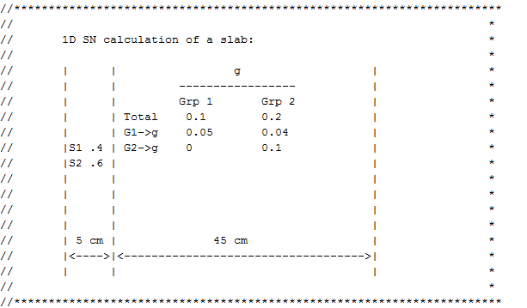
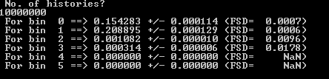
In class exercise: Write 1D slab 2 group

Slide 23
Homework 9-1
Prove the first bullet of slide 9-19.
Prove the last bullet of slide 9-21.
(Hint: The same way we did it before, but with summations replacing integrals)

Slide 24
Homework 9-2
Work an absorption-only problem:
5 mean free paths thick slab
Isotropic flux on left boundary (for incoming directions) with current of 1
Use Step, Diamond difference, and Weighted with α=0.8
Use S₄, S₈, S₁₂
Use as fine a spatial discretization as required for convergence
Analytic outgoing current on the right boundary is 2E₃(5)=1.755E-3
(See App. A)
Check accuracy vs. spatial discretization, auxiliary equation used, angular quadrature
Extra credit:What would be the optimum value of α_{n}?

