Slide 1
Using Neural Networks to Analyze LIBS Data

Slide 2
Outline
What is LIBS?
The data set
Benchmark
Classification
Patternnet
Probabilistic Neural Network
Regression
Moving forward

Slide 3
What is LIBS?
LASER Induced Breakdown Spectroscopy
Handheld devices
Notes:
A short (ns or fs) laser pulse ablates the surface of a sample, forms a plasma. The elements/constituents of this plasma form larger compounds, emitting light as they do. This light is collected and turned into a spectrograph. It depends on laser power and the delay between ablation and collection of the signal

Slide 4
The Dataset
11 samples
20 spectra per sample
11725 channels
Notes:
Made 11 Samples
All samples had SiO2 (sand), Fe2O3 (rust), and NaO (to make it stick together)
10 samples had an additional analyte of interest from our urban meltglass
Al2O3, CaO, KOH, MgO, S, BaO, MnO, Ca3(PO4)2, TiO
No Uranium! ☹
Each sample shot 20 times at slightly different location on puck

Slide 5
Classify Sample by Analyte
First Task:

Slide 6
Quantify the Constituent Elements
Second Task

Slide 7
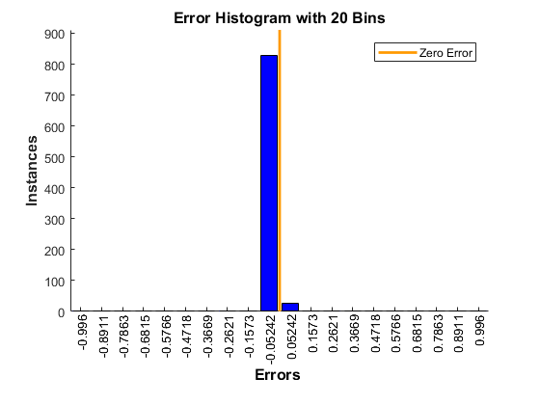
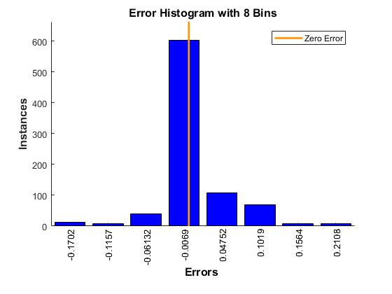
Comparison with PatternNet
RBF
PatternNet
Error (val): 1.5201
Error (val): 0.0056

