Slide 1
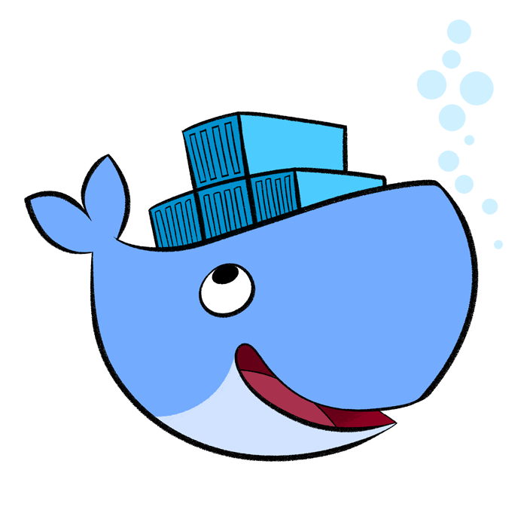
Dockerize Your Build Toolchain
Talk By Michael Pinnegar

Slide 2
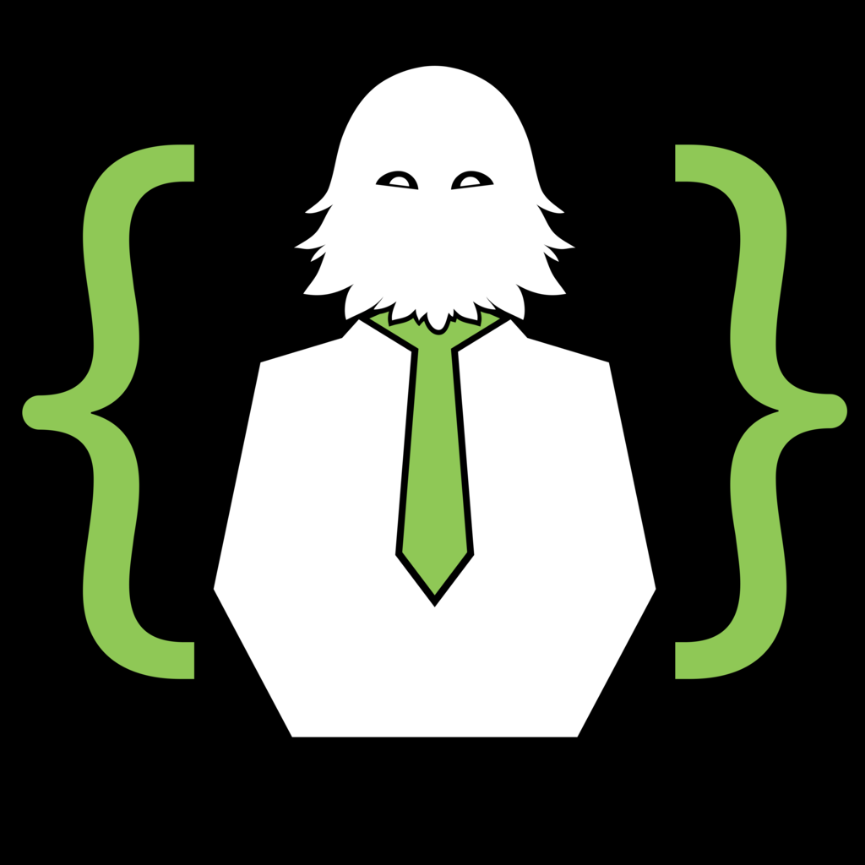
Me, Myself, and I
During the day
Full time lead developer Chemical Abstracts Service
Devops focused force multiplier, improving developer workflows, making them go faster
During the night
Part of a consulting firm in Columbus, Ohio called Sasquatch Technology
We focus on improvements to your in house software development pipeline. Test automation, Continuous Integration, and Deployment at Scale
http://sasquatch.technology/

Slide 3
What is a Dockerized Build Toolchain?
Place all the dependencies needed to build your project into a Docker image.
Top level build tools (Gulp, npm, Maven, Gradle, Rake)
Language SDKs (Ruby, Groovy, Java, Node.js)
Native dependencies (.so files and .dlls)
Day to day binaries like ls, less, htop, grep, ack, sed, etc.
Run your developer builds in temporary containers built off the above Docker image.

Slide 4
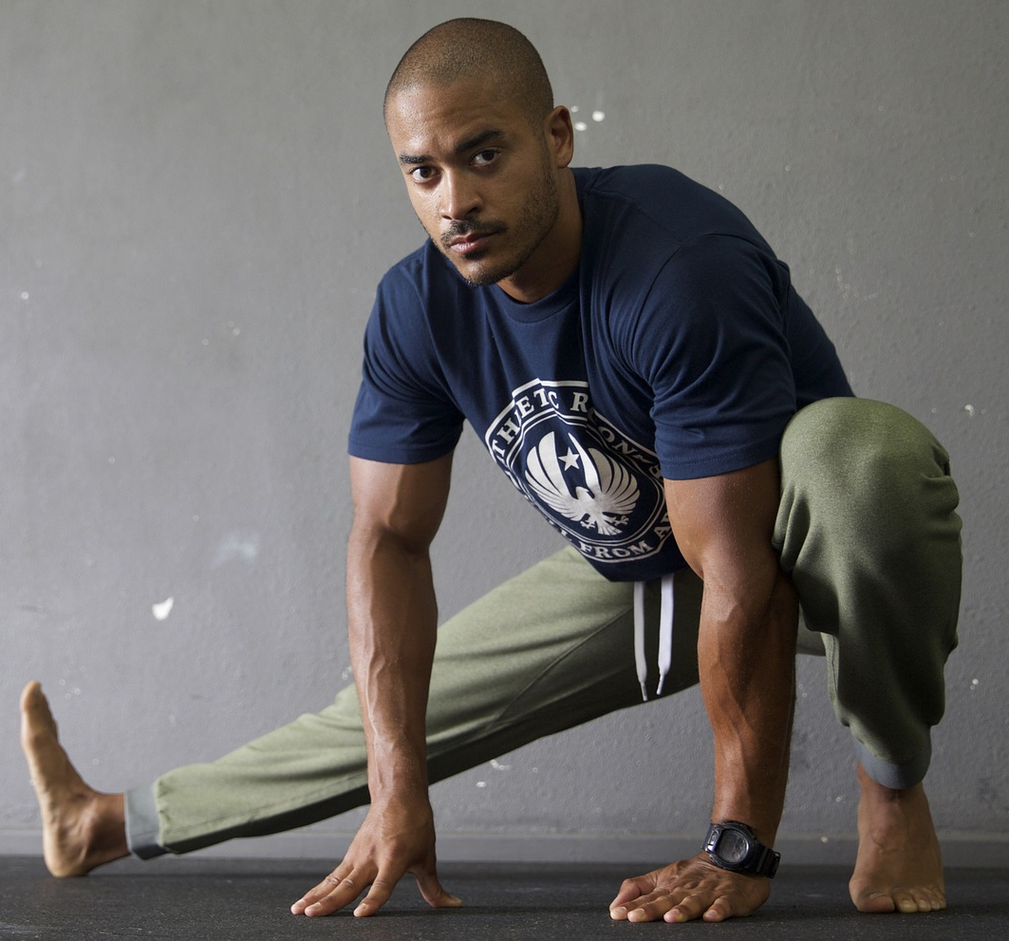
Why Would I Use a Dockerized Build Toolchain?
Flexibility
Decide which composition of libraries to use each time you invoke a command.
Run two completely different applications (Ruby 1.8.7 and Ruby 2.4) on the same machine without application specific solutions like RVM, rbenv, or SDKMAN!.
Most applications don’t even have these sorts of solutions available.
Try out a new version risk free!

Slide 5
Why Would I Use a Dockerized Build Toolchain?
Reduced dependency management at the VM level
Only have to manage git and Docker as dependencies. If you’re clever you don’t even have to manage git (package a bootstrapping git installation into a Docker image).
Relieve the tension related to your configuration management system wanting to be in charge of dependencies and let the user chose when and how they upgrade their Docker image.
Upgrading and patching VM operating system for developer machines becomes painless.

Slide 6

Why Would I Use a Dockerized Build Toolchain?
Consistency
Since all your dependencies are packaged into a Docker image you no longer have drifts in dependencies between different environments.
Reduce the “It works on my machine” syndrome by removing build tools from the equation.

Slide 7

Why Would I Use a Dockerized Build Toolchain?
Historic Versionability
Version your Docker build environment image alongside your codebase. Now you can go back and build historical projects 100% of the time.
Always get the right build environment with the right codebase.
git bisect becomes a lot easier to use when triaging

Slide 8
Why Would I Use a Dockerized Build Toolchain?
Lowers barriers to entry on a project
Onboarding a new developer becomes as simple as them joining the project. No more long setup times.
Collaborating with another team? Want to build their project? Help someone out? If they’re on a Dockerized build toolchain getting started is as simple as running commands inside their Docker.
Stop breaking your VM to join another project. Just use their docker image.

Slide 9
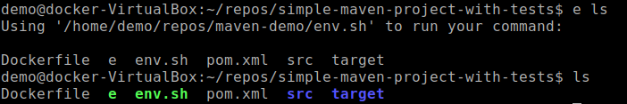
Why Would I Not Use a Dockerized Build Toolchain?
Weirdness
Running commands inside the Docker container can have subtly different results
Where’d my highlighting go? ☹

Slide 10
Why Would I Not Use a Dockerized Build Toolchain?
It’s not free
You are on the hook for packaging all your dependencies together in a Docker image
You need deep knowledge of where your tooling is writing files. For example, ~/.m2/repository is the default place used by Maven for caching jars, npm uses ~/.npm
You have to be careful about how you support multiple versions persisting data outside their containers. Maven 2 and 3 both support the same repository, but are all your dependencies going to be able to share persisted data across different versions?
You need to decide if the investment in time and labor are going to be paid back by the return you get from a more flexible, repeatable environment. If you’re not already using Docker and you only have on dependency like Java Dockerization may not be worth it!

Slide 11
How Do I Dockerize My Build Toolchain?
env.sh in the base directory of each project
Contains the docker run invocation specific to your project
Determines the current version of the Docker image to use from the project’s versioning system (pom.xml, gradle.build, package.json, etc.)
e (shell script) in your path
Recursively looks one directory up to find the env.sh for the project that you’re in. Ensures that the env.sh gets executed in the context of the directory that you’re in.
Dockerfile versioned alongside your codebase
Packages all your dependencies, should have the same version as your application code.
You can find example of a project that with a build tool chain based off of maven, npm, gulp, chromium, and selenium https://github.com/Jazzepi/dockerized-build-toolchain

Slide 12
e (shell script)
lookup() {
local file="${1}"
local curr_path="${2}"
[[ -z "${curr_path}" ]] && curr_path="${PWD}"
# Search recursively upwards for file.
until [[ "${curr_path}" == "/" ]]; do
if [[ -e "${curr_path}/${file}" ]]; then
echo "${curr_path}/${file}"
break
else
curr_path=$(dirname "${curr_path}")
fi
done
}
Recursively looks one directory up to find the env.sh for the project that you’re in.

Slide 13
e (shell script)
execute_with_env_sh() {
local env_sh_file_path=$(lookup "${ENV_SH_FILE}")
if [[ -n "${env_sh_file_path}" ]]; then
cd "$(dirname "${env_sh_file_path}")"
else
err "Unable to find a ${ENV_SH_FILE} file, bailing out."
fi
# Say what we are gonna do, then do it.
err "Using '${env_sh_file_path}' to run your command:\n"
"${env_sh_file_path}" "$@"
}
# Save the current directory for use inside the env.sh
export PWD_FOR_COMMAND=$(pwd)
execute_with_env_sh "$@"
exit $?
Ensures that the env.sh gets executed in the context of the directory that you’re in.

Slide 14
env.sh
Determines the current version of the Docker image to use from the project’s versioning system (pom.xml, gradle.build, package.json, etc.)
#!/usr/bin/env bash
#Read the version from the pom file
function readversion {
cat $(dirname $0)/pom.xml | \
docker run -i --rm jakubsacha/docker-xmlstarlet \
sel -N m=http://maven.apache.org/POM/4.0.0 \
-t -v '/m:project/m:version' -
}

Slide 15
env.sh
#Change to the directory we invoked our original ‘e whatever’ command from
if [[ -n $PWD_FOR_COMMAND ]]; then
cd $PWD_FOR_COMMAND
fi
#Snag the GITROOT so that we can mount the entire source code tree. If you’re not using git you’ll need something else like this (but you should be using git).
GITROOT=$(git rev-parse --show-toplevel)
#Invoke our xml reading version function to get the current version of the project. 1.0-SNAPSHOT
VERSION=$(readversion)
#In the container add ourselves to any groups that we are in outside the container
GROUP_ADDS=$(for group in $(id --groups); do echo "--group-add=${group}"; done)

Slide 16
env.sh - docker run invocation
docker run \
#We’re going to spin up a temporary container to run this code in, we just want to trash it afterwards. Without this you’d have a new container laying around after each invocation of the command.
--rm=true \
#Be on the same networking interface as our host machine. This makes the Docker have access to all the networking connections that you do as a normal user.
--net=host \
#Be ourselves inside of the container. If you don’t do this you’ll do wacky stuff like write out your files as root.
--user=$(id -u):$(id -g) \
#Maintain the same terminal settings inside the container. This makes programs like less, and nano happy who don’t like not having TERM set.
-e TERM=${TERM} \
#Workdir sets the place where our command will execute inside of the Docker container. Make it the current working directory so Docker will run our command in the same place.
--workdir=$(pwd) \

Slide 17
env.sh - docker run invocation
#Makes the x11 socket available for the Docker container. Allows GUI apps to run and pump bytes to our display through the same socket that we’re normally using. To run GUI style apps you either need to run xvfb inside the Docker, or let it share your display.
--volume=/tmp/.X11-unix:/tmp/.X11-unix \
#Works with the above to identify the display. :0 is the normal value.
-e DISPLAY=$DISPLAY \
#Gives the internal Docker the same passwd and group collections that we have. Without this the --user=$(id -u):$(id -g) -it won’t work properly because we need the tables of numbers -> names.
--volume=/etc/passwd:/etc/passwd \
--volume=/etc/group:/etc/group \
#In the container add ourselves to any groups that we are in outside the container
$GROUP_ADDS \
#Setup a TTY and connect our standard in to the container. Without this if you get a prompt from a shell script you can’t answer it.
-it \

Slide 18
env.sh - docker run invocation
#Often times your build process wants to create a Docker. You absolutely want to avoid “Dockers inside of Dockers”. What this does is make it so that when you use the docker client inside of the container it’s actually connecting to the docker daemon outside the container. This means that any containers you create are actually siblings your environment container.
--volume=/var/run/docker.sock:/var/run/docker.sock \
#Same timezone/time inside the container as your host.
--volume=/etc/localtime:/etc/localtime \
--volume=/etc/timezone:/etc/timezone \
#Mount your home directory inside the container. Since we’re becoming the same user inside the container we want access to their home directory as well.
--volume=${HOME}:${HOME} \
#Mount the entire source tree inside of your docker. Makes it so that when you do things like write out /target or /build or /node_modules they write to your host machine instead of being written to the container and being deleted each time you run this command.
--volume=${GITROOT}:${GITROOT} \
#User the ${VERSION} we got earlier, and pass in whatever arguments were given to us
sasquatch-technology-build-environment:${VERSION} "$@"

Slide 19
Dockerfile
FROM ubuntu:16.10
MAINTAINER Sasquatch Technology
ENV LANG en_US.UTF-8
ENV JAVA_HOME=/usr/lib/jvm/java-8-oracle
#This isn't best practice. You should pin each one of these dependencies.
RUN apt-get update && apt-get -y install ca-certificates maven curl git xvfb wget chromium-browser build-essential software-properties-common libxi6 libgconf-2-4
# Install Java.
RUN echo oracle-java8-installer shared/accepted-oracle-license-v1-1 select true | debconf-set-selections && \
add-apt-repository -y ppa:webupd8team/java && \
apt-get update && \
apt-get install -y oracle-java8-installer && \
rm -rf /var/lib/apt/lists/* && \
rm -rf /var/cache/oracle-jdk8-installer
#This isn't best practice. You should pin the nodejs dependency
# Install node and gulp
RUN curl -sL https://deb.nodesource.com/setup_6.x | bash && \
apt-get -y install nodejs && \
npm -g install gulp@3.9.1

Slide 20

Dockerize Your Build Toolchain
http://sasquatch.technology/
sasquatch_tech

