Slide 1
Training Module Presentation BY Bruce Abshire & Cole Crain
Bootstrap + Chart.js

Slide 2
Learning Outcomes
The student will demonstrate understanding the basics of bootstrap and Chart.js.
The student will learn how to change a chart and implement several functions.
The student will learn how to create an update button to update the chart.
The student then will demonstrate what they have learned by creating a chart on their own
The student will then reflect on what they have learned with a short assessment

Slide 3
Bootstrap Explanation
Bootstrap is a potent front-end framework used to create modern websites and web apps.
It's open-source and free to use, yet features numerous HTML and CSS templates for UI interface elements such as buttons and forms.
Bootstrap also supports JavaScript extensions.

Slide 4
Chart. Js Explanation
Chart.js renders in HTML 5 canvas and is widely covered as one of the best data visualization libraries.
Chart.js is a free open-source JavaScript library for data visualization, which supports 8 chart types: bar, line, area, pie (doughnut), bubble, radar, polar, and scatter.

Slide 5
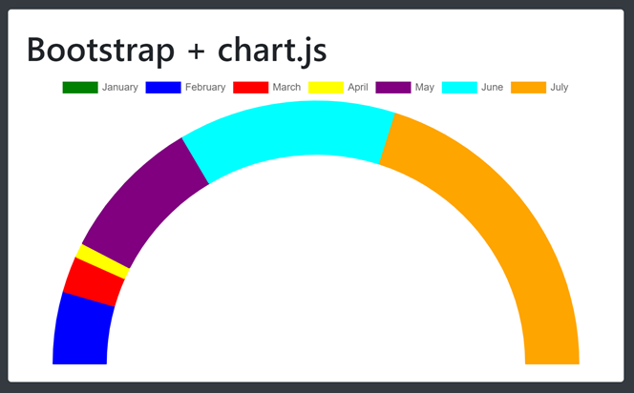
Gauge Chart Explanations
Gauge Chart
Gauge chart can be called a dial chart that gauge something
like your speed on a vehicle or the temperature out side.
Also provides a very basic way of showing data. As well as allow a number of properties to be specified for each dataset like by color.

Slide 6
Demonstration the Training Module
Demo and Examples

Slide 7
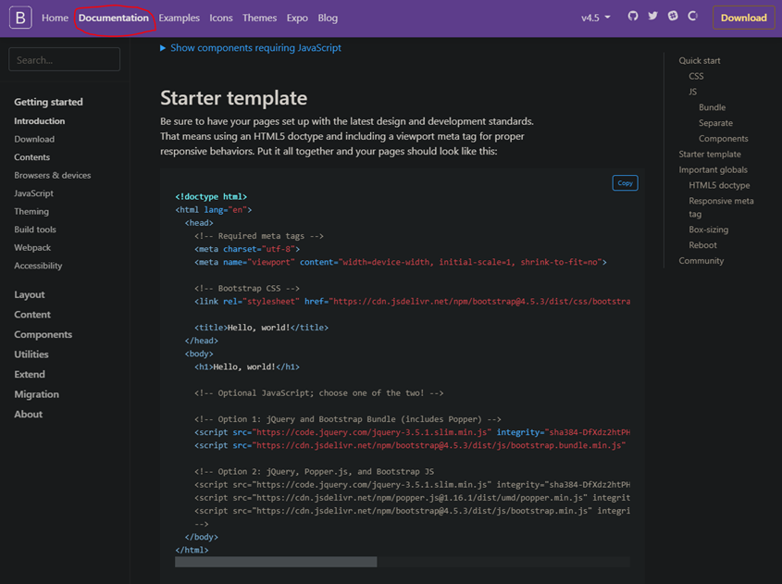
Getting started
This is the link to the bootstrap
starting template for the demo we will be going through with you.
Be sure to save the type as a Html file

Slide 8
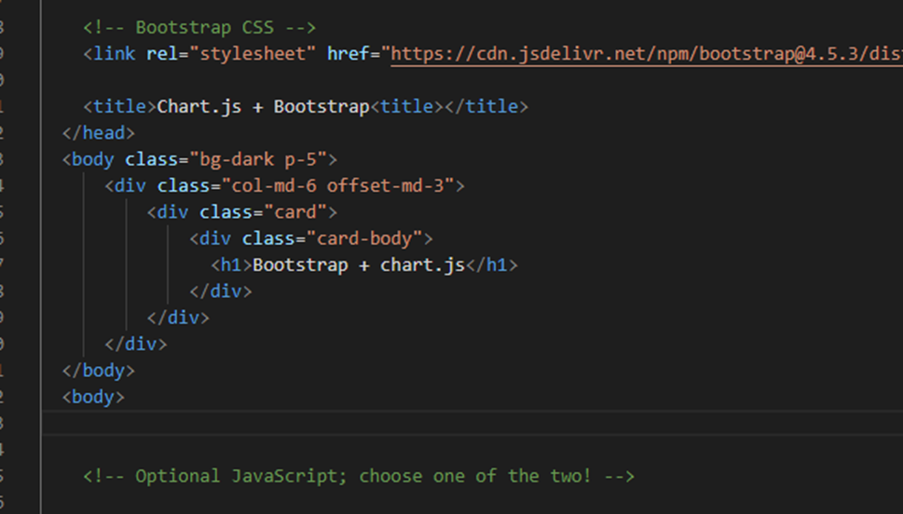
Adding a card
This Code is so that you can use a card so that we can put the chart on the page.
After you have entered the code you will need to also add a canvas tag for the graph.

Slide 9

Adding a Chart.js
You must add the Chart.js source under the last div tag inside of the body of the page.
This will add all of the functions of Chart.js much like how bootstrap is added to the page.

Slide 10
Adding the starter graph
Chart command script which is essential for drawing a particular chart.
And this must be underneath the chart.js library

Slide 11
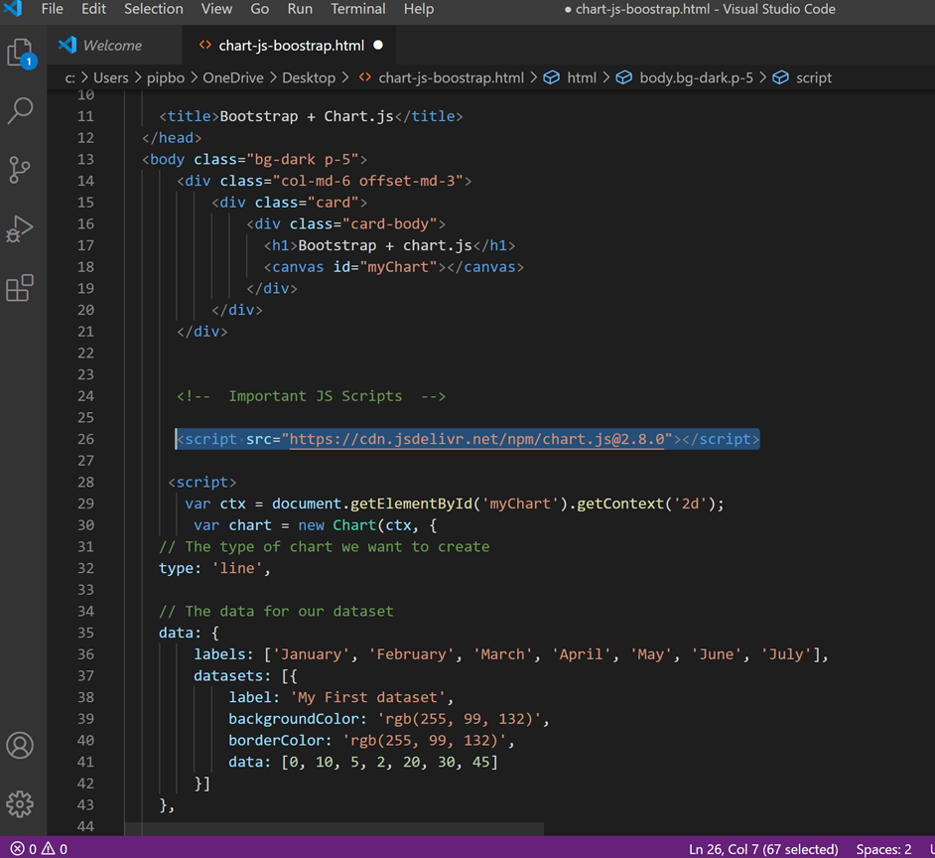
All put together
This is what your code should look like now after it has all been entered.

Slide 12
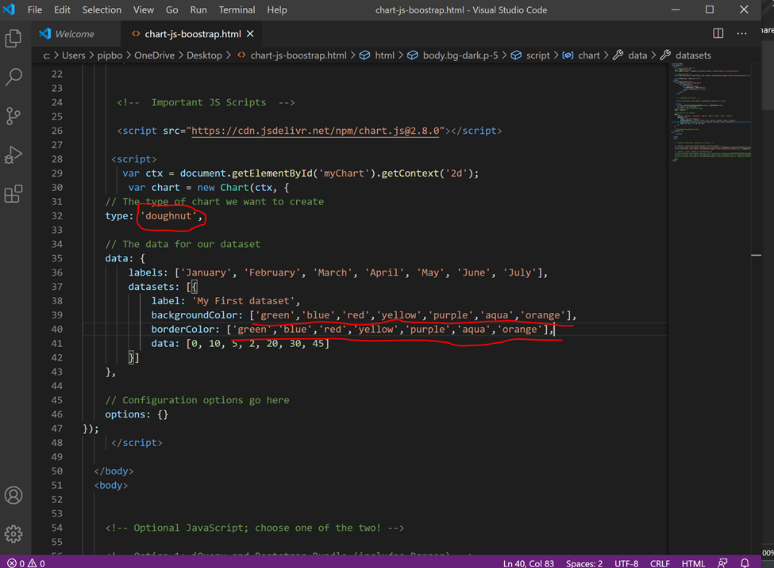
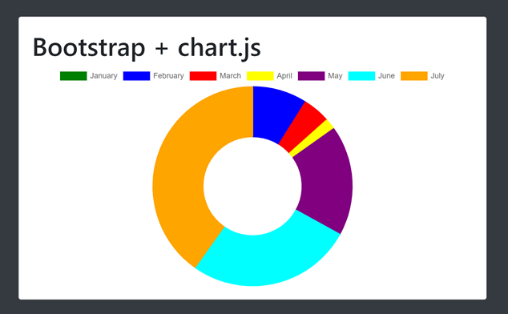
Mmmmm Doughnuts…
Change the type of chart to a doughnut and also to help with differentiate the different datasets on the chart, change the backgroundColor and borderColor into Json.
And the Chart below is what it should look like.

Slide 13
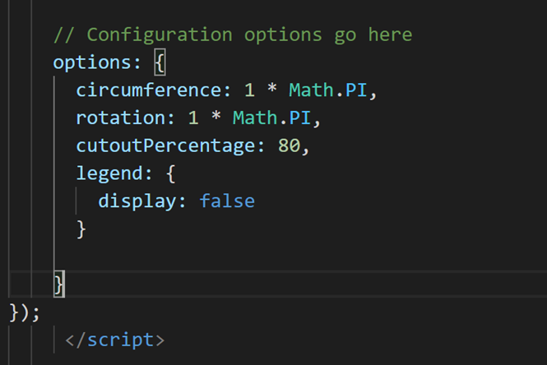
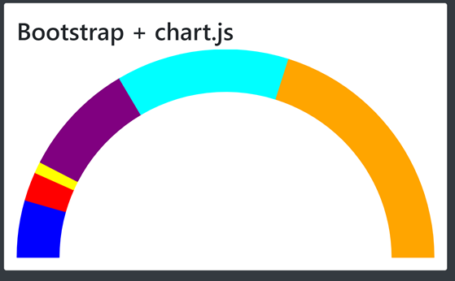
Graph taking shape
Circumference: 1 * Math.PI is to create a gauge chart but to rotate it to look like the gauge chart shown you will have to use rotation: 1 * Math.PI
To make the gauge chart look better we use the command cutoutPercentage: 80 to make it look more accurate to the percentage of the data given.

Slide 14
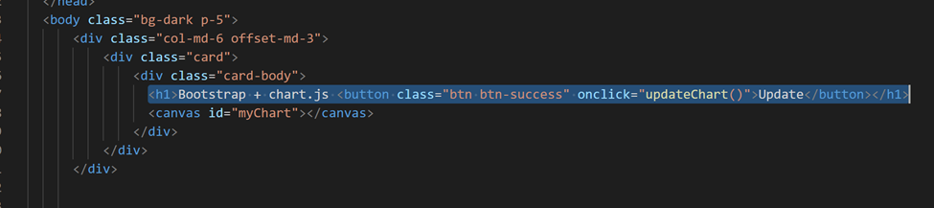
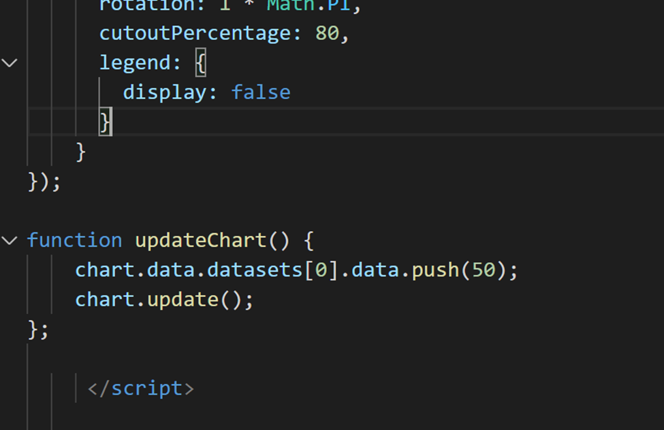
Update button*
Adding a button to the body and refresh the button at this time will not do anything because there is not a function of what the button does.
We will add the updateChart() function shown so that when clicked it will add the value that you put into the chart.
*This is for extra credit

Slide 15
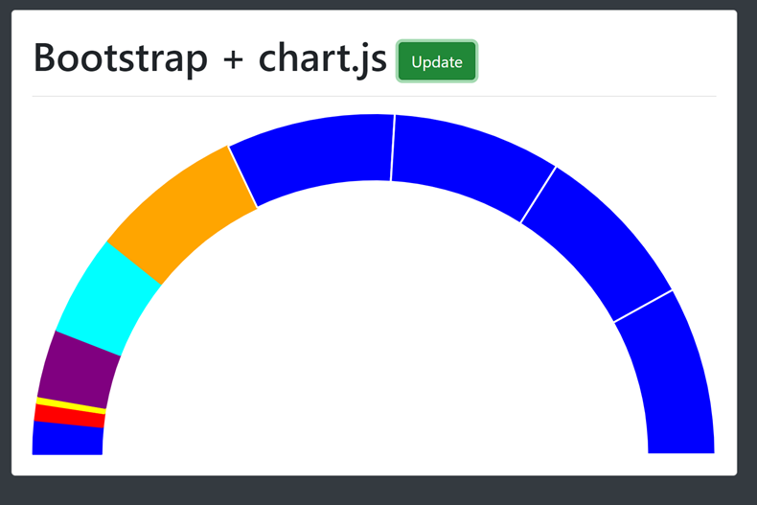
Updated Graph
Now you probably noticed that when you update the gauge chart that there is no color well we still have to add it so we will add this line of Code:
chart.data.datasets[0].backgroundColor.push(“blue”);
Then it will look like the example below.

Slide 16
Any Questions?

