Slide 1



Slide 2

We will begin by presenting a general approach to modular design. In specific, we will discuss how to organize software blocks in an effective manner. The ultimate success of an embedded system project depends both on its software and hardware.

Slide 3
The main objective of this class is to combine effective design processes together with practical software techniques in order to develop a quality embedded system.

Slide 4
As the size and especially the complexity of the software increase, the software development changes from simple "coding" to "software engineering", and the required skills also vary along this spectrum. These software skills include modular design, layered architecture, abstraction, and verification.

Slide 5
Therefore, both hardware and software skills are essential for developing embedded systems. Writing good software is an art that must be developed, and cannot be added on at the end of a Project.

Slide 6
Learning Objectives:
Understand system development process as a life cycle
Take requirements and formulate a problem statement.
Write code → Test → Write code … cycle)
Run on real board

Slide 7
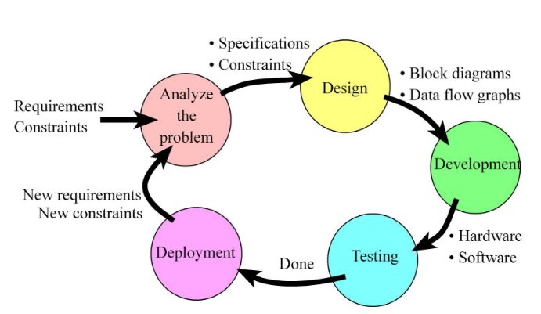

Slide 8
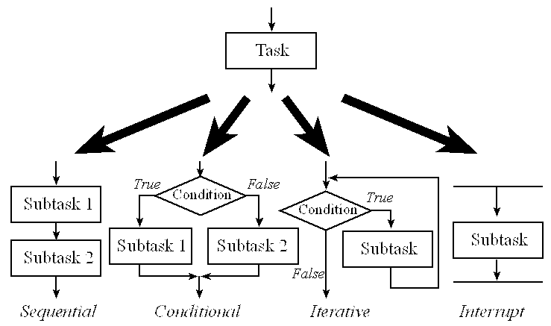

Slide 9
Andrés Felipe Aguirre García
afaguirreg@misena.edu.co
SENA – Regional Caldas
2016

