Slide 1
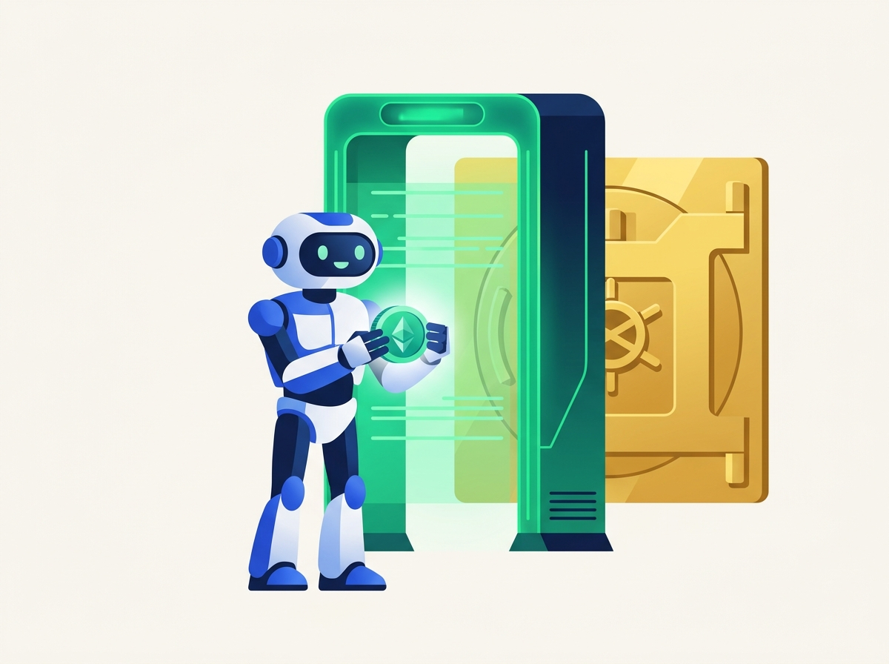
NEAR HACKATHON | AGENT SECURITY
MpcFirewall
Never Let Your AI Agent
Sign a Sealed Envelope.
Think of it as an airport X-ray security scanner for NEAR AI agents. Before your agent spends crypto on Ethereum, Base, Arbitrum, or Bitcoin via Chain Signatures, MpcFirewall opens the package and checks every rule.
Zero Blind Signing
Drop-In NEAR Guard
Human Approval Limits
Private AI Audit
Built on NEAR Chain Signatures (v1.signer), Rust Smart Contracts, NEAR AI Cloud TEE & SputnikDAO
Notes:
Welcome! MpcFirewall adds a missing security scanner to NEAR AI agents. In simple terms: it opens the sealed crypto envelope before NEAR Chain Signatures signs it.

Slide 2

01 / THE SETUP
Imagine Hiring an AI Butler to Run Your Errands
AI assistants on NEAR are great at moving fast — until someone tricks them.
The Dream: Helpful Automation
You want an AI agent on NEAR to pay a $25 vendor bill, rebalance savings, or buy supplies across Ethereum, Base, or Bitcoin automatically.
The Reality: One Trick Can Empty Your Vault
A fake website or hidden prompt-injection message can whisper a scam instruction to your AI butler — convincing it to hand over your entire life savings instead of $25.
Rule #1 of Personal Finance: You wouldn't hand your butler an unlimited credit card with zero spending rules. Why do that with AI?
MpcFirewall | Zero-Blind-Signing Security Layer for NEAR Agentic Transactions
2 / 13
Notes:
Start with a relatable story: Giving an AI agent a crypto wallet is like hiring a butler to run errands. Great when it buys a $25 coffee or pays a supplier. Terrifying if a scammer tricks your butler via prompt injection.

Slide 3
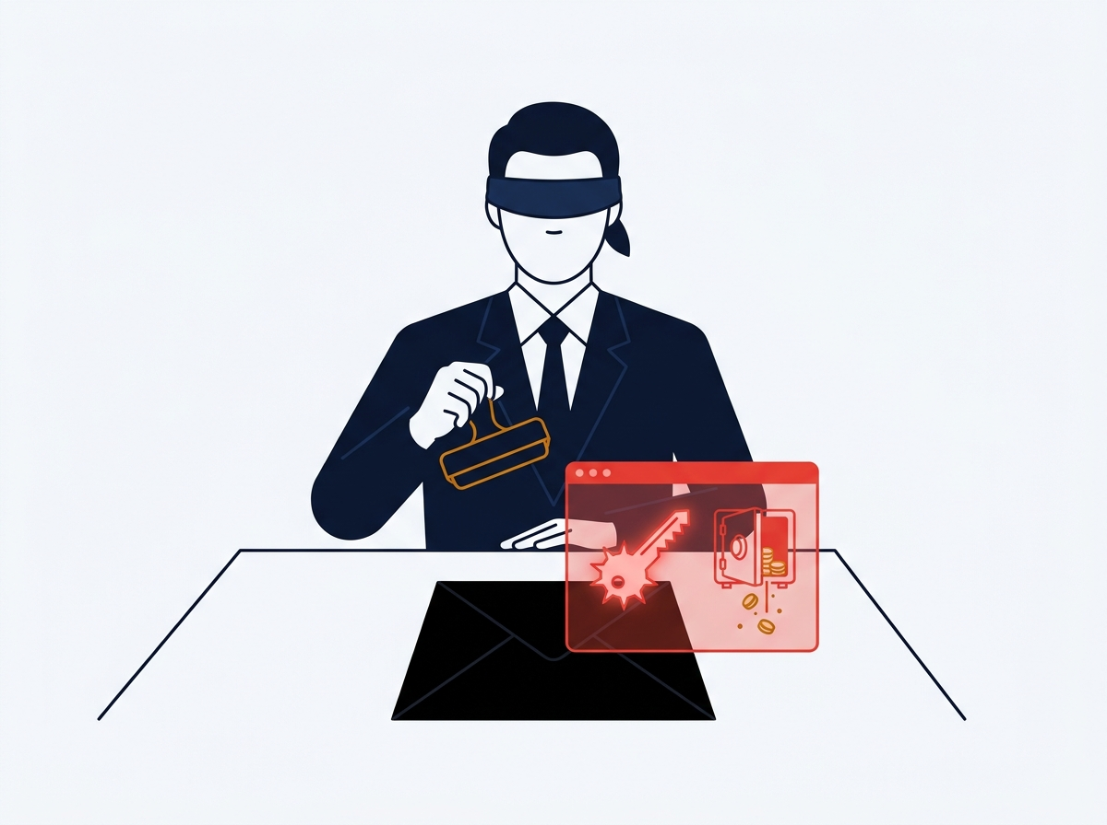
02 / THE HIDDEN TRAP
The Problem Today: Stamping a Sealed Black Envelope
Why existing crypto locks on NEAR can't see what your AI is actually signing on other chains.
WHAT HAPPENS TODAY
The Vault Only Sees a 32-Byte Scrambled Code
When your AI asks NEAR's shared signer (v1.signer) to approve an Ethereum or Bitcoin transfer, it only sends a scrambled 32-byte fingerprint (a hash) — like a sealed black envelope.
WHY OLD SECURITY FAILS
Blindfolded Notary: Old NEAR locks only check WHO handed over the envelope — they can't open it to read the check inside.
Total Blind Spot: A $25 payment and a 'drain my whole wallet' attack look identical as a 32-byte hash.
MpcFirewall | Zero-Blind-Signing Security Layer for NEAR Agentic Transactions
3 / 13
Notes:
Here is the core technical gap explained simply: NEAR Chain Signatures (v1.signer) only sees a 32-byte hash. Existing NEAR Function Call Keys can't decode Ethereum or Bitcoin hashes—so they stamp a sealed envelope blindfolded.

Slide 4
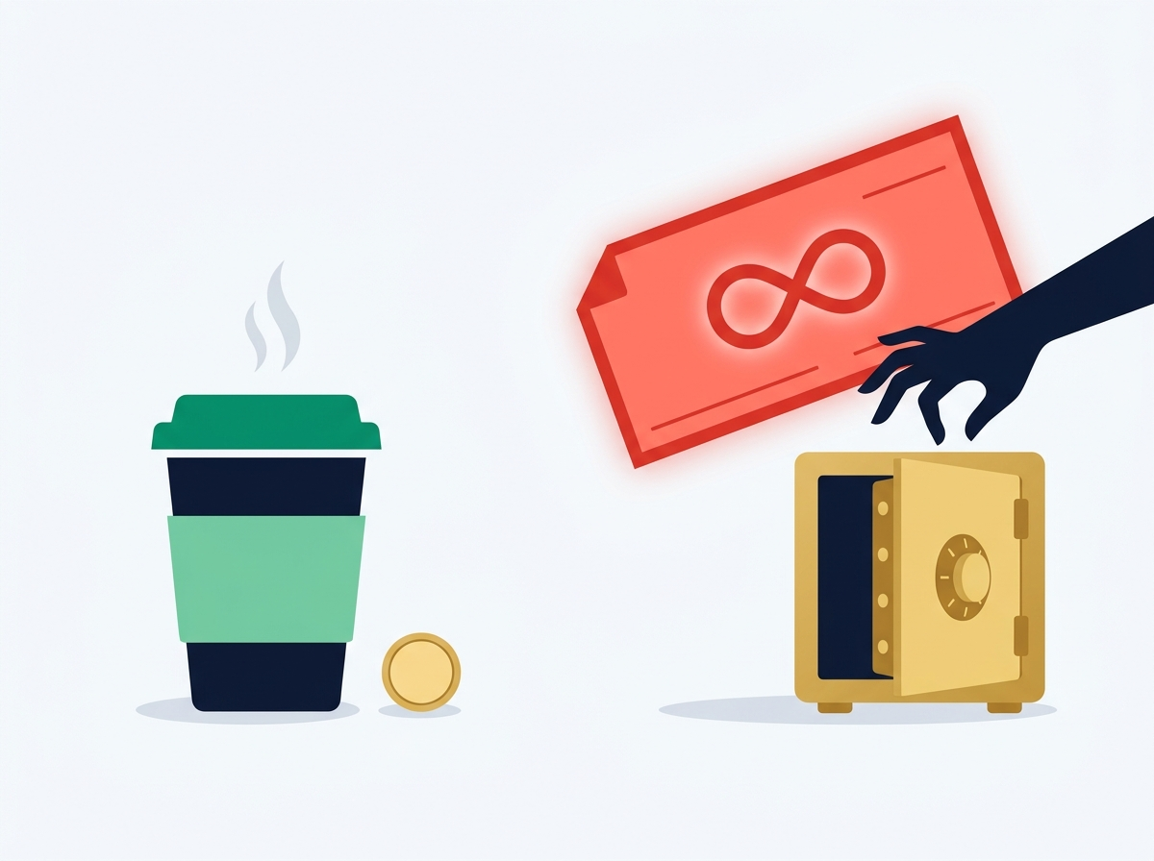
03 / REAL ATTACK #1
The "Blank Check" Scam (Unlimited Approvals)
How one tricked click gives a stranger permission to empty your account forever.
What You Thought You Signed:
"Pay $25 USDC to my trusted vendor on Base."
Small, routine, totally harmless errand.
What the Hacker Actually Slipped Inside:
ERC20.approve(drainer, INFINITY)
That's crypto-speak for signing a blank power-of-attorney check allowing a thief to withdraw 100% of your tokens anytime later.
MpcFirewall Result: BLOCKED ($0 Lost)
MpcFirewall | Zero-Blind-Signing Security Layer for NEAR Agentic Transactions
4 / 13
Notes:
In crypto, one of the deadliest traps is an unlimited token approval (MaxUint256). To a human, it looks like a normal prompt; to the blockchain, it's handing a stranger a signed blank check to your entire bank vault.

Slide 5
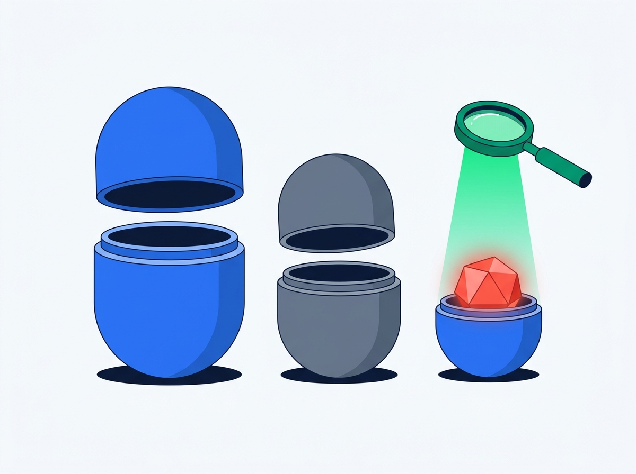
04 / REAL ATTACK #2
The "Russian Nesting Doll" Trick (Hidden Multicall)
Even smart scanners get fooled when hackers hide poison inside a bundle of normal transactions.
Layer 1 (Outer Doll): Looks Innocent
Says: "Hey, I'm just bundling two routine actions together (multicall)." Surface-level filters wave it right through.
Layer 2 (Middle Doll): Harmless Transfer
First action inside the box: "Send 5 USDC to a normal address." Everything still looks calm.
Layer 3 (Inner Doll): Smuggled Wallet Drain!
Buried inside is an unlimited approval to a hacker. MpcFirewall unwraps every doll layer-by-layer and blocks it immediately.
MpcFirewall | Zero-Blind-Signing Security Layer for NEAR Agentic Transactions
5 / 13
Notes:
Hackers don't just attack on the surface—they bundle commands inside a 'multicall' like Russian nesting dolls. MpcFirewall recursively unwraps up to 3 layers deep so no drain can hide inside a harmless wrapper.

Slide 6
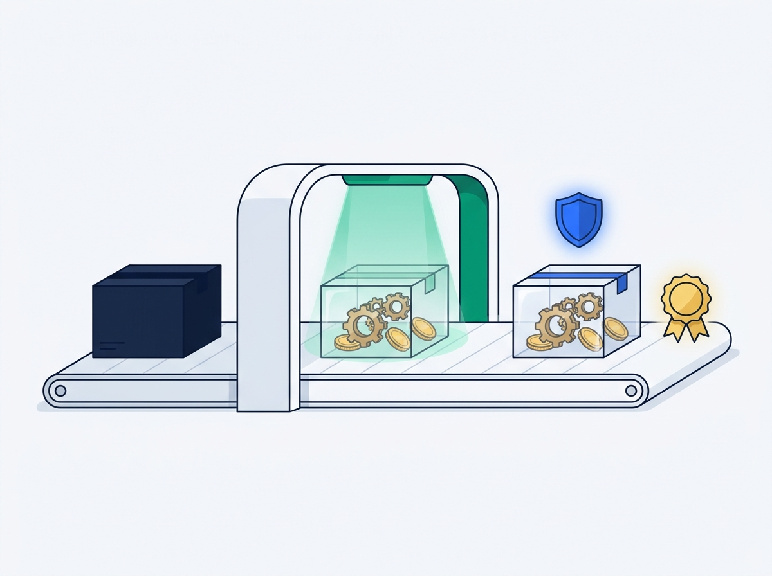
05 / WHERE IT FITS ON NEAR
Where MpcFirewall Sits Inside NEAR Agentic Transactions
Your AI agent can no longer take a sealed envelope straight to NEAR's signing vault , every transaction goes through MpcFirewall first.
CURRENT NEAR AGENTIC FLOW (RISKY)
WITH MPCFIREWALL (PROTECTED NEAR FLOW)
AI Assistant (with Function Call Key) --> Seals 32-byte Hash --> v1.signer Vault
AI Assistant --> MpcFirewall Security Desk (Unsealed) --> v1.signer Vault
Analogy: Like a building keycard that lets your assistant walk past the lobby guard straight to the notary's stamp desk with a sealed black envelope. The lobby guard only checks his ID , never what check is inside(could be carrying a bomb)
Analogy: We move the vault's master stamp behind MpcFirewall's security counter. Your AI agent's keycard only opens our inspection window , if we can't open and verify the transaction, v1.signer never stamps it.
Why This Changes Everything
Zero Bypass: MpcFirewall owns the wallet's derivation path , the AI cannot go around it.
Same NEAR Vault: Still uses official v1.signer Chain Signatures at the end.
MpcFirewall | Zero-Blind-Signing Security Layer for NEAR Agentic Transactions
6 / 13
Notes:
THIS SLIDE BRIDGES THE STORY: Today on NEAR, an AI agent uses a Function Call Key to call v1.signer directly with a 32-byte hash—like a butler whose building keycard lets him walk straight up to the notary with a sealed envelope. MpcFirewall moves the vault behind our security counter: the agent must hand over the unsealed transaction to MpcFirewall first, and only MpcFirewall calls v1.signer.

Slide 7
06 / DROP-IN INTEGRATION
How Any NEAR AI Agent Plugs Into MpcFirewall (3 Steps)
Keep your existing AI brain, NEAR account, and v1.signer — just swap the middle step in minutes.
1. Your AI Agent Bot
(NEAR AI / Shade / Custom)
2. Scoped NEAR Key
(Calls MpcFirewall Only)
3. MpcFirewall Contract
(X-Ray + TEE Audit)
4. v1.signer
(Signs Safely)
STEP 1: ONE-TIME SETUP
STEP 2: RESTRICT THE KEY
STEP 3: ONE LINE CHANGE
Park the Treasury Under MpcFirewall
Lock Down the Agent's NEAR Key
Send Raw Transaction + Reason
What Teams Do: Deploy or point your treasury derivation path to mpc-firewall.testnet and list your agent in authorized_agents.
In Plain English: Lock the company checkbook inside the security desk instead of letting the butler carry it.
What Teams Do: Give the AI a NEAR Function Call Key restricted ONLY to verify_and_sign_evm / verify_and_sign_btc.
In Plain English: The assistant keycard now only opens the X-ray security window, he can never sneak past to v1.signer.
What Teams Do: Instead of hashing locally and calling v1.signer.sign(hash), send raw unsigned bytes + plain-English intent.
In Plain English: Tell the security desk what you're buying and hand over the open box. We handle the hash & v1.signer!
MpcFirewall | Zero-Blind-Signing Security Layer for NEAR Agentic Transactions
7 / 13
Notes:
Explain how real NEAR builders plug this in today: (1) Bind the MPC derivation path to the MpcFirewall contract and allowlist the agent; (2) Scope the agent's NEAR Function Call Key so it can ONLY call MpcFirewall, never v1.signer directly; (3) Change one call in the agent so it passes raw unsigned tx bytes + stated intent instead of a pre-hashed 32-byte digest.

Slide 8
07 / INSIDE THE GATE
What Happens Before Your Agent's Transaction Is Stamped
Three automatic checkpoints run inside NEAR before v1.signer ever sees a byte.
CHECKPOINT 1
CHECKPOINT 2
CHECKPOINT 3
The X-Ray Unwrapper
The Private Lie Detector
On-Chain Seal & Rollback
On-Chain Math & Rules
NEAR AI Cloud TEE Audit
Safe Promise to v1.signer
Reads Raw Bytes: Decodes Ethereum, Base, Arbitrum, and Bitcoin instructions inside Rust.
Unwraps Nesting Dolls: Opens nested multicall bundles up to 3 layers deep.
Hard Guardrails: Blocks unlimited approvals, wrong chains, and banned addresses.
Story vs. Reality: Checks if the butler's stated reason ('Pay $25 bill') matches the decoded math.
Zero Strategy Leaks: Runs inside NEAR AI Cloud's private enclave (TEE) so prompts stay confidential.
Fail-Closed Option: Production mode blocks signing if live TEE verification fails.
Contract Computes Hash: MpcFirewall hashes the verified tx on-chain and dispatches it to v1.signer.
Replay Protection: Blocks duplicate tx IDs / digests so thieves can't replay old approvals.
Auto-Rollback: If v1.signer fails, on_mpc_sign_complete refunds the daily budget counter.
MpcFirewall | Zero-Blind-Signing Security Layer for NEAR Agentic Transactions
8 / 13
Notes:
Walk through what happens inside MpcFirewall once the AI agent submits a transaction: (1) Rust smart contract decodes RLP/ABI/multicall/BTC; (2) NEAR AI Cloud TEE verifies the agent's stated intent matches the decoded action; (3) MpcFirewall seals the hash, calls v1.signer, prevents replays, and even rolls back daily spend limits if the cross-contract promise fails.

Slide 9
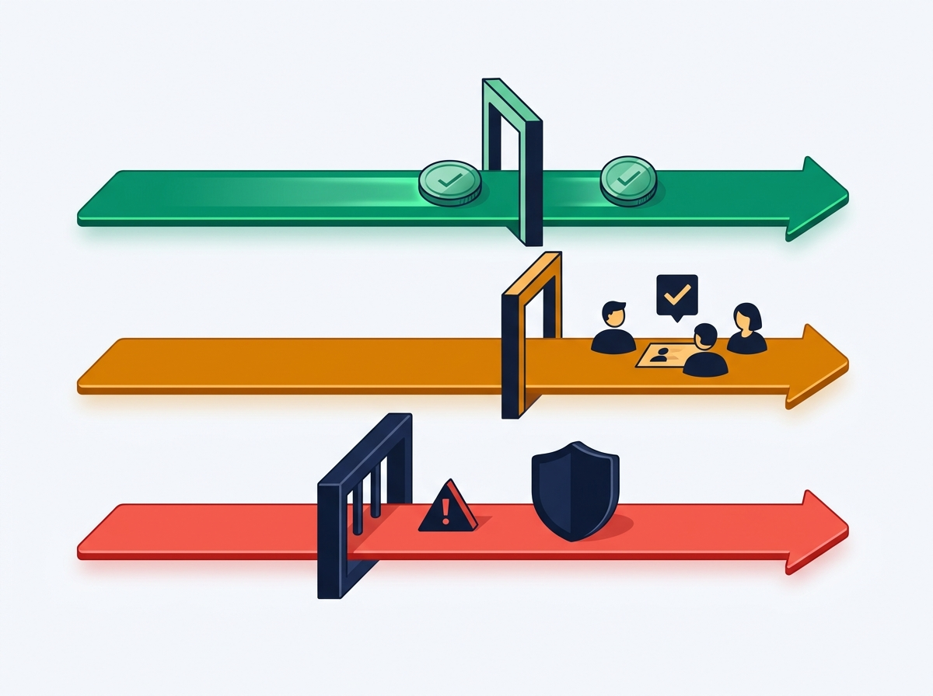
08 / SMART SPENDING TIERS
Keeping Your AI Agent on a Real Expense Policy
Small errands run autonomously on NEAR. Big moves ask humans. Scams hit a brick wall.
GREEN LANE: Up to $100 USDC
Agent Acts Autonomously
Routine $25 vendor bills pass straight to v1.signer while staying under the daily agent budget.
AMBER LANE: $100 – $500 USDC
Ask the Human Team (Trezu / SputnikDAO)
Valid larger transfers pause and create a multisig add_proposal so humans approve before signing.
RED LANE: Over $500 or Scam Signals
Hard Blocked ($0 Signed)
Unlimited approvals, banned addresses, wrong chains, or oversized transfers never reach v1.signer.
MpcFirewall | Zero-Blind-Signing Security Layer for NEAR Agentic Transactions
9 / 13
Notes:
Show how this fits into everyday agent autonomy: your agent isn't slowed down on small tasks (<= $100), automatically routes medium decisions ($100-$500) to human DAO governance via Trezu / SputnikDAO, and never risks the treasury on scams.

Slide 10
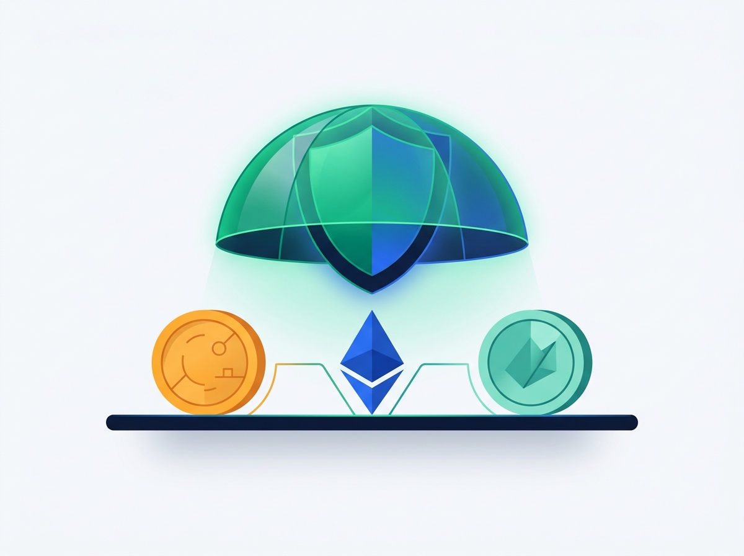
09 / UNIVERSAL PROTECTION
One Guardrail Across Every Chain Your NEAR Agent Uses
Because NEAR Chain Signatures controls multi-chain wallets, MpcFirewall guards all of them from one place.
Ethereum, Base & Arbitrum (EVM)
Checks exact chain ID (stopping wrong-chain replays), ERC-20 caps, permit limits, and NFT approvals.
Bitcoin Raw Transactions
Reads raw Bitcoin outputs directly inside the NEAR contract — enforcing satoshi caps and approved scripts.
NEAR Intents 1Click Confidential Refuels
Lets agents preview cross-chain treasury refuel quotes privately (confidentiality: 'advanced') before moving funds.
MpcFirewall | Zero-Blind-Signing Security Layer for NEAR Agentic Transactions
10 / 13
Notes:
Highlight why this matters specifically for NEAR: Chain Signatures gives one AI agent access to Ethereum, Base, Arbitrum, and Bitcoin simultaneously. MpcFirewall protects all of those chains from one NEAR contract—and pairs with NEAR Intents for confidential cross-chain refuels.

Slide 11
10 / LIVE DEMO WALKTHROUGH
Watch Our AI Agent Try 4 Real Transactions Live
Everything you'll see in our 60-second console demo against v1.signer-prod.testnet.
SCENARIO 1: SAFE PAYOUT
APPROVED_FOR_MPC_SIGN
SCENARIO 2: BLANK CHECK
BLOCKED ($0 Signed)
Butler Pays $25 Base USDC Bill
Compromised Agent Sends MaxUint256 Approve
Passes deterministic rules + TEE audit. Generates the exact verify_and_sign_evm payload for v1.signer-prod.testnet.
MpcFirewall exposes the hidden infinite approval behind the 32-byte hash and blocks it (ERR_UNLIMITED_APPROVAL).
SCENARIO 3: NESTING DOLL
BLOCKED ($0 Signed)
SCENARIO 6: TEAM VOTE
ESCALATE_TO_DAO
Agent Hides Drain Inside Nested multicall
Agent Requests $250 USDC Transfer
Unwraps depth=0 -> depth=1 call tree live on screen and catches the smuggled drain (ERR_NESTED_MULTICALL_VIOLATION).
Legitimate tx above the $100 auto-cap ,automatically builds a Trezu / SputnikDAO add_proposal for human sign-off.
MpcFirewall | Zero-Blind-Signing Security Layer for NEAR Agentic Transactions
11 / 13
Notes:
Connect the demo directly back to the AI agent story: Scenario 1 = safe $25 errand; Scenario 2 = tricked agent trying a blank check; Scenario 3 = tricked agent hiding a drain inside nested multicall; Scenario 6 = agent politely asking the DAO for $250.

Slide 12
11 / NEAR ECOSYSTEM IMPACT
The Missing Security Layer for NEAR's Agent Economy
Turning 'hope your AI doesn't get prompt-injected' into verifiable on-chain safety.
Without MpcFirewall
Built End-to-End on the NEAR Stack
Blind Keycard: Function Call Keys let agents call v1.signer with opaque 32-byte hashes.
Total Treasury Risk: One prompt injection can drain Ethereum, Base, and Bitcoin at once.
Chain Signatures (v1.signer)
Multi-chain MPC keys locked behind MpcFirewall's derivation path.
Rust NEAR Smart Contract
Decodes EVM RLP, ABI, multicall & Bitcoin on-chain before hashing.
NEAR AI Cloud TEE
Confidential intent-vs-calldata audit keeps agent prompts private.
With MpcFirewall
Drop-In Shield: Agents keep their NEAR accounts — keys simply route through MpcFirewall first.
Full Human Control: Daily caps, private TEE intent checks, and DAO votes built right in.
Trezu / SputnikDAO
Automatic add_proposal escalation for mid-sized agent spends.
NEAR Intents 1Click
Live token discovery & confidential cross-chain refuel quotes.
MpcFirewall | Zero-Blind-Signing Security Layer for NEAR Agentic Transactions
12 / 13
Notes:
Wrap up how MpcFirewall strengthens the entire NEAR ecosystem: any agent framework on NEAR can adopt this without changing Chain Signatures, simply by scoping their Function Call Key to MpcFirewall.

Slide 13
12 / RECAP & TRY IT
Stop Blind Signing. Let NEAR AI Agents Act , Not Drain.
One drop-in NEAR contract between your AI agent and v1.signer turns mystery hashes into verifiable safety.
Drop-In Integration
X-Ray + Private Audit
Human-Sized Limits
Scope your agent's Function Call Key to MpcFirewall and keep using v1.signer.
Unwraps nested EVM/Bitcoin bytes on-chain and verifies agent intent inside NEAR AI TEE.
Auto-approves small errands, escalates mid-tier bills to DAO, and blocks scams at $0.
Try MpcFirewall Locally in 60 Seconds (Zero API Keys Required)
1. Run pnpm verify:judge to test all 7 real EVM & Bitcoin attack scenarios in your terminal.
2. Run pnpm start and open http://localhost:3000 to inspect live call trees, TEE signatures & v1.signer-prod.testnet.
MpcFirewall | Zero-Blind-Signing Security Layer for NEAR Agentic Transactions
13 / 13
Notes:
Thank you! MpcFirewall is the drop-in security gate between NEAR AI agents and Chain Signatures—stopping blind signing without slowing down real agent workflows.

