Slide 1
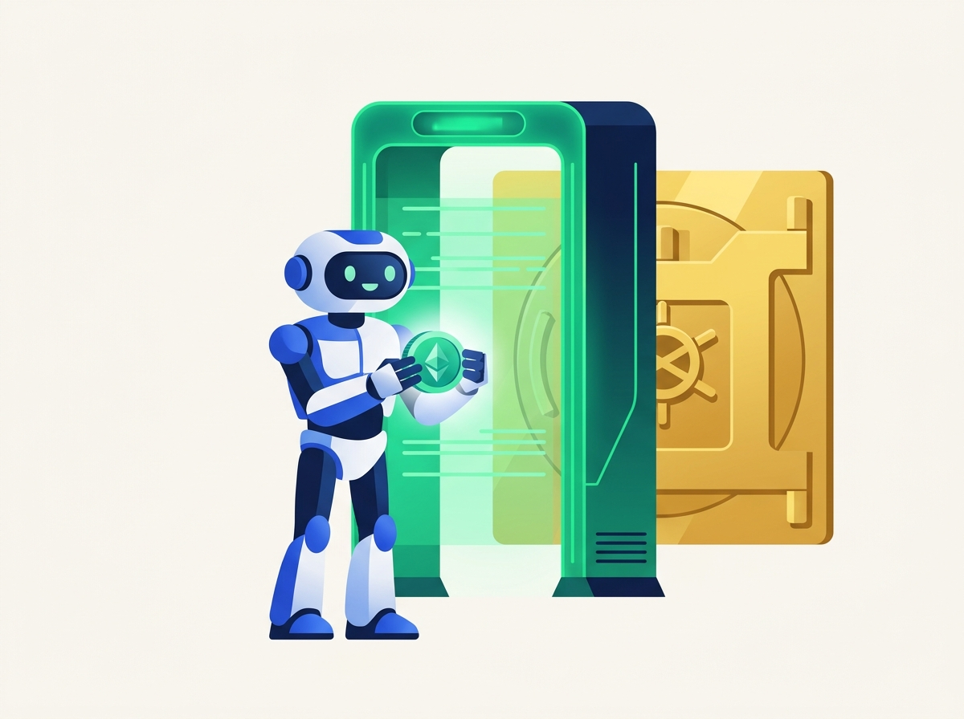
NEAR HACKATHON | AGENT SECURITY
MpcFirewall
Never Let Your AI Agent
Sign a Sealed Envelope.
Think of it as an airport X-ray security scanner for AI money bots. Before your AI spends crypto on Ethereum, Base, Arbitrum, or Bitcoin, MpcFirewall opens the package and checks every rule.
Zero Blind Signing
Multi-Chain Guard
Human Approval Limits
Private AI Audit
Built on NEAR Chain Signatures (v1.signer), Rust Smart Contracts, NEAR AI Cloud TEE & SputnikDAO
Notes:
Welcome! MpcFirewall solves a huge problem for anyone using AI agents with crypto. In simple terms: it's an X-ray security gate that stops AI bots from signing hidden scam transactions blindfolded.

Slide 2

01 / THE SETUP
Imagine Hiring an Onchain AI Assistant to Run Your Errands
AI assistants are great at moving fast, until someone tricks them.
The Dream: Helpful Automation
You want an AI agent to pay a $25 vendor bill, rebalance savings, or buy supplies across different networks (Ethereum, Base, Bitcoin) automatically.
The Reality: One Trick Can Empty Your Vault
A fake website or hidden prompt-injection message can whisper a scam instruction to your AI assistant convincing it to hand over your entire life savings instead of $25.
Rule #1 of Personal Finance: You wouldn't hand your butler an unlimited credit card with zero spending rules. Why do that with AI?
MpcFirewall | Zero-Blind-Signing Firewall for NEAR Chain Signatures
2 / 12
Notes:
Start with a relatable story: Giving an AI agent a crypto wallet is like hiring a butler to run errands. Great when it buys a $25 coffee or pays a supplier. Terrifying if a scammer tricks your butler via prompt injection.

Slide 3
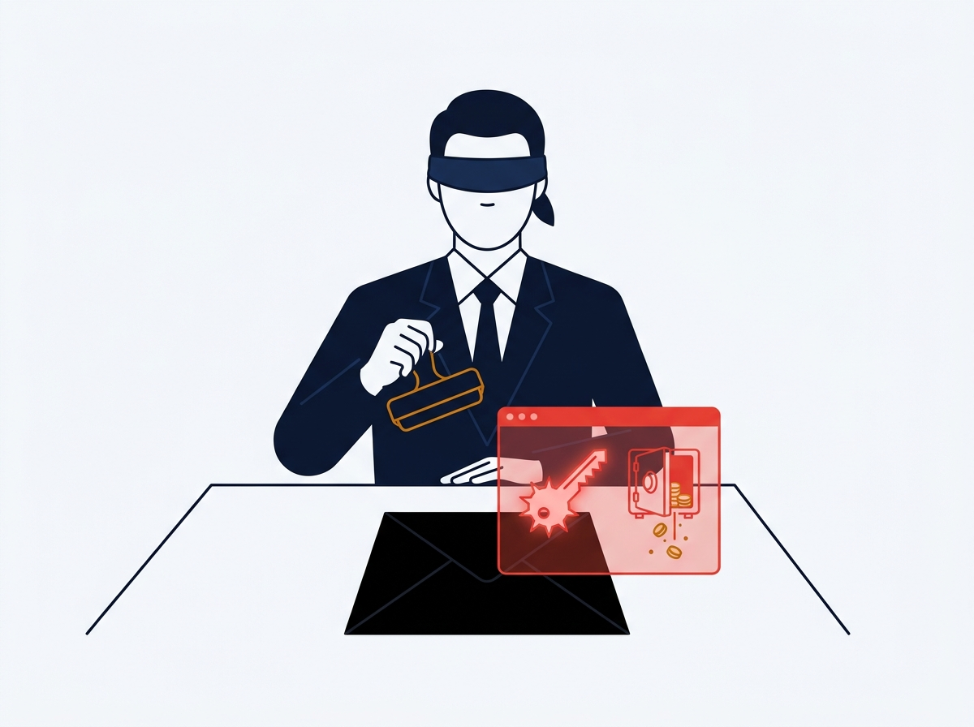
02 / THE HIDDEN TRAP
The Problem Today: Stamping a Sealed Black Envelope
Why existing crypto locks on NEAR can't see what your AI is actually signing on other chains.
WHAT HAPPENS TODAY
The Vault Only Sees a 32-Byte Scrambled Code
When your AI asks NEAR's shared signer (v1.signer) to approve an Ethereum or Bitcoin transfer, it only sends a scrambled 32-byte fingerprint (a hash) — like a sealed black envelope.
WHY OLD SECURITY FAILS
Blindfolded Notary: Old NEAR locks only check WHO handed over the envelope they can't open it to read the check inside.
Total Blind Spot: A $25 payment and a 'drain my whole wallet' attack look identical as a 32-byte hash.
MpcFirewall | Zero-Blind-Signing Firewall for NEAR Chain Signatures
3 / 12
Notes:
Here is the core technical gap explained simply: NEAR Chain Signatures (v1.signer) only sees a 32-byte hash. Existing NEAR Function Call Keys can't decode Ethereum or Bitcoin hashes—so they stamp a sealed envelope blindfolded.

Slide 4
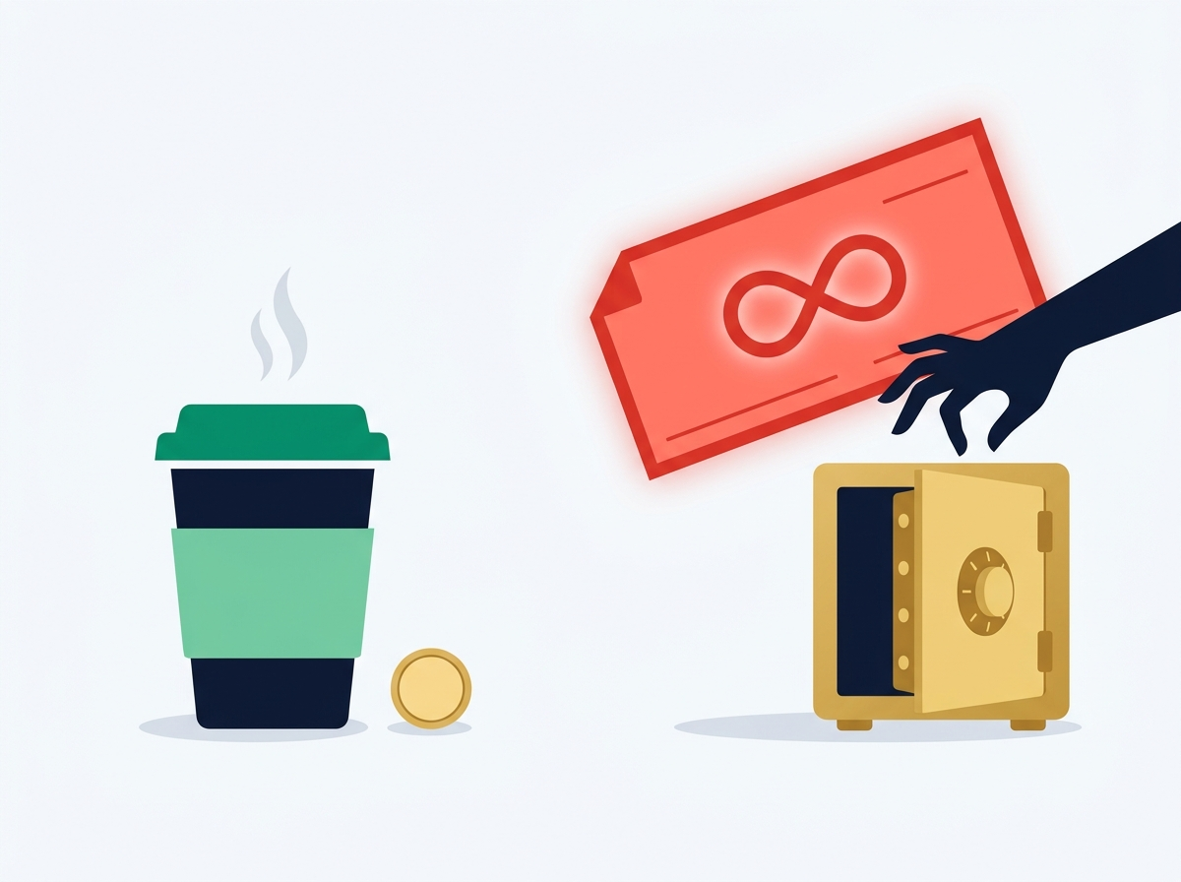
03 / REAL ATTACK #1
The "Blank Check" Scam (Unlimited Approvals)
How one tricked click gives a stranger permission to empty your account forever.
What You Thought You Signed:
"Pay $25 USDC to my trusted vendor on Base."
Small, routine, totally harmless errand.
What the Hacker Actually Slipped Inside:
ERC20.approve(drainer, INFINITY)
That's crypto-speak for signing a blank power-of-attorney check allowing a thief to withdraw 100% of your tokens anytime later.
MpcFirewall Result: BLOCKED ($0 Lost)
MpcFirewall | Zero-Blind-Signing Firewall for NEAR Chain Signatures
4 / 12
Notes:
In crypto, one of the deadliest traps is an unlimited token approval (MaxUint256). To a human, it looks like a normal prompt; to the blockchain, it's handing a stranger a signed blank check to your entire bank vault.

Slide 5
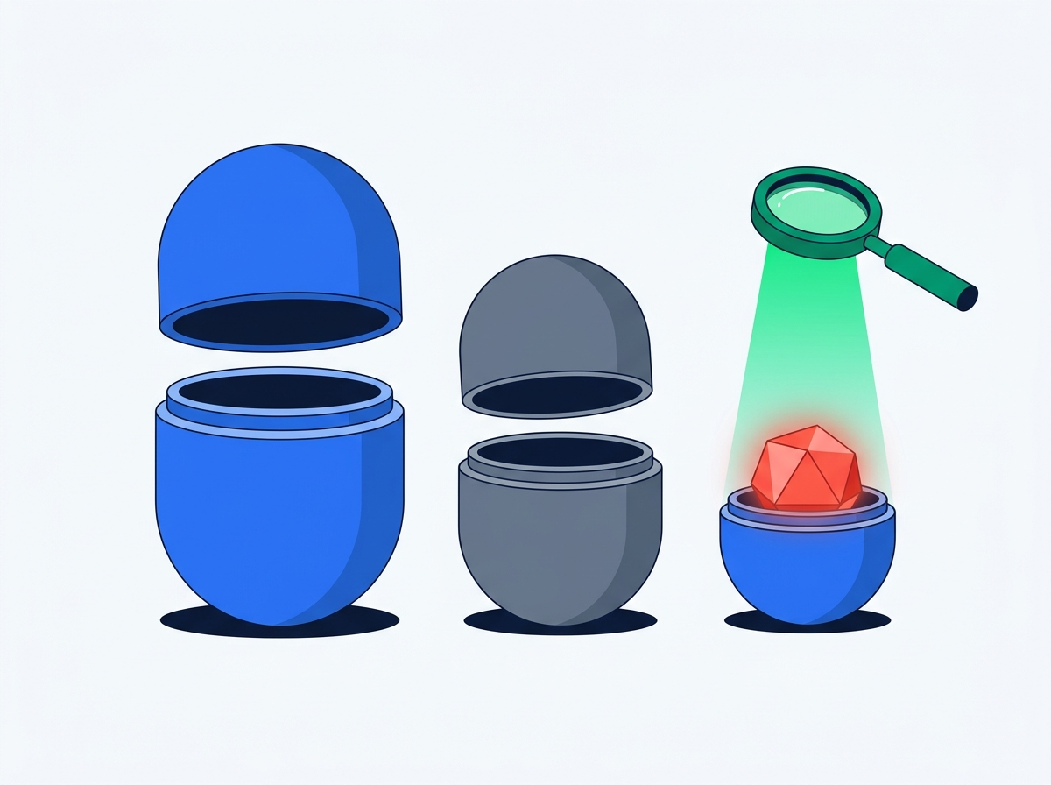
04 / REAL ATTACK #2
The "Russian Nesting Doll" Trick (Hidden Multicall)
Even smart scanners get fooled when hackers hide poison inside a bundle of normal transactions.
Layer 1 (Outer Doll): Looks Innocent
Says: "Hey, I'm just bundling two routine actions together (multicall)." Surface-level filters wave it right through.
Layer 2 (Middle Doll): Harmless Transfer
First action inside the box: "Send 5 USDC to a normal address." Everything still looks calm.
Layer 3 (Inner Doll): Smuggled Wallet Drain!
Buried inside is an unlimited approval to a hacker. MpcFirewall unwraps every doll layer-by-layer and blocks it immediately.
MpcFirewall | Zero-Blind-Signing Firewall for NEAR Chain Signatures
5 / 12
Notes:
Hackers don't just attack on the surface—they bundle commands inside a 'multicall' like Russian nesting dolls. MpcFirewall recursively unwraps up to 3 layers deep so no drain can hide inside a harmless wrapper.

Slide 6
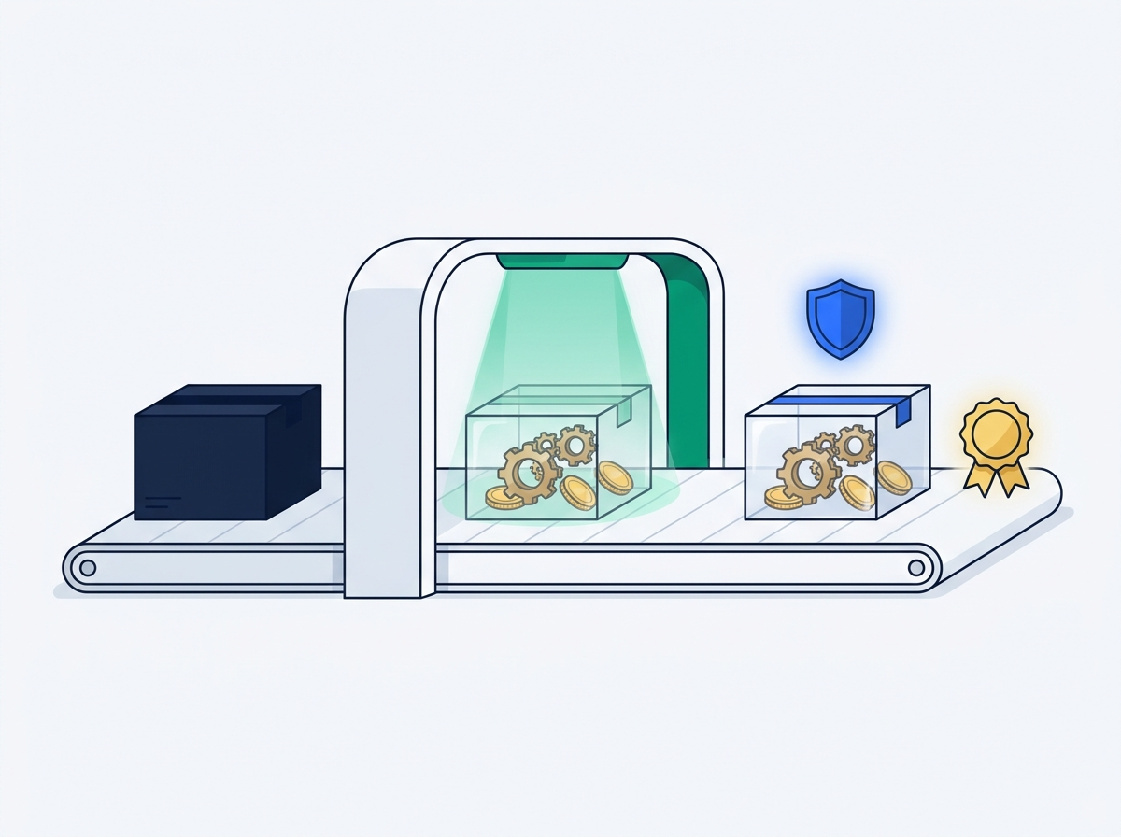
05 / THE SOLUTION
Meet MpcFirewall: Open the Envelope Before Stamping
The AI agent never touches the stamp directly. No raw luggage X-ray = no signature.
1. Unsealed Package Only
2. Full X-Ray Inspection
3. Stamp Only If Safe
AI must submit the full, raw unsigned transaction — never a mystery 32-byte hash.
Our NEAR smart contract opens every byte & nesting layer and checks spending rules + AI intent.
Only after passing every rule does MpcFirewall seal the hash and ask v1.signer to sign.
MpcFirewall | Zero-Blind-Signing Firewall for NEAR Chain Signatures
6 / 12
Notes:
Here is the breakthrough: MpcFirewall owns the MPC derivation path, meaning the AI has zero direct access to v1.signer. Just like airport TSA, you can't board with a locked mystery box—you must put the raw transaction on the X-ray belt first.

Slide 7
06 / HOW IT WORKS
Three Checkpoints Before a Single Penny Moves
Math rules + a private AI lie detector + on-chain vault sealing.
CHECKPOINT 1
CHECKPOINT 2
CHECKPOINT 3
The X-Ray Unwrapper
The Private Lie Detector
The Vault Stamp
Strict Math & Rules
Confidential AI Audit
On-Chain Seal & Replay Lock
No Guessing: Reads raw Ethereum, Base, Arbitrum, and Bitcoin instructions.
Unwraps Bundles: Opens nested multicall dolls up to 3 layers deep.
Hard Guardrails: Blocks unlimited approvals, wrong blockchains, and banned addresses.
Story vs. Reality: Compares what the AI claimed ('Pay $25 bill') against the actual decoded math.
Keeps Secrets Safe: Runs inside NEAR AI Cloud's private enclave (TEE) so trading strategies stay hidden.
Fail-Closed Option: Can block everything automatically if the enclave isn't verified.
Contract Seals It: MpcFirewall computes the final hash itself inside the Rust smart contract.
No Double-Spending: Remembers every stamped transaction so thieves can't replay an old approval.
Daily Budgets: Tracks cumulative daily spend across every request.
MpcFirewall | Zero-Blind-Signing Firewall for NEAR Chain Signatures
7 / 12
Notes:
Even a non-technical user can follow the three checkpoints: (1) Deterministic math unwraps the transaction, (2) a confidential AI inside NEAR AI Cloud checks that the AI's story matches the transaction, and (3) the contract seals the hash and prevents replays.

Slide 8
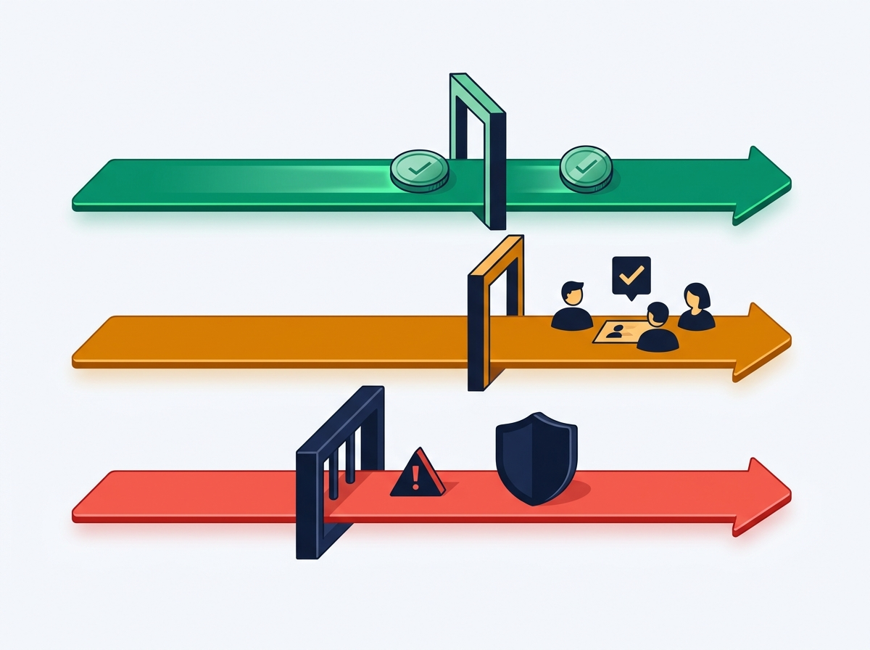
07 / SMART SPENDING TIERS
Just Like a Real Company Expense Policy
Small coffee runs happen fast. Medium bills ask the boss. Scams hit a brick wall.
GREEN LANE: Up to $100 USDC
Auto-Approved Instantly
Routine vendor bills & small errands pass automatically while staying within your daily budget.
AMBER LANE: $100 – $500 USDC
Ask the Human Team (DAO)
Valid larger transfers pause and generate a team vote proposal (Trezu / SputnikDAO) for human sign-off.
RED LANE: Over $500 or Scam Signals
Hard Blocked ($0 Signed)
Unlimited approvals, banned addresses, wrong chains, or oversized transfers never reach the signer.
MpcFirewall | Zero-Blind-Signing Firewall for NEAR Chain Signatures
8 / 12
Notes:
People intuitively understand corporate expense cards: under $100 goes straight through, $100 to $500 escalates to human managers via Trezu / SputnikDAO multisig, and anything over the hard cap or suspicious is blocked flat.

Slide 9
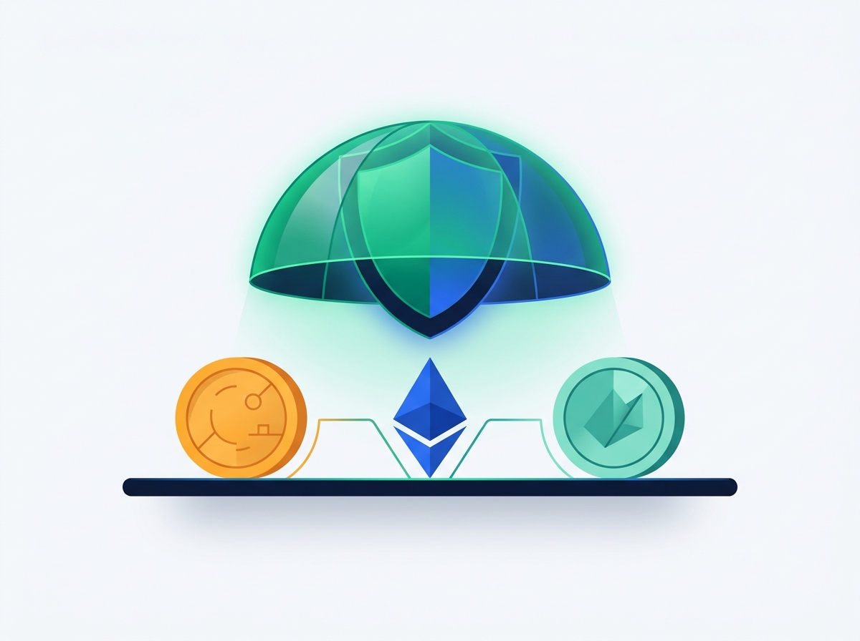
08 / UNIVERSAL PROTECTION
One Guardrail for Ethereum, Base, Arbitrum & Bitcoin
Not locked to one chain — one universal customs desk for your AI's multi-chain wallet.
Ethereum, Base & Arbitrum (EVM)
Checks exact destination network (stopping wrong-chain replay attacks), token amounts, and NFT permissions.
Bitcoin Raw Transactions
Reads raw Bitcoin outputs directly — enforcing satoshi spending caps and approved Bitcoin receiver scripts.
NEAR Intents 1Click Previews
Previews confidential cross-chain refuel routes so your agent can move liquidity safely without leaking strategy.
MpcFirewall | Zero-Blind-Signing Firewall for NEAR Chain Signatures
9 / 12
Notes:
Most security tools only guard one blockchain. Because NEAR Chain Signatures controls keys across Ethereum, Base, Arbitrum, AND Bitcoin, MpcFirewall speaks all of them—plus previews NEAR Intents cross-chain swaps.

Slide 10
09 / LIVE DEMO WALKTHROUGH
Watch MpcFirewall Catch Real Attacks in 60 Seconds
Four real-world tests you can click live inside our Security Operations Console.
SCENARIO 1: SAFE PAYOUT
APPROVED_FOR_MPC_SIGN
SCENARIO 2: BLANK CHECK
BLOCKED ($0 Signed)
Compliant $25 Base USDC Payout
Hidden ERC-20 approve(MaxUint256)
Passes math checks + TEE audit. Generates the exact verify_and_sign_evm payload for v1.signer-prod.testnet.
Reveals the hidden unlimited check behind the 32-byte hash and blocks with ERR_UNLIMITED_APPROVAL.
SCENARIO 3: NESTING DOLL
BLOCKED ($0 Signed)
SCENARIO 6: TEAM VOTE
ESCALATE_TO_DAO
Smuggled Nested multicall Drain
Compliant $250 USDC Transfer
Unwraps depth=0 -> depth=1 call tree live on screen and catches the hidden drain (ERR_NESTED_MULTICALL_VIOLATION).
Safe transaction, but above the $100 autonomous cap — builds a Trezu / SputnikDAO add_proposal for human approval.
MpcFirewall | Zero-Blind-Signing Firewall for NEAR Chain Signatures
10 / 12
Notes:
During the live demo, we walk through four real scenarios: Scenario 1 approves $25 USDC cleanly; Scenario 2 catches a hidden unlimited blank check; Scenario 3 unwraps a nested multicall doll; and Scenario 6 escalates a $250 payment to the human DAO.

Slide 11
10 / WHY IT MATTERS
Real-World Trust for the AI Agent Economy
Moving from 'hope the AI doesn't get hacked' to verifiable guardrails.
Before MpcFirewall
Built End-to-End on the NEAR Stack
Blind Trust: v1.signer stamps 32-byte hashes without knowing what's inside.
All-or-Nothing Risk: One prompt injection can drain every chain at once.
Chain Signatures (v1.signer)
Multi-chain MPC wallet keys protected by contract ownership.
Rust NEAR Smart Contract
Decodes EVM RLP, ABI, multicall & Bitcoin on-chain before hashing.
NEAR AI Cloud TEE
Confidential intent-vs-calldata audit keeps strategy prompts private.
With MpcFirewall
Full Visibility: Every byte & nested call unwrapped on-chain before signing.
Human-Sized Rules: Daily caps, private TEE intent checks, and DAO escalation built in.
Trezu / SputnikDAO
Automatic add_proposal escalation for mid-sized transactions.
NEAR Intents 1Click
Live token discovery & confidential cross-chain refuel quotes.
MpcFirewall | Zero-Blind-Signing Firewall for NEAR Chain Signatures
11 / 12
Notes:
Summarize the impact for both normies and NEAR judges: MpcFirewall turns blind signing into verifiable multi-chain safety using 5 core pieces of the NEAR ecosystem.

Slide 12
11 / RECAP & TRY IT
Stop Blind Signing. Let AI Act, Not Drain.
MpcFirewall turns opaque 32-byte crypto hashes into crystal-clear approvals before v1.signer ever signs.
X-Ray Every Transaction
Verify Private Intent
Keep Humans in Control
Opens raw EVM & Bitcoin bytes + unwraps nested multicall tricks on-chain.
Checks that the AI's promised goal matches the decoded math inside a private TEE.
Auto-approves pocket money, escalates mid-tier bills to DAO, and blocks scams cold.
Try MpcFirewall Locally in 60 Seconds (Zero API Keys Required)
1. Run pnpm verify:judge to test all 7 real EVM & Bitcoin attack scenarios in your terminal.
2. Run pnpm start and open http://localhost:3000 to inspect live call trees, TEE signatures & v1.signer-prod.testnet.
MpcFirewall | Zero-Blind-Signing Firewall for NEAR Chain Signatures
12 / 12
Notes:
Thank you! In one sentence: MpcFirewall stops AI agents from blind-signing sealed envelopes by X-raying every transaction on-chain before NEAR Chain Signatures ever signs.

