Slide 1


Introduction
Dataset comprises of Car Insurance policy details in the United Kingdom.
Consists of 40 Columns x 100000 rows.
The period of written policies is between the April 2018 to March 2020 and claims is between April 2018 to September 2020.

Slide 2

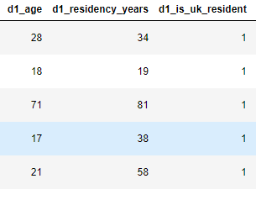
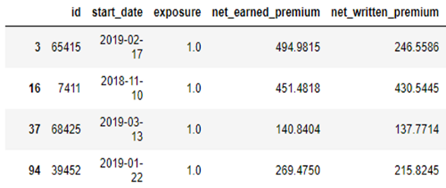
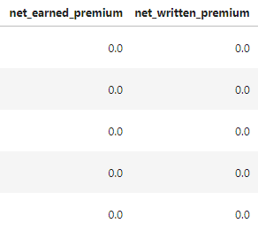
Data Cleaning
Eliminated 9671 rows having ambiguous start/vehicle_purchase _date
Eliminated 5 rows with ambiguous age and residency years
Imputed values in ‘net_earned_premium’ as ‘net_written _premium * exposure’(Rectified 5509 rows)
Dropped 3388 rows with net_written_premium = 0 as a written policy should always have a decided premium

Slide 3
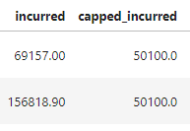
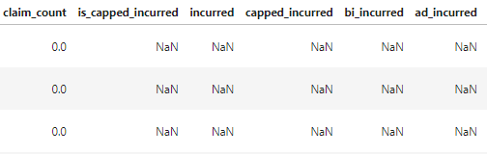
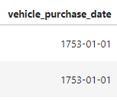
Data Cleaning
Imputed values in capped_incurred column as 50K whenever it exceeded 50K according to glossary. Safeguards the Insurance company against exorbitant claims. Rectified 6 rows.
When claim count = 0, imputed above columns and more with 0. Rectified values in 13 columns * 80107 rows. Made sure all ‘counts’ added to ‘claim_count’ and all ‘*_incurred’ columns added to form ‘incurred’
Eliminated 749 rows with ambiguous vehicle_purchase_date

Slide 4
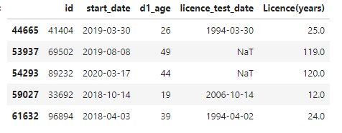

Data Cleaning
Imputed Vehicle age as 1 where it was -1 based on average vehicle_value (1 row). Filled all N/A’s in ‘vehicle_make’,’transmission’,’primary_car_colour’,’region’ as Unknown
Deleted 5 rows where people seemed to have had a license since they were under the age of 16. Improbable possibility!!!
FINAL DATASET = 100000-9671-5-3388-749-5 =86182ROWS

Slide 5
KPI’s
Number Of Policies
86.18K
Total Claim Amount
£18.49M
Number Of Claims
7175
Total Capped Claim Amount
£16.95M
Average Claim Value
£2.58K
Profit %
26.73%
Total Net Earned Premium
£23.14M
Profit
£6.18M

Slide 6



INSIGHTS ROADMAP
COMPANY
CUSTOMERS
CLAIMS

Slide 7
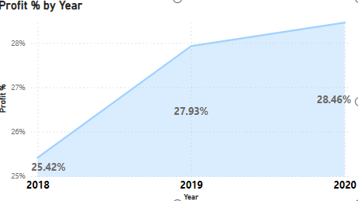
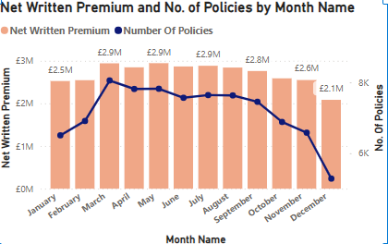
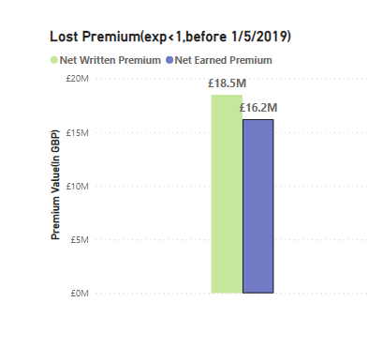
COMPANY INSIGHTS
INSIGHTS
Seems like a good Y-O-Y growth. Insurances written throughout the year reach its peak in March and then descend, hitting bottom in December. This could be due to the approach of the financial year end. Before the 1st of May 2019, policies who have an exposure less than 1 result in lost net earned premium of £2.3M(~12.43% ↓)
RECOMMENDATIONS
Ensure we have marketing campaigns targeting towards engaging customers throughout the year. Check for policies before 1/5/2019 to see if people stopped their policies midway and why?

Slide 8
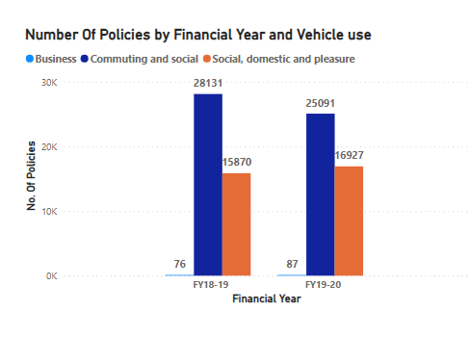
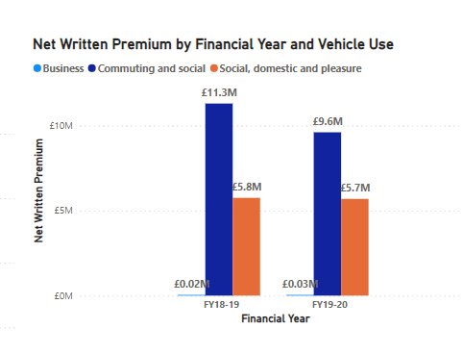
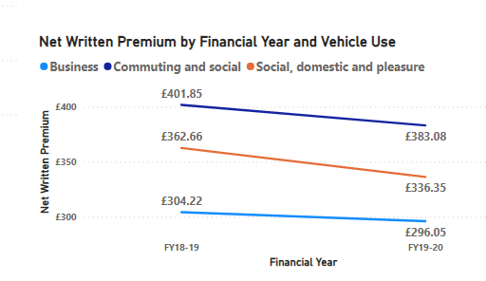
COMPANY INSIGHTS
INSIGHTS
Sold around 3000 lesser ‘Commuting and Social’ policies at a lower average price resulting in a loss of premium of around £1.7M(~16%↓), compared to last FY. Wrote more policies in the other 2 categories. Overall less policies sold, could be due to Covid/Work-from-home- culture.
PRICING RECOMMENDATIONS
Maintaining £401. 85(avg price) for C & S policy would have got our written premium to around £10.08m (~11%↓) Hiking the average price of SDP policies to around £350 would have increased our net premium to around £5.92m(~2% ↑)

Slide 9
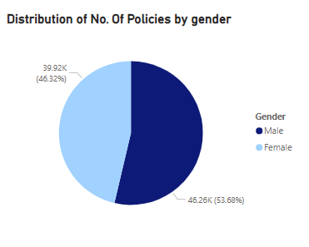
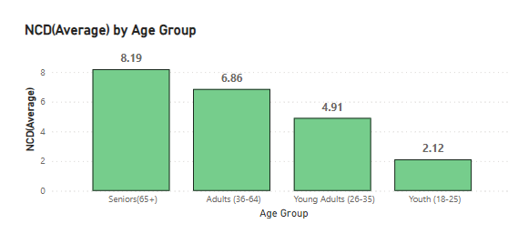
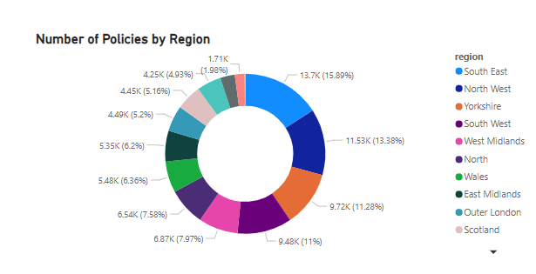
CUSTOMER INSIGHTS
INSIGHTS
Healthy mix of ‘Male and ‘Female’ Customers Seniors prove to be the safest drivers with an average NCD of around 8 years. ‘South East’, ‘North West’ and ‘Yorkshire’ constitute to around 40% of the total policies
RECOMMENDATIONS
Research if our products can be enhanced anymore to meet region specific needs. Target advertising campaigns to promote our products in other regions as well

Slide 10
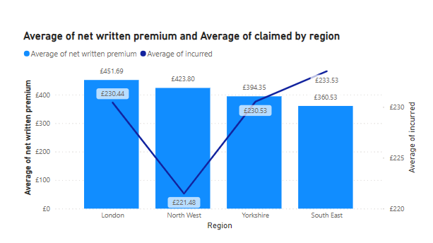
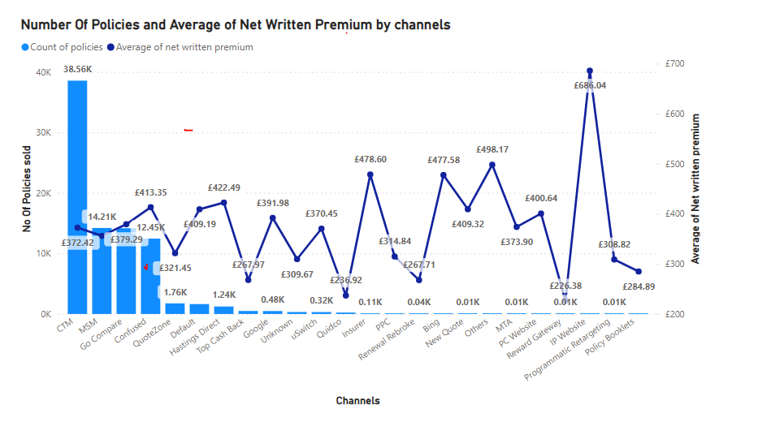
CUSTOMER INSIGHTS
PRICING RECOMMENDATIONS
‘London’ region has an average claim size lesser than ‘Yorkshire’ and ‘North-East’ yet has higher premiums (~25% and ~14% respectively). Restructuring of pricing is needed here. CTM sells the greatest number of Policies. Yet the average policy value is way lower than some other aggregators, thereby causing a fall in the net average. Need to go over the commissions to improve net written premium

Slide 11
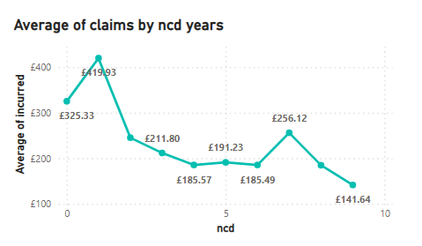
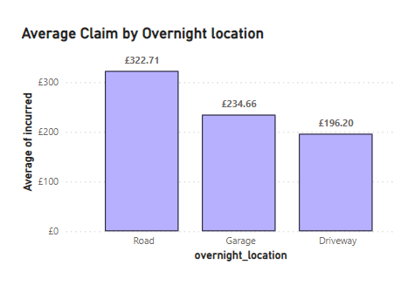
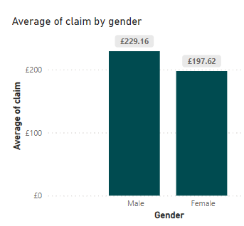
CLAIM PREDICTORS
Predictors chosen here are ‘ncd’,’overnight location’,’gender’
Apart from the predictors’ relationship with the average claim size, also chose these because :- Smaller ‘ncd’ count could be because of past claims. Somebody with a history of claims is susceptible to future claims. Parking on the road could result in unknown hit and runs causing higher frequency of claims.

Slide 12
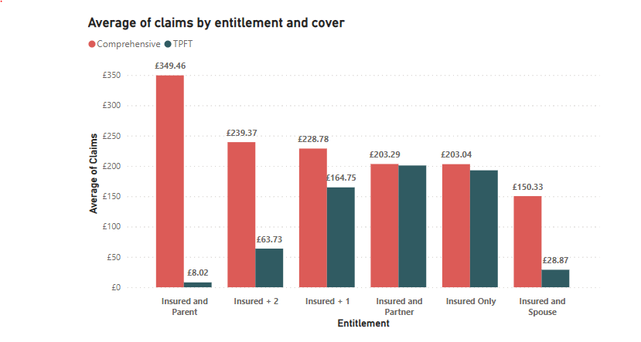
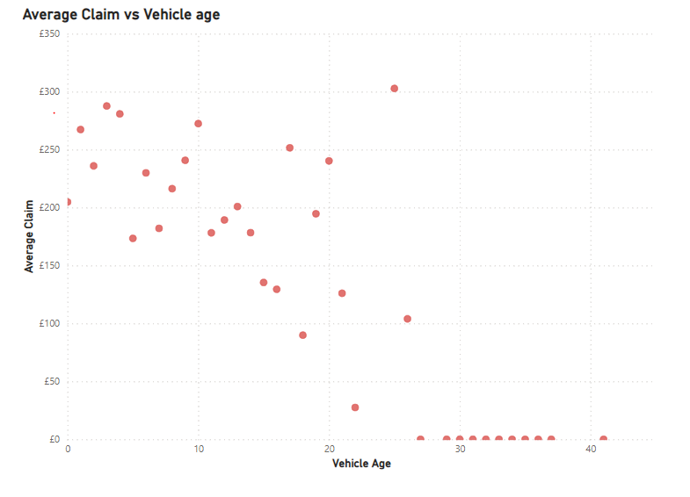
CLAIM PREDICTORS
Predictors chosen here – ‘Entitlement’ and ‘Cover’
Apart from their relationship with ‘Average Claim size’. Chose them because :- ‘Insured and Parent’ gave me an impression that the customer wanted to share the liabilities with an elder, if there were any. Most of the policies were of ‘Comprehensive’ type. Besides they also cover 3rd party charges, hence larger claims.
DESCRIPTION
Not used ‘vehicle_age’ as an active predictor. The dip after 10 years is faster, indicating lower average claim size for vehicles after this age. Therefore, used this to check if all the other predictors coincided with this information.

Slide 13
CLAIM PREDICTORS(Results from data)
Age_group | NCD | Overnight Location | Gender | Entitlement | Average Vehicle_age | No. Of Claims | Total Claims(£) | Average Claims(£) | Max Claims(£)
Youth(18-25) | 1 | Road | Male | Insured and Parent | 9.12 | 36 | £1,100,828 | £3335.84 | £489,298
Youth(18-25) | 0 | Road | Male | Insured and Parent | 9.91 | 41 | £146,361 | £423.01 | £22,087
Young Adults(26-35) | 1 | Road | Male | Insured and Parent | 9.97 | 2 | £11,391 | £367.45 | £7,960
Young Adults(26-35) | 0 | Road | Male | Insured and Parent | 10.21 | 8 | £18,952 | £242.97 | £10,314
Youth(18-25) | 2 | Road | Male | Insured and Parent | 9.17 | 16 | £45,125 | £197.92 | £18,867
Young Adults(26-35) | 2 | Road | Male | Insured and Parent | 10.52 | 1 | £1,102 | £52.48 | £1,102
SUMMARY |  |  |  |  | 9.53 | 104 | £1,323,759 | £1280.23 | £489,298

Slide 14

SUMMARY
Policies written before the 1st of May 2019, could have higher net earned premium of around £2.3m. Thereby resulting in 12.43% less premium than what could be earned.
‘South East’, ‘North West’ and ‘Yorkshire’ are the biggest markets, together constituting to around 40% of the total policies sold.
Revisit pricing for London which has lower average claim amount than higher grossing regions , but have higher premiums(14%-25%) than them.
Re- analyze the commissions to our largest delivery channel ,‘CTM’ who sell the largest number of policies but generate an average net written premium of ~£372.
Chose ‘Age- Group’ ,’ncd’ , ‘overnight_location’, ‘entitlement’ and ‘cover’ as the claim predictors.
In one sentence ‘ A male who is aged 18-35 years, with a no claim discount between 0-2 years, parks his vehicle on the road, takes a ‘Insured + Parent’ entitlement and a comprehensive cover tends to have an average claim amount of £1280.23’.

