Slide 1


PFFP
Python FastQ Filtering Program
Presented by
Jittin Pomprakay 6737930
Chakrit Jiarasatit 6737934
Division of Medical Bioinformatics Faculty of Medicine, Siriraj Hospital
Notes:
Today, I’m going to talk about an important process in sequencing technology which is quality control, or QC.
This step is crucial in ensuring that the sequencing data we work with is accurate and reliable.
In this presentation, I will introduce a program that has been developed to make QC for FASTQ files faster and more efficient.
I’ll walk you through the key features of our program, explain how it operates, and demonstrate the results it generates.
So now, before we go on the key features, โด่ง will guide you through the collaborate and introduction of this program.

Slide 2

Collaboration
Notes:
collaborate

Slide 3




Introduction
FastQ file format
Program
Report in TSV file format
Generate a new file containing only good-read
Notes:
The program will receive input in the FASTQ file format
After that the program will generate a new file containing only good-read
We let the users choose the output format they want between the fastq file format or Report in TSV file format
Next, pipe will explain the objective of creating this programs

Slide 4

OBJECTIVE
To build the program that can do QC reads in the input fastq file.
PFFP
Notes:
As my partner presented previously, our objective is to build the program that can do QC reads in the input fastq file. And now, it’s time to present the best program that we have been developed together. We call PFFP program.

Slide 5

Extract Subpackage
Stat Subpackage
pulls out each line from the FASTQ file
calculates the quality score for each read
PFFP
Filter Subpackage
Report Subpackage
removes any reads that don’t pass QC, keeping only the high-quality ones
creates a new FASTQ and summary TSV file
Notes:
The PFFP program is a user-friendly tool for quality control (QC) of reads in FASTQ files. It’s made up of four key subpackages:
The Extract subpackages: This pulls out each line from the FASTQ file for processing.
The Stat subpackages: It calculates the quality score for each read.
The Filter subpackages: It removes any reads that don’t pass QC, keeping only the high-quality ones. These good reads are then sent to the report package.
The Report subpackages: This creates a new FASTQ file with only the good reads. It can also generate a summary TSV file that shows which read IDs passed the QC.

Slide 6


PFFP
main_extract.py
Extract module
__init__.py

Slide 7

Extracting FASTQ Data
ID, Sequence, Strand, and Quality Scores
PFFP
Extract Subpackage
main_extract module
Line 1: @read_ids
Line 2: sequence
Line 3: +/- (Separator line)
Line 4: quality sequence
Line 5: @read_ids
Line 6: sequence
Line 7: +/- (Separator line)
Line 8: quality sequence
.
.
.
.
extract_read_ids(file_path)
extract_sequence(file_path)
extract_strand(file_path)
extract_phred_seq(file_path)
Notes:
So now let’s deeply describe about each package, start from Extract subpackage
The Extract subpackage comprise with main_extract module, containg with 4 functions which is extract_read_ids(file_path), extract_sequence(file_path), extract_strand(file_path) and extract_phred_seq(file_path). As you can see from this slide, you will see the component of fastq file, and you also see what the line that each function was extracted.

Slide 8
Extracting FASTQ Data
ID, Sequence, Strand, and Quality Scores
PFFP
Extract Subpackage
main_extract module
Line 1
extract_read_ids(file_path)
[ (reads_num, reads_id),... ]
Line 2
extract_sequence(file_path)
{ “barcode01”: [(reads, seq),...], “barcode02”: [(reads, seq),...]}
Line 3
extract_strand(file_path)
[ (reads_num, strand),... ]
Line 4
extract_phred_seq(file_path)
[ (reads_num, phred_seq),... ]
Notes:
To extract line 1, this function was extracted the read numbers and their corresponding IDs from the FASTQ file. The output is a list of tuples where each tuple contains a read number and its read ID.
For Line 2, we constructed extract_sequence function. Here, the sequences are extracted and organized by barcodes. The output is a dictionary where each key is a barcode, such as barcode01, and the value is a list of tuples containing the read numbers and their respective sequences.
For Line 3, we constructed extract_strand function. This function extracts the strand information for each read. Similar to the first function, it outputs a list of tuples, with each tuple containing the read number and its strand information.
For line 4 we constructed extract_phred_seq function ,this function retrieves the Phred quality scores for each read. The output is a list of tuples where each tuple consists of a read number and its corresponding Phred score sequence.

Slide 9
Analyzing FASTQ Data with Qscore
and Qmedian
PFFP
main_extract.py
extract_phred_seq(file_path)
Stat Subpackage
[(rec_nums, rec_ids)]
main_stat module
Qscore(file_path)
{rec_nums: [each integer Phred quality scores]}
Qmedian(file_path)
{rec_nums: quality score of that read}
Notes:
In this slide, I’ll explain how the PFFP program uses the Stat subpackage, specifically the Qscore and Qmedian functions, to analyze FASTQ data. This process is implemented in main_stat.py and involves calculating Phred quality scores and summarizing them for each read.
The process begins with the extract_phred_seq function from main_extract.py. The outputs of this function will be given to the Qscore function, and Qscore will takes the extracted data and calculate it into a dictionary. Here, the keys are the record numbers, and the values are lists of integer quality scores for each base. This structured format makes it easier to calculate statistical measures in the next step.
Finally, the Qmedian function processes the dictionary created by Qscore and computes the median quality score for each read. The output is another dictionary where each record number maps to its median quality score. This provides a concise representation of the overall quality of each read.

Slide 10
Read: 1
PFFP
[30, 30, 25, 28, 2, 4]
Mean: 19.83
[2, 4, 25, 28, 30, 30]
Median: 26.50
Notes:
In this slide, I’ll explain how the PFFP program uses the Stat subpackage, specifically the Qscore and Qmedian functions, to analyze FASTQ data. This process is implemented in main_stat.py and involves calculating Phred quality scores and summarizing them for each read.
The process begins with the extract_phred_seq function from main_extract.py. The outputs of this function will be given to the Qscore function, and Qscore will takes the extracted data and calculate it into a dictionary. Here, the keys are the record numbers, and the values are lists of integer quality scores for each base. This structured format makes it easier to calculate statistical measures in the next step.
Finally, the Qmedian function processes the dictionary created by Qscore and computes the median quality score for each read. The output is another dictionary where each record number maps to its median quality score. This provides a concise representation of the overall quality of each read.

Slide 11
Filtering Sequence Reads with filter_goodread
Filtering Subpackage
PFFP
Filters read from a FASTQ file based on a quality score threshold (Qcutoff)
INPUT
OUTPUT
filter_goodread(file_path, Qcutoff)
File_path
Qcutoff
A dictionary (filtered_reads)
for rec, Q2 in Q_values.items():
if int(Q2) >= Qcutoff:
filtered_reads[rec] = Q2
code snip
User defined Qcutoff
Only reads that pass the quality threshold
Notes:
I’ll explain the function filter_goodread, a fn for filtering sequence reads from a FASTQ file
the core logic filters out any read with a quality score below the threshold, returning only the reads that meet or exceed the set Qcutoff.
Input include File Path and Qcutoff: A user-defined threshold for quality scores.
So how It Works:
1. The filter_goodread function uses a helper function that is Qmedian, to calculate median quality scores for each read in the file.
2. It iterates through the calculated quality scores and compares them against the Qcutoff.
3. With scores greater than or equal to Qcutoff are stored in a dictionary.
The function returns a dictionary containing only the reads that passed the quality threshold. Each entry includes:
Key that is the read identifier-
Its corresponding quality score so call value
Here are some possible Q&A suggestions for your coding presentation based on the provided code:
Q1: What does the filter_goodread function do?
Answer:
The filter_goodread function takes a file path (file_path) and a quality cutoff value (Qcutoff) as inputs. It then uses the Qmedian function from the FilQ.stat.main_stat module to get the quality scores (Q-values) of sequences in the provided file. The function filters out any sequences whose quality score is below the specified Qcutoff and returns a dictionary of sequences (or reads) with their corresponding quality scores above or equal to the cutoff.
Q2: How does the code determine which reads are considered “good”?
Answer:
The code uses the Qmedian function to obtain the quality scores for each read in the file. A read is considered “good” if its quality score is greater than or equal to the Qcutoff value passed to the filter_goodread function. Only reads that meet or exceed this cutoff are included in the filtered_reads dictionary.
Q3: What is the role of the Qmedian function in this code?
Answer:
The Qmedian function is called to extract the quality scores (Q-values) of the reads in the file specified by file_path. It returns a dictionary where the keys are the read identifiers (or sequence names) and the values are their corresponding quality scores. This information is then used in the filter_goodread function to filter reads based on their quality.
Q4: What would happen if the quality score of a read is below the Qcutoff value?
Answer:
If the quality score of a read is below the Qcutoff value, that read is excluded from the filtered_reads dictionary. Only the reads with quality scores greater than or equal to the cutoff are kept.
Q5: Why is the int(Q2) used in the condition if int(Q2) >= Qcutoff?
Answer:
The quality score Q2 returned by the Qmedian function is likely a string, so it needs to be converted to an integer using int(Q2) in order to properly compare it with the integer Qcutoff. This ensures that the comparison is numeric and not lexicographic.
Q6: Can the filter_goodread function handle any type of file?
Answer:
The filter_goodread function is designed to work with files that can be processed by the Qmedian function. Typically, this would be a FASTQ file or another type of file containing sequence data with quality scores. The function assumes that the Qmedian function can read and process the file correctly, so the file format should be compatible with that function.
Q7: How can this code be improved for larger datasets?
Answer:
For larger datasets, performance improvements might be necessary. Possible improvements include:
• Using a more efficient data structure to store the reads and their quality scores.
• Adding error handling to manage unexpected file formats or corrupted data.
• Parallel processing to speed up the filtering process if the dataset is very large.
Q8: What would happen if Qcutoff is not provided or is set to an invalid value?
Answer:
If Qcutoff is not provided or is set to an invalid value, the function may either throw an error or return an empty dictionary. It’s important to validate Qcutoff before passing it into the function, ensuring that it is a valid integer value and within an acceptable range.

Slide 12
Generate a new FASTQ file with write_fastq
in main_report.py
PFFP
Creates a new FASTQ file containing only the reads that pass the quality score threshold (Qcutoff)
INPUT
USE
filter_goodread(file_path, Qcutoff)
extract_fastq_ids(file_path)
extract_sequences(file_path)
extract_strand(file_path)
extract_phred(file_path)
File_path
File_naming
Qcutoff
Report Subpackage
Retrieve
read ID
Sequence
Strand
quality score
OUTPUT
Open the new FASTQ file (file_naming)
in write mode
New FASTQ file
read_id = None
for rec_num, read in line1:
if rec_num == record_num:
read_id = read
code snip
Notes:
Next, the process of generating a new FASTQ file using the write_fastq function. The goal here is to extract only the reads that pass a specified quality score threshold, known as Qcutoff, and save them into a new FASTQ file.
Let’s start with the inputs.
This process requires three main inputs, which include
1. file_path
2. Qcutoff
3. file_naming – This is the name for the output FASTQ file we’ll generate.
Next, I’ll highlight the primary functions used to extract, filter, and format the data
Here’s the workflow for generating the new FASTQ file:
1. We start by filtering the reads based on Qcutoff using the filter_goodread function.
2. Then, we extract the required information: Read IDs, sequences, strand details, and quality scores.
3. we write the passing records into a new FASTQ file. Each record includes four lines.
This process ensures that only the high-quality reads are saved

Slide 13
Report in TSV file format with pass_report_tsv
in main_report.py
Report Subpackage
PFFP
Generates a detailed TSV (tab-separated values) report
Report module
INPUT
USE
File_path
File_naming
Qcutoff
filter_goodread(file_path, Qcutoff)
extract_fastq_ids(file_path)
Create an empty dictionary
Extract
read ID
Barcode
Check if the read ID is in the filtered list (good_id)
Append to the result dictionary
for nums_id, rec_ids in reads_id:
rec_id = re.match(r"^@\S+", rec_ids)
bar_id = re.search(r"barcode=(\S+)", rec_ids)
if bar_id:
barcode = bar_id.group(1)
if nums_id in good_id:
result["Read Number"].append(nums_id)
result["Read ID"].append(rec_id)
result["QC"].append("Pass")
result["Barcode"].append(barcode)
code snip
code snip
OUTPUT
New file in TSV format
Notes:
Next the function pass_report_tsv, which generates a quality control (QC) report for sequencing reads in a FASTQ file.
The function follows these key steps:
1. Input Parameters: same as previous fn
2. Using helper functions like extract_fastq_ids : Regular expressions help parse specific fields, such as barcodes and record IDs, from each read.
3. Check if the read ID is in the filtered list
4. Each passing read is appended to the result dictionary, which stores the data for the TSV output file.”
The final output is a user-friendly TSV report that summarizes the QC status of all reads in the input file.

Slide 14
Command-Line Tool for FASTQ File Filtering and Reporting with argparserlocal and main
in main.py
PFFP
main.py
argparserlocal()
main()
Check Subcommand
filterRead
write_fastq (file_path, file_naming, Qcutoff)
generateReport
Error while filtering reads
Error while generating report
pass_report_csv(file_path , Qcutoff, file_naming)
Written/generated successfully
Notes:
Focuses on the main function, the core component of our command-line tool for FASTQ file processing. It has key subcommands, such as filtering reads and generating reports, ensuring a streamlined workflow for sequence quality control.
The main function ties together the user input, subcommands, and core functionalities of our tool.
Here’s how it works:
1. It begins by parsing command-line arguments with argparserlocal.
2. Based on the specified subcommand, either filtered or generateReport, it executes tasks to the appropriate function.
3. Finally, it shows that the written new file is successful or not
Subcommand 1: filtered
• “When the user chooses filterRead, the function calls write_fastq to filter reads based on quality scores.
• If successful, a new FASTQ file is generated with only high-quality reads.”
• Error Handling:
• “If an error occurs during filtering, the exception is caught and logged.”
Subcommand 2: generate report
• “For the generate report subcommand, the function invokes pass_report_csv to create a comprehensive QC report summarizing:
• The quality control status.
• Metadata like read IDs and barcodes.”
• Error Handling:
• “Similarly, any errors during report generation are logged for troubleshooting.”

Slide 15
Command-Line Tool for FASTQ File Filtering and Reporting with argparserlocal and main
in main.py
PFFP
main.py
python main.py filterRead -f test.fastq
-q 25
-o filtered_reads.fastq
argparserlocal()
Main module
-h, --help
show this help message and exit
-o OUTPUT, --output OUTPUT
Name of the output FASTQ file for filtered reads
-f FILE, --file FILE
Path to the input FASTQ file
-q QCUTOFF, --qcutoff QCUTOFF
Quality score threshold for filtering reads
Notes:
Argument Parsing with argparserlocal()
“The function starts by calling argparserlocal, which defines and processes the command-line arguments, such as:
• The input file path (file).
• The quality cutoff (qcutoff).
• The output file name (output).
Next, let

Slide 16
MANUAL
Notes:
For the manual, i wil demonstrate how to use this program. So, this program is command-line based. Therefore, i will use the linux os to demonstrate this program; in this case i will use wsl to use this program.

Slide 17
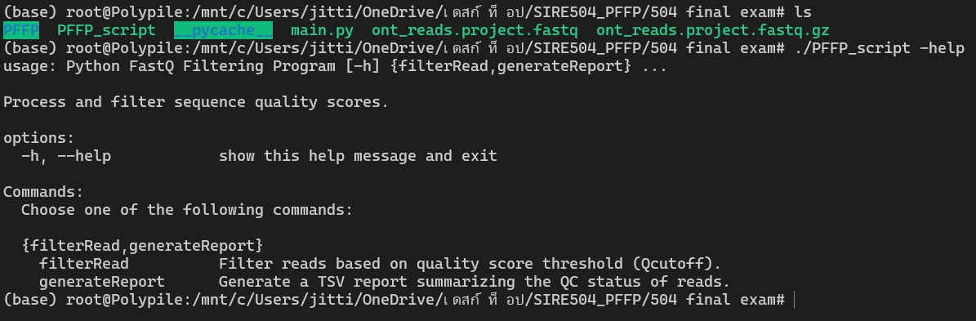
Notes:
Due to this program is designed for newbie-user, so that the users can use help to read the detail of this program.

Slide 18
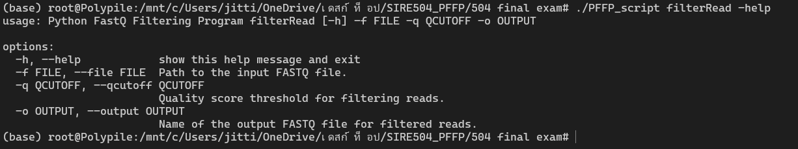
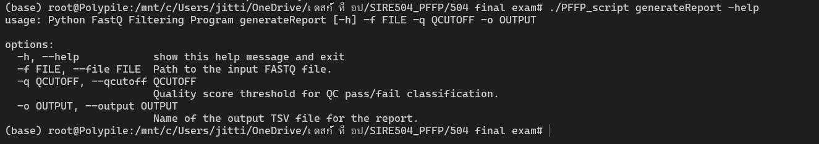
Notes:
For the manual, i wil demonstrate how to use this program. So, this program is command-line based. Therefore, i will use the linux os to demonstrate this program; in this case i will use wsl to use this program

Slide 19
generateReport function
Syntax
$ ./PFFP_script generateReport –f file_name.fastq(or .fastq.gz) –q Quality_cutoff –o new_file_name.tsv
Notes:
This is the syntax that we summarize from the manual ...

Slide 20
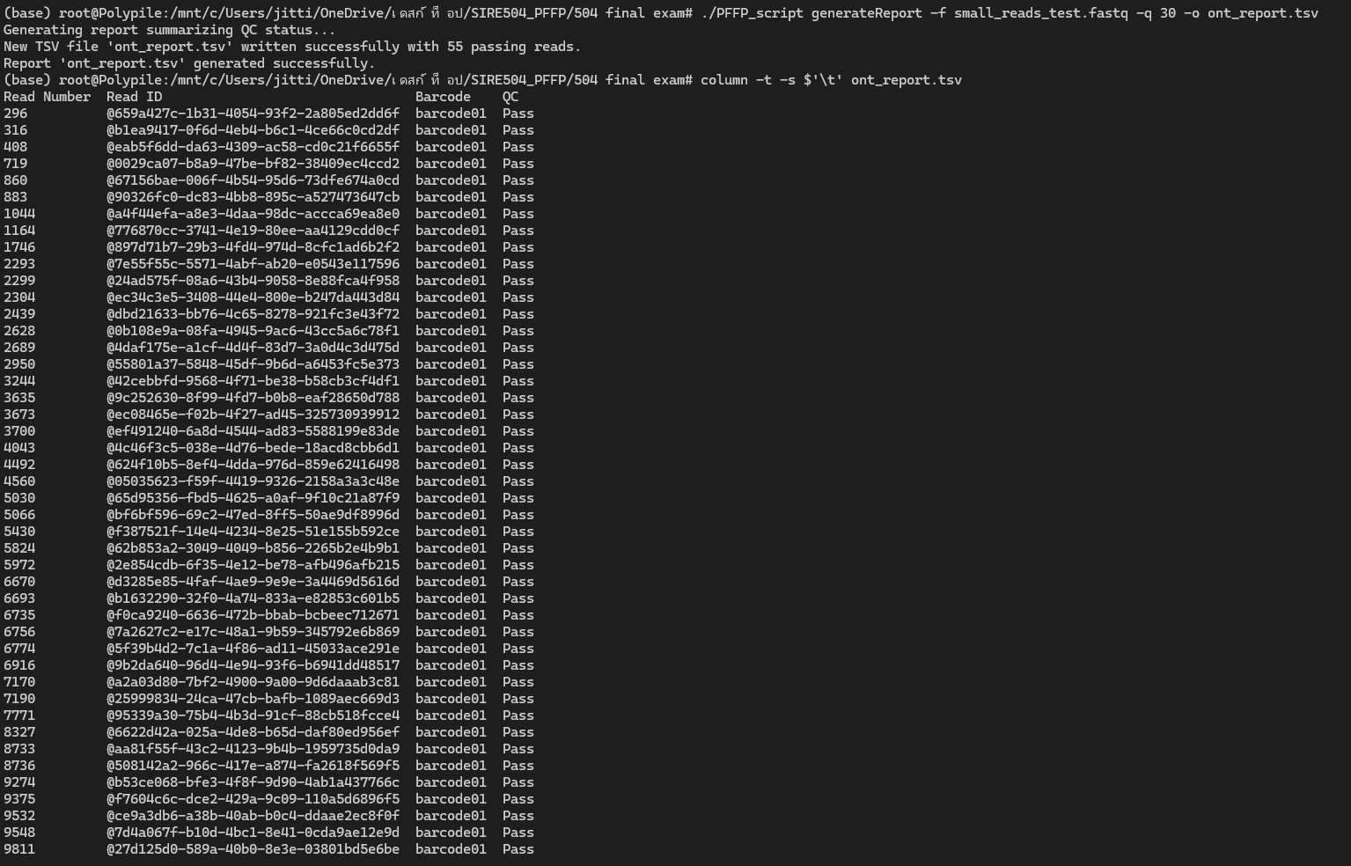

Slide 21
filterRead function
Syntax
$ ./PFFP_script filterRead –f file_name.fastq(or .fastq.gz) –q Quality_cutoff –o new_file_name.fastq

Slide 22
