Slide 1
T1A2
Portfolio Assignment

Slide 2
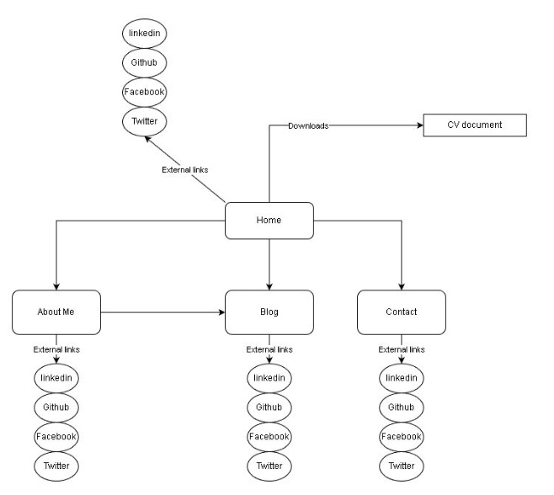
Sitemap

Slide 3
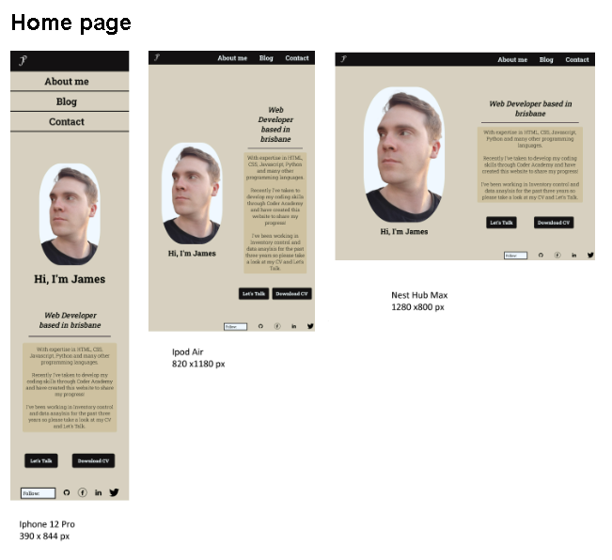
Home Page
Key Points
Navigation – The same on all pages and used to navigate the entire website, changes with viewport.
Image and side text – when it starts to squish the image will go on top of the text.
Two buttons – Let’s talk to increase traffic to contact page and a CV download.
Follow links at the bottom of the page will shake on hover.

Slide 4
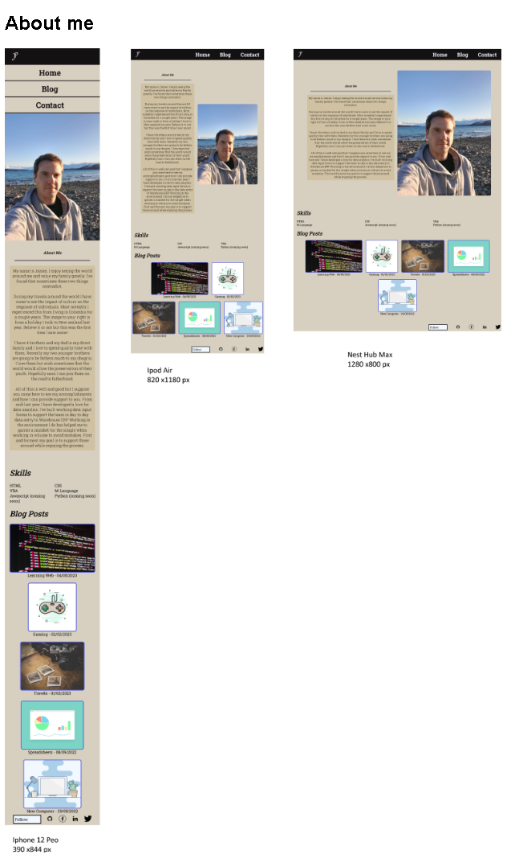
About Me
Key Points
Same visual split with text and image as the landing page but done in reverse to add diversity.
Skills are in a grid layout , 2 columns in phone view, 3 in tablet and desktop.
Blog images expand on hover and are wrapped in the flex-box.

Slide 5
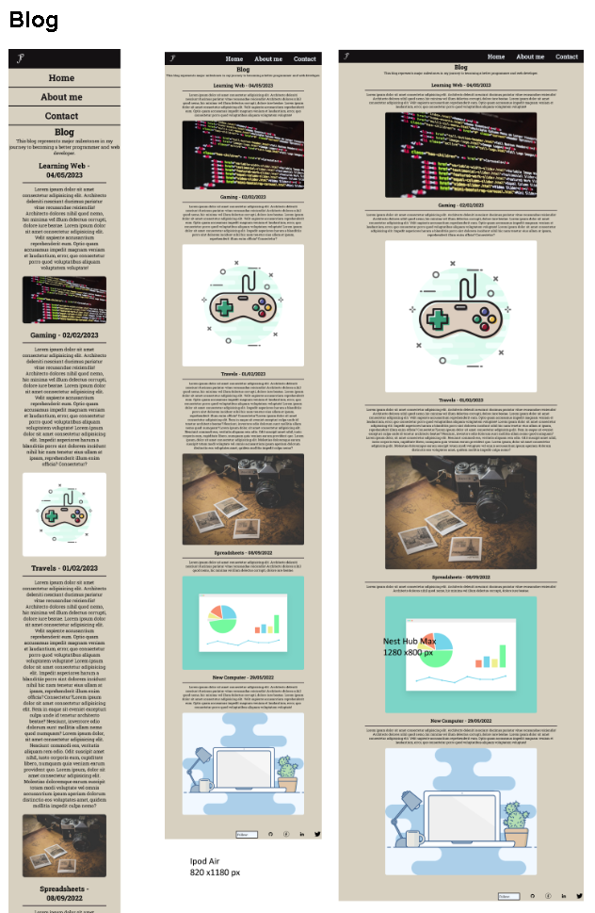
Blog Page
Key Points
Images dynamically change with the size of the viewport to use the space efficiently.

Slide 6
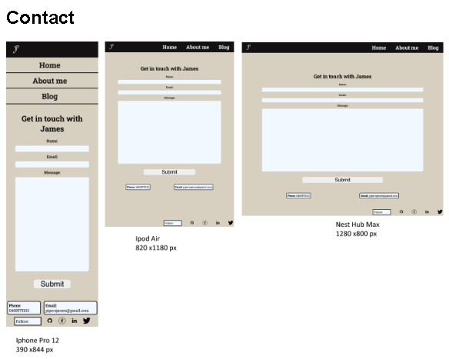
Contact Page
Key points
Large area so you can see the message that you are writing.
Alternative contact information if you want to call or email directly.

Slide 7
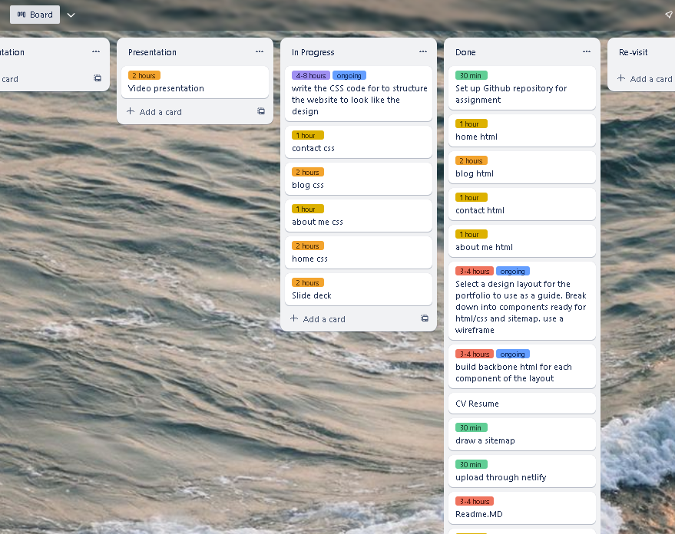
Trello board
Started with a KANBAN in Trello.
Helped to track progress.
Added to the board when there was more to do.

Slide 8
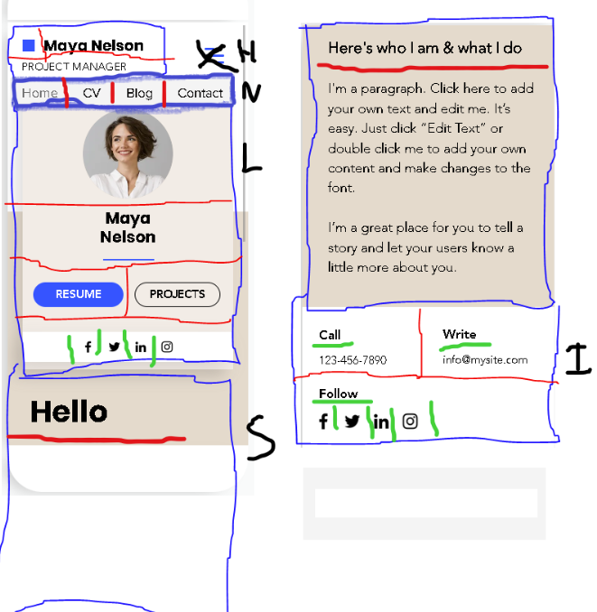
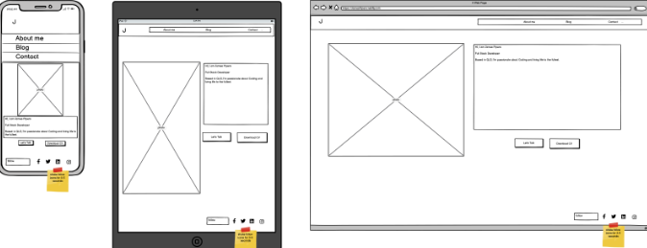
Start of the Design Process
1. Looking at Portfolio designs on the net. Aesthetic decisions were taken from here and additionally from https://coolors.co/ , just what I liked.
2. Converting into a more refined wireframe, Designs on layout were done to maximize the page with what I thought was important and made small less important details.

Slide 9
Writing the HTML + CSS
1. Started by writing the HTML for the Home page in visual studio code.
2. Worked on the CSS for home page to get a good visual breakdown. Used SCSS and organised into component files.
3. Reworked elements out of my scope.
4. Wrote the HTML for the remaining 3 pages.
5. Styled the remaining elements that weren’t accounted for using SCSS.
6. Built sitemap.

Slide 10
Challenges of the Process
Design Process – having never really interacted with Portfolio websites it was a learning curve.
Recording of all the sites used to prevent Plagiarism.
Realizing that the error in CSS is not always with the what I have written but rather a semantic issue preventing the SCSS from updating.
Time management – did not read the Due Date properly.
Finding the proper assets – don’t have a lot of photos.
Drop-down menu – will re-visit in future as it was my first Aesthetic decision just felt I did not have the skill set to pull it off.

Slide 11
Favourite parts
Trying to style for the bigger piece to prevent having to do something multiple times.
Organising a workflow that needs to be achieved.
Realising I’ve memorized a lot.

