Slide 1
IRT Model for EDSS in Multiple Sclerosis
Longitudinal Pharmacometric Analysis of Cladribine Treatment
Based on Novakovic et al., 2016
다발성 경화증 EDSS 항목반응이론 모델 | 클라드리빈 치료 효과 분석
多発性硬化症 EDSS 項目反応理論モデル | クラドリビン治療効果分析
NONMEM 7.3 | Laplacian Conditional Estimation | Item Response Theory

Slide 2
Presentation Overview
1
Model Structure
Longitudinal IRT framework with drug effects
2
Parameter Estimates
Population PK/PD parameters and variability
3
Random Effects
Correlation structure via Cholesky decomposition
4
IRT Analysis
Item characteristic curves and information functions
5
Drug Effects
Symptomatic and disease-modifying mechanisms
6
Clinical Implications
Key insights for MS treatment optimization

Slide 3
Clinical Background: Multiple Sclerosis & EDSS
Multiple Sclerosis (MS)
EDSS (Expanded Disability Status Scale)
• Chronic autoimmune disease of the CNS
• Affects ~2.8 million people worldwide
• Progressive neurological disability over time
• Characterized by relapses and remissions
• Cladribine: oral disease-modifying therapy
• Gold standard for MS disability assessment
• Composite score from 0 (normal) to 10 (death)
• Based on 8 functional system subscores:
- Pyramidal, Cerebellar, Brainstem, Sensory
- Bowel/Bladder, Visual, Mental, Ambulation
Why Item Response Theory (IRT) for EDSS?
Traditional Analysis Limitations:
• EDSS is ordinal, not continuous → standard regression inappropriate
• Subscores have different scales (0-4, 0-5, 0-6, 0-9) → not directly comparable
• Floor/ceiling effects mask true disability changes
IRT Solution: Models a latent 'disability' trait that underlies all observed subscores, providing unified disease metric

Slide 4
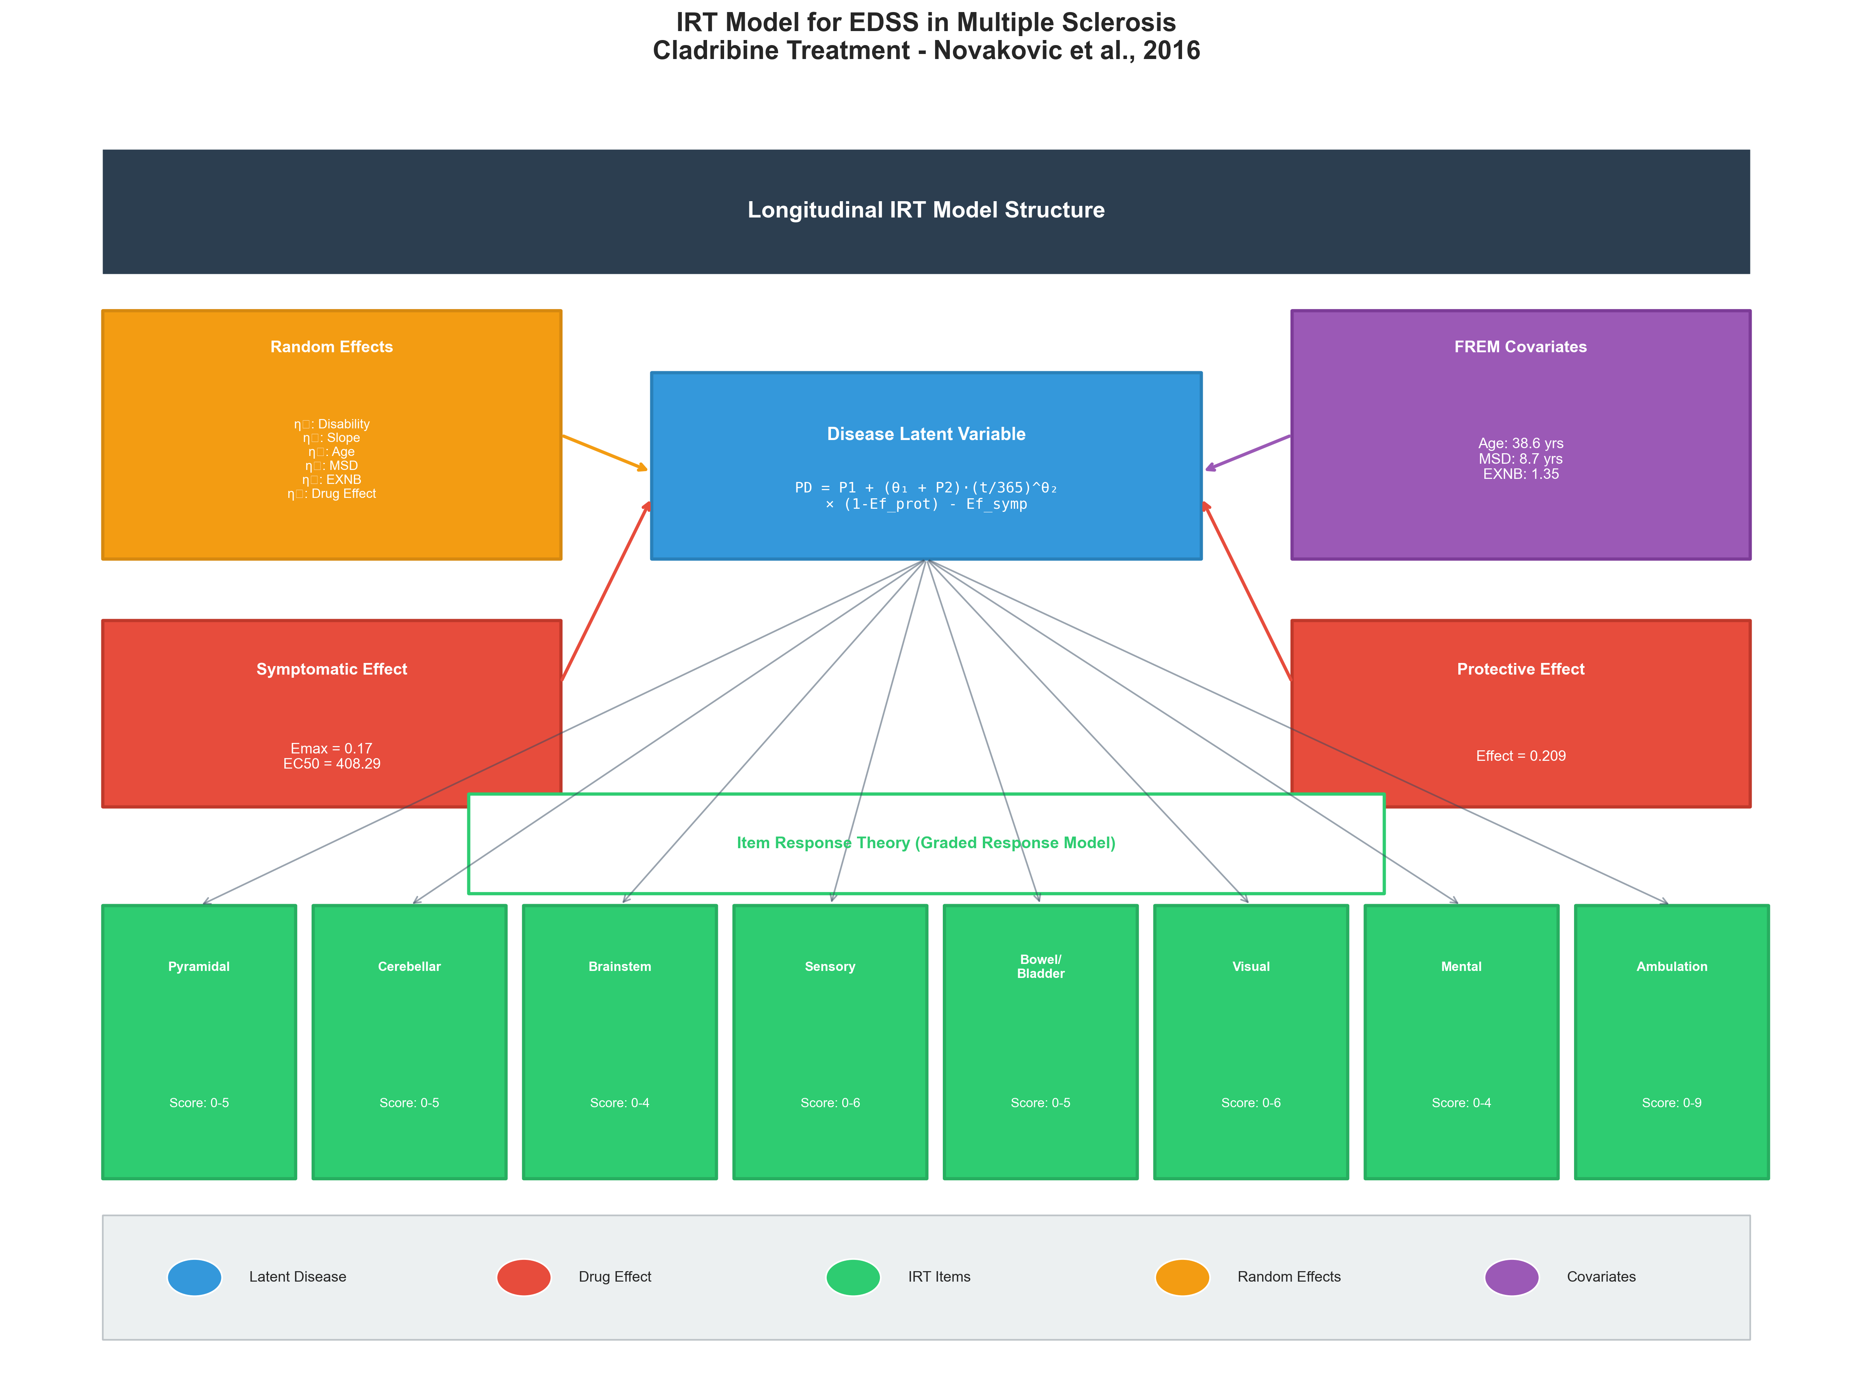
Model Structure Overview
Longitudinal IRT Model Architecture
Key Points & Discussion
• Central latent variable (PD) represents true underlying disability
• Power model captures non-linear disease progression over time
• Two distinct drug effect mechanisms: symptomatic and protective
• FREM approach incorporates Age, MS Duration, Exacerbation count as covariates
• 8 functional systems linked via IRT graded response model
• Cholesky decomposition ensures valid correlation structure

Slide 5
Model Structure: Mathematical Framework
Disease Latent Variable Equation:
PD = P₁ + (θ₁ + P₂) × (t/365)^θ₂ × (1 - Ef_prot) - Ef_symp
Where: P₁ = baseline disability (η₁), P₂ = individual slope (η₂), θ₁ = population slope, θ₂ = power parameter
Disease Progression
Symptomatic Effect
Protective Effect
Power Model
Emax Model
Disease-Modifying
• Slope (θ₁) = 0.093
• Power (θ₂) = 0.710
• Non-linear time course
• Sub-linear progression pattern
• Emax = 0.17
• EC50 = 408.29
• Exposure-dependent
• Immediate effect on symptoms
• Effect = 20.9%
• Exposure-independent
• Slows progression rate
• Long-term benefit
IRT Link: Connecting Latent Disease to Observed Subscores
Graded Response Model: P(X ≥ k | θ) = 1 / (1 + exp(-a × (θ - bₖ)))
• Each functional system has unique discrimination (a) and boundary (b) parameters
• Higher discrimination → item better differentiates disability levels | Boundaries define score thresholds

Slide 6
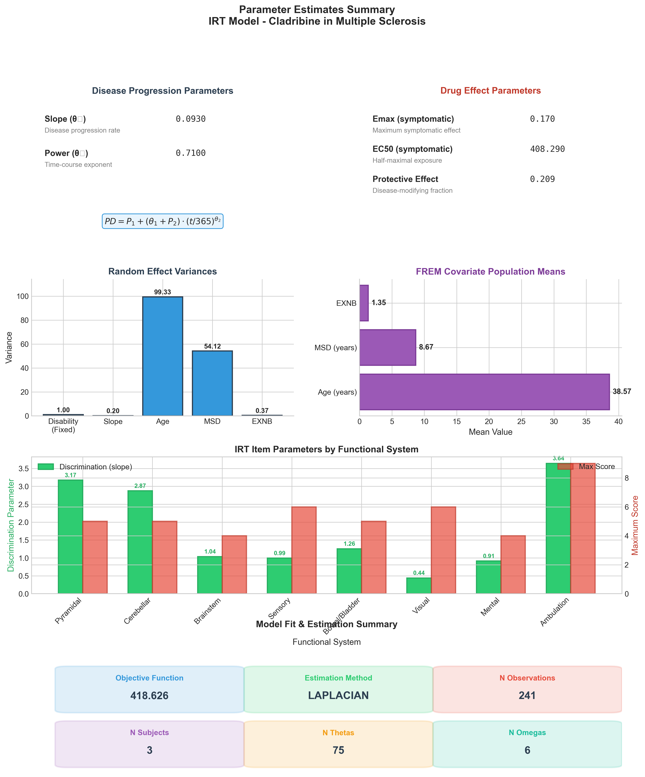
Parameter Estimates Summary
Population Parameters and Variability
Key Points & Discussion
• Disease progression slope (0.093) indicates slow accumulation of disability
• Power < 1 (0.71) suggests decelerating progression over time
• Large variance in Age (99.3) reflects patient heterogeneity
• Ambulation has highest discrimination (3.64) - most informative subscore
• Visual has lowest discrimination (0.44) - less reliable indicator
• OFV = 418.626 for model evaluation

Slide 7
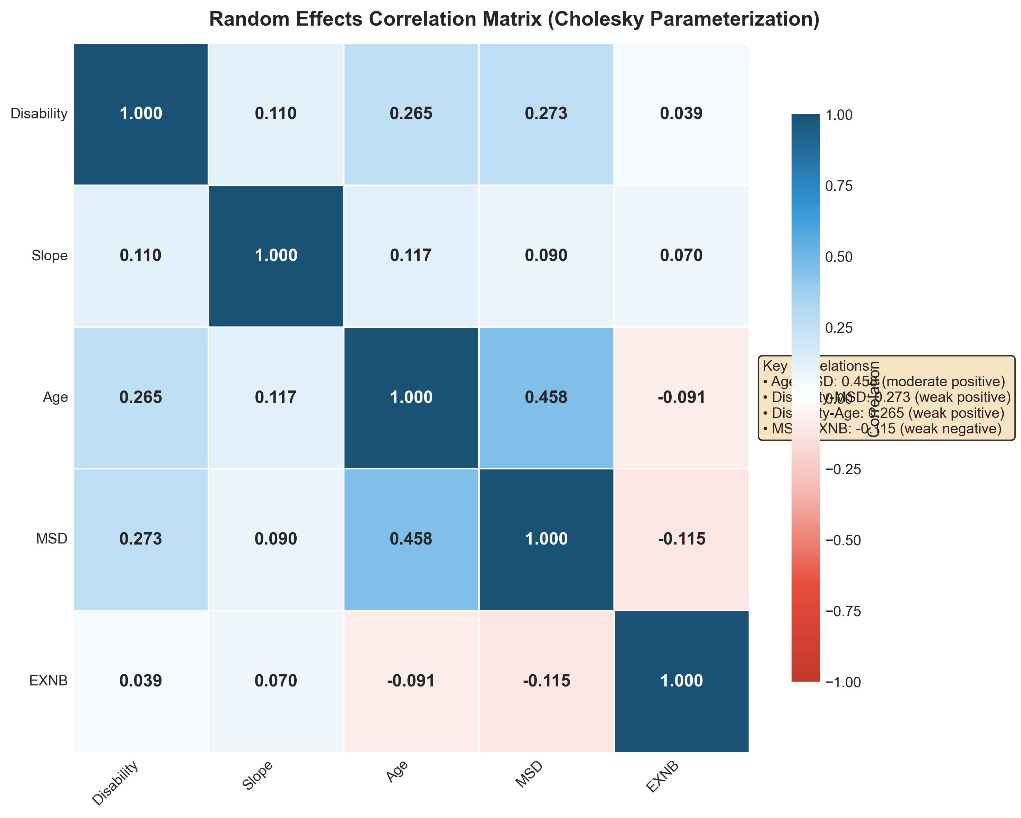
Random Effects Correlation Structure
Cholesky Parameterization of 5×5 Omega Matrix
Key Points & Discussion
• Age-MSD correlation (0.46) is clinically expected and validates the model
• Disability correlates weakly with Age (0.26) and MSD (0.27)
• Slope shows minimal correlation with covariates (good for identifiability)
• Negative EXNB correlations may reflect disease phase transitions
• Overall weak correlations support parameter estimability
• FREM enables covariate effects without traditional covariate modeling

Slide 8
Random Effects: Clinical Interpretation of Correlations
Cholesky Parameterization
5×5 Correlation Structure
• Ensures positive-definite covariance matrix
• Correlations estimated as separate parameters
• FREM: Covariates as random effects for correlation
Random effects: η₁ (Disability), η₂ (Slope),
η₃ (Age), η₄ (MSD), η₅ (EXNB)
Plus η₆ (Drug Emax) - separate block
Age ↔ MS Duration
r = 0.458 (Moderate Positive)
Disability ↔ MS Duration
r = 0.273 (Weak Positive)
Older patients have longer disease duration on average. Expected clinical finding validates model.
Longer disease associates with higher baseline disability. Supports progressive nature of MS.
Disability ↔ Age
r = 0.265 (Weak Positive)
MS Duration ↔ EXNB
r = -0.115 (Weak Negative)
Age contributes to disability beyond disease duration. May reflect age-related neural reserve decline.
Longer disease duration associated with fewer recent exacerbations. Possible transition to progressive phase.
Note: Weak correlations (|r| < 0.3) suggest relatively independent random effects, supporting model identifiability

Slide 9
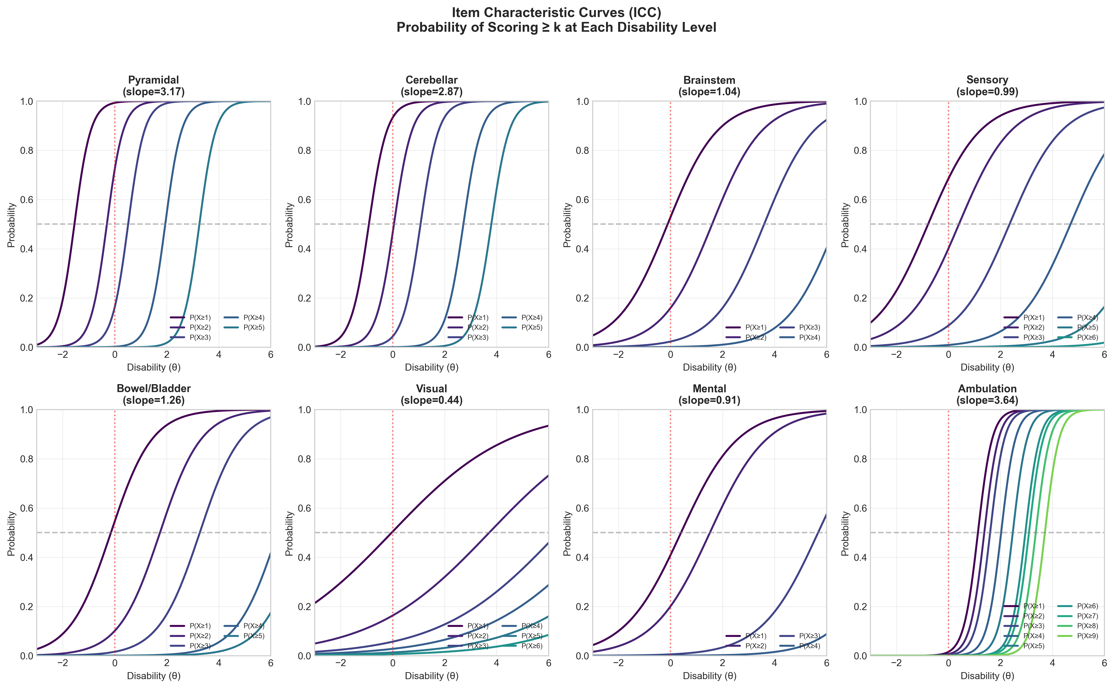
Item Characteristic Curves
Probability of Scoring ≥ k at Each Disability Level
Key Points & Discussion
• Steeper curves = higher discrimination = better differentiation
• Ambulation shows sharp transitions - excellent disability marker
• Visual shows gradual curves - less sensitive to changes
• Curve spacing indicates boundary (threshold) locations
• Items most informative where curves are steepest
• Can guide selection of endpoints for clinical trials

Slide 10
IRT Analysis: Clinical Implications of Item Parameters
High Discrimination Items (slope > 2.5)
Lower Discrimination Items (slope < 1.5)
• Ambulation (3.64)
Most sensitive to disability changes. Walking ability strongly reflects underlying disease severity.
• Pyramidal (3.17)
Motor function highly informative. Corticospinal tract involvement is a key MS feature.
• Cerebellar (2.87)
Balance and coordination discriminate well between disability levels.
• Visual (0.44)
Optic neuritis often occurs early and may recover. Less reflective of overall progression.
• Mental (0.91)
Cognitive symptoms variable and may not correlate linearly with physical disability.
• Sensory (0.99)
Sensory symptoms fluctuate and are subjective. Less reliable disability indicator.
Clinical & Trial Design Implications
• Trial Endpoints: Consider weighting functional systems by discrimination. Ambulation-focused endpoints may be more sensitive to treatment effects.
• Patient Monitoring: Track high-discrimination items more closely for early detection of progression or treatment response.
• Sample Size: IRT-based analysis can increase power by modeling the latent trait directly, potentially reducing required sample size.
• Precision Medicine: Patients with primarily visual or sensory symptoms may show less response on standard EDSS despite treatment benefit.

Slide 11
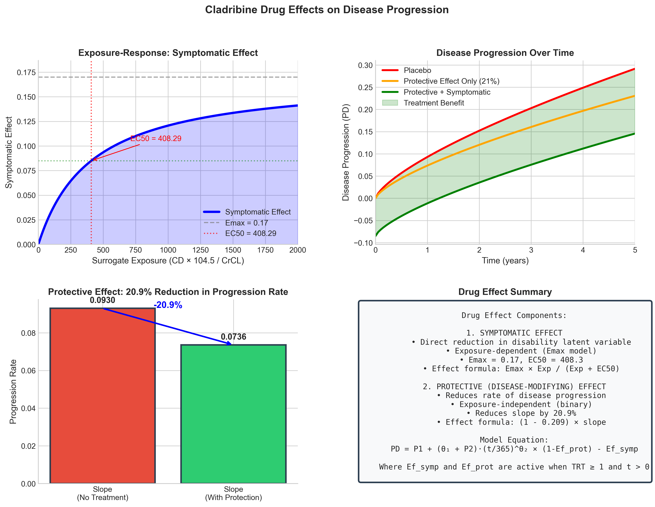
Cladribine Drug Effects
Symptomatic and Disease-Modifying Mechanisms
Key Points & Discussion
• Emax model: saturable symptomatic effect with exposure
• EC50 = 408.29 guides dosing for optimal symptomatic relief
• Protective effect (20.9%) acts on progression rate, not absolute level
• Combined effects separate over time - greatest benefit long-term
• Model supports both immediate benefit and disease modification claims
• Enables simulation of various dosing regimens

Slide 12
Cladribine: Dual Mechanism Drug Effects
Symptomatic Effect
Protective (Disease-Modifying) Effect
Ef_symp = Emax × Exposure / (Exposure + EC50)
Progression × (1 - Ef_prot) where Ef_prot = 0.209
• Emax = 0.17 (17% maximum reduction)
• EC50 = 408.29 (half-maximal exposure)
• Exposure-dependent: higher dose → greater effect
• Direct reduction in disability latent variable
• Rapid onset, dependent on drug levels
• Surrogate exposure: CD × 104.5 / CrCL
• 20.9% reduction in progression rate
• Exposure-INDEPENDENT (binary effect)
• Slows the underlying disease process
• Cumulative benefit over time
• Active when TRT ≥ 1 and time > 0
• Mechanism: lymphocyte depletion
Clinical Significance & Therapeutic Implications
Dual Mechanism Advantage:
• Symptomatic effect provides immediate benefit patients can perceive (improved daily function)
• Protective effect provides long-term disease modification (delayed disability progression)
• Combined effect: both symptom relief AND slower progression trajectory
• Model enables prediction of long-term outcomes from short-term exposure data
Key Insight: The protective effect (20.9%) compounds over time - a patient treated for 5 years accumulates substantial disability reduction vs. placebo

Slide 13
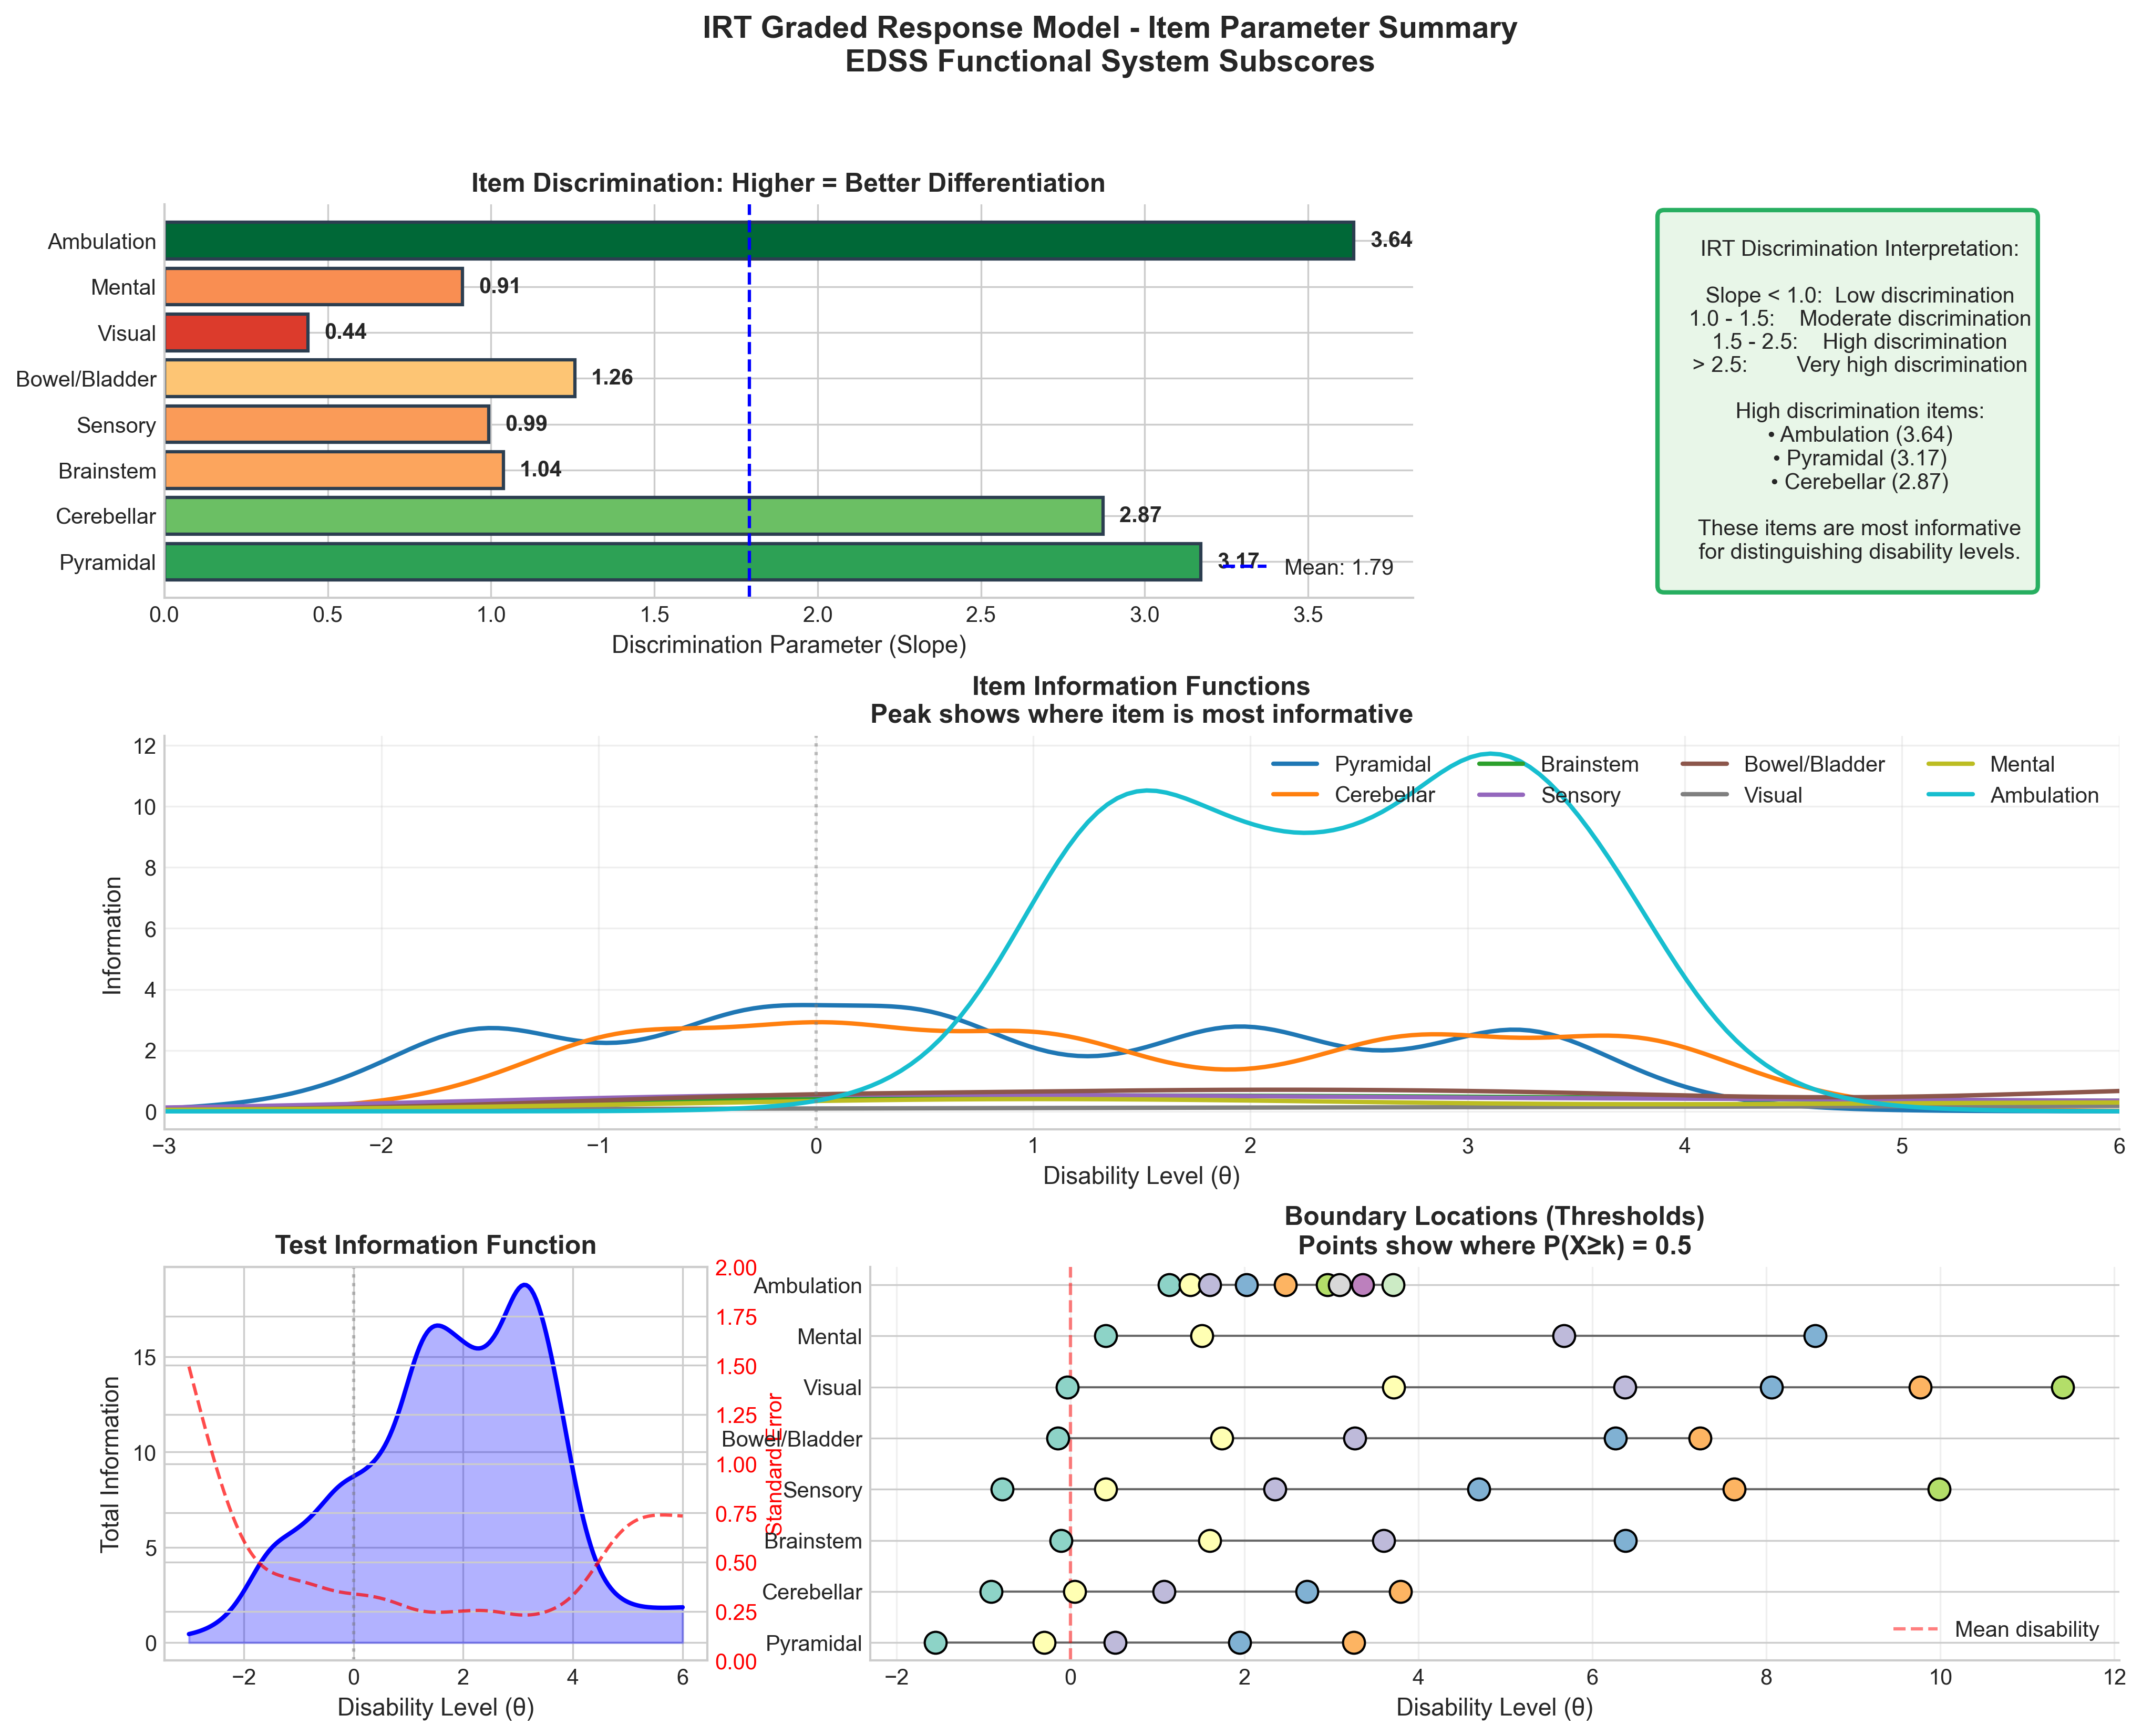
IRT Item Parameter Analysis
Discrimination, Information, and Boundary Thresholds
Key Points & Discussion
• Test Information Function peaks around θ = 2-3 (moderate disability)
• Less precision at extremes (very low or very high disability)
• Ambulation boundaries span wide θ range (0-9 score range)
• Item information curves show where each subscore is most useful
• Standard error inversely related to information
• Results support IRT as superior to simple sum scoring

Slide 14
Summary: Key Findings & Clinical Implications
Disease Model
Drug Effects
IRT Insights
Power function progression
Slope = 0.093, Power = 0.71
Non-linear, sub-linear course
Dual mechanism: Symptomatic (Emax)
+ Protective (20.9% rate reduction)
Both contribute to efficacy
Ambulation most informative (a=3.64)
Visual least informative (a=0.44)
Consider weighted endpoints
Correlations
Population
Model Fit
Age-MSD: r=0.46 (expected)
Weak inter-correlations support
model identifiability
Mean age: 38.6 years
Mean MS duration: 8.7 years
Mean exacerbations: 1.35
OFV = 418.626
Laplacian estimation
241 obs, 3 subjects (simulated)
Conclusion: IRT-based longitudinal modeling provides mechanistic insights into cladribine's dual action,
enabling optimized dosing strategies and more sensitive clinical trial endpoints for MS treatment.

Slide 15
References & Further Reading
Primary Reference:
• Novakovic AM, et al. (2016). Longitudinal Item Response Theory Model for EDSS in Multiple Sclerosis. CPT: Pharmacometrics & Systems Pharmacology.
IRT Methodology:
• Samejima F. (1969). Estimation of latent ability using a response pattern of graded scores. Psychometrika Monograph Supplement, 34(4).
• Ueckert S, et al. (2014). Modeling composite assessment data using item response theory. CPT: Pharmacometrics & Systems Pharmacology.
NONMEM & Pharmacometrics:
• Beal S, Sheiner LB, Boeckmann A, & Bauer RJ. (2009). NONMEM User's Guides. Icon Development Solutions.
• Karlsson MO & Holford N. (2008). A Tutorial on Visual Predictive Checks. PAGE Meeting.
Multiple Sclerosis & EDSS:
• Kurtzke JF. (1983). Rating neurologic impairment in multiple sclerosis: an expanded disability status scale (EDSS). Neurology.
• Thompson AJ, et al. (2018). Diagnosis of multiple sclerosis: 2017 revisions of the McDonald criteria. Lancet Neurology.
Cladribine:
• Giovannoni G, et al. (2010). A placebo-controlled trial of oral cladribine for relapsing multiple sclerosis. NEJM.

