Slide 1
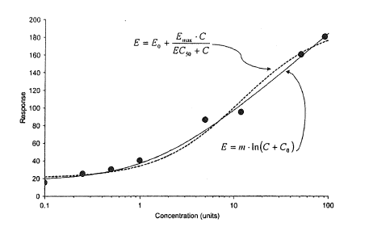


$$E=E_{0}+ \frac{E_{max}∙C}{{EC}_{50}+C}$$
Response
$$E={m ∙( C+ C}_{0})$$
Concentration (units)

Slide 2
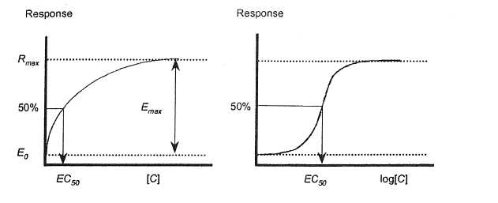
R

Slide 3
