Slide 1
4장 그림수정

Slide 2
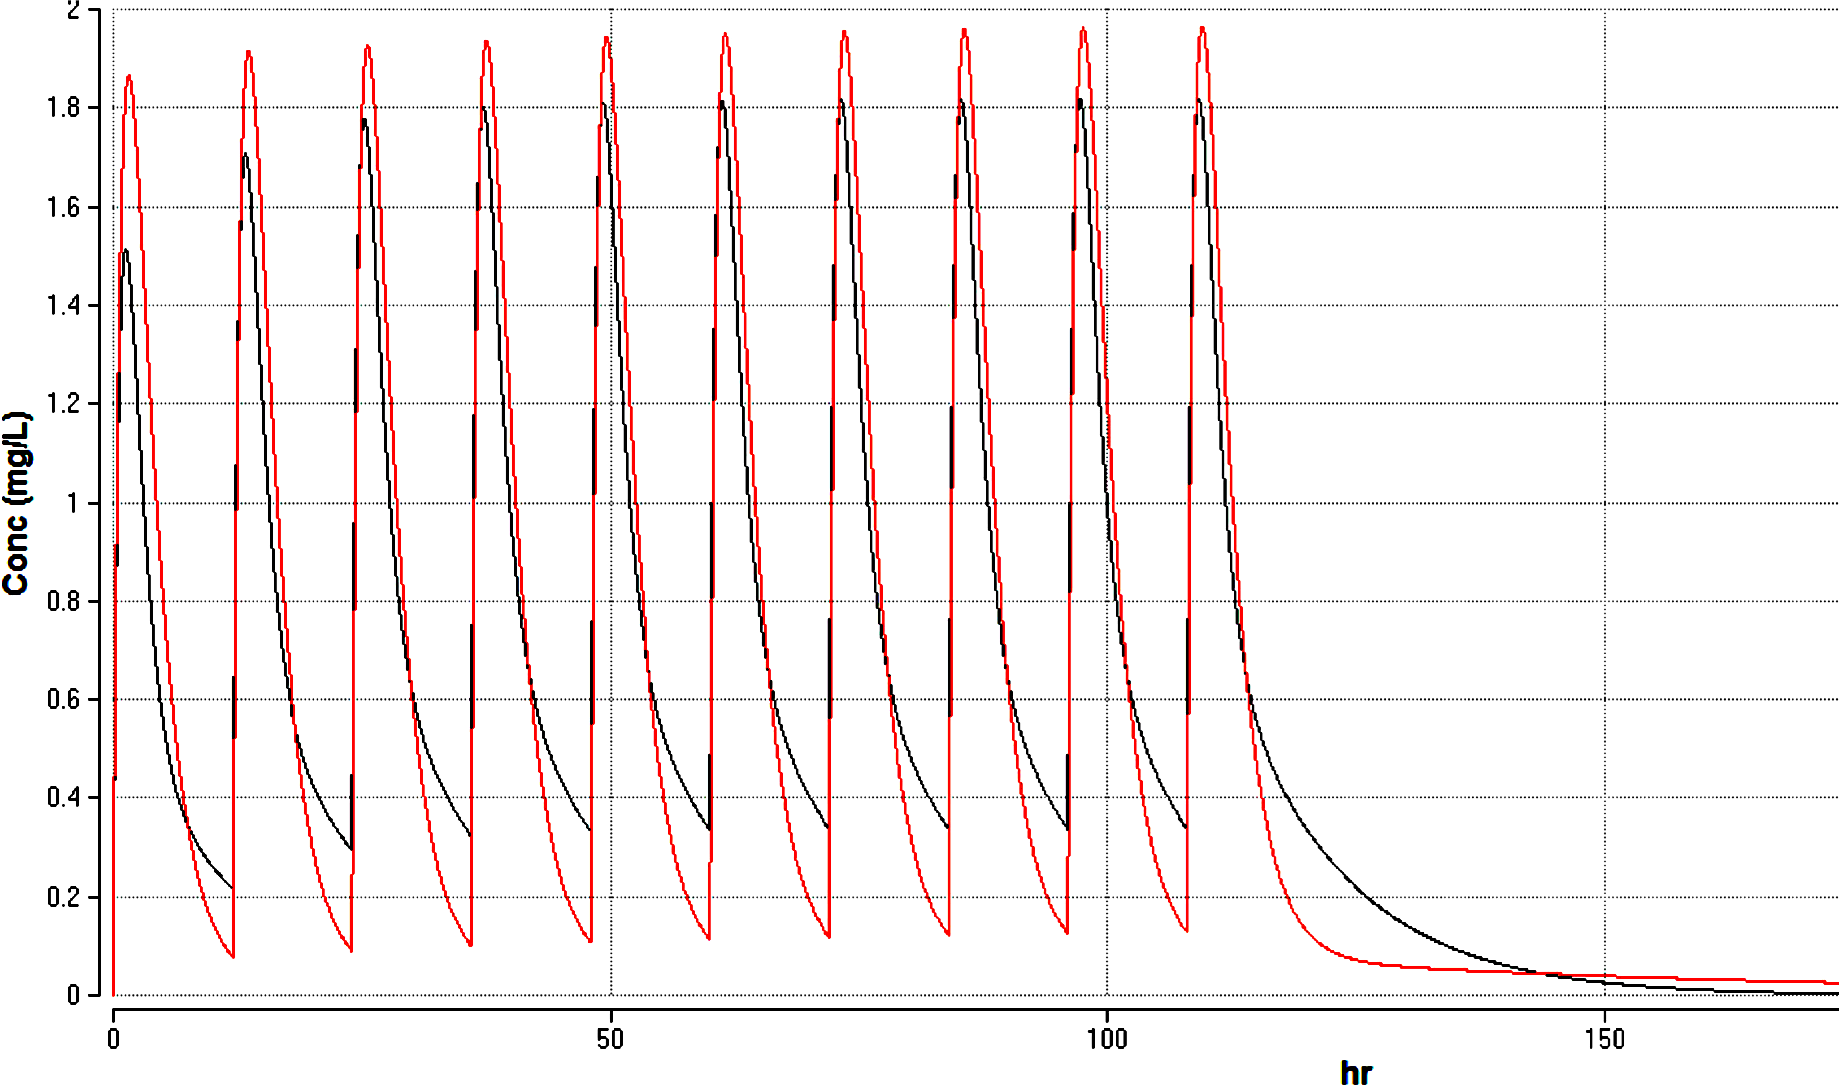
Plasma drug conc (mg/L)
Time (hr)

Slide 3
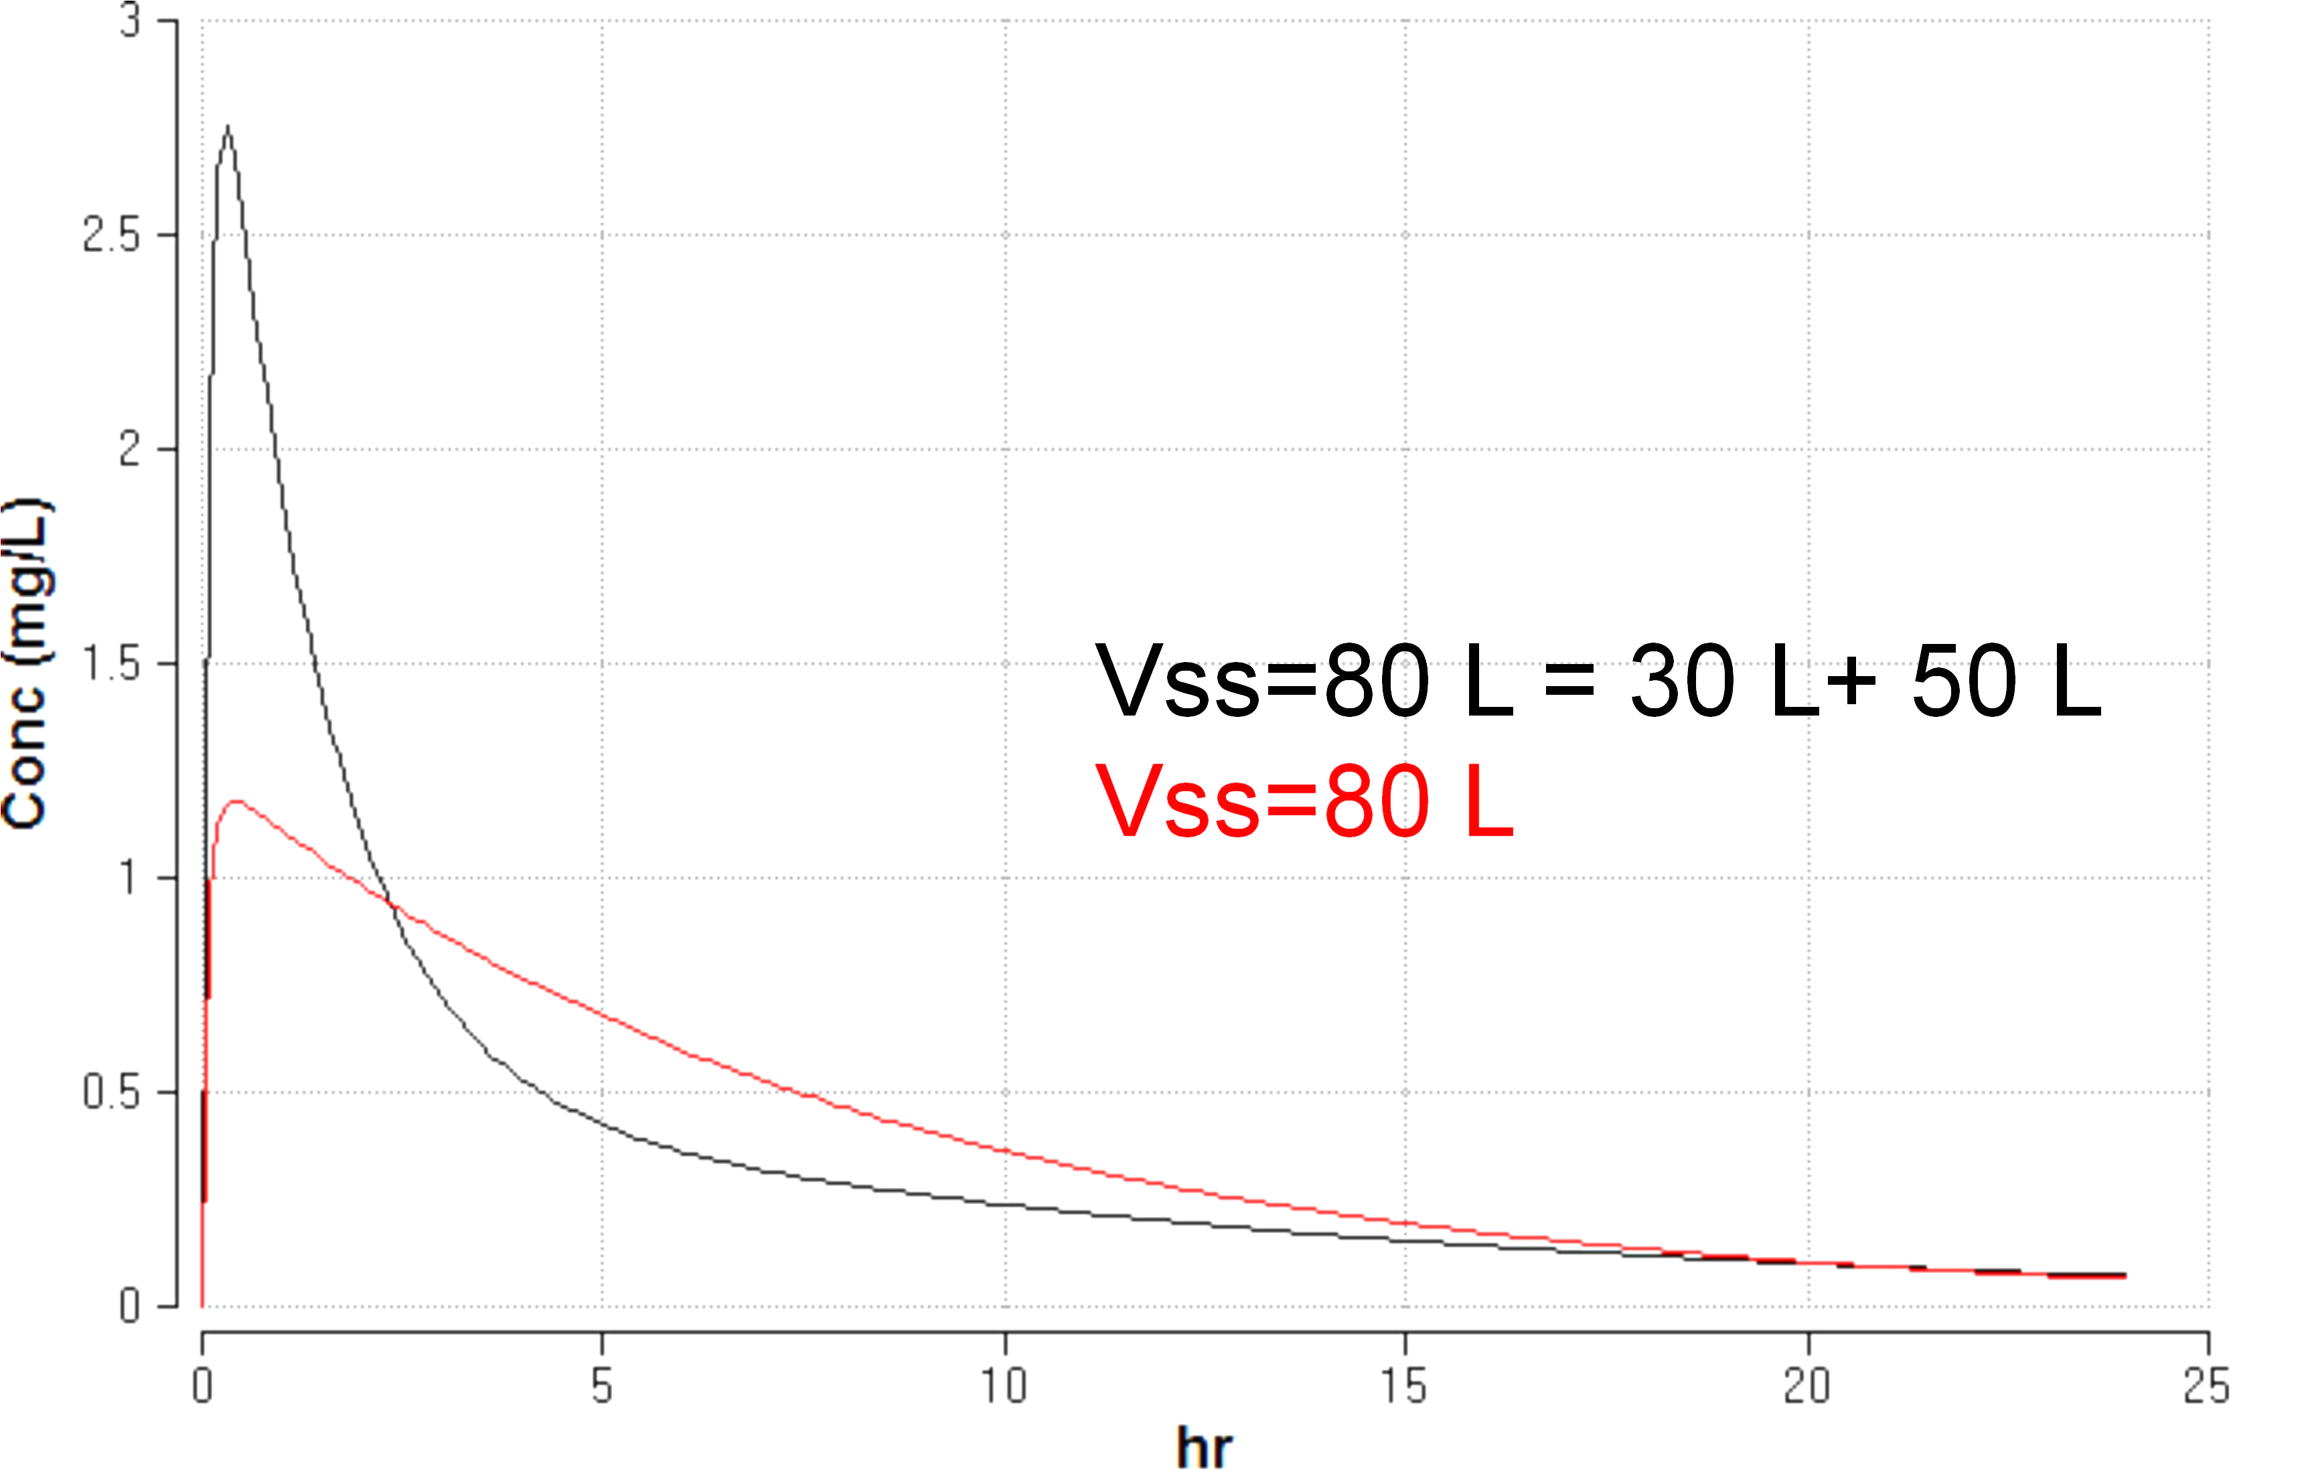
Plasma drug conc (mg/L)
Time (hr)

Slide 4
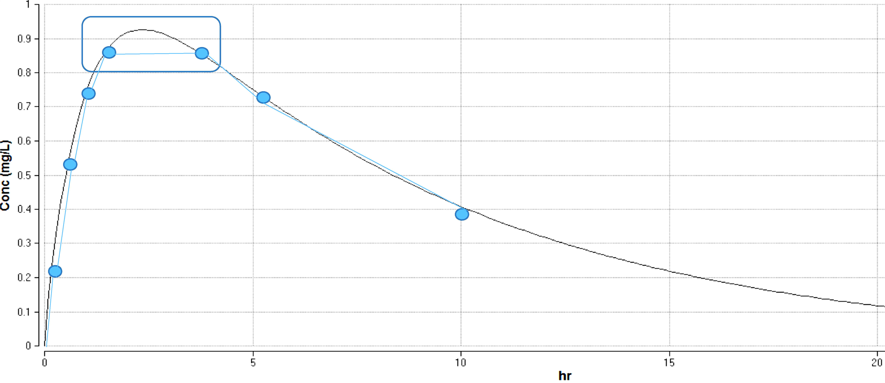
Plasma drug conc (mg/L)
Time (hr)

