Slide 1
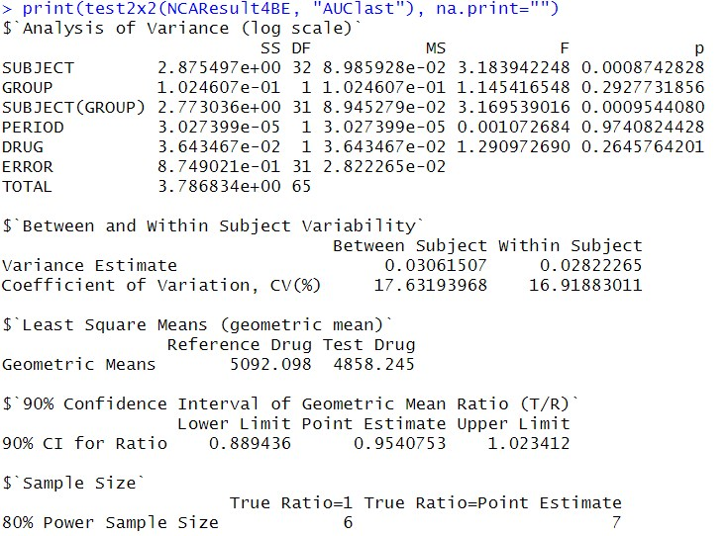
1. ANOVA Table
2. Variability
3. LSM
4. 90% CI of GMR
5. Sample size

Slide 2
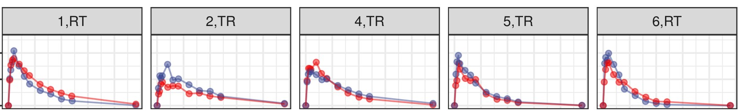

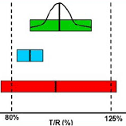
Dataset: 2x2 BE test
NCA (Commercial S/W)
Edison Science App:
NonCompartEdison
Data modification
Simple,
seemless,
open-source,
reproducible,
costless,
and fast process
File type conversion
Edison Science App:
edisonBE
BE test (Commercial S/W)
Output:
- ANOVA table
- 90% CI of
GMR of C_{max}, AUC
- Sample size calculation

