Slide 1
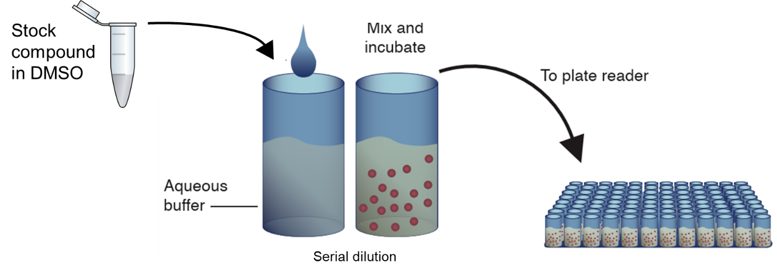

Slide 2
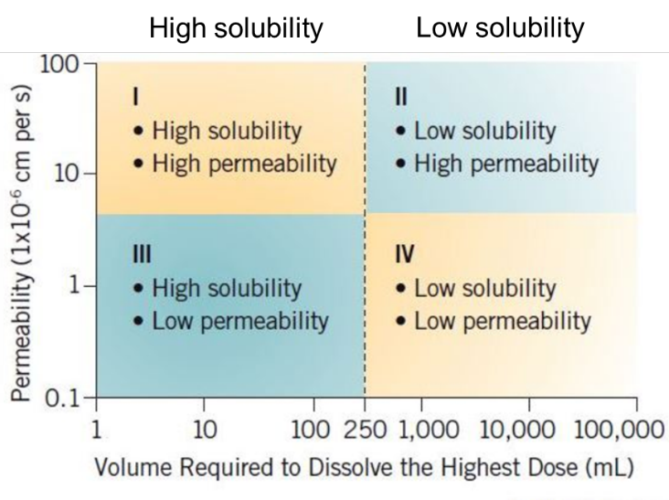

Slide 3
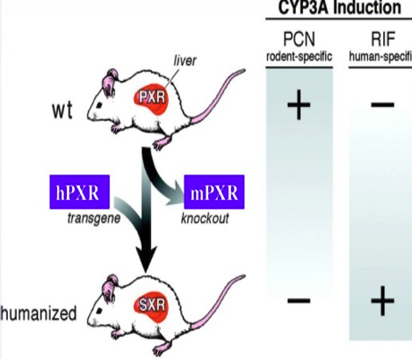
CYP3A4 induction
PCN rodent-specific
RIF human-specific
wt
Humanized

