Slide 1
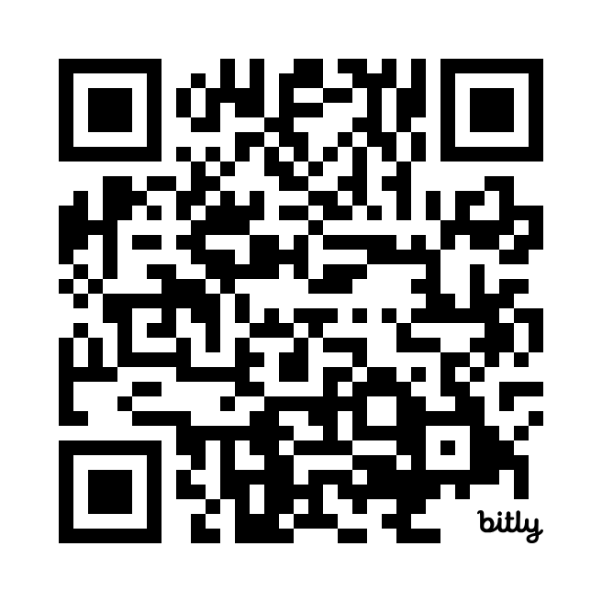
(사)한국독성학회 2026 추계 제42차 정기학술대회
From Drug Discovery to Approval: Safety Assessment and Regulatory Toxicology
Systems-Based Quantitative Modeling for Clinical Safety
Assessment: Role and Perspectives of QSP
발표자료 다운로드
Sungpil Han, MD, PhD
Associate Professor,
Dept of Pharmacology, College of Medicine, The Catholic Univ. of Korea
Dept of Clinical Pharmacology & Therapeutics, Seoul St. Mary’s Hospital
Notes:
(사)한국독성학회 2026 추계 제42차 정기학술대회
◇ 일 시 : 2026. 11. 2(월) - 4(수)
◇ 장 소 : 부산 BEXCO 컨벤션홀
◇ 대주제 : From Drug Discovery to Approval: Safety Assessment and
Regulatory Toxicology (신약개발 전주기 안전성 평가와 규제독성)
◇ 강연요청 : Session 5: Mechanistic Insights and Quantitative Approaches for
Drug Development and Safety Assessment
- Systems-Based Quantitative Modeling for Clinical Safety
Assessment: Role and Perspectives of QSP
- Sungpil Han (The Catholic University of Korea)

