Slide 1
OS 2025 MP2
Memory Management: Kernel Memory Allocation (slab)
TAs: 楊子慶、黃敬瑋
Due Date: 2025/04/03 (Thursday) 23:59:59
Email: ntuos@googlegroups.com
TA hours: Wed. 13:00~14:00, Fri. 11:00~12:00 CSIE B04

Slide 2
Guideline
Introduction
Environment Setting
Code Structure
More about Git
Slab Design
Implementation Requirement
Testing
Reference

Slide 3
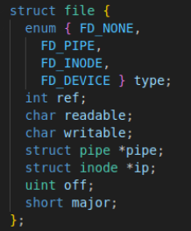
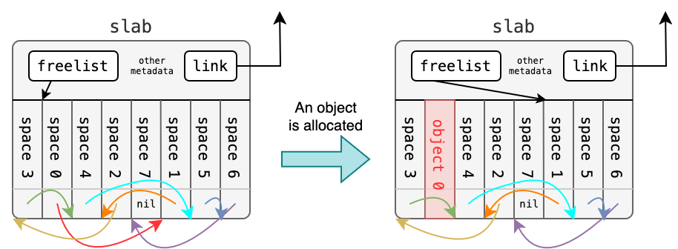
Introduction
Imaging kernel metadata (e.g., file) need to be allocated in kernel
If just simply allocate a page, too many space will be wasted
Slab is a solution of kernel memory management
The space is split to segments, which size is equal to object size
It maintain a “freelist”, which is a linked list of free space

Slide 4
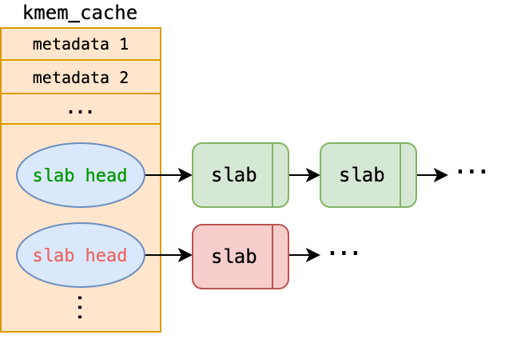
Introduction
Another structure, kernel memory cache (kmem_cache) is used to manage all slabs containing the same type of object
For example, the system may create a separate kmem_cache for struct file or struct proc

Slide 5
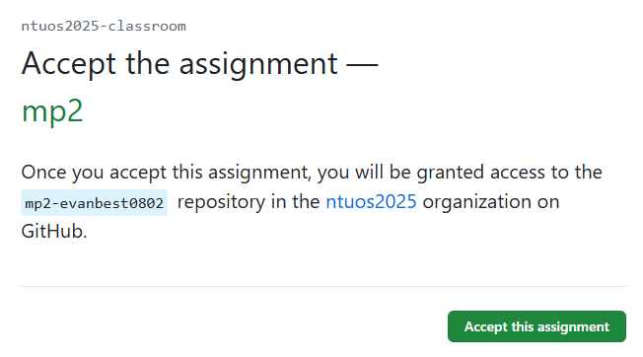
Environment Setting
Install Git
Register a GitHub account
Access the MP2-specific Github Classroom Link and click “Accept this assignment”. The system will create a dedicated repository for you: mp2-<USERNAME>.

Slide 6
Environment Setting
Clone repository: git clone https://github.com/ntuos2025/mp2-<USERNAME>
Fill in your student ID in student_id.txt in the repository, e.g., b12345678
Run the mp2.sh MP2 script tool: ./mp2.sh setup
After development, run specific tests: ./mp2.sh test [case]
For further usage of mp2.sh, please refer to specification

Slide 7
Environment Setting (Optional)
Set up VS Code development environment inside the container
Install the Docker and Dev Containers extensions.
Open VS Code, go to the Docker sidebar, and locate ntuos/mp2.
Right-click and select Attach Visual Studio Code.
Choose ntuos/mp2. VS Code will open a new development environment, allowing direct development within the container.

Slide 8
Code Structure
The repository contains the following files and directories:
student_id.txt: A file to assist with grading; please ensure you fill in your student ID.
mp2.sh: A tool for managing the MP2 assignment.
doc/: Specification requirements for this MP2 assignment in both Chinese and English (Markdown + PDF).
scripts/: Various helper scripts.
test/: A testing system based on the original source code Makefile.
.github/: Code related to GitHub Actions.
update.md: Update logs for students.
update.sh: A script that can update restricted files and documents. Usage: ./update.sh

Slide 9
More about Git
After git clone the repository…
Modify code
Add your changes to repository: git add <file name>
Commit the change: git commit
Push the change to Github: git push
If you want to refine your code, go back to first step
Other utilities
Check which files change: git status
Check commit history: git log
For other details of Git, you can refer to docs

Slide 10
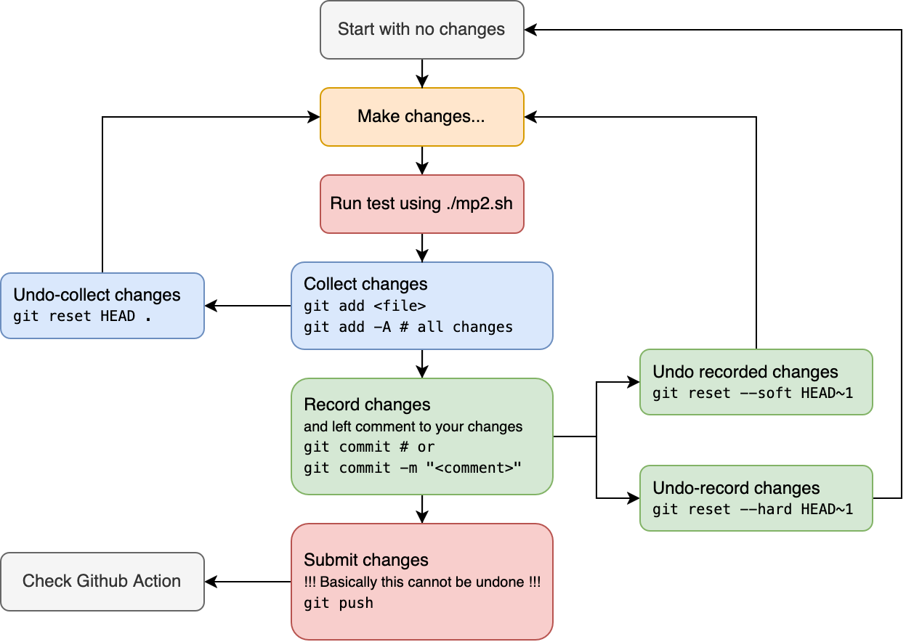
More about Git
A development flow using Git

Slide 11
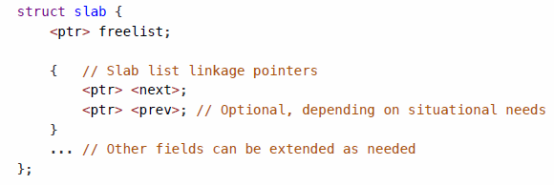
Slab design: struct slab
We encourage students to minimize memory footprint so as to maximize memory utilization.
freelist: linked list of free space
next and prev: Let slab be a linked list

Slide 12
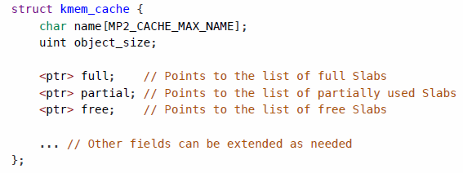
Slab design: struct kmem_cache
Usually contains 3 linked lists of slabs
full: All objects are allocated.
partial: Some objects remain available.
free: Unused slabs.
full and free are actually optional members (please refer to specification)

Slide 13
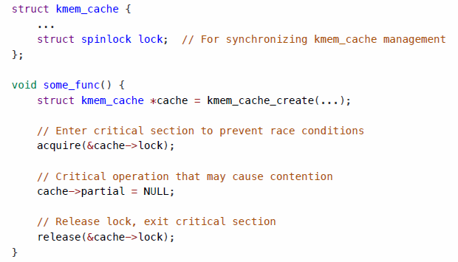
Slab design: struct kmem_cache
kmem_cache use spinlock to ensure thread safety.
The right figure is the usage when kmem_cache needs to be modified

Slide 14
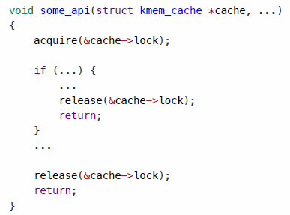
Slab design: struct kmem_cache
In API developing, use conservative approach: acquire lock at the beginning and release lock before return.

Slide 15
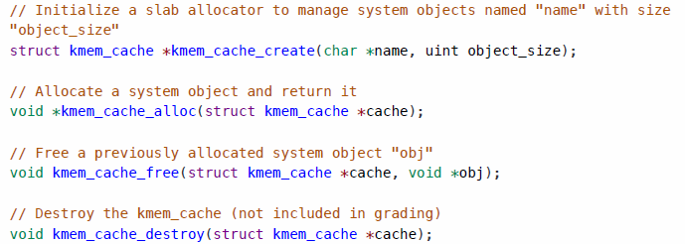
Slab design: Functions Overview
Function signature:

Slide 16
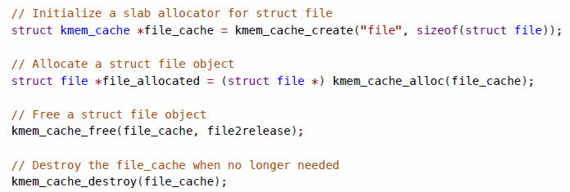
Slab design: Functions Overview
Usage:

Slide 17
Slab design: kmem_cache_create()
name: Name of the new kmem_cache (kmem_cache.name).
obj_size: Size of objects within the kmem_cache (kmem_cache.object_size, in bytes).
Before successfully creating and returning kmem_cache, print:
[SLAB] New kmem_cache (name: <name>, object size: <obj_size> bytes, at: <kmem_cache_addr>, max objects per slab: <max_objs>, support in cache obj: <in_cache_obj>) is created

Slide 18
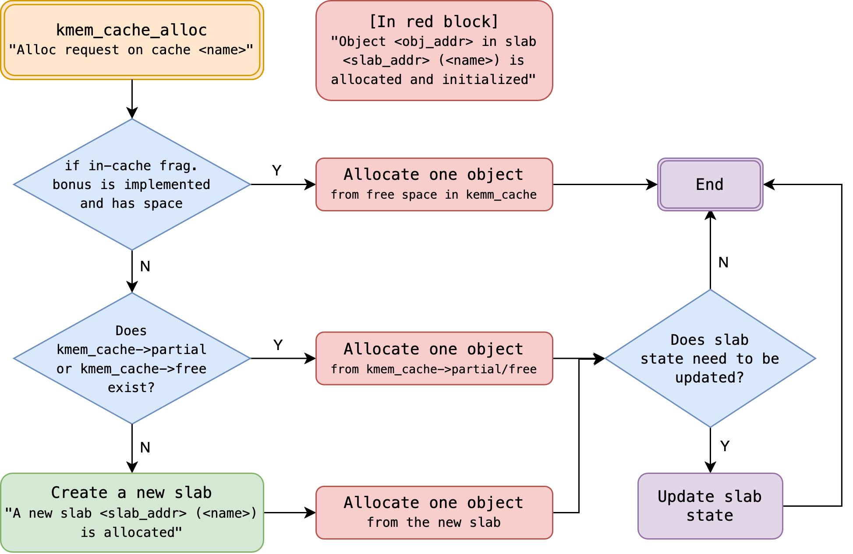
Slab design: kmem_cache_alloc()
name: Name of the kmem_cache (cache.name)
slab_addr: Memory address of the slab containing the object
obj_addr: Memory address of the allocated object

Slide 19
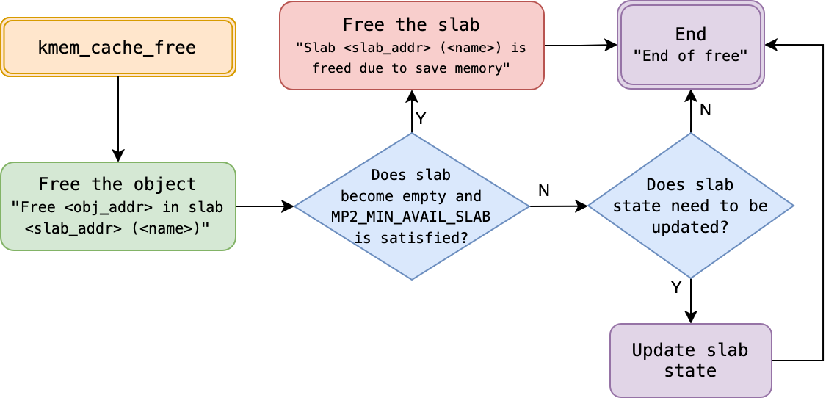
Slab design: kmem_cache_free()
name: Name of the kmem_cache (kmem_cache.name)
slab_addr: Memory address of the slab containing the object
obj_addr: Memory address of the object to be freed
before: State of the object’s slab before freeing (full/partial/free/cache)
after: State of the object’s slab after freeing (full/partial/free/cache)

Slide 20
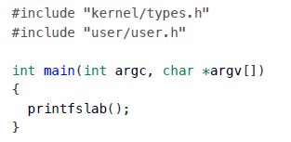
Slab design: sys_printfslab() and print_kmem_cache()
void print_kmem_cache(struct kmem_cache *, void (*)(void *));
Print struct kmem_cache information
For format details, please refer to specification.
sys_printfslab() is a system call
Usage:

Slide 21
Implementation Requirement
Ensure your student ID is filled in the student_id.txt file.
Modification of these files is prohibited:
mp2.h
scripts/action_grader.h, scripts/pre-commit
kernel/main.c, kernel/mp2_checker.h, kernel/file.h, kernel/list.h, kernel/param.h
All code within the .github/ directory
All files within the test/ directory, except test/custom/mytest.txt
All existing files within the user/ directory; students may additionally implement other user programs for testing purposes
Students are free to add new files and modify other code.
Using ./mp2.sh setup can automatically prevent students from attempting to submit problematic changes.

Slide 22
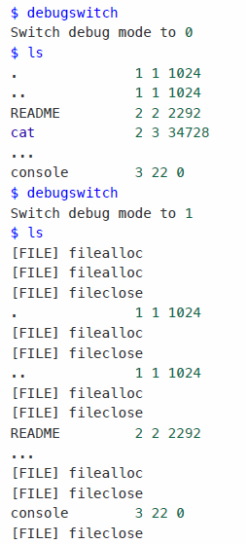
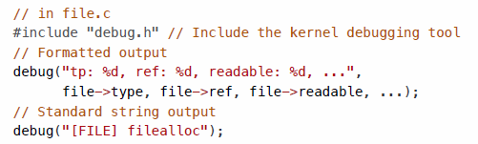
Implementation Requirement: debug
We offer debugging tool
In xv6, use debugswitch to turn on/off debug messages
(default mode is “on”)
The debug message API is below. The format is the same as printf
All output must be handled using the debug API to ensure compatibility with the testing and grading system
For detailed usage instructions, please refer to kernel/debug.h

Slide 23
Testing
Slab structure test (5% + 5% bonus)
Functionality test (75%)
If the functionality test score exceeds 66 points, the following two bonus tests will be conducted; otherwise, the bonus item evaluation will be skipped:
List API Test (+10%)
In-Cache Test (+10%)
Note: This logic differs from the execution method of ./mp2.sh test all. The latter is designed to allow students to test all cases in one go, regardless of their score.
Hidden test (20%)
Check “mp2.sh Script Usage Guide” in specification for other testing command options

Slide 24
Reference
xv6: a simple, Unix-like teaching operating system
ISO/IEC 9899:2024 (C Language Standard)
linux/mm/slab.h
linux/mm/slub.c
sysprog21/lab0-c
linux/include/linux/list.h
Slab Memory Allocator

Slide 25
Q&A

