Slide 1
Information Enrichment of the DARPA Claims Dataset
Through Multiple Data Source
Xuesong, Liu, PhD in ECE
Tianyu, Yuan, Master’s in BIA
Yangyang, Yu, PhD in Data Science

Slide 2


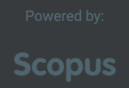

Information Selection Workflow
Scopus DB
through Scopus API
Connection: DOI (as Document Identification ID)
Paper, Author Info & PlumX metrics
Total record count: 2804
Journal Ranking
Connection: Journal Name
DARPA Claim Paper Dataset
Journal Rankings and H index broken by research sub-categories
World University Rankings 2019-2020
Connection: Researcher’s Affiliation Name and Country
Top 2000 Research Institution worldwide ranking and factors highly relevant to current rankings
Notes:
Scopus is the largest abstract and citation database of peer-reviewed literature: scientific journals, books and conference proceedings.
Delivering a comprehensive overview of the world's research output in the fields of science, technology, medicine, social sciences, and arts and humanities, Scopus features smart tools to track, analyze and visualize research.
The SCImago Journal & Country Rank is a publicly available portal that includes the journals and country scientific indicators developed from the information contained in the Scopus® database (Elsevier B.V.). These indicators can be used to assess and analyze scientific domains. Journals can be compared or analyzed separately.
The Center for World University Rankings (CWUR) is a leading consulting organization providing policy advice, strategic insights, and consulting services to governments and universities to improve educational and research outcomes.
Since 2012, CWUR has been publishing the only academic ranking of global universities that assesses the quality of education, alumni employment, research output, and citations without relying on surveys and university data submissions.
Since our target paper set contains works from multiple nations, for the institution ranking and Jornal ranking, we choose the worldwide ranking as the selected information instead of that for individual countries.

Slide 3
Information Source One: Scopus DB
Contributor: Yangyang Yu
Tool: pybliometrics, a Python-based API-Wrapper to access Scopus
Three Layers of Information Acquired:
Author level information (2492 author records matched, matching conducted by 1st author ID) – Search API: Author Search/Retrieval API: Author Retrieval
Important Attributes: author’s affiliation information, author’s citation count, author’s
documentation count, author’s H index, author’s cited by count, author’s affiliation
history
Paper level information (2510 paper records matched, matching conducted by DOI ) – Search API: Scopus Search
Important Attributes: 1st author information (ID + Name), full author list (ID + Name), funding
information, paper cited by count, open access or not
Paper PlumX metrics Information (2787 paper records matched, matching conducted by DOI ). – Metadata API: PlumX Metrics
Important Attributes: abstract views, bookmark count, download count, exports saves, full text
views, link click count, link outs, reader count, paper citation, mention count, paper social median
appearance, capture count, paper usage

Slide 4
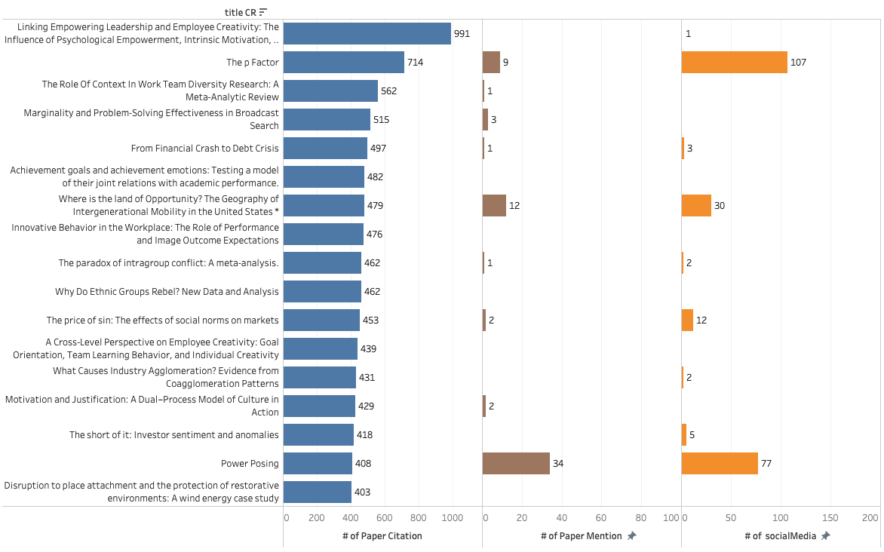
Information Source One: Scopus DB
Data exploratory:
Citation count vs. mentions vs. social media appearances for top cited papers
Notes:
Scopus is the largest abstract and citation database of peer-reviewed literature: scientific journals, books and conference proceedings.
Delivering a comprehensive overview of the world's research output in the fields of science, technology, medicine, social sciences, and arts and humanities, Scopus features smart tools to track, analyze and visualize research.
The SCImago Journal & Country Rank is a publicly available portal that includes the journals and country scientific indicators developed from the information contained in the Scopus® database (Elsevier B.V.). These indicators can be used to assess and analyze scientific domains. Journals can be compared or analyzed separately.
The Center for World University Rankings (CWUR) is a leading consulting organization providing policy advice, strategic insights, and consulting services to governments and universities to improve educational and research outcomes.
Since 2012, CWUR has been publishing the only academic ranking of global universities that assesses the quality of education, alumni employment, research output, and citations without relying on surveys and university data submissions.
Since our target paper set contains works from multiple nations, for the institution ranking and Jornal ranking, we choose the worldwide ranking as the selected information instead of that for individual countries.

Slide 5
Information Source Two: SJR Site
Contributor:Tianyu Yuan
Method: Journal Name Hard Matching
Information Acquired:
Journal worldwide ranking and H-index split by research sub-category
Counted from year 2018 (latest), citable documents in the past 3 years
Matched paper record count appearing at the ranking list for each research category are shown below
Computer & Education = Computer and Education (symbol)
The Journal of Finance = Journal of Finance (the problem)
DEMOGRAPHY = demography (capital and small letter)
Econ Finance | Education | Social Sciences | Psychology | Public Admin | Sociology Political Sci | Demography | Business Management | Not in Rank List
632 | 321 | 1,519 | 1,008 | 93 | 814 | 47 | 725 | 49
Note: The paper records not listed are all from “﻿Journal of the Academy of Marketing Science”, which could be caused by a bug in the SJR or Scopus.

Slide 6
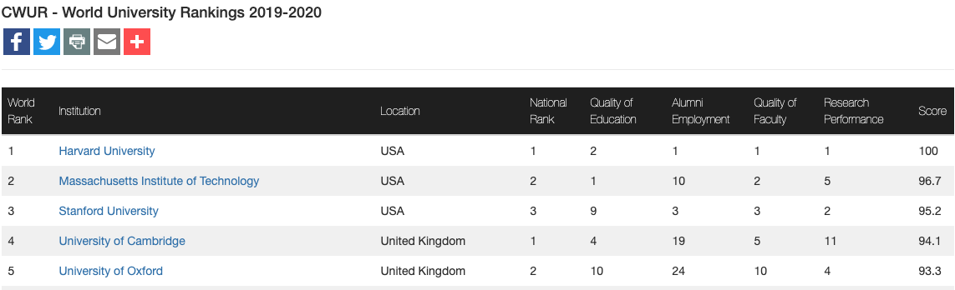
Information Source Three: CWUR Site
Contributor: Xuesong Liu
Method:
1) hard matching on affiliation country
2) Hierarchical search for affiliation name by number of matched keywords
Information Acquired:
2019-2020 latest worldwide research institution ranking(1170 affiliation records matched, matching conducted by 1st author ID)
Important Attributes: world rank, nation rank, education quality, alumni employment, research
performance, faculty quality
The affiliation information for all authors associate with paper is also available in our extracted data for further scraping and credibility validation.
Notes:
Other authors other than the 1st author is relevantly secondary for the credibility assessment, therefore, we don’t include this time.

Slide 7
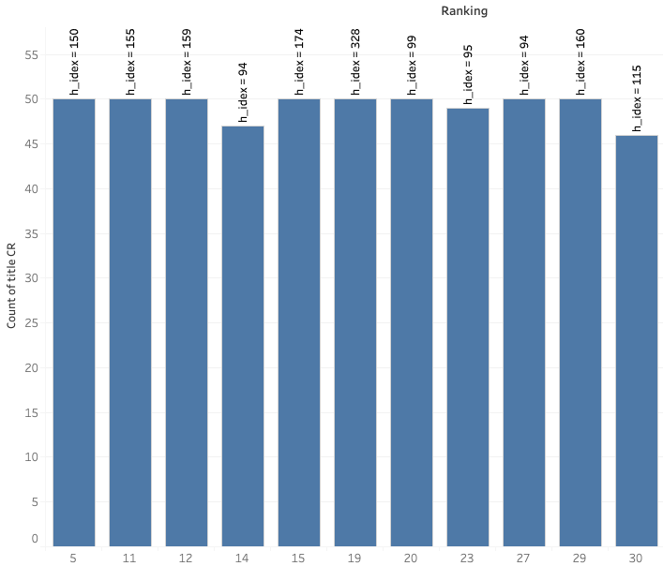
One Deep Dive on Validating paper’s creditability
For Social Science:
Distribution of paper counts of Journal Ranking Top 30 in Social Sciences Category
Are they all high-credibility papers?

Slide 8
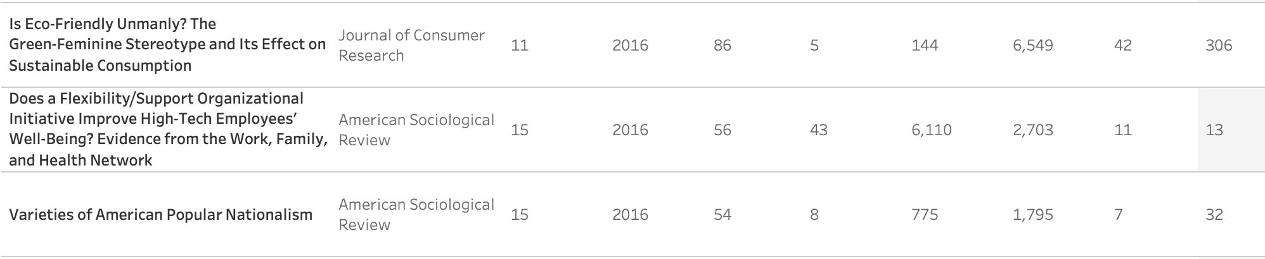
One Deep Dive on Validating paper’s creditability
For Social Science:
Distribution of paper counts of Journal Ranking Top 30 in Social Sciences Category
Possible examples for high credibility:
Published on top journals in the corresponding areas
Had high academic and social activity indicator
… other factors to be discovered
Paper Name | Journal | Journal Ranking | Year | Paper Citation | Author H Index | Author Citation | Full Text View # | Mention # | Social Media#

Slide 9
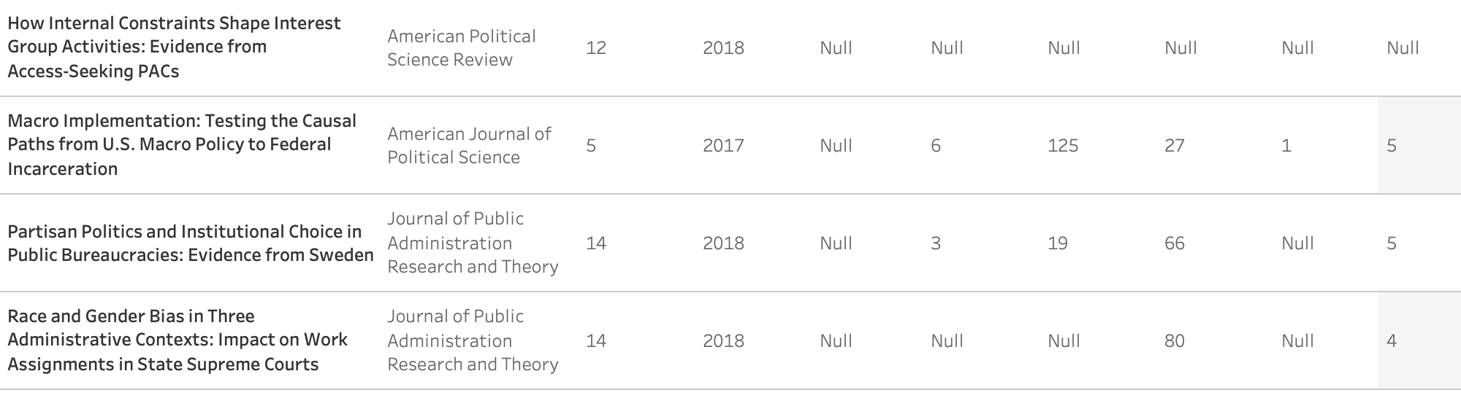
One Deep Dive on Validating paper’s creditability
For Social Science:
Distribution of paper counts of Journal Ranking Top 30 in Social Sciences Category
Type 1 possible examples for low credibility: -- From Paper Perspective
36 papers missing citations information in Scopus, other than them …
Published on top journals in the corresponding areas
Had low or zero academic and social activity records for past 3 years
Other factors to be discovered
Paper Name | Journal | Journal Ranking | Year | Paper Citation | Author H Index | Author Citation | Full Text View # | Mention # | Social Media#

Slide 10
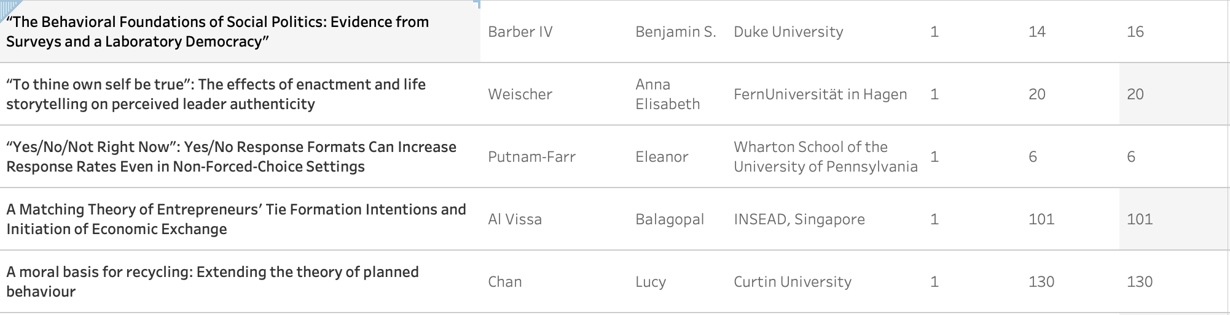
One Deep Dive on Validating paper’s creditability
For Social Science:
Distribution of paper counts of Journal Ranking Top 30 in Social Sciences Category
Type 2 possible examples for low credibility: -- From Author Perspective
313 papers missing author information in Scopus, other than them …
Had low academic records for past 3 years
University Name | Author Name | Affiliation | Author H Index | Author Citation | Paper Citation

Slide 11
Future Work
We notice that there is information inconsistency between Scopus and Google Scholar.
Scrapping information from Google Scholar as complementary can be conducted to ensure the data integrity.
Notes:
Why still choose Scopus:
it is representative and official given its huge academic database. Many popular academic rankings are referred to its data.
Its API allows us to access more paper and author information than Google Scholar

