Slide 1
Automated Priority Judgment for Sabre Fencing via Multimodal PoseAnalysis
Yucheng Zhu CS207 Final Project
https://github.com/pipipig-yz/Auto-Fencing-Referee/tree/master
Notes:
Good afternoon. My name is Yucheng Zhu, and this is my CS207 final project. The work I will present today addresses a longstanding challenge in competitive fencing: the automated determination of scoring priority in sabre bouts. The system I developed leverages multimodal pose analysis to replicate, and potentially augment, the judgment process currently performed by human referees.

Slide 2
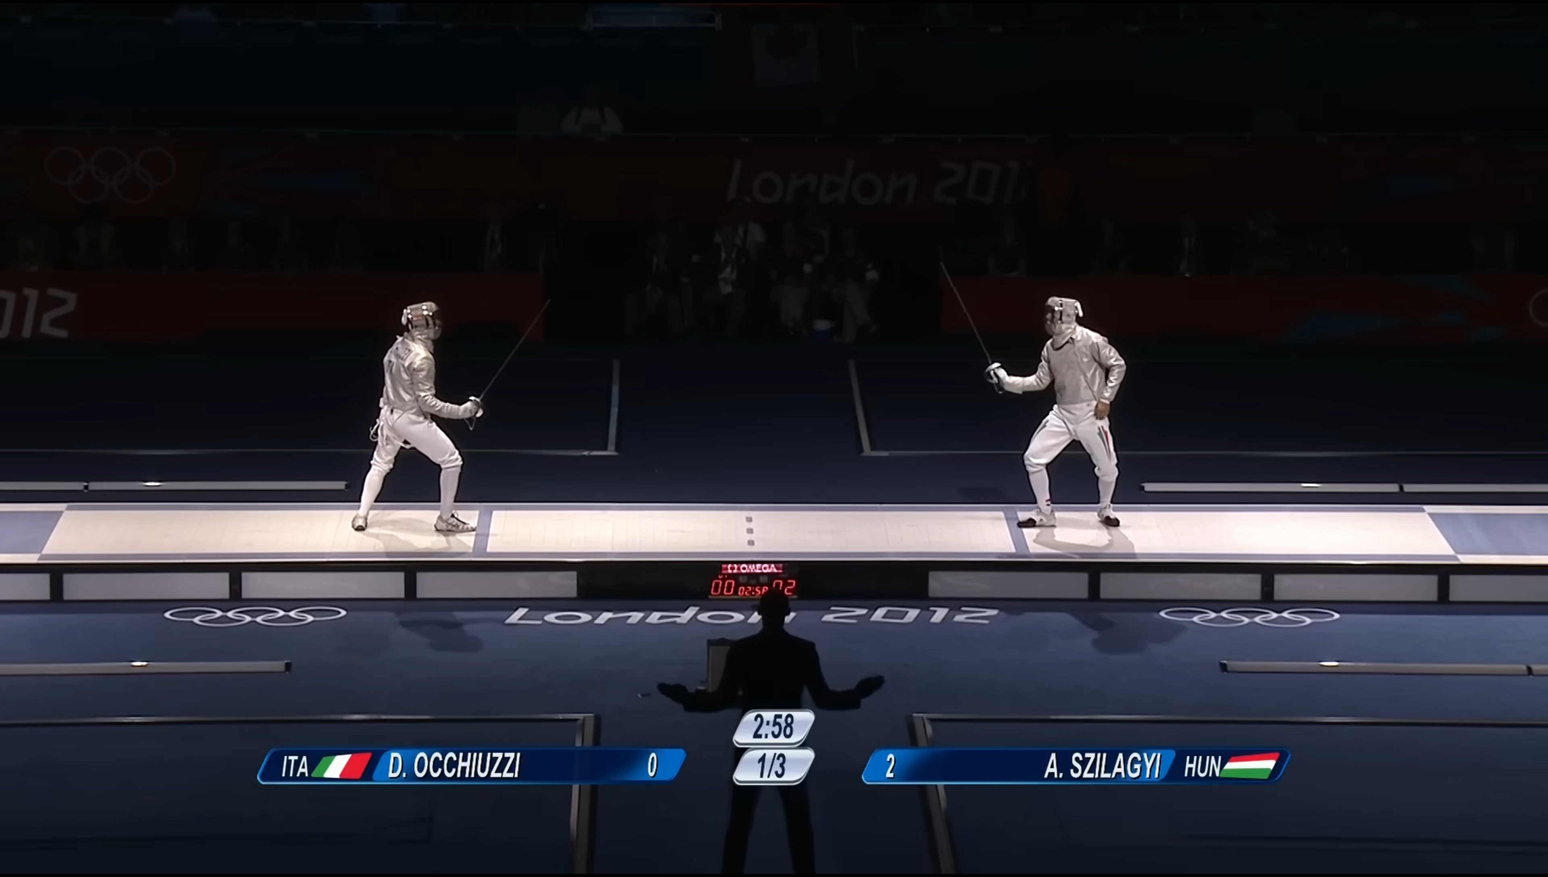
Preliminary: how fencing referee judge double hit
Check whose arm extension (attack) first
Check whose lunge first
Check whose launch first
But saber is too fast, everything is done in 1 seconds.
Even if the referee have the slow motion, it is still hard to judge
Notes:
To appreciate the difficulty of this problem, it is necessary to understand how human referees currently adjudicate double-hit situations. When both fencers are hit simultaneously, the referee must resolve priority by examining three sequential criteria: which fencer initiated arm extension first, which fencer committed to a lunge first, and which fencer launched their attack first. The fundamental challenge is that sabre exchanges unfold in under one second. Even with access to slow-motion footage, accurate human judgment remains inconsistent and prone to error.

Slide 3
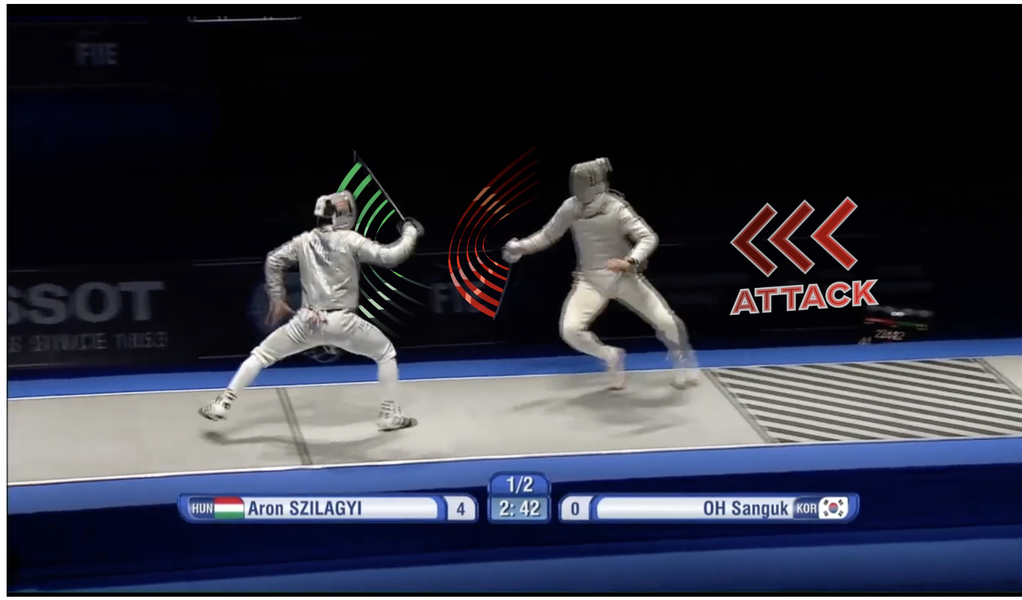
Related work:
Allez Go: Computer Vision and Audio Analysis for AI Fencing Referees
Multimodal audio-visual fusion for automated refereeing
First attempt to use audio cues instead of purely visual methods
Lightweight TCN-based temporal modeling
FERA: Foil Fencing Referee Assistant Using Pose-Based Multi-Label Move Recognition and Rule Reasoning
End-to-end priority reasoning pipeline (perception → action classification → rule inference)
Publicly released dataset and evaluation benchmark
First application of LLM-based reasoning to fencing refereeing rules
FenceNet: Fine-Grained Footwork Recognition in Fencing
No wearable sensors required; relies solely on 2D pose data
BiFenceNet captures bidirectional temporal dynamics in movement
One of the earliest works enabling direct video-based fencing footwork recognition
Allez Go: marking priority (attack) to help automated refereeing
Notes:
Prior work in this domain has explored several directions. Allez Go introduced multimodal audio-visual fusion, incorporating audio cues such as the referee's spoken commands and the electronic scoring buzzer alongside visual information -- a first of its kind. FERA proposed an end-to-end pipeline for foil fencing, combining pose-based action recognition with rule-based inference, and released a public benchmark dataset. FenceNet focused specifically on fine-grained footwork recognition. My work builds upon these foundations and extends them to the more demanding context of sabre, where speed and rule complexity present additional constraints.

Slide 4
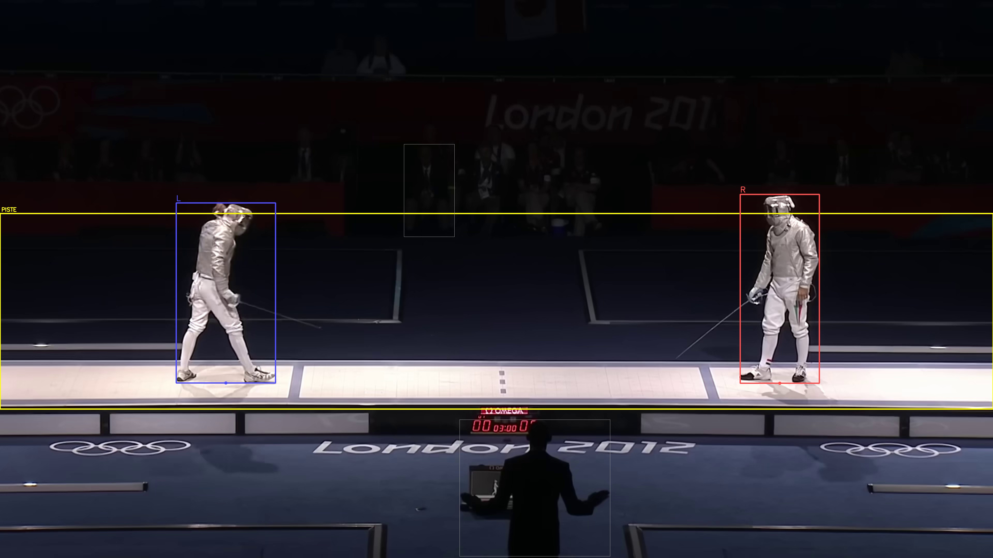
Core Design: Temporal Segmentation
Multimodal Event Monitoring
Audio: referee vocal commands (Allez ) and electronic scoring buzzer activations.
Vision: scoring apparatus indicator lights and athlete pose states
Figure selections
Piste: The ground for fencing
Athletes: The biggest human body on the piste
Score machine light: red or green
Notes:
The first core design component is temporal segmentation. Rather than processing the entire video uniformly, the system isolates the active fencing bout through multimodal event monitoring. On the audio channel, it detects the referee's 'Allez' command and the electronic buzzer. On the visual channel, it monitors the scoring apparatus indicator lights as well as athlete pose states. To reliably identify the relevant figures in each frame, the system selects the fencing piste as the ground region and identifies the two largest human bodies within it as the athletes. The scoring machine light -- red or green -- provides additional event anchoring.

Slide 5
Core Design: Motion Detection
Baseline detection
athlete’s static on-guard joint angles serving as the reference zero-point for all subsequent motion thresholds
Lunge detection
the primary offensive move-ment and the clearest physical expression of an attack on foot
Attack detection
Joint angles on arm and shoulder
Pause detection
A pause event signals that an athlete’s forward action hasbeen interrupted after launch, causing loss of priority
Notes:
The second core component is motion detection, which extracts four categories of events from the segmented bout. First, baseline detection establishes each athlete's static on-guard joint configuration, which serves as the reference zero-point for all subsequent motion thresholds. Second, lunge detection identifies the primary offensive footwork commitment. Third, attack detection monitors joint angles at the arm and shoulder to identify weapon arm extension. Fourth, pause detection flags any interruption in forward momentum following launch -- a condition that, under the rules of sabre, results in loss of priority.

Slide 6
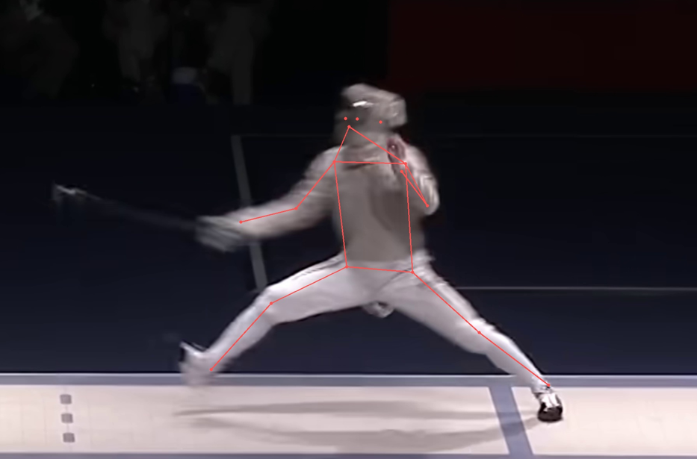
Lunge Detection
Angle inter-thigh
>120°
Angle of the front knee joint
>150°
Width between two feet>2*width baseline
Notes:
This slide illustrates the specific geometric criteria used for lunge detection. Three conditions must be jointly satisfied: the front knee joint angle must exceed 150 degrees, the inter-thigh angle must exceed 120 degrees, and the stance width must exceed twice the baseline width recorded during the on-guard phase. The combination of these three criteria ensures that only a committed lunge is flagged, rather than minor weight shifts or preparatory movements.

Slide 7
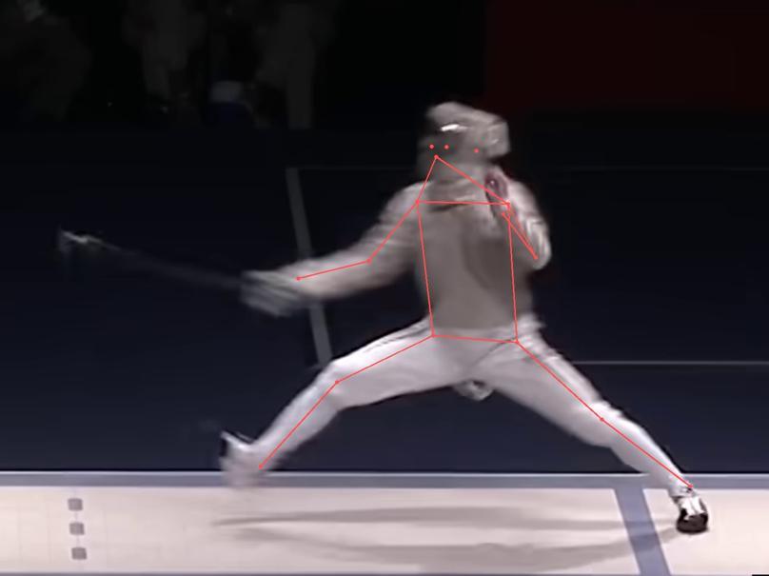
Attack detection
Elbow angle>140°
Shoulder angle>60°
Notes:
Attack detection is defined by two joint angle thresholds measured on the weapon arm. The elbow joint must form an angle greater than 140 degrees, indicating a substantially extended arm, and the shoulder joint must exceed 60 degrees of elevation. These thresholds were determined empirically based on the typical biomechanics of a sabre attack and are designed to discriminate between an active extension and a resting or preparatory arm position.

Slide 8
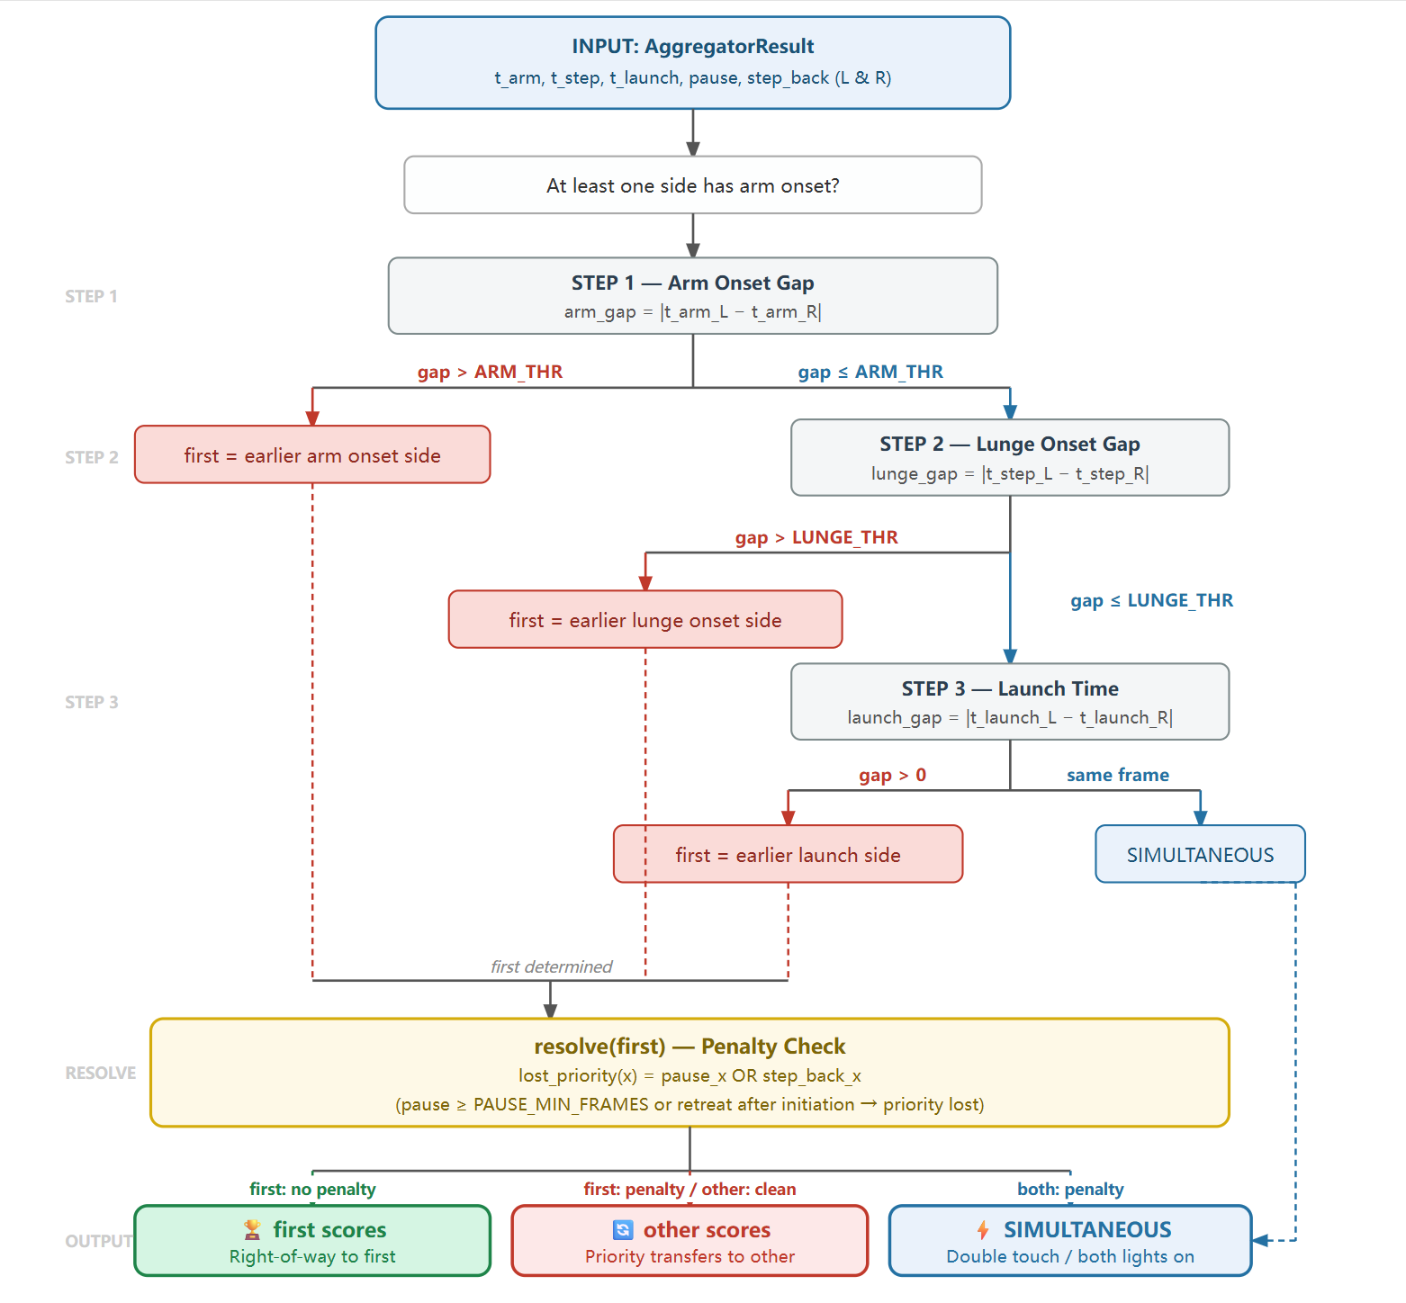
Core Design: Priority Decision Workflow
It follows up with the most resent fencing rules
Step 1 — Arm Onset. The algorithm first compares the arm-onset times of both fencers (the time of attack). Threshold=2 frame
Step 2 — Lunge Onset. Step 2 compares lunge-onset times. A lunge represents the committed forward displacement of the body. Threshold=2 frame
Step 3 — Launch Time. Step 3 compares raw launch times with 10 frame simultaneity threshold. Threshold=10 frame
Step 4 -- Forfeiture Check: No pause or step back ward in the whole attacking process after launch.
Notes:
The priority decision workflow mirrors the official FIE rules of sabre fencing and proceeds through four sequential steps. In Step 1, the algorithm compares arm-onset times between the two fencers; if the gap is within two frames, the comparison is considered simultaneous and the algorithm advances to Step 2. Step 2 applies the same logic to lunge-onset times with an identical two-frame threshold. Step 3 compares raw launch times using a more generous ten-frame simultaneity window, which accounts for the earlier and less deterministic nature of the launch action. Finally, Step 4 performs a forfeiture check, verifying that neither fencer paused or stepped backward after launch -- either of which would forfeit priority under the rules.

Slide 9
Output Result: Log (from debug_aggregator
Verdict process
INFO Priority step 1: arm gap=1 ≤ 3 → check lunge
INFO Priority step 2: lunge gap=1 ≤ 3 → check launch
INFO Priority step 3: launch gap=12 > 10 → first_mover=L
INFO Priority step 3: first_mover=L penalty=False | other=R penalty=False
=================================================================
Event Table
INFO SYSTEM LEFT RIGHT
INFO f0009 0.30s BASELINE_CAPTURED
INFO f0016 0.53s WINDOW_OPEN
INFO f0020 0.67s LAUNCH
INFO f0032 1.07s LAUNCH
INFO f0041 1.37s ATTACK_START
INFO f0042 1.40s ATTACK_START
INFO f0042 1.40s LUNGE
INFO f0043 1.43s LUNGE
INFO f0044 1.47s LIGHT_ON_L
INFO f0046 1.53s LIGHT_ON_R
INFO f0046 1.53s LIGHT_ON_BOTH
INFO f0056 1.87s WINDOW_CLOSE
INFO KEY TIMESTAMPS (frame | seconds @ 30 fps)
INFO T_arm_L f0042 1.40s
INFO T_arm_R f0041 1.37s
INFO T_step_L f0042 1.40s
INFO T_step_R f0043 1.43s
INFO T_launch_L f0020 0.67s
INFO T_launch_R f0032 1.07s
INFO pause_L = False | pause_R = False
INFO step_back_L = False | step_back_R = False
Result VERDICT: Verdict.LEFT_SCORES
Notes:
This slide shows a representative output log from the debug aggregator module. The verdict proceeds step by step. In this example, the arm gap of one frame falls within the two-frame threshold, so the algorithm advances to the lunge comparison. The lunge gap is also within threshold, so the algorithm proceeds to Step 3. The launch gap of twelve frames exceeds the ten-frame threshold, and the left fencer is identified as the first mover. The key timestamps reveal that the left fencer launched at 0.67 seconds, while the right fencer launched at 1.07 seconds -- a 400-millisecond difference that is decisive. The final verdict is LEFT_SCORES, with no penalties assessed for either side.

Slide 10
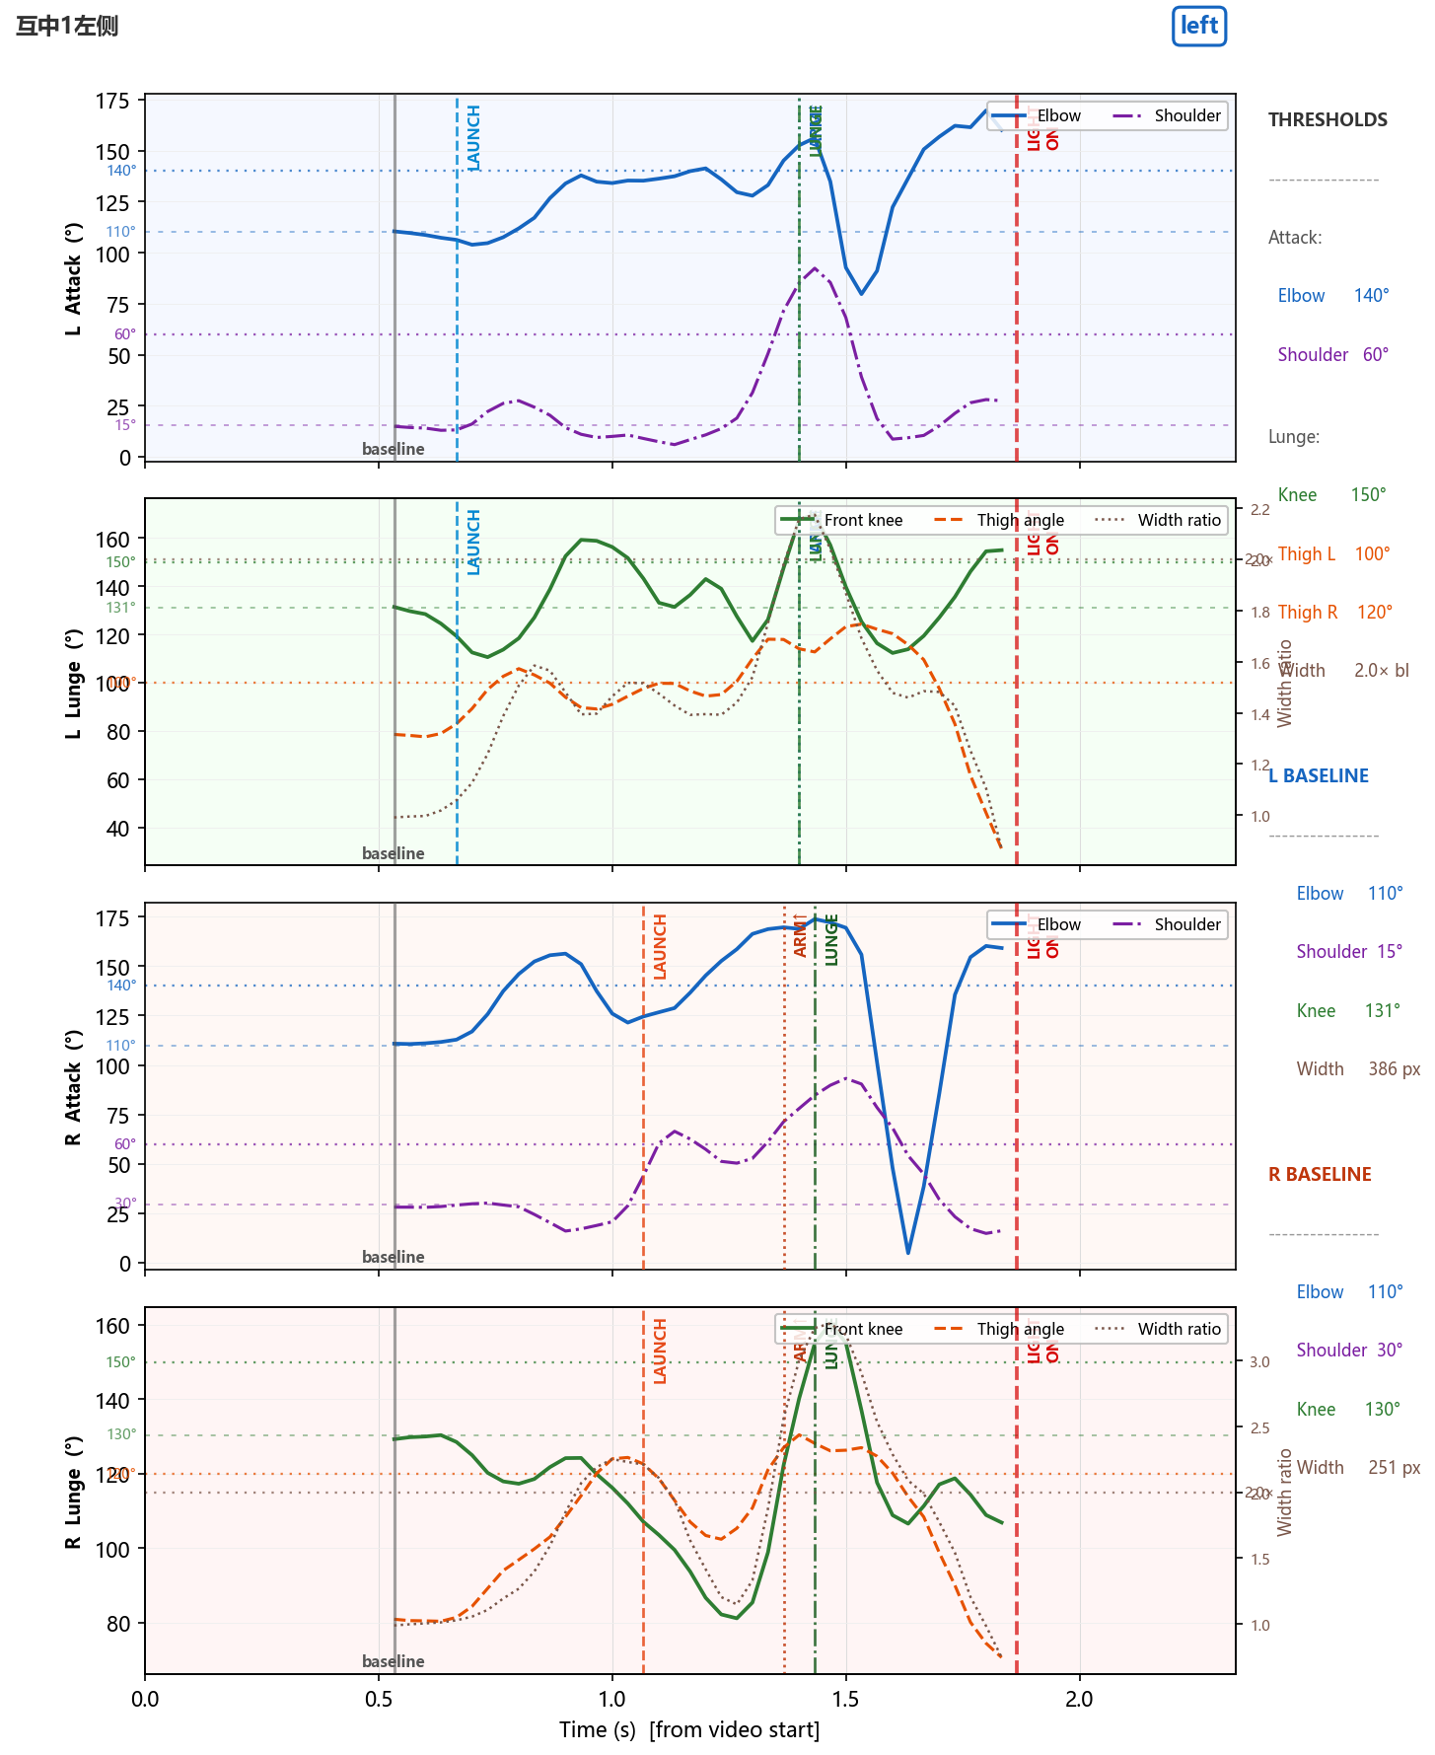
Output Result: visualization
Verdict result by the algorihtm
File name and truth result
Lunge values
Knee angle>150
Thigh angle:
Left: >100
Right:>120
Stance width: >2*of baseline width
Thigh value is different for left and right side is because the project of the camera and the body angle influence
Attack joint angle
Elbow>140
Shoulder>60
Notes:
The visualization output provides a per-frame overlay of all computed motion metrics. For each frame, the display shows the file identifier and ground-truth label alongside the algorithm's verdict. The attack joint angle panel reports elbow and shoulder values relative to their respective thresholds. The lunge panel reports knee angle, inter-thigh angle for both sides, and stance width relative to the baseline. One important note: the thigh angle threshold differs between the left and right fencer because the camera perspective and body orientation introduce an asymmetric projection effect on the detected joint angles.

Slide 11
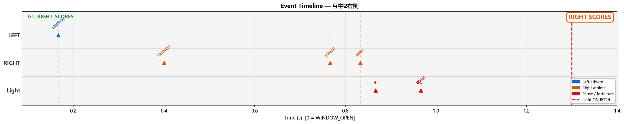
Output Result: Event visualization
The event output will help the judge to see when which event is happened. It will be easier to compare different athletes’ action and their difference of time.
Notes:
The event visualization provides a timeline-based view of all detected events for both fencers across the duration of the bout. This representation allows a reviewer to directly compare when each event -- arm onset, lunge, launch -- occurred for each athlete, and to quantify the temporal gaps between them. This output is particularly valuable for post-hoc analysis and for identifying edge cases where the threshold margins are narrow.

Slide 12
Accuracy
Video GT Predicted Match
互中1左侧 LEFT_SCORES LEFT_SCORES ✓
互中2右侧 RIGHT_SCORES RIGHT_SCORES ✓
互中3右侧 RIGHT_SCORES RIGHT_SCORES ✓
互中4右侧 RIGHT_SCORES RIGHT_SCORES ✓
互中5右侧 RIGHT_SCORES LEFT_SCORES ✗
互中5右侧慢动作 RIGHT_SCORES RIGHT_SCORES ✓
同时1 SIMULTANEOUS SIMULTANEOUS ✓
同时2 SIMULTANEOUS SIMULTANEOUS ✓
同时3 SIMULTANEOUS SIMULTANEOUS ✓
同时4 SIMULTANEOUS SIMULTANEOUS ✓
同时飞剑-1 SIMULTANEOUS LEFT_SCORES ✗
Labelled videos : 11
Correct : 9
Accuracy : 81.8%
In the 11 test cases, the accuracy is 81%
For the future, I should also get a larger data set to test on the accuracy on the algorithm
Notes:
The system was evaluated on eleven test cases, achieving an overall accuracy of 81 percent. Ten of the eleven cases were correctly classified. The single misclassification occurred in video sequence 5, where the algorithm predicted LEFT_SCORES against a ground truth of RIGHT_SCORES. The current test set is limited in size, which constrains the statistical reliability of this figure. A primary direction for future work is the construction or curation of a larger, more diverse annotated dataset to enable more rigorous evaluation of the algorithm's generalization.

Slide 13
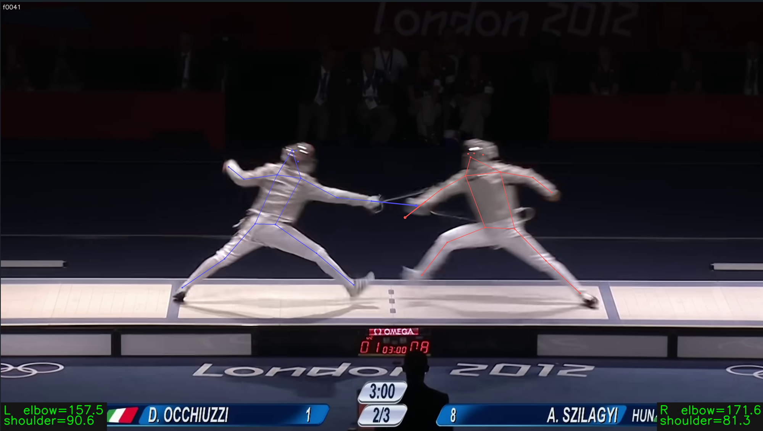
Need improvement: sword tracking
Sword detection will help a lpt in define the priority of attack
There is no such data set or library to tracking yet
Notes:
The most significant limitation of the current system is its inability to track the sword itself. Weapon tracking would substantially improve the accuracy of attack detection, as the moment of arm extension is more precisely defined by the blade tip trajectory than by joint angles alone. Furthermore, there are fencing scenarios -- such as a parry-riposte -- where the weapon's interaction with the opponent's blade is determinative for priority. Unfortunately, no publicly available dataset or library currently supports reliable sabre sword tracking. This remains an open problem and represents the most impactful avenue for future development.

