Slide 1

Download CCC Test Log Tool Guide
Author: Evan Liu
Version: 3.0

Slide 2
About:
This is a quick download tool for CCC website test logs.（https://cesium.cisco.com/）
The tool can solve the repetitive and tedious steps of manually downloading the log, provide the function of batch downloading the test log to the local, and improve the work efficiency.
Principle of realization:
This tool is developed in Python language. It uses the crawler technology to visit the CCC website and request the background interface of data query to obtain data.
To improve download speed, multiple threads are used, and the default number of concurrent threads is 10, which should be sufficient for most of the requirements.
Matters need attention:
This script is packaged as an EXE executable, so it can only be used on Windows systems.
If you start the tool with a Cisco laptop, you can only login using your CEC account, not any other account.
If the tool is executing and you want to stop downloading, click the Quit button on the tool instead of closing the tool directly.

Slide 3
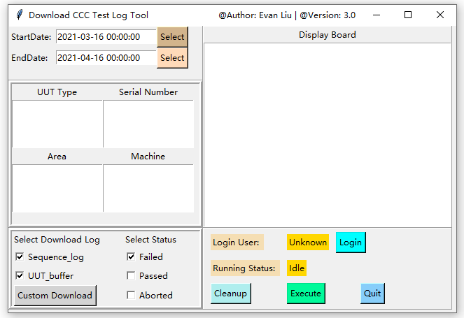
Main Interface
Description of interface layout:
This location is a time control, which defaults to a time range from one month ago to today.
This location is the query control, and the query format is the same as the CCC query.
This location is for the select download type and test status controls, as well as the custom download controls. Sequence_log, UUT_buffer, and Failed are selected by default.
This location is the display control that displays the list of downloaded files after the program is executed.
This location is an action control that provides login, execution, and exit functions, and displays the current status of the tool.
1
4
2
3
5

Slide 4
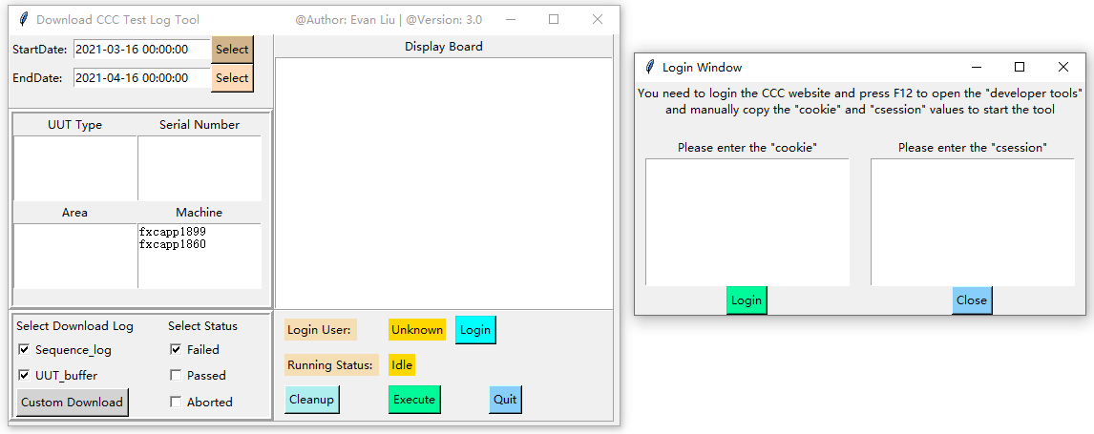
Instructions of Operation Process
First Click the Login button to Login the CEC account, see the next page for details.
Fill in the condition information to query, select the date to query and the type of log to download and test status.
After logging in successfully and filling in the query information, click Execute to launch the tool.
When the program is running, the Running States is changed from the idle state to a scroll bar indicating that it is running.
When the program finishes, the list of downloaded logs will be displayed on the Display Board, and the log files will be saved in the download_results folder in the current directory.

Slide 5
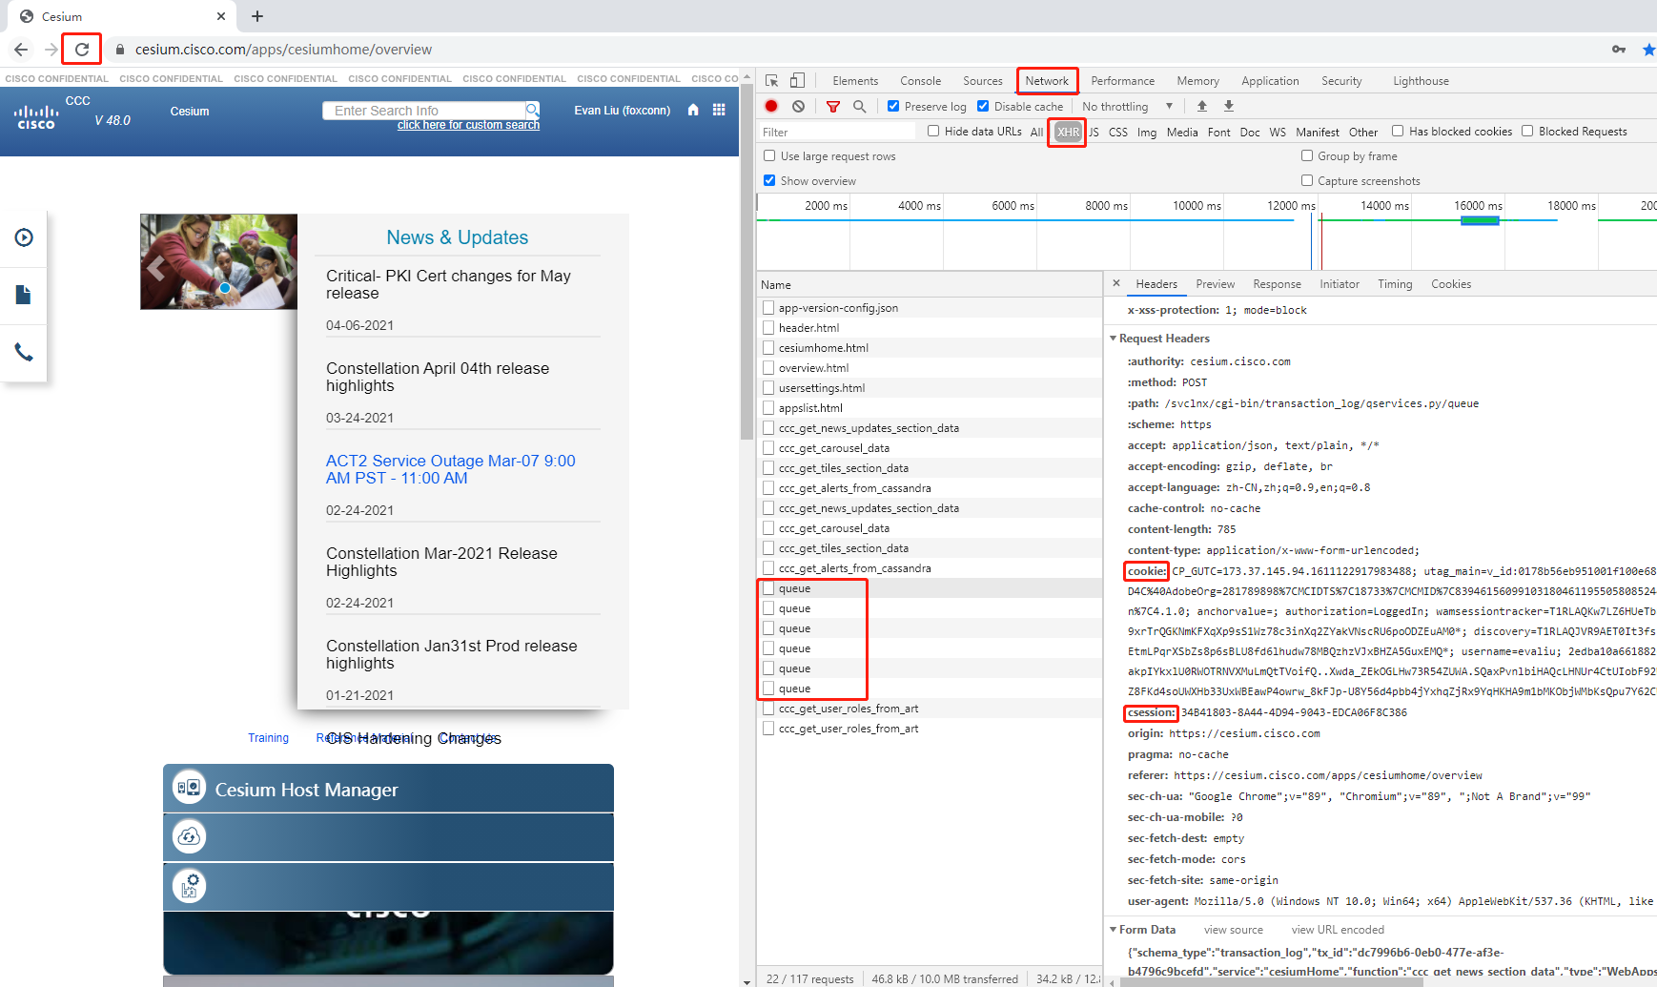
Login method:
Login the CCC website manually using the Google browser (login with your own account), enter the home page, press F12 to open the developer window, then click Network and XHR, press F5 to refresh the page.
Locate the request named queue (you can select anyone) and copy the cookie and csession values into the login input box of the tool.

Slide 6
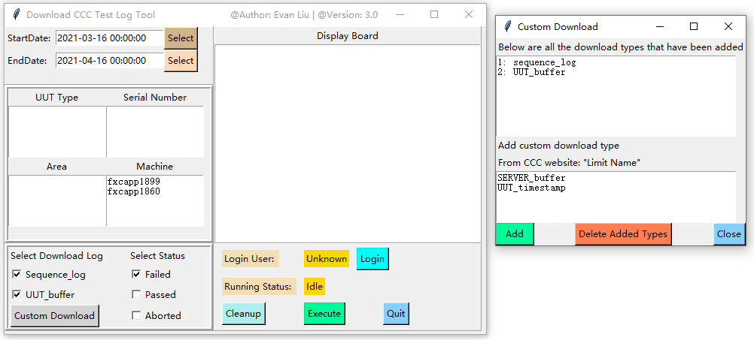
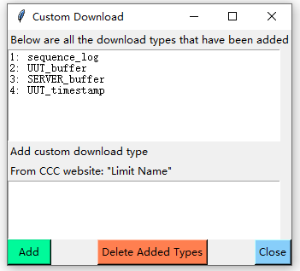
Custom Download method:
If you want to add more log download types, click the Custom Download button.
The download name is taken from the Measures on the CCC website, and the measurement location corresponding to the Limit Name must be the file type, see the next page for details.

Slide 7
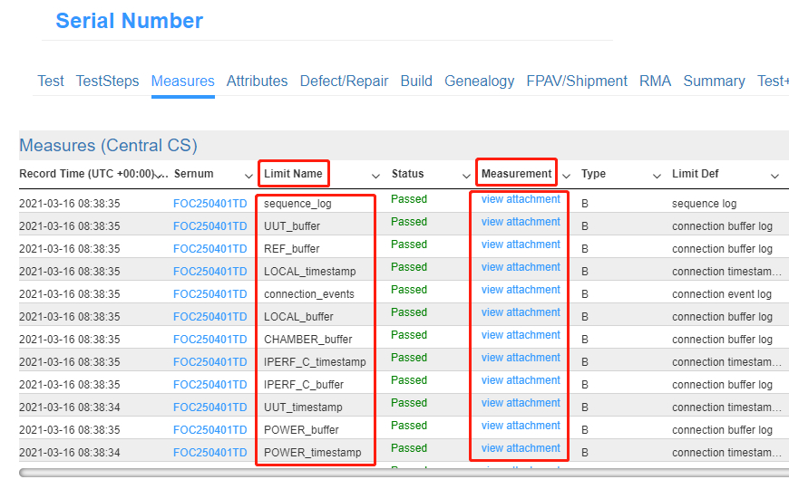
Custom Download method:
3. Add the Limit Name you want to Download to the Custom Download input box in the tool.

Slide 8
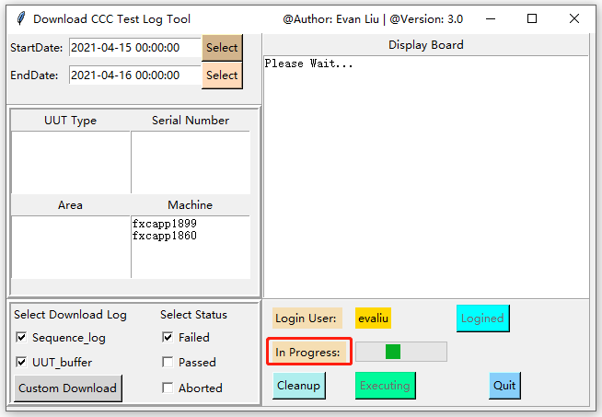
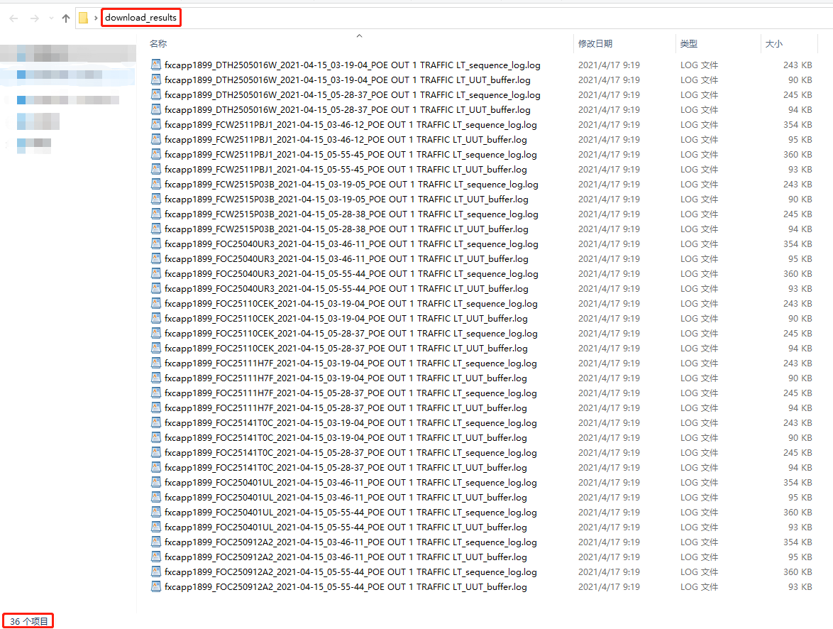
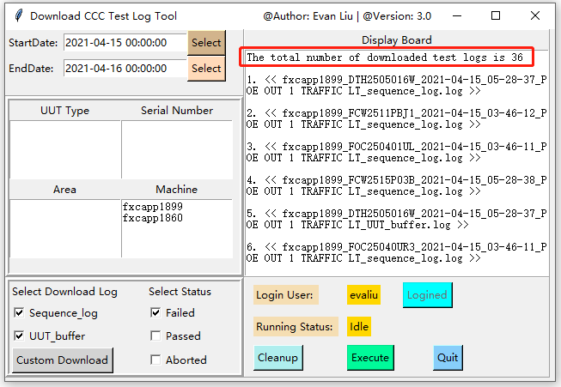
Complete execution process
Log Name Format：
Server_SN_RecTime_TestStatus(PASS or FailName)_MeasureType.log

