Slide 1

LEARN PYTHON FROM Scratch with Prospero.
Prospero O. Anuforo:
Python, R, Julia Maverick | AI Researcher | Biochemist |
Computational Biologist | Writer | Poet | Scicommer |
Tel: +2348132963184

Slide 2
The Way of the program.
DAY 1 :

Slide 3
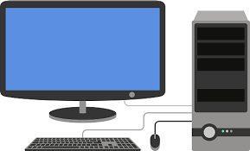
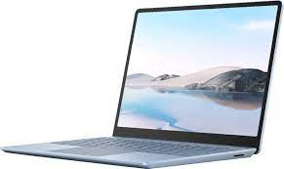
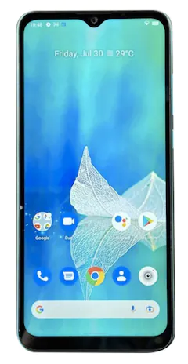
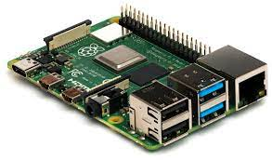
COMPUTER SYSTEMS
LAPTOP
DESKTOP
RASPBERRY PI
ANDROID PHONE

Slide 4
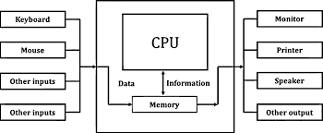
Computer hardware architecture.

Slide 5
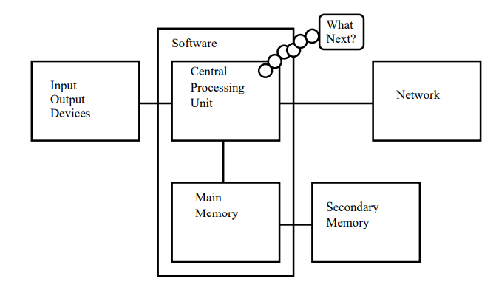
Computer hardware architecture.

Slide 6
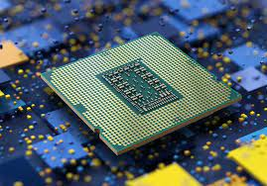
CENTRAL PROCESSING UNIT (CPU)
A central processing unit, or CPU, is a piece of hardware that enables your computer to interact with all of the applications and programs installed. A CPU interprets the program’s instructions and creates the output that you interface with when you’re using a computer.

Slide 7
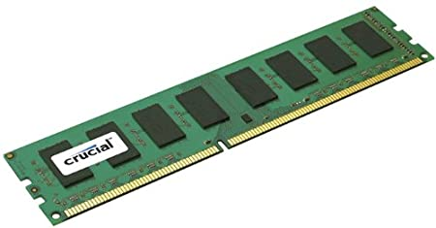
Random access memory (ram)
Alternatively referred to as main memory, primary memory, or system memory, RAM (random-access memory) is a hardware device that allows information to be stored and retrieved on a computer.
Currently, the largest single stick of RAM is 128 GB.

Slide 8
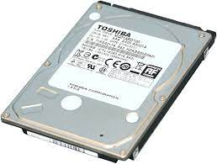
Read-only memory
Read-only memory (ROM) is a type of storage medium that permanently stores data on personal computers (PCs) and other electronic devices.

Slide 9
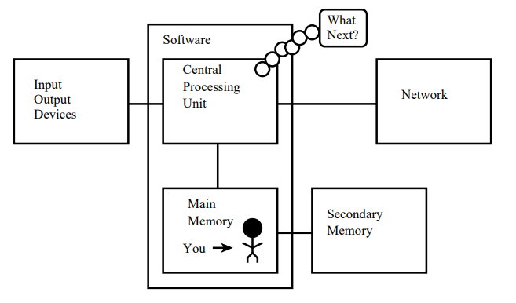
YOUR POSITION IN THE SCHEME OF THINGS

Slide 10
What is a program?
A program is a sequence of instructions that specifies how to perform a computation. The computation might be something mathematical, such as solving a system of equations or finding the roots of a polynomial, but it can also be a symbolic computation, such as searching and replacing text in a document or something graphical, like processing an image or playing a video.
You use a programming language to create programs.

Slide 11
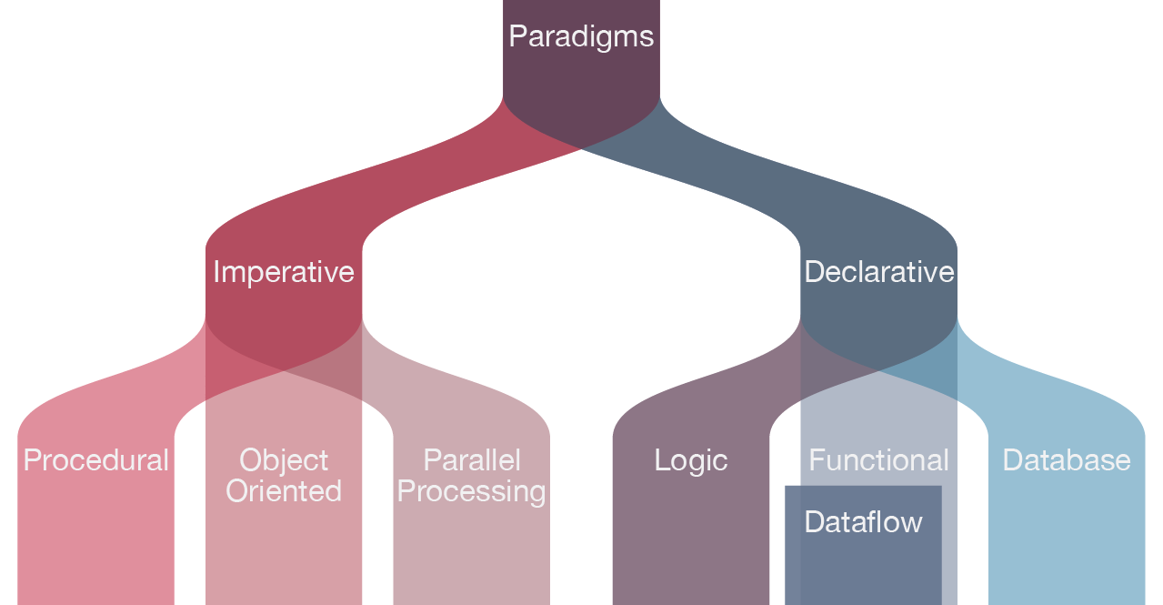
Types of programming languages

Slide 12
Python programming language
Python is an interpreted, high-level, general-purpose programming language.
Created by Guido van Rossum and first released in 1991, Python’s design philosophy emphasizes code readability with its notable use of significant whitespace. Its language constructs and object-oriented approach aim to help programmers write clear, logical code for small and large-scale projects.

Slide 13
INTERPRETED language VS COMPILED LANGUAGE
Python is commonly classified as an interpreted language. Another term used to describe an interpreted language is scripting language. To run a computer program on the CPU, the program must be in a format that the CPU understands, namely machine code. Interpreted languages do not compile directly to machine code, instead, there is a layer above, an interpreter that performs this function.

Slide 14
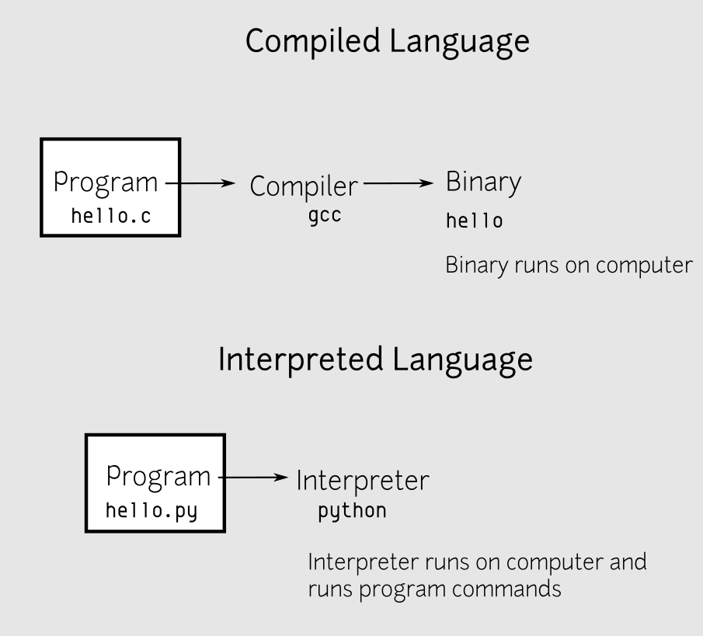

Slide 15
THE PYTHON INTERPRETER
Python has an interactive interpreter or REPL (Read Evaluate Print Loop). This is a loop that waits until there is input to read in, then evaluates it (interprets it), and prints out the result. When you run the python3 executable by itself, you launch the interactive interpreter in Python. Other environments, such as IDLE, also embed an interactive interpreter.

Slide 16
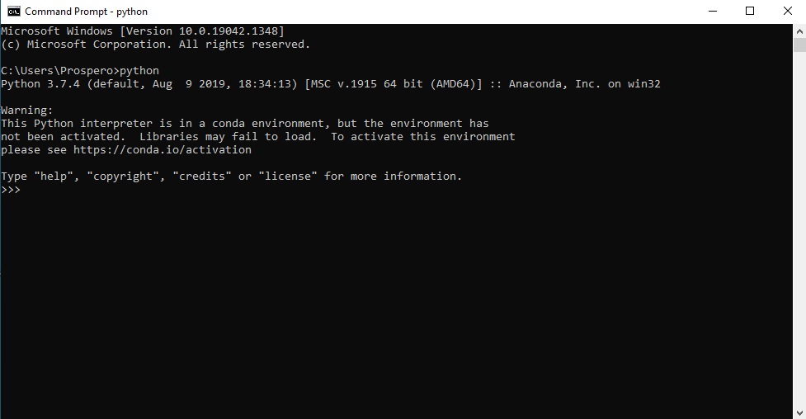
Python shell

Slide 17
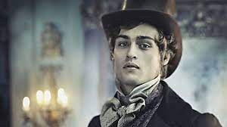
WHO IS pip?
In Python, Pip is a recursive acronym which stands for Pip Installs Packages or Pip Installs Python. It can also mean Preferred Installer Package. Pip is Python’s package manager for python libraries.
The boy from George Orwell’s novel, Great Expectations?
To check if pip was installed with your Python Interpreter, open up your system terminal and type:
pip --version

Slide 18
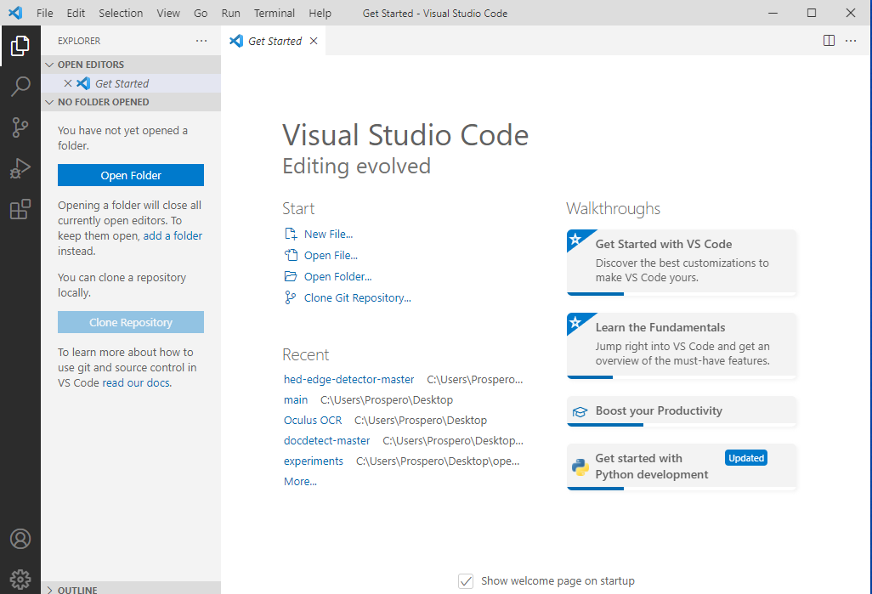
Have you met vscOde?
Visual Studio Code is one of the many code editors for writing code.
Here, we configure it to be able handle python code by installing the Python extension and other automation tools to make our coding easier and a lot more interesting.
Don’t forget to ask me about the difference between an IDE and an IDLE, ok?

Slide 19
Installing python extensions
Python Extension for VSCode
AREPL for Python
Kite extension
autoDocstring

Slide 20
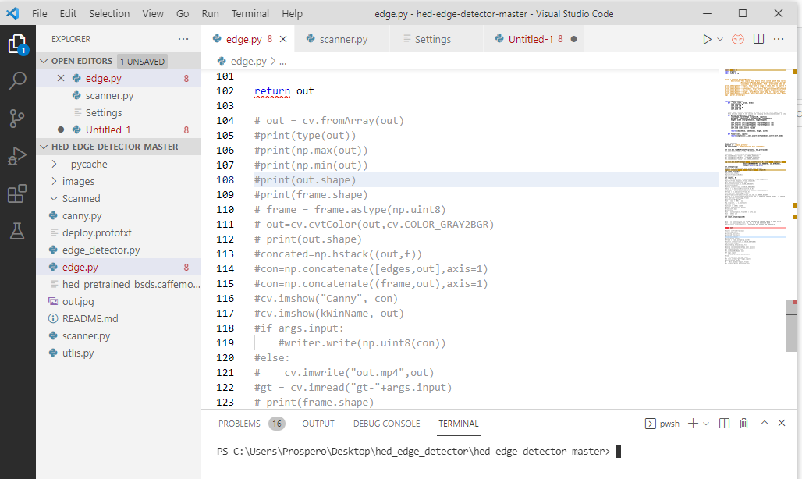

“Dot py” files.
“ dot py” is the python extension. Just the way you use “dot txt” for text files and “ dot doc” for document files.
In Python, a dot py file with executable code in it is called a MODULE.
We will discuss more about the Module in subsequent classes, when we have learnt enough to populate a file with.

Slide 21
Basic mathematical operations in python
Addition
Subtraction
Multiplication
Division
Modulus
Exponentiation
Floor division
Addition Operator : In Python, + is the addition operator. It is used to add 2 values.
EXAMPLE:
Val_1 = 1
Val_2 = 3
Val_3 = Val_1 + Val_2

Slide 22
Subtraction Operator : In Python, – is the subtraction operator. It is used to subtract the second value from the first value.
EXAMPLE:
Val_1 = 7
Val_2 = 3
Val_3 = Val_1 - Val_2
Multiplication Operator : In Python, * is the multiplication operator. It is used to find the product of 2 values..
EXAMPLE:
Val_1 = 5
Val_2 = 3
Val_3 = Val_1 * Val_2

Slide 23
Division Operator : In Python, / is the division operator. It is used to find the quotient when first operand is divided by the second.
EXAMPLE:
Val_1 = 6
Val_2 = 3
Val_3 = Val_1 / Val_2
Modulus Operator : In Python, % is the modulus operator. It is used to find the remainder when first operand is divided by the second. EXAMPLE:
Val_1 = 7
Val_2 = 3
Val_3 = Val_1 % Val_2

Slide 24
Exponentiation Operator : In Python, ** is the exponentiation operator. It is used to raise the first operand to power of second.
EXAMPLE:
Val_1 = 2
Val_2 = 3
Val_3 = Val_1 ** Val_2
Floor division : In Python, // is used to conduct the floor division. It is used to find the floor of the quotient when first operand is divided by the second.
EXAMPLE:
Val_1 = 6
Val_2 = 3
Val_3 = Val_1 // Val_2

Slide 25
Reference books
How to Think Like a Computer Scientist: Learning with Python 3 Documentation Release 3rd Edition. Peter Wentworth, Jeffrey Elkner, Allen B. Downey and Chris Meyers.
Python for Informatics Exploring Information. Charles Severance.
Think Python. Allen B. Downey.
Learn to Program with Python 3: A Step-by-Step Guide to Programming — Second Edition — Irv Kalb.
Treading on Python Series: Illustrated Guide to Python 3. Matt Harrison.
Introduction to Computation and Programming Using Python with Application to Understanding Data. John V. Guttag.

