Slide 1
Lesson 8 The List Data Structure:
Sequential Unfoldment of
Natural Law

Slide 2
Wholeness Statement
Lists are a way of collecting objects of the same type. Everything in creation is the same. The unity of everything is really the more powerful quality.

Slide 3
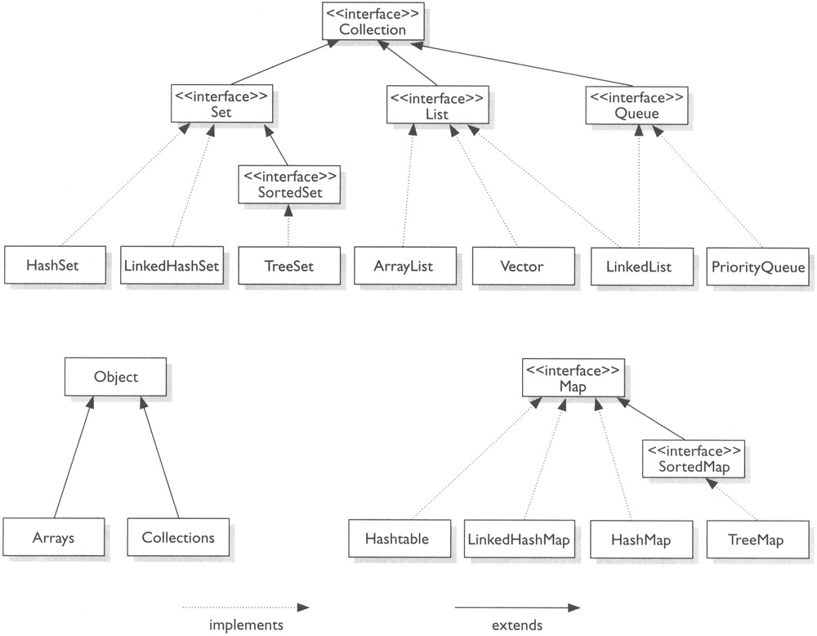
Java Collections framework interface and class hierarchy
Stack

Slide 4
List
A list is a popular data structure to store data in sequential order.
For example, a list of students, a list of available rooms, a list of cities, and a list of books, etc. can be stored using lists.
The common operations on a list are usually the following:
· Retrieve an element from this list.
· Insert a new element to this list.
· Delete an element from this list.
· Find how many elements are in this
list.
· Find if an element is in this list.
· Find if this list is empty.

Slide 5
List
There are two ways to implement a list.
ArrayList
LinkedList

Slide 6
Contd..
An array is a collection of individual data values with two distinguishing characteristics:
1. An array is ordered. You must be able to count off the individual components of an
array in order: here is the first, here is the second, and so on.
2. An array is homogeneous. Every value stored in an array must be of the same type.
Thus, you can define an array of integers or an array of floating-point numbers but not
an array in which the two types are mixed.

Slide 7
Contd..
array has two fundamental properties that apply to the array as a whole:
• The element type, which is the type of value that may be stored in the elements of the
array
• The length, which is the number of elements the array contains

Slide 8
Contd..
Array is a fixed-size data structure. Once an array is created, its size cannot be changed.
Nevertheless, you can still use array to implement dynamic data structures. The trick is to create a new larger array to replace the current array if the current array cannot hold new elements in the list.
Initially, an array, say data of Object[] type, is created with a specified size.
When inserting a new element into the array, first ensure there is enough room in the array. If not, create a new array with the size as twice as the current one.
Copy the elements from the current array to the new array. The new array now becomes the current array.

Slide 9
Down Side of Arrays
We cannot perform following operations on arrays
Increase or decrease its length , which is fixed
Add an element at a specified position without shifting the other elements to make a room
Remove an element at a specified position without shifting the other elements to fill in the resulting gap.

Slide 10
Array List Class
• The ArrayList class IS COMPLETELY DIFFERENT THAN an array
– It is a more flexible way to store data
– ArrayList can grow automatically as needed • Has capacity that is increased when needed • Has size() method that returns actual
number of elements in the ArrayList

Slide 11
Contd..
– ArrayList can hold elements of different types
• As long as each is an Object (reference),
• Technically an ArrayList cant hold a basic type
(int, double, etc.)
• But, conversion of primitive to an object happens automatically. This is called auto-boxing.
• Wrapper classes allow objects (e.g., Boolean or Double) that hold basic types (e.g. boolean or double)

Slide 12
Array List
ArrayList class is not in the core Java language
It is in package java.util, which we must import:
import java.util.*; // At top of program
ArrayLists are slightly slower than arrays
– This matters only in large numerical applications
ArrayList class has many methods that provide functionality beyond what arrays provide
• You can declare an ArrayList as containing objects of a particular type.
Example: ArrayList<Point> pList = new ArrayList<Point>( );

Slide 13
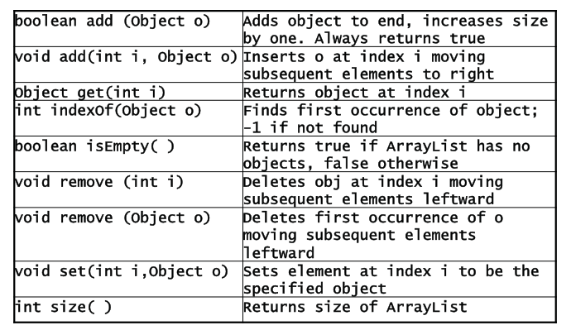
Some Methods of ArrayList

Slide 14
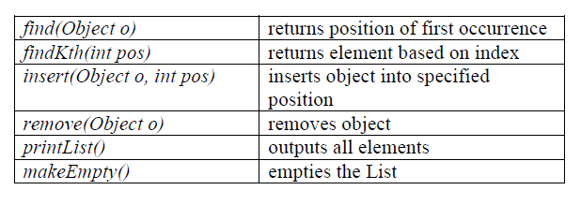
Typical operations:

Slide 15
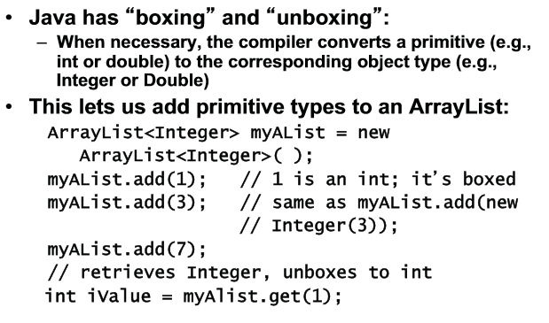
Automatic conversion of primitives to objects

Slide 16
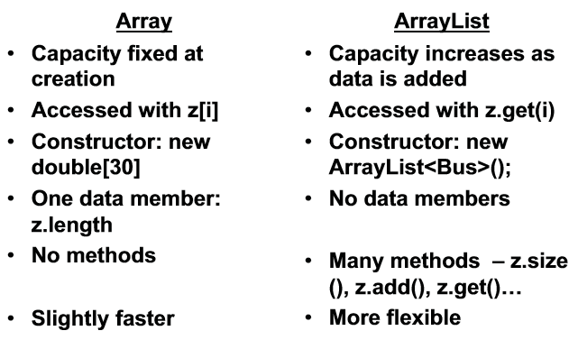
Arrays and ArrayLists

Slide 17
Observations
The ArrayList is a standard object class, which means that each of its operations is invoked as a method call.
An object that can grow and shrink while your program is running (unlike arrays, which have a fixed length once they have been created).
ArrayList<BaseType> aList =
new ArrayList<BaseType>();

Slide 18
Contd..
ArrayList<Employee> staff=new ArrayList<Employee>();
In Java 7 the type parameter can be omitted from Right Hand Side
ArrayList<Employee> staff=new ArrayList<>();
This is called diamond syntax.

Slide 19
Wrapper classes:
Wrapper classes is used to convert primitive data values into java objects. for 8 primitive data types java has 8 corresponding wrapper classes. All these classes implementing comparable interface.

Slide 20
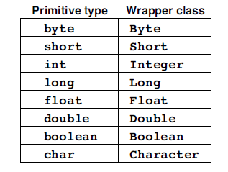
Wrapper Class
Allows them to be stored in a list
Super Class is Number Class
Notes:
20

Slide 21
Contd..
Each of the wrapper classes has a constructor that creates a new object from the
corresponding primitive type. For example, if the variable n is an int, the declaration
Integer nAsInteger = new Integer(n)

Slide 22
Contd..
The wrapper classes also include several static methods that you are likely to find useful, particularly those in the Integer class that support numeric conversion in arbitrary bases.
To convert the integer 50 into a hexadecimal string, you would need to Write
Integer.toString(50, 16)

Slide 23
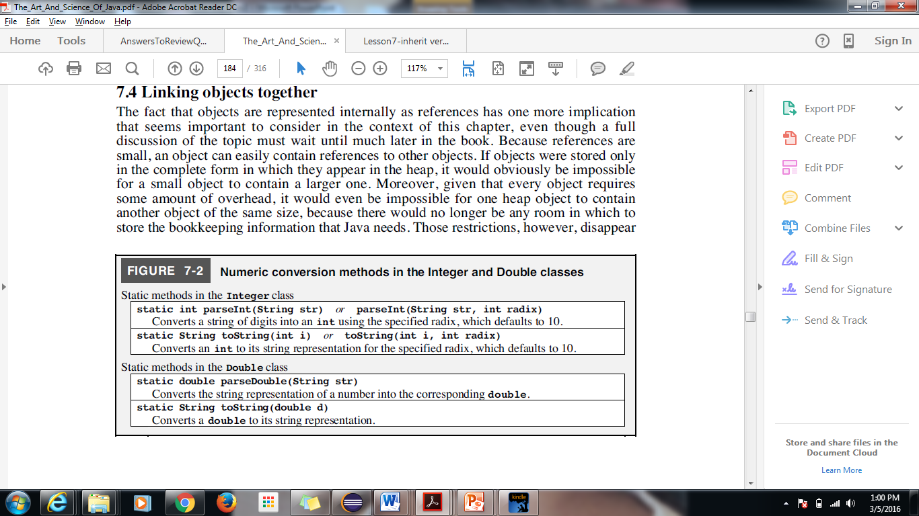
Numeric Conversion methods in the Integer and Double Classes

Slide 24
Contd..
Creating a Generic Collection
CollectionClassName<E> variable=new CollectionClassName<E>();
E.g.
List<String> myList=new ArrayList<String>();
ArrayList<Integer> numList=new ArrayList<Integer>();
Explaination-An initially empty CollectionClassName<E> object is created that can be used to store references to object of type E(the type parameter).The actual object type stored in an object of type CollectionClassName<E> is specified when the object is created. If the CollectionClassName is an interface, the CollectionClassName on the right must be class that implements it or must be same class or a subclass of the one on the left.

Slide 25
Creating an ArrayList
An initial capacity can be specified when creating an ArrayList
The following code creates an ArrayList that stores objects of the base type String with an initial capacity of 20 items
ArrayList<String> list = new ArrayList<String>(20);
Specifying an initial capacity does not limit the size to which an ArrayList can eventually grow
Note that the base type of an ArrayList is specified as a type parameter
Notes:
25

Slide 26
Dynamic Array
Java’s ArrayList class provides a more robust abstraction, allowing a user to add elements to the list, with no apparent limit on the overall capacity. To provide this abstraction, Java relies on an algorithmic sleight of hand that is known as a dynamic array.

Slide 27
Implementing a Dynamic Array
The key is to provide means to “grow” the array A, when more space is needed.
we cannot actually grow that array, as its capacity is fixed. Instead, when a call to add a new element risks overflowing the current array, we perform the following additional steps:
1. Allocate a new array B with larger capacity.
2. Set B [k]=A[k], for k=0, . . . ,n−1, where n denotes current number of items.
3. Set A = B, that is, we henceforth use the new array to support the list.
4. Insert the new element in the new array.

Slide 28
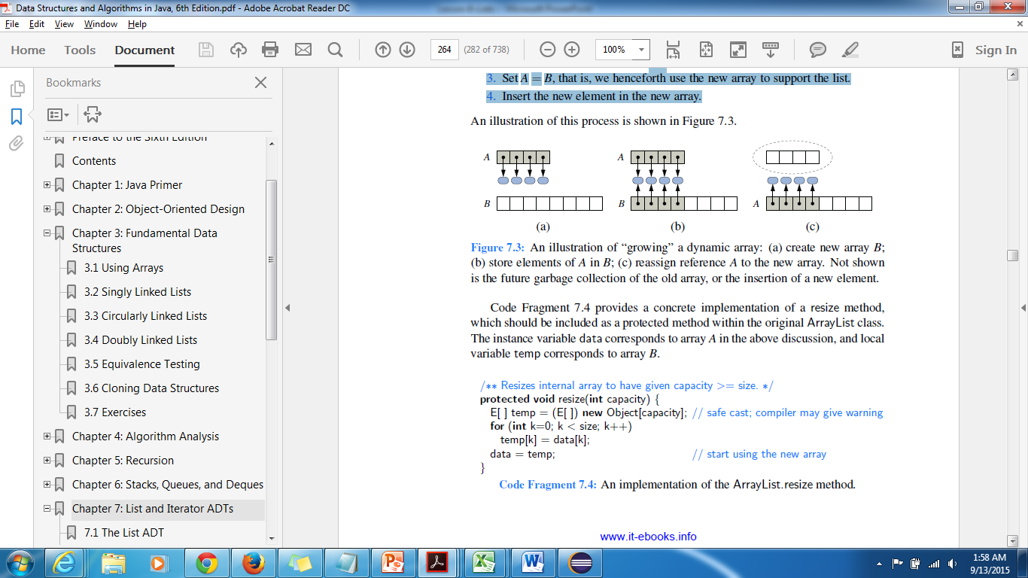
Contd..
An illustration of the “growing” dynamic array : (a) create new array B; (b) store elements of A in B; (c) reassign reference A to the new Array.

Slide 29
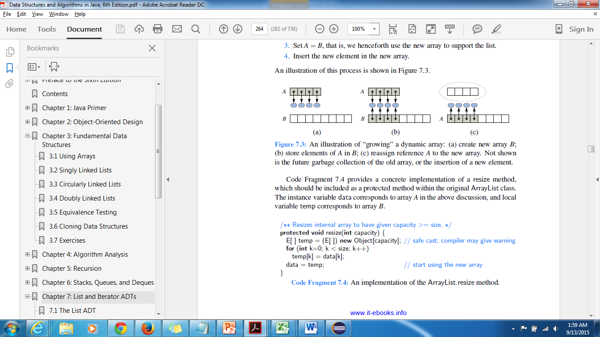
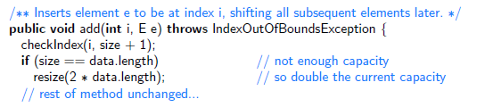
Contd..
An implementation of the ArrayList.resize method.

Slide 30
Adding elements to an ArrayList
The add method is used to add an element at the “end” of an ArrayList
public boolean add(Object o);
list.add("something");
The method name add is overloaded
void add(int index, Object element) This version that allows an item to be added at any currently used index position or at the first unused position
Notes:
30

Slide 31
How many elements?
The size method is used to find out how many indices already have elements in the ArrayList
int howMany = list.size();
The set method is used to replace any existing element, and the get method is used to access the value of any existing element
list.set(index, "something else");
String thing = list.get(index);
size is NOT capacity
size is the number of elements currently stored in the ArrayList
Capacity is the maximum number of elements which can be stored. Capacity will automatically increase as needed
Notes:
31

Slide 32
ArrayList code Example
// Note the use of Integer, rather than int
public static void main( String[ ] args)
{
ArrayList<Integer> myInts = new ArrayList<Integer>(25);
System.out.println( “Size of myInts = “ + myInts.size());
for (int k = 0; k < 10; k++)
myInts.add( 3 * k );
myInts.set( 6, 44 );
System.out.println( “Size of myInts = “ + myInts.size());
for (int k = 0; k < myInts.size(); k++)
System.out.print( myInts.get( k ) + “, “ );
}
// output
Size of myInts = 0
Size of myInts = 10
0, 3, 6, 9, 12, 15, 44, 21, 24, 27

Slide 33
Methods in the Class ArrayList with Example
Lesson-8-ListMethods.doc
Notes:
33

Slide 34
Demo code
Array.java
Array1.java
ArrayListDemo.java
TallySale.java
ArrayStructures.java(User Implementation)

Slide 35
Iterator
An iterator is a software design pattern that abstracts the process of scanning through a sequence of elements, one element at a time. The underlying elements might be stored in a container class, streaming through a network, or generated by a series of computations.
It enables to cycle through a collection, obtaining or removing elements.
Java defines the java.util.Iterator interface
with the following two methods:

Slide 36
Iterator
1.hasNext( ): Returns true if there is at least one additional element in the sequence, and false otherwise.
2.next( ): Returns the next element in the sequence.
3.while (iter.hasNext( )) {
String value = iter.next( );
System.out.println(value);
}
4.remove( ): Removes from the collection the element returned by the most recent call to next( ). Throws an IllegalStateException if next has not yet been called, or if remove was already called since the most recent call to next.
If removal is not supported, an UnsupportedOperationException is conventionally
thrown.
Notes:
36

Slide 37
Contd..
For ArrayLists, any approach to iterating through elements is ok,
but for LinkedLists, the get(int pos) operation is very slow, so the Iterator or for each approach is preferable

Slide 38
Contd..
We note that the iterator’s remove method cannot be invoked when using the for-each loop syntax. Instead, we must explicitly use an iterator. As an example,
the following loop can be used to remove all negative numbers from an ArrayList of floating-point values.
ArrayList<Double> data; // populate with random numbers (not shown)
Iterator<Double> walk = data.iterator( );
while (walk.hasNext( ))
if (walk.next( ) < 0.0)
walk.remove( );

Slide 39
Iterators
Java’s lists can be traversed as :
1. Loop through the list
Object next = null;
for(int i = 0; i < list.size(); ++i) {
next = list.get(i);
//do something with next
}
2. Use an Iterator
Object next2 = null;
ArrayList<String> list = new ArrayList<String>(
Arrays.asList("Hello", "Welcome", "Java", "Object", "Array", "String", "Inheritance"));
Iterator it = list.iterator();
while(it.hasNext()) {
nextitem = it.next();
System.out.println(nextitem);
}
Notes:
39

Slide 40
The Iterable Interface and “for each” Loops
New in Java 8: A default method forEach was added to the Iterable interface. Consequently, any Java library class that implements Iterable, as well as any user-defined class that implements Iterable, has automatic access to this new method. The forEach method takes a lambda expression of the form x -> function(x) where function(x) does not return a value, like System.out.println(x).
List<String> javaList = new ArrayList<>();
javaList.add(“Bob”);
javaList.add(“Carol”);
javaList.add(“Steve”);
javaList.forEach( name -> System.out.println(name));
//output
Bob
Carol
Steve

Slide 41
Implementation
Two ways
Java Collections – Linked List
Create by your own without Collection
Notes:
41

Slide 42
Comparable and Comparator Interface

Slide 43
Comparing Objects for Sorting and Searching
1. Java supports sorting of many types of objects. To sort a list of objects, it is necessary to have some “ordering” on the objects.
For example, there is a natural ordering on numbers and on Strings. But what about a list of Employee objects?
2. In practice, we may want to sort business objects in different ways. An Employee list could be sorted by name, salary or hire date.

Slide 44
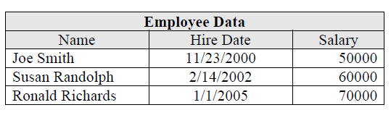
Contd..
3. To accomplish this, you specify your own ordering on a class using the Comparator
interface, whose only method is compare(). Like lists, in j2se5.0, Comparators are parametrized.

Slide 45
Comparator and Comparable are two interfaces in Java API.

Slide 46
Comparable Interface:
Comparable Interface is actually from java.lang package.
It will have a method compareTo(Object obj)to sort objects
public int compareTo(Object obj){ }
Comparable interface used for natural sorting these is the reason all wrapper classes and string class implementing this comparator and overriding compareTo(Object obj) method.
So in String and all wrapper classes compareTo(Object obj) method is implemented in such way that it will sort all objects.

Slide 47
Contd..
One of the classes that implements Comparable is String: int compareTo(String t)
Given a String s and another String t, s.compareTo(t) returns
➢a positive integer if s is "greater than" t
➢a negative integer if s is "less than" t
➢zero, if s and t are equal as Strings

Slide 48
The Comparable interface defines the compareTo method for comparing objects.
package java.lang;
public interface Comparable<E>{
public int compareTo(E o);
}
The compareTo method determines the order of this object with the specified object o and returns a negative integer, zero, or a positive integer if this object is less than, equal to, or greater than object o.

Slide 49
String class:
If we observe String class it is implementing comparable interface.
If compareTo(String str) methods returns 0 : both strings are equal
If compareTo(String str) method returns 1: string is lexicographically greater than the string argument
If compareTo(String str) method returns -1: string is lexicographically less than the string argument

Slide 50
public class StringCompareDemo {
public static void main(String [] args){
String str1="comparable";
String str2="comparator";
int value=str1.compareTo(str2);
if(value==0){
System.out.println("Strings are equal");
}
else{
System.out.println("Strings are not equal");
} }}
Output:
Strings are not equal

Slide 51
example on Integer wrapper class
public class IntegerComparableDemo {
public static void main(String [] args){
// compares two Integer objects numerically
Integer obj1 = new Integer("37");
Integer obj2 = new Integer("37");
int retval = obj1.compareTo(obj2);
if(retval > 0) {
System.out.println("obj1 is greater than obj2");
}
else if(retval < 0) {
System.out.println("obj1 is less than obj2");
}
else {
System.out.println("obj1 is equal to obj2");
}}}
Output:
obj1 is equal to obj2;

Slide 52
import java.util.ArrayList; import java.util.Collections; import java.util.Iterator; public class Employee implements Comparable { String name; int id; public String getName() { return name; } public void setName(String name) { this.name = name; } public int getId() { return id;} public void setId(int id) { this.id = id; } public Employee(String name, int id) { this.name=name; this.id=id; } | @Override public int compareTo(Object in) { return new Integer(this.id).compareTo(((Employee)in).id);} public static void main(String[] args) {Employee e1= new Employee("xyz", 37); Employee e2= new Employee("abc", 46); Employee e3= new Employee("sai", 38); ArrayList al= new ArrayList(); al.add(e1); al.add(e2); al.add(e3); Collections.sort(al); Iterator itr= al.iterator(); while (itr.hasNext()) { Employee em = (Employee) itr.next(); System.out.println(em.getId()+" "+em.getName()); }}} Output ..37 xyz 38 sai 46 abc

Slide 53
Comparator:
Comparator Interface is actually from java.util package.
Comparator can be used to compare the objects of a class that doesn’t implement Comparable.
It will have a method compare(Object obj1, Object obj2)to sort objects
public int compare(Object obj1, Object obj2){ }
Comparator interface used for customized sorting.
Will place sorting logic in other class so that its easy to change.
An example program which will sort employee objects by name

Slide 54
Comparator Interface
A comparator object is an instance of a class that implements the Comparator interface
To implement the Comparator interface, we must implement its compare method.
To do so, define a class that implements the java.util.Comparator<T> interface.
The Comparator<T> interface has one method.
public int compare(T element1, T element2);
Returns a negative value if element1 is less than element2,
a positive value if element1 is greater than element2,
and zero if they are equal.

Slide 55
Contd..
4. The compare() method is expected to behave in the following way (so it can be used in conjunction with the Collections API):
For objects a and b,
compare(a,b) returns a negative number if a is “less than” b
compare(a,b) returns a positive number if a is “greater than” b
compare(a,b) returns 0 if a “equals” b

Slide 56
Contd..
5. If compare is not used in a “sensible” way, it will lead to unexpected results when used by utilities like Collections.sort.
The compare contract It must be true that:
a is “less than” b if and only if b is “greater than” a
if a is “less than” b and b is “less than” c, then a must be “less than” c.
It should also be true that the Comparator is consistent with equals; in other words:
compare(a,b) == 0 if and only if a.equals(b)

Slide 57
Contd..
If a Comparator is not consistent with equals, problems can arise when using different container classes. For instance, the contains method of a Java List uses equals to decide if an object is in a list. However, containers that maintain the order relationship among elements (like TreeSet – more on this one later) check whether the output of compare is 0 to implement contains. X

Slide 58
Observations
Writing a compareTo method is similar to writing an equals method, but there are a few key differences.
compareTo method is not declared in Object. Rather, it is the sole method in the Comparable interface.
It is similar in character to Object’s equals method, except that it permits order comparisons in addition to simple equality comparisons, and it is generic.
Because the Comparable interface is parameterized, the compareTo method is statically typed, so you don’t need to type check or cast its argument. If the argument is of the wrong type, the invocation won’t even compile. If the argument is null, the invocation should throw a NullPointerException, and it will, as soon as the method attempts to access its members.

Slide 59
Contd..
ClassCastException if two object
references being compared refer to objects of different classes.
The equality test imposed by the
compareTo method should generally return the same results as the equals method. If this provision is obeyed, the ordering imposed by the compareTo method is said to be consistent with equals. If it’s violated, the ordering is said to be inconsistent with equals.

Slide 60
Note
The general contracts for these interfaces are defined in terms of the equals method, but sorted collections use the equality test imposed by compareTo in place of equals

Slide 61
Parameter | Comparable | Comparator
Package | java.lang.Comparable | java.util.Comparator
Sorting logic | Must be in Same class | Separate class
Method definition | public int compareTo(Object obj) | public int compare(Object obj1, Object obj2)
Method call | Collections.sort(list) | Collections.sort(list, new OtherSortClass())
Purpose | Natural Sorting | Custom Sorting

Slide 62
Methods from Java collections
Java.lang.Comparable<T>
Int compareTo(T other)
Compares this object with other and returns int
Java.util.Arrays
Static void sort(Object[] a)
sorts the elements in the array a .All elements in the array must belong to the classes that implement the Comparable interface and they must be comparable to each other

Slide 63
Contd..
Java.lang.Integer
Static int compare(int x, int y)
Returns a negative integer if x< y, zero if x and y are equal and a positive integer otherwise
Java.lang.Double
Static int compare(double x,double y)
Returns a negative integer if x< y, zero if x and y are equal and a positive integer otherwise

Slide 64
Main Point 3
An Array List encapsulates the random access behavior of arrays, and incorporates automatic resizing and optionally may include support for sorting and searching. Using a style of sequential access instead, Linked Lists improve performance of insertions and deletions, but at the cost of fast element access by index. Random and sequential access provide analogies for forms of gaining knowledge. Knowledge by way of the intellect is always sequential, requiring steps of logic to arrive at an item of knowledge. Knowing by intuition, or by way of ritam-bhara pragya, is knowing the truth without steps – a kind of “random access” mode of gaining knowledge.

Slide 65
Further Reading

Slide 66
In the following description, the notation sgn(expression) designates the mathematical signum function, which is defined to return -1, 0, or 1, according to whether the value of expression is negative, zero, or positive.
• The implementor must ensure sgn(x.compareTo(y)) == -sgn(y.compare-To(x)) for all x and y. (This implies that x.compareTo(y) must throw an exception
if and only if y.compareTo(x) throws an exception.)
• The implementor must also ensure that the relation is transitive: (x.compareTo(y) > 0 && y.compareTo(z) > 0) implies x.compareTo(z) > 0.
• Finally, the implementor must ensure that x.compareTo(y) == 0 implies that sgn(x.compareTo(z)) == sgn(y.compareTo(z)), for all z.
• It is strongly recommended, but not strictly required, that (x.compareTo(y) == 0) == (x.equals(y)). Generally speaking, any class that implements the Comparable interface and violates this condition should clearly indicate thisfact.
The recommended language is “Note: This class has a natural ordering that is inconsistent with equals.”

