Slide 1
Lesson 8
The List Data Structure:
Sequential Unfoldment of
Natural Law

Slide 2
Linked Structure
Creating an object that contains references to other objects is an extremely powerful programming technique. Such objects are said to be linked.
A linked structure is one in which the objects contain references to other objects.
In most cases, these links define the relationships among the objects in the structure.

Slide 3
Link List
Link List is a data structure, which provides
an alternative to an array-based structure.
A linked list, in its simplest form, is a collection of nodes that collectively form a linear sequence.
In a singly linked list, each node stores a reference to an object that is an element of the sequence, as well as a reference to the next node of the list.

Slide 4
Linked List
Link List is useful when we need to insert and remove elements at arbitrary locations and when we do frequent insertions and deletions.
Motivation:
The only value stored in memory is the numeric address, which is sufficient to find the next object in the chain.
The other approach is to use a linked structure. A linked structure consists of nodes. Each node is dynamically created to hold an element. All the nodes are linked together to form a list.
eliminate the need to resize the array
grows and shrinks exactly when necessary
efficient handling of insertion or removal from the middle of the data structure random access is not often needed.

Slide 5
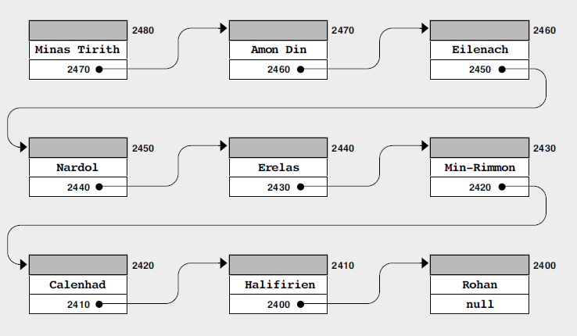
Memory layout for the objects
Courtesy: Art & Science of Java

Slide 6
UML diagram for Node
Node
E data
next

Slide 7
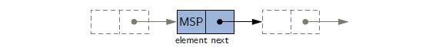
Contd..
Node instance form a singly linked list. The node’s element refers to an object that is an element of the sequence e.g. MSP here, while the nest field refers subsequent node of the linked list(or null if there is no further node)
A link list representation is a collaboration of many objects. The link list instance must keep reference to the first node of the list known as Head
Without an explicit reference to the head, there would be no way to locate that node (or indirectly, any others).
The last node of the list is known as the tail. The tail of a list can be found by traversing the linked list—starting at the head and moving from one node to another by following each node’s next reference.

Slide 8
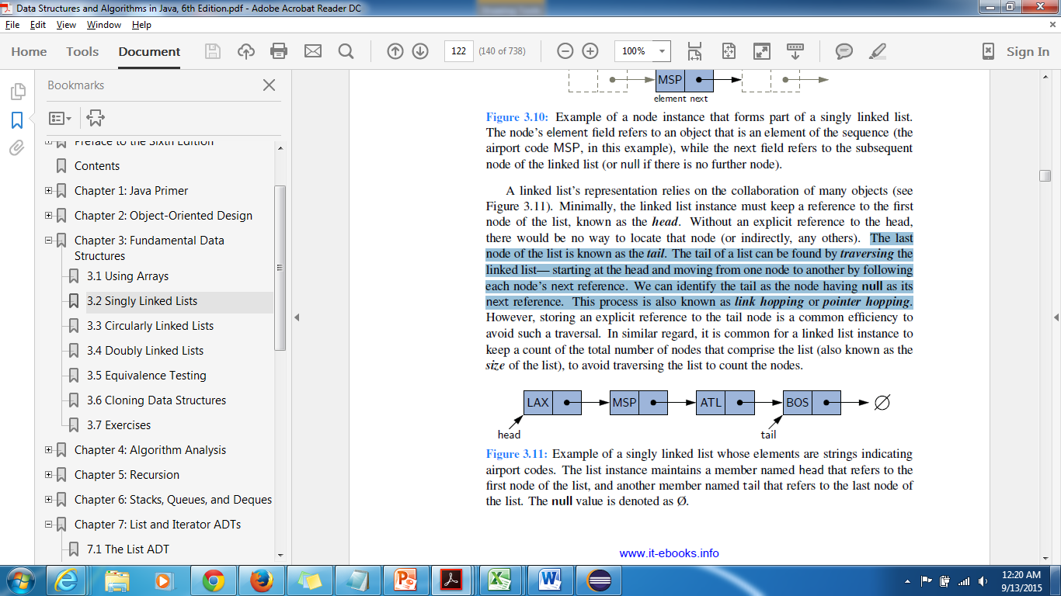
Contd..
Example of single link list. The list instance maintains a member named head that refers to the first node of the list, and another member named tail that refers to the last node of the list.
We can identify the tail as the node having null as its next reference. This process is also known as link hopping or pointer hopping.

Slide 9
Inserting an Element at a
Singly Linked List
String
Step 1
Step 2
value = Bob
Single Link List
Node
Node
Node
Head
next=
next=
next=
null
data =
data =
data =
String
String
String
value = Tom
value = Dick
value = Sam

Slide 10
Inserting an Element at the Head of a Singly Linked List
An important property of a linked list is that it does not have a predetermined fixed size; it uses space proportional to its current number of elements. When using a singly linked list, we can easily insert an element at the head of the list.

Slide 11
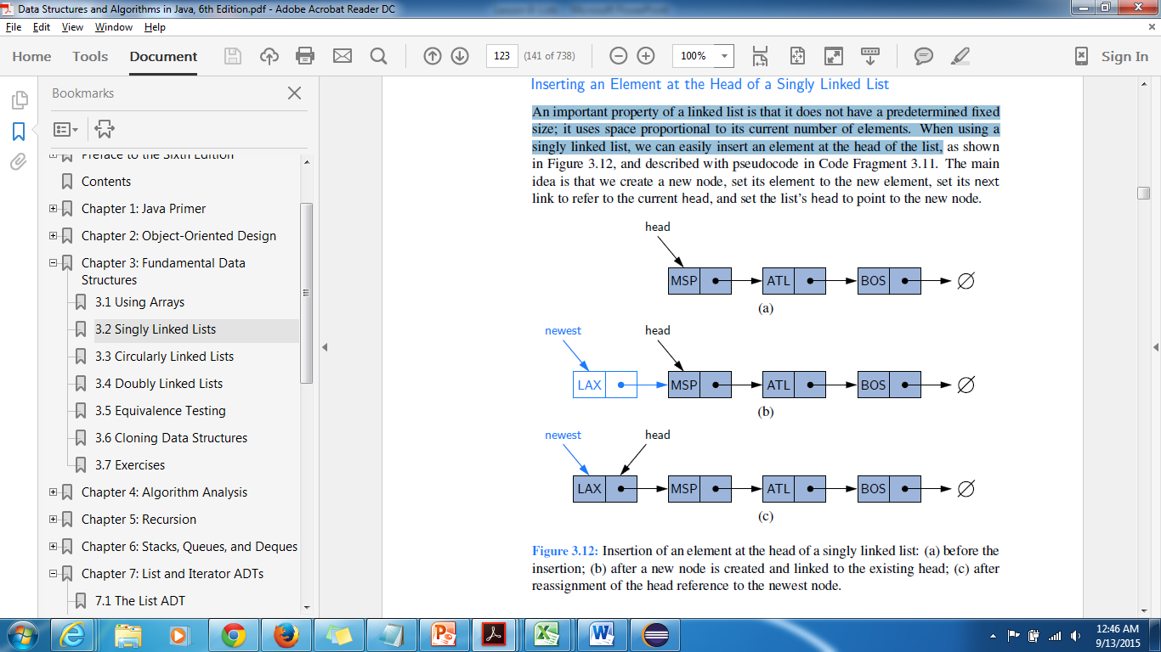
Contd..
Insertion of an element at the head of a singly linked list: (a) before the insertion: (b) after a new node is created and linked to the existing head: (c) after reassignment of the head reference to the newest node.

Slide 12
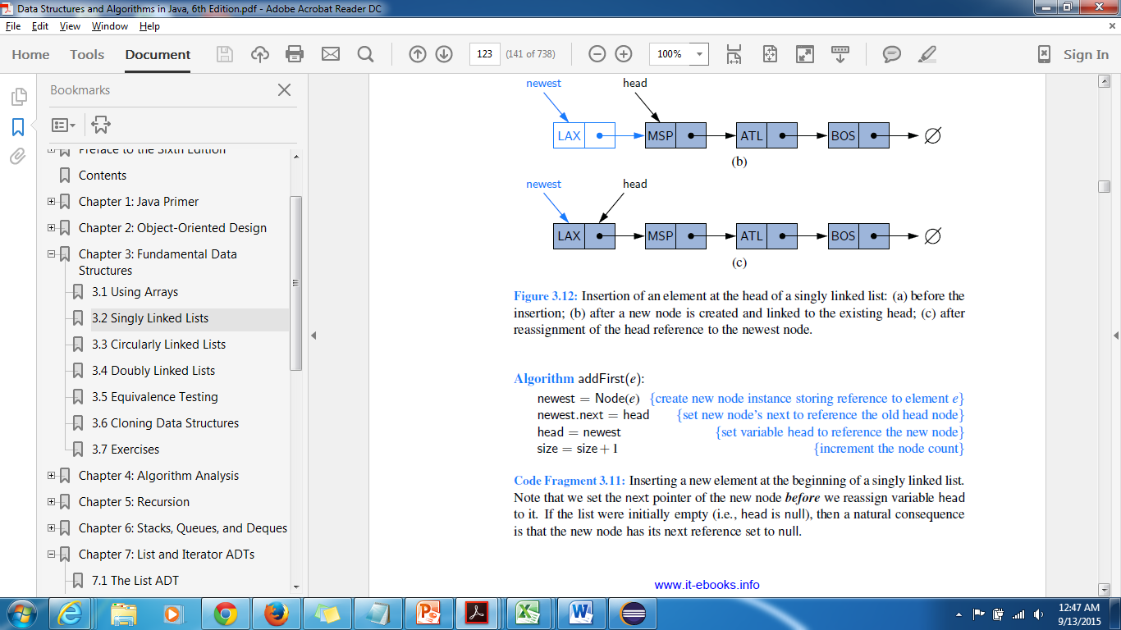
Contd..
Inserting a new element at the beginning of a singly linked list. We set the next pointer of the new node before we reassign variable head to it. If the list were initially empty(i.e. head is null), new node has its next reference set as null.

Slide 13
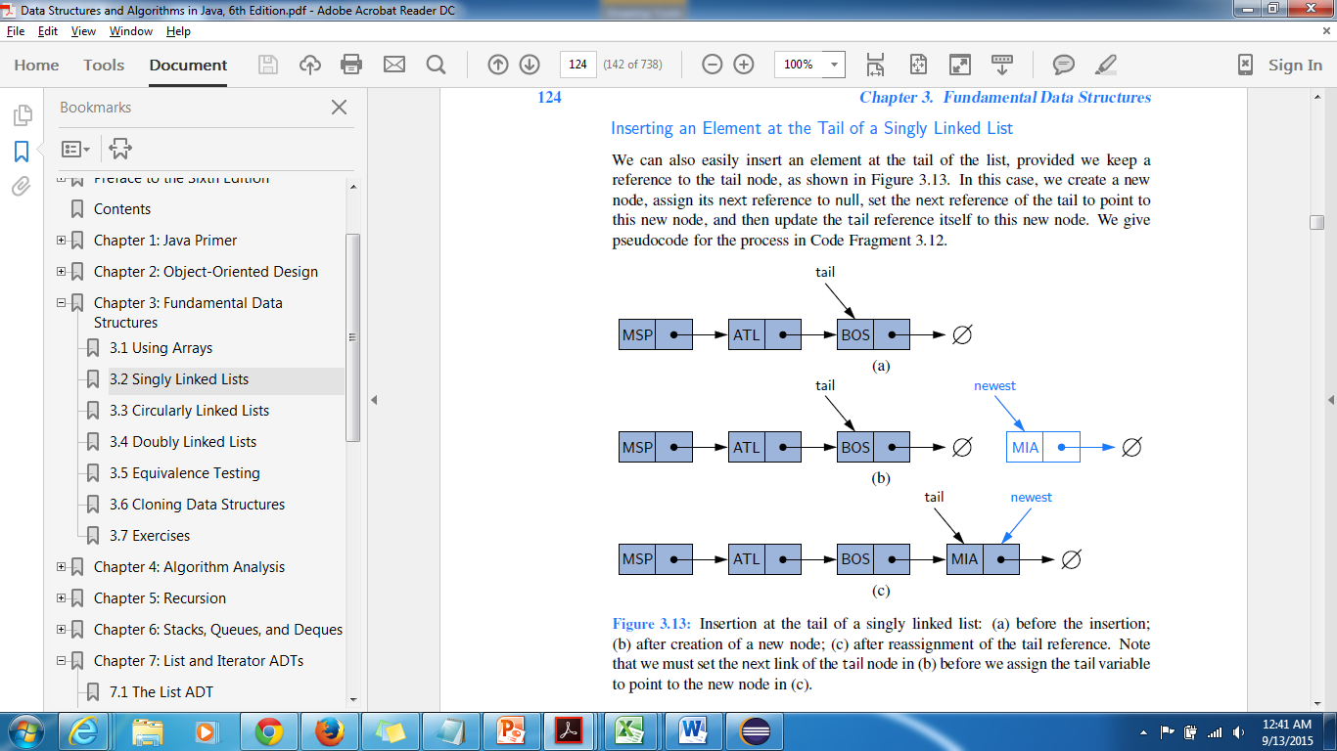
Inserting an Element at the Tail of a Singly Linked List
Here, we create a new node, assign its next reference to null, set the next reference of the tail to point to this new node, and then update the tail reference itself to this new node.
Before Insertion (b)After Creation of a new node
(c) After reassignment of the tail reference.
Note: Set the next link of the tail node in (b) before we assign the tail
variable to point to the new node in (c)

Slide 14
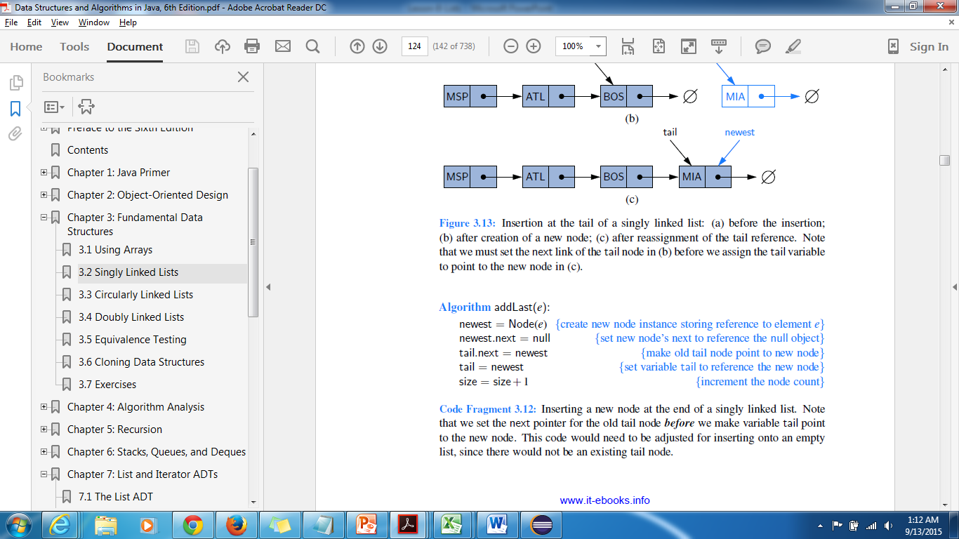
Contd..
Insert a new node at the end of a singly linked list. Note We set the next pointer for the old tail node before we make variable tail point to the new node. This code would need to be adjusted for inserting onto an empty list, since there would not be an existing tail node.

Slide 15
Removing an Element from a Singly Linked List
Removing an element from the head of a singly linked list is essentially the reverse
operation of inserting a new element at the
head.

Slide 16
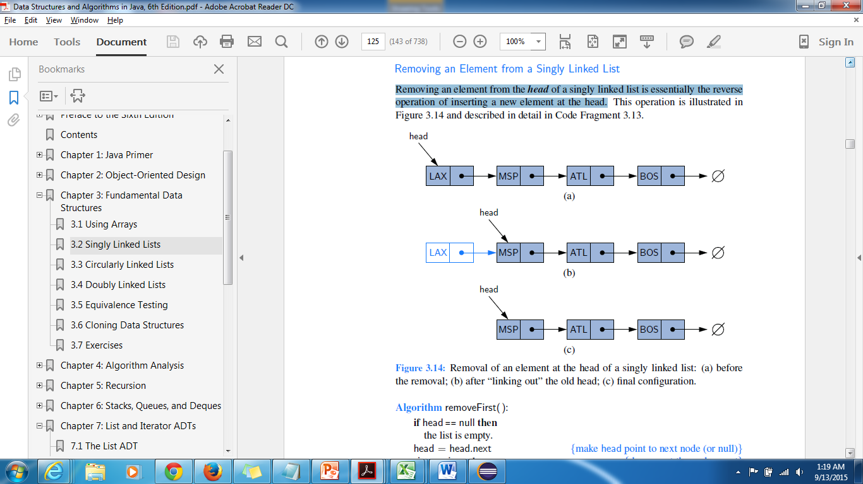
Contd..
Removal of an element at the head of a singly linked list: (a) Before removal (b) after “linking out” the old head (c) final configuration

Slide 17
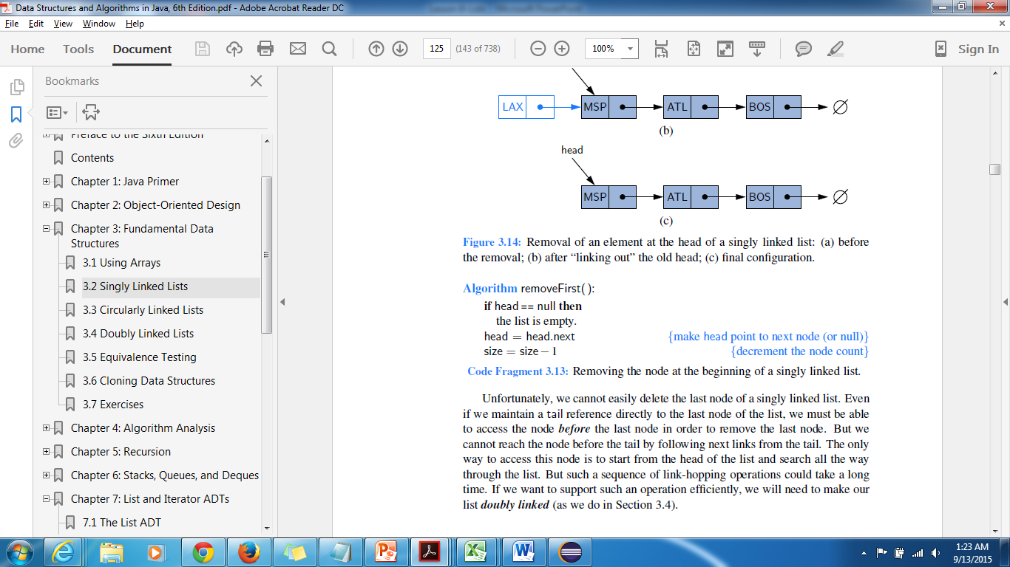
Contd..
To remove last node is a tedious process as we cannot reach the node before the tail by following next links from the tail. The only way to access this node is to start from the head of the list and search all the way through the list. But such a sequence of link-hopping operations could take a long time. If we want to support such an operation efficiently, we will need to make our list doubly linked

Slide 18
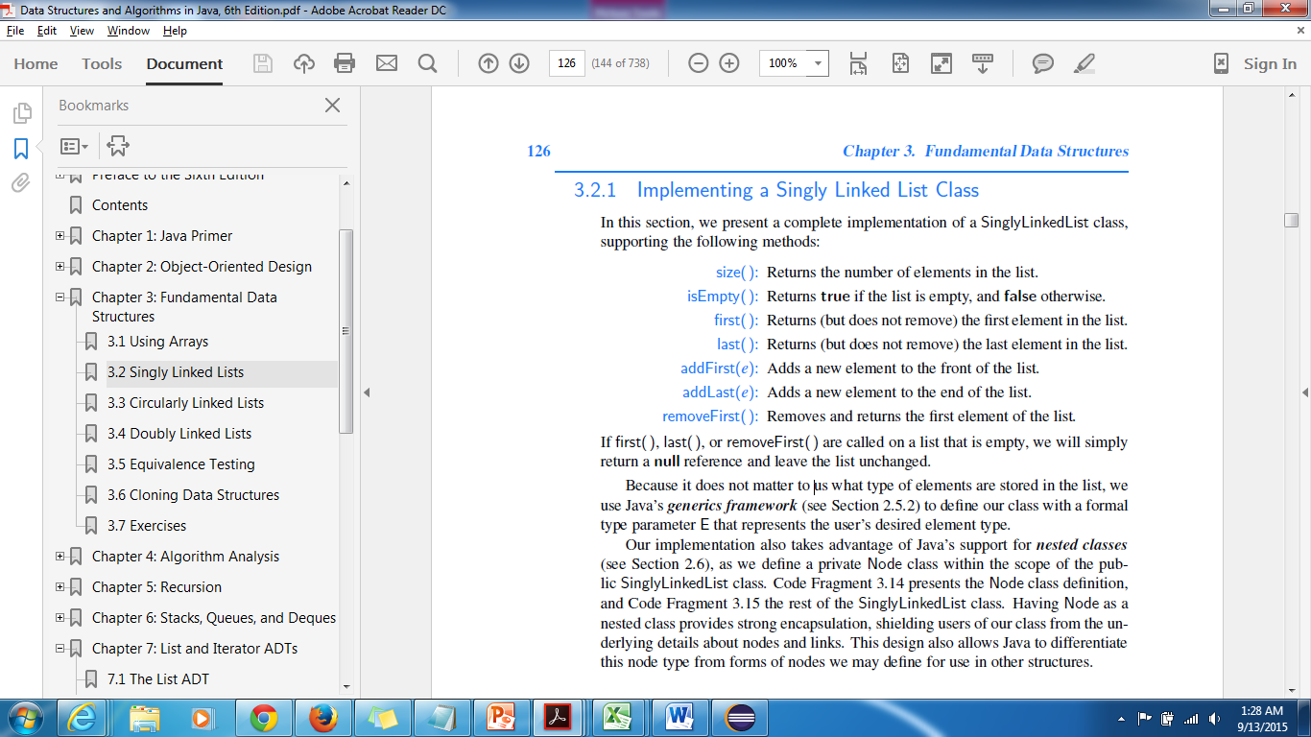
Implementing Single Linked List
Note
If first( ), last( ), or removeFirst( ) are called on a list that is empty, we will simply return a null reference and leave the list unchanged.

Slide 19
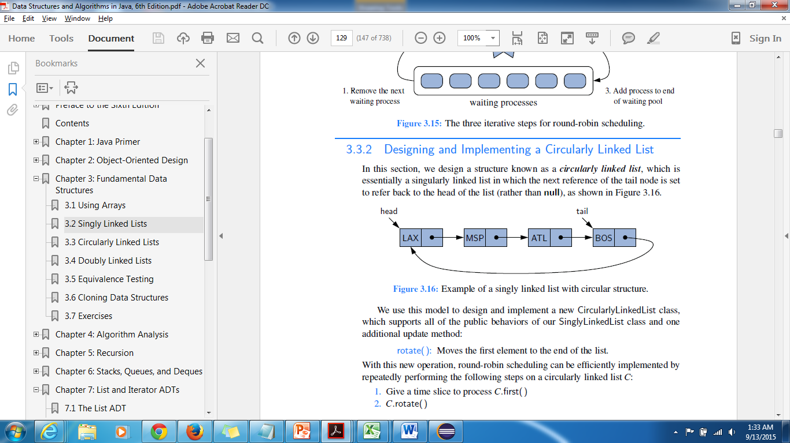
Circularly Linked Lists
It is essentially a singularly linked list in which the next reference of the tail node is set to refer back to the head of the list (rather than null).
SinglyLinkedList class and one additional update method:
rotate( ): Moves the first element to the end of the list.

Slide 20
Contd..
With this new operation, round-robin scheduling can be efficiently implemented by
repeatedly performing the following steps on
a circularly linked list C:
1. Give a time slice to process C.first( )
2. C.rotate( )
tail.getNext( ) helps to maintain reference to the tail.
Making a doubly linked list circular cuts the search time for the operations
insert(Object o, int pos) and findKth in half.

Slide 21
Doubly Linked Lists
In case of single linked list we are unable to efficiently delete a node at the tail of the list.
More generally, we cannot efficiently delete an arbitrary node from an interior position of the list if only given a reference to that node, because we cannot determine
the node that immediately precedes the node to be
deleted (yet, that node needs to have its next reference
updated).
Doubly linked list provides greater symmetry and each node keeps an explicit reference to the node before it and a reference to the node after it.

Slide 22
UML Diagram for Node
Node
E data
prev
next

Slide 23
Representation of Double linked list
Node
Node
Node
Node
Next=
Next=
Next=
Prev=
Null
Prev=
Next=
Null
Prev=
data=
“Tom”
data=
“Dick”
data=
“Bob”
Prev=
data=
“Tom”

Slide 24
User Defined Linked List

Slide 25
Nodes
A linked list is composed of nodes linked together; each node contains the data
find and get – traverse the nodes
insert – inserts a new node by changing the links
remove – removes a node by changing the links

Slide 26
An Inner Class node
/** Node is the building block for a single linked list*/
private static class Node<E>{
//Data Fields
/** The reference to the data*/
Private

Slide 27
public class MyObjectLinkedList {
Node header;
public void insert(Object element, int pos){
…
}
public void remove(int pos){
…
}
public Object get(int pos){
…
}
public int find(Object element){
…
}

Slide 28
class Node {
Object value;
Node next;
Node previous;
Node(Node next, Node previous, Object value){
this.next = next;
this.previous = previous;
this.value = value;
}
}

Slide 29
Demo code
MyLinkedList.java
LinkedListExample.java
LinkingLogic.java
LinkingLogic2.java
CreatingLinkedList3.java
CreatingLinkedList4.java
MyStringLinkedList.java
MyStringLinkedList1.java
MailList.java
MyStringLinkedList.java

Slide 30
Example
Creation of Linked List
LinkedList <Integer>list = new LinkedList<Integer>();
list.add(10);
List.add(20);
int size = list.size();
Lesson8-ListMethods.doc

Slide 31
Genericising the Objects Stored in a List
1. One difficulty with our examples of Lists – MyStringList and MyStringLinkedList is that they don’t work if the objects we wish to store are not Strings.
2. Unsatisfactory Solution: Rewrite the List code for each type as the need arises. E.g.
MyEmployeeList, MyIntegerList, MyAccountList. . .
3. A Better Solution: Could create a List that stores elements of type Object.

Slide 32
Contd..
Example: MyObjectList
public class MyObjectList {
private final int INITIAL_LENGTH = 4;
private Object[] objArray;
private int size;
public MyObjectList() {
objArray = new Object[INITIAL_LENGTH];
size = 0;
}
public void add(Object ob){
if(size == objArray.length) resize();
objArray[size++] = s;
}
. .

Slide 33
Contd..
//USAGE
MyObjectList list = new MyObjectList();
list.add(“Bob”);
list.add(“Sally”);
String name = (String)list.get(1);

Slide 34
Sun’s Pre-J2SE5.0 Solution
1. Before j2se5.0, Sun provided versions of these two kinds of Lists having
implementations similar to the above.
2. Sun’s ArrayList. This is an array-backed list that accepts any type of object, like
MyObjectList above.

Slide 35
Contd..
Usage:
ArrayList list = new ArrayList();
list.add(“Bob”);
list.add(“Sally”);
String name = (String)list.get(1);

Slide 36
Contd..
3. Sun’s LinkedList. This is a linked list that accepts any type of object, like MyObjectLinkedList above. Usage is like that of an ArrayList; however, as in ourearlier examples, LinkedList performs better for insert and delete operations, and
never needs to be resized.

Slide 37
Contd..
Usage:
LinkedList list = new LinkedList();
list.add(“Bob”);
list.add(“Sally”);
String name = (String)list.get(1);

Slide 38
Best Practice
Different kinds of lists provide different advantages. LinkedLists are a superior choice when many inserts and deletions are expected, or when the number of add operations would force too many resize() operations in an ArrayList. If the requirement is instead for repeated access by index, ArrayList is preferable.

Slide 39
Contd..
Sometimes you won’t know which type of list will be the best choice. And even if
you have a preference at the beginning of a project, the need may change as
development proceeds. For these reasons, the best way to create a list is to use the
principle of Programming to the Interface:

Slide 40
Contd..
//start with an ArrayList
List myList = new ArrayList();
myList.add(“Bob”);
myList.add(“Dave”);

Slide 41
Contd..
Later, if you need to switch to a LinkedList, only one change in the code is necessary:
List myList = new LinkedList();
myList.add(“Bob”);
myList.add(“Dave”);

Slide 42
For efficiency –Use looping
To ensure optimal efficiency and flexibility, looping through a list should always be
done with an Iterator (when using pre-j2se5.0
style of coding) (unless information about the
indices is actually necessary)

Slide 43
Contd..
//code works when ArrayList is replaced by LinkedList
//or any other implementor of the List interface
List myList = new ArrayList();
myList.add(“Bob”);
myList.add(“Dave”);
String next = null;
Iterator it = myList.iterator();
while(it.hasNext()) {
next = (String)it.next();
}

Slide 44
Warnings!
1. Rules for Java syntax forbid the creation (but not declaration) of an array of parametrized
Lists:
//compiler error
List<String>[] arrayOfLists = new ArrayList<String>[10];
//Workaround: can use an ArrayList instead of an Array:
ArrayList<List<String>> listOfLists =
new ArrayList<List<String>>(10);
//The following works but produces a warning
List<String>[] arrayOfLists = new ArrayList[10];

Slide 45
Good Programming Practice
Different kinds of lists provide different advantages.
LinkedLists are a superior choice when many inserts, deletions are expected, or when the number of add operations would force to many resize() operations in an ArrayList.
If the requirement is instead for repeated access by index, ArrayList is preferable.

Slide 46
Main List
An Array List encapsulates the random access behavior of arrays, and incorporates automatic resizing and optionally may include support for sorting and searching.
Using a style of sequential access instead, Linked Lists improve performance of insertions and deletions, but at the cost of losing fast element access by index.

Slide 47
Contd..
Random and sequential access provide analogies for forms of gaining knowledge. Knowledge by way of the intellect is always sequential, requiring steps of logic to arrive at an item of knowledge. Knowing by
intuition (prathibha) , or by way of ritam-bhara pragya, is knowing the truth
without steps – a kind of “random access” mode of gaining knowledge.

Slide 48
Main Point
Linked lists are much more efficient than arrays when many insertions or deletions need to be made to random parts of the list. Nature always functions with maximum efficiency and minimum effort.

Slide 49
CONNECTING THE PARTS OF KNOWLEDGE WITH THE WHOLENESS OF KNOWLEDGE
1. An implementation of the abstract class
AbstractSequentialList in Java (such as a
LinkedList) results in a list that has only sequential access to its elements.
2. An implementation of the RandomAccess interface in Java
(such as ArrayList and Vector) results in a list that has random access (and therefore, effectively, instantaneous access) to its elements.

Slide 50
Further Reading

Slide 51
Objects as references
The fact that objects are represented internally as references has one more implication.
Because references are small, an object can easily contain references to other objects.
If objects were stored only in the complete form in which they appear in the heap, it would obviously be impossible for a small object to contain a larger one.
Every object requires some amount of overhead, it would even be impossible for one heap object to contain another object of the same size, because there would no longer be any room in which to store the bookkeeping information that Java needs.
Courtesy: Art and Science of Java

Slide 52
Contd..
If objects are stored as references these restrictions would not be there.
Although it is true that a small object cannot physically contain a larger object, there is nothing to prevent one object from containing a reference to another object no matter how much heap storage those objects
might consume.
A reference, after all, is simply the address of an object in memory and can therefore be represented using just a few bytes.
Courtesy: Art and Science of Java

Slide 53
Thus, there is no problem in having one object contain a reference to another object of a different class, or even an object of the same class.
Creating an object that contains references to other objects is an extremely powerful programming technique. Such objects are said to be linked.

Slide 54
Popular Issue
Keeping List Data Synchronized

Slide 55
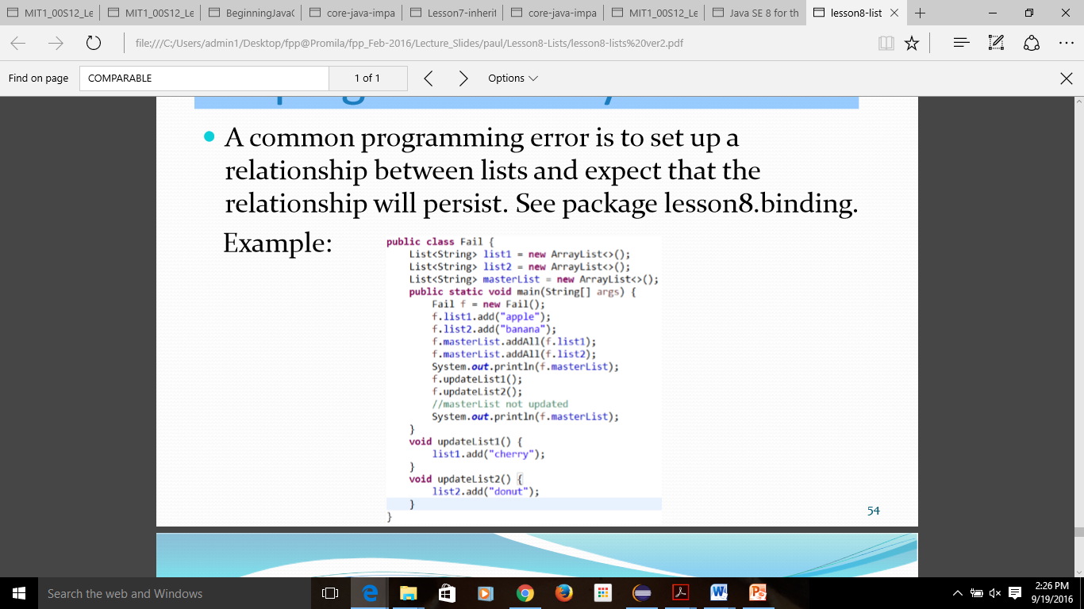
Keeping List Data Synchronized

Slide 57
Contd..
Java 8 introduces the Binding API that supports keeping data fields synchronized. See package lesson8.binding

Slide 58
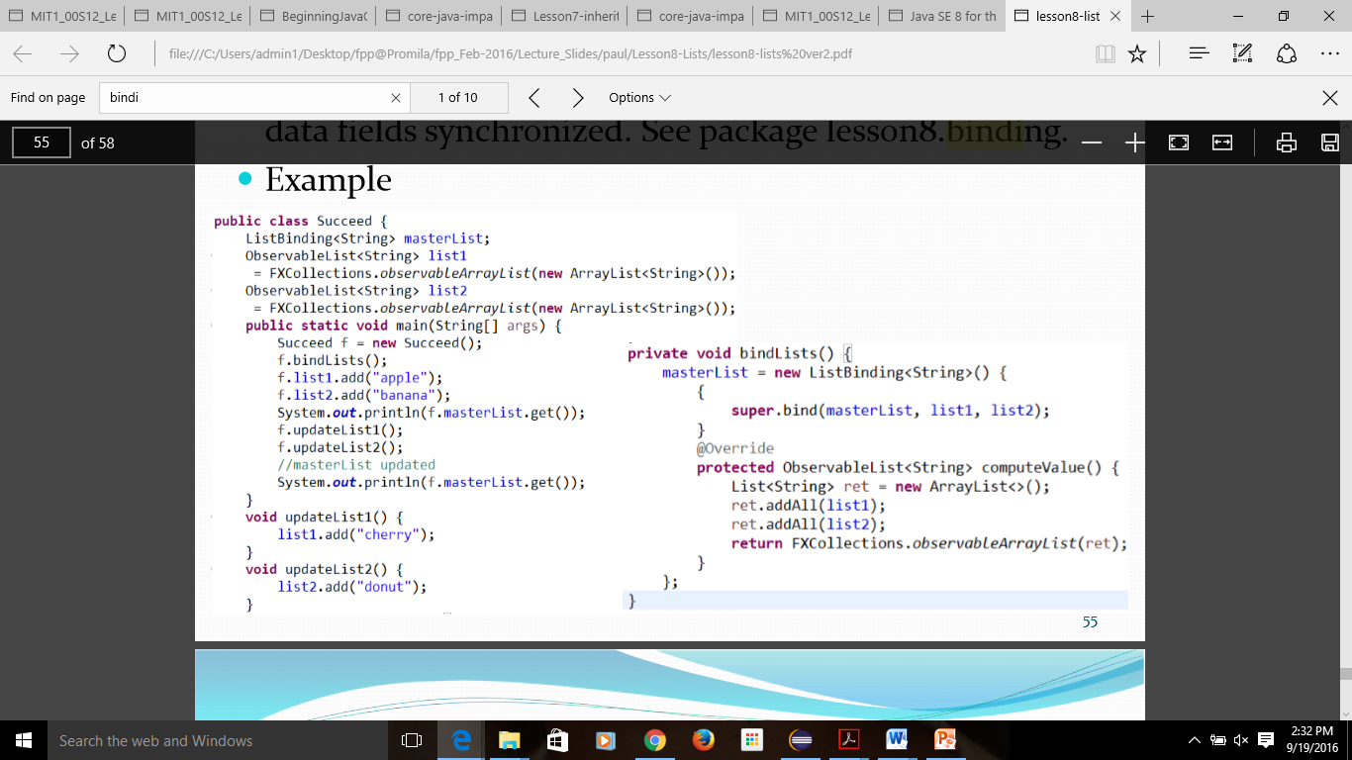

Slide 59
Limitations of the Binding API in Java 7
The Binding API cannot be applied everywhere in Java 7 – in particular, you cannot bind a Swing list model to its backing list using the new Binding API (since list models cannot be made "Observable").
To accomplish this kind of binding with Swing, listeners need to be introduced.  Using a ListDataListener, the backing list of a list model can be kept up to date as changes are made to the list at the UI level.
See package lesson8.listbindingswing.

