Slide 1
Walmart Sales Forecasting
Pipitton Sanseeha
9/Jan/2023

Slide 2
Outline
Executive summary
Problem understanding
Exploratory data analysis (EDA)
California
Texas
Wisconsin
Sales performance by state
Total
Predictive analysis
Conclusions

Slide 3
Executive summary
In this study, we examine Walmart sales in three states (California, Texas, and Wisconsin). First, we find business insight by doing exploratory data analysis. We found total sales depend on population density and month but do not depend on event. Finally, we employ a decision tree regression model to forecast revenues for the following 28 days. The model performs well.

Slide 4
Problem understanding
Walmart is one of the notable retail corporation. They have provided sales data for stores in three states and includes item level, department, product categories, and store details.
The goal of this study is to gain business insight and predict daily sales for the next 28 days.

Slide 5
Exploratory data analysis

Slide 6
How to calculate total sales
Calendar
d | wm_yr_wk
d_1 | w_1
d_2 | w_2
d_n | w_n
Sales_train
Item_id | quantity | d
Item_1 | x_1 | d_1
Item_2 | x_2 | d_2
Item_n | x_n | d_n
…
Sell prices
Item_id | wm_yr_wk | sell_price
Item_1 | w_1 | p_1
Item_2 | w_2 | p_2
Item_n | w_n | p_n
…
…

Slide 7
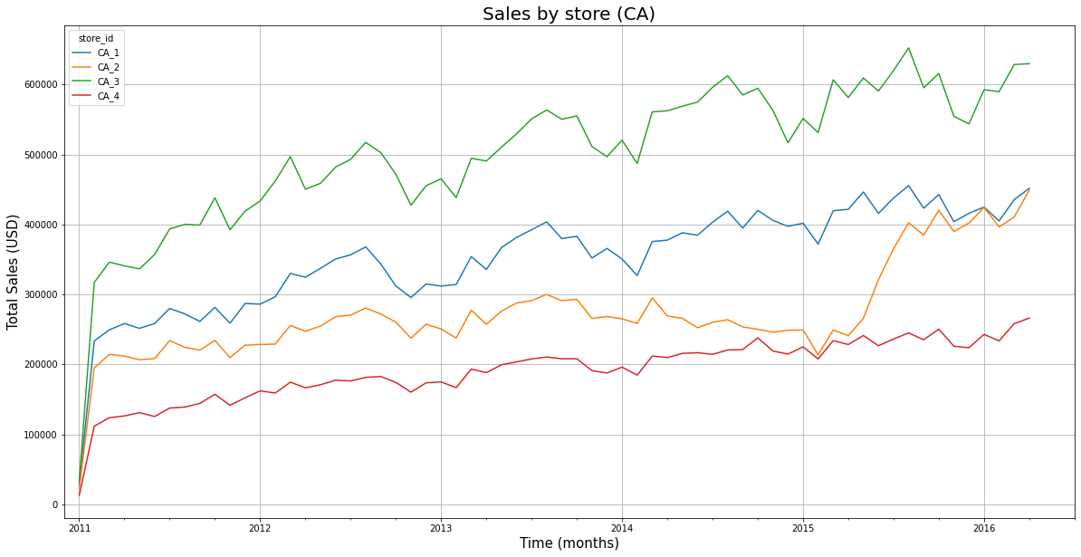
California (CA)

Slide 8
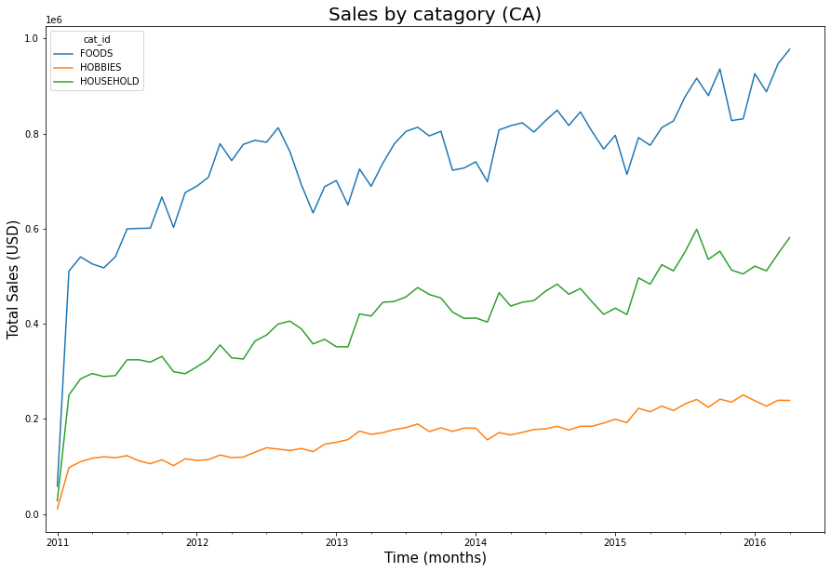
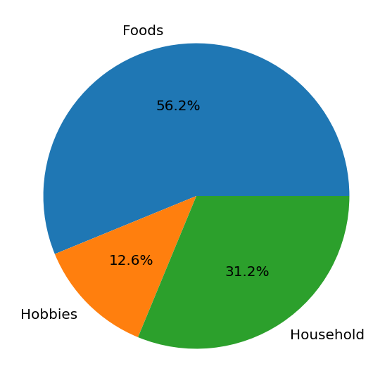
California (CA)

Slide 9
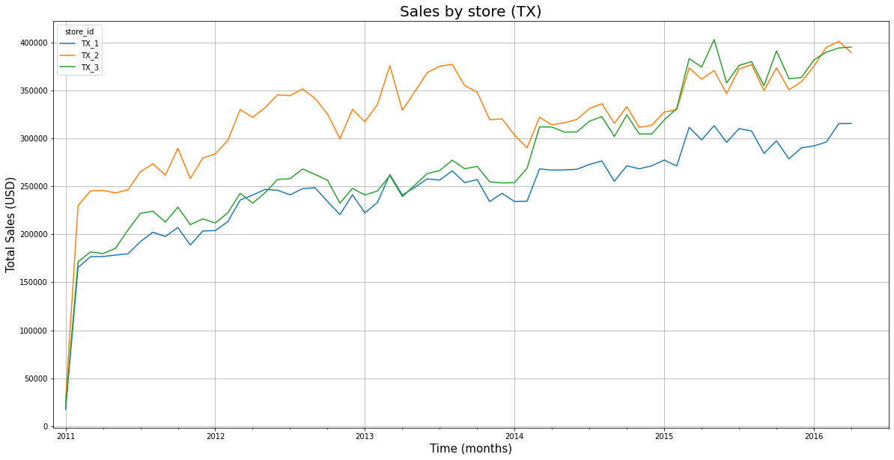
Texas (TX)

Slide 10
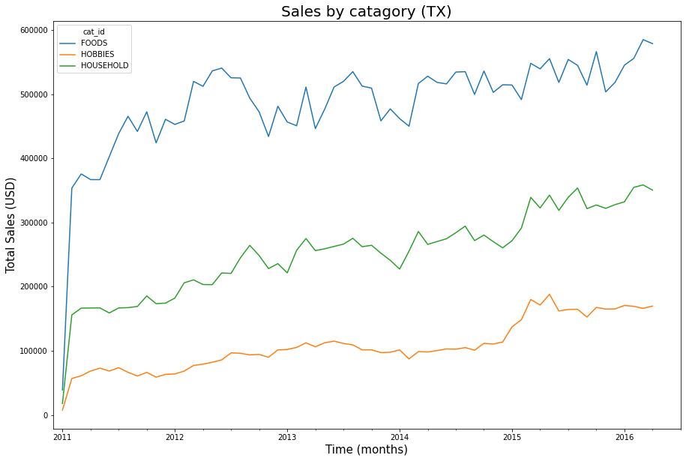
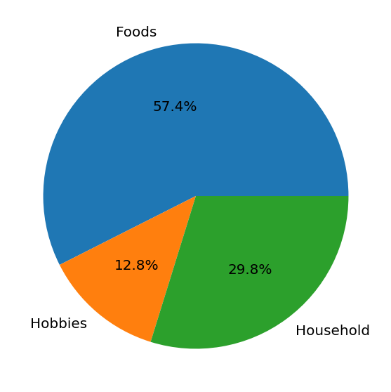
Texas (TX)

Slide 11
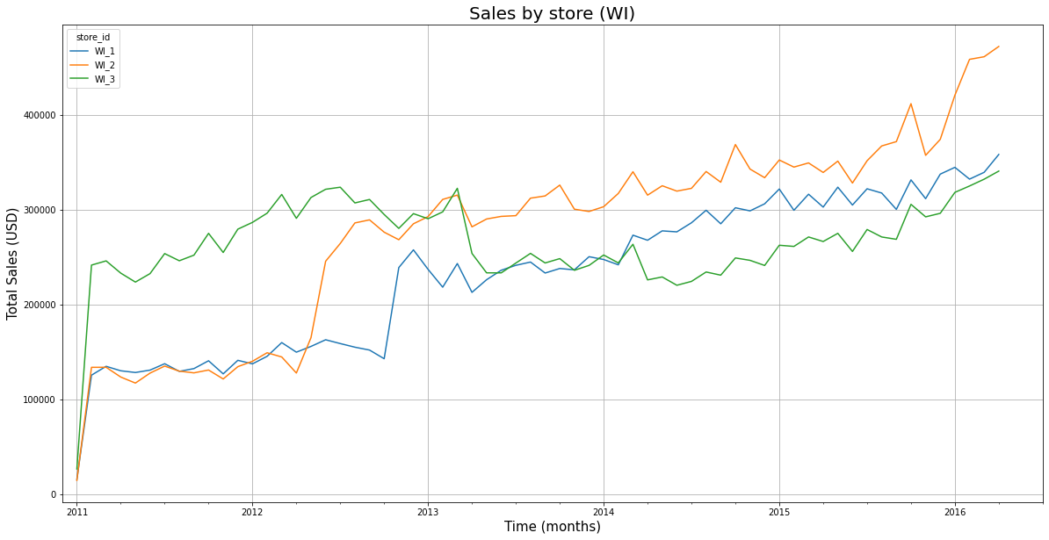
Wisconsin (WI)
Trend changed in 2013

Slide 12
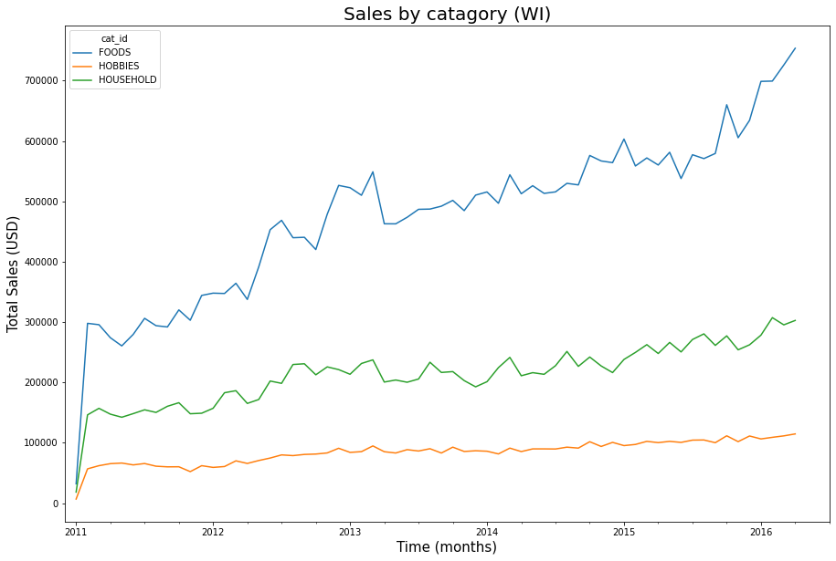
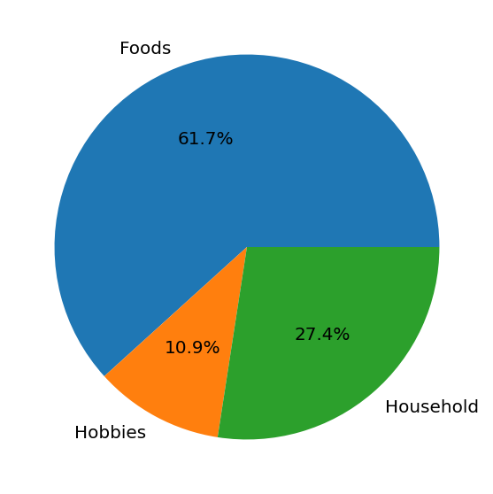
Wisconsin (WI)

Slide 13
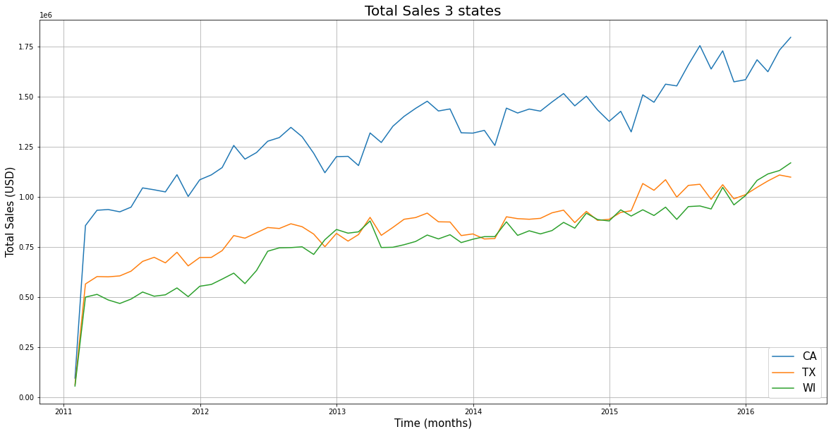
Sales performance by state

Slide 14
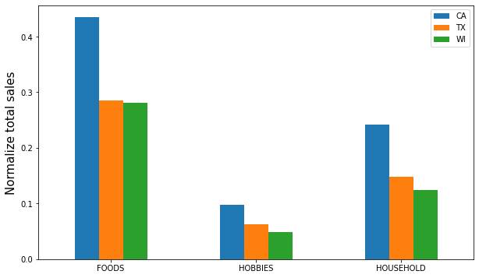
Sales performance by state

Slide 15
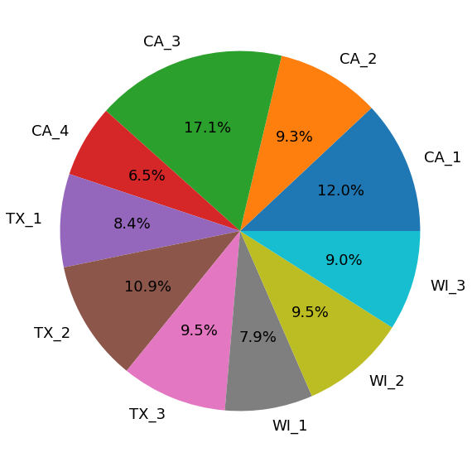
Sales performance by state
CA_1 has the highest sales.
CA_4 has the lowest sales.
All stores in WI have contribute lower than 10% to the total sales.

Slide 16
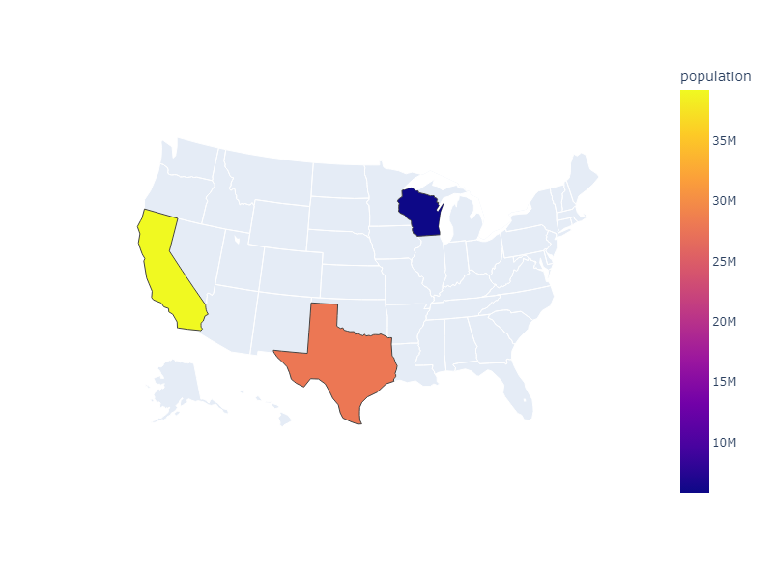
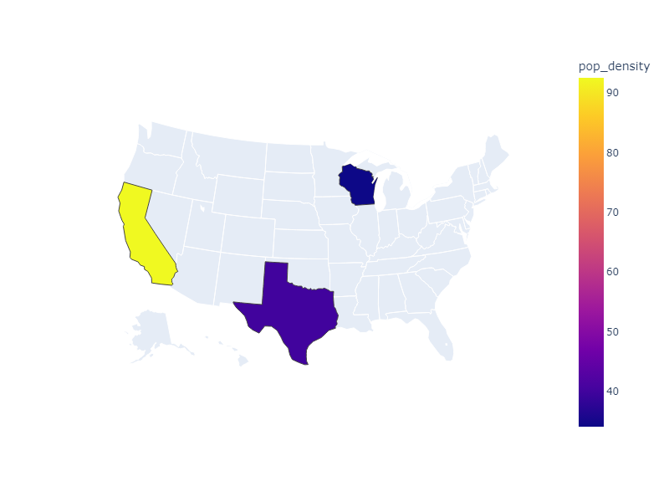
Population density
TX and WI have the same population density. This might be the reason that total sales in TX and WI are roughly the same.

Slide 17
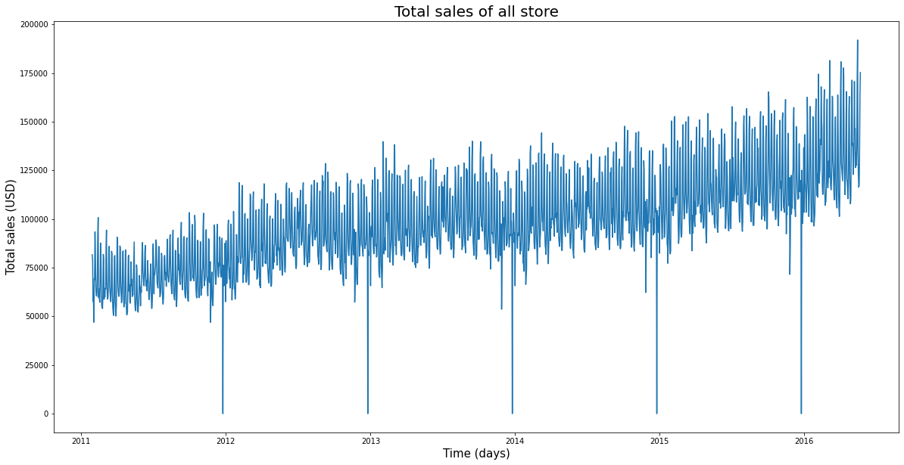
Sales performance of all store

Slide 18
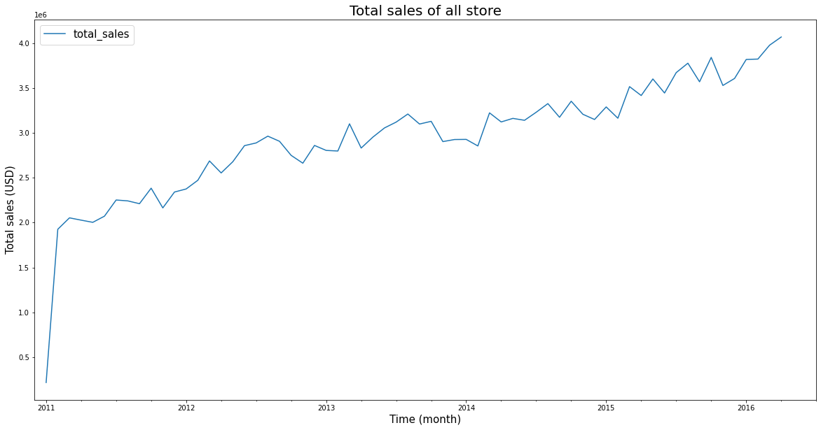
Sales performance of all store

Slide 19
Predictive analysis

Slide 20
Predictive analysis
We predict daily sales for the next 28 days by using a decision tree model.
Model
Input | target
d_1 | d_29
d_2 | d_30
d_3 | d_31
d_n-2 | None
d_n-1 | None
d_n | None
Train/test data for a decision tree model
…
The next 28 days

Slide 21

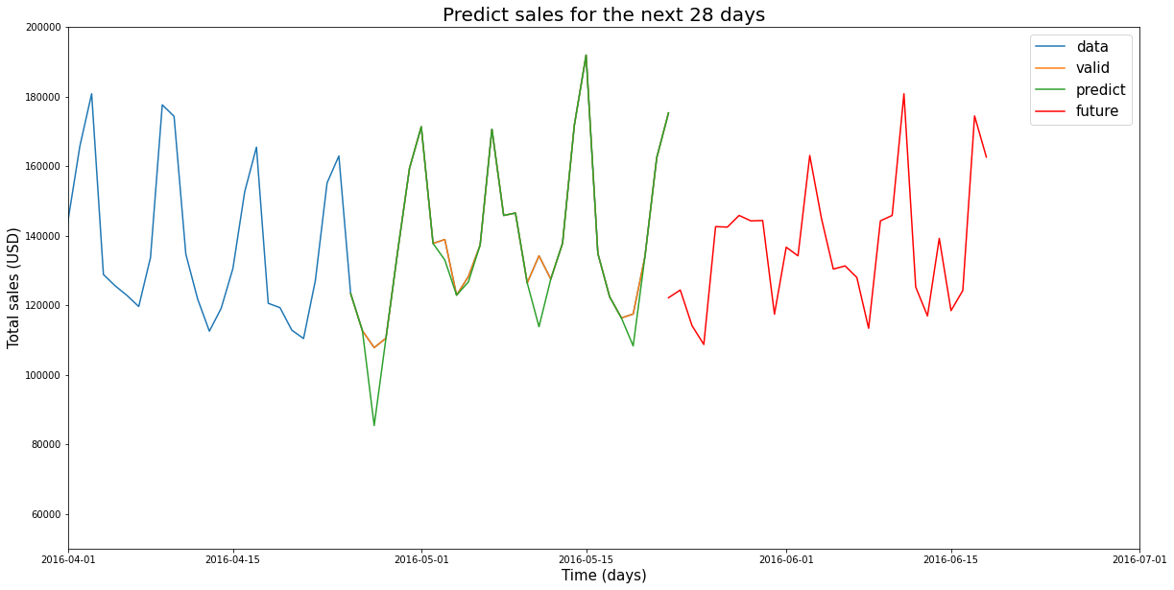
Predictive analysis
The model has r2 score of 0.92

Slide 22
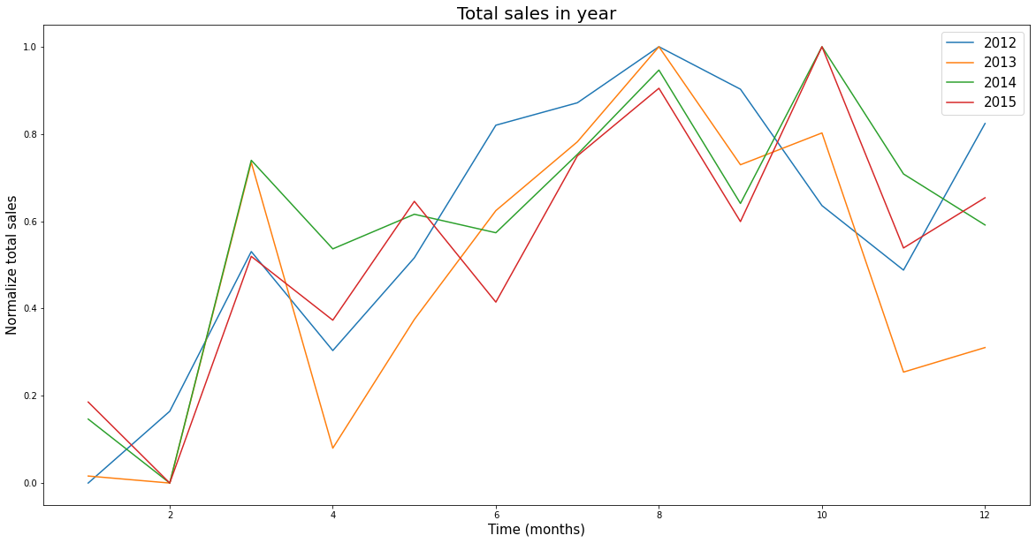
Predictive analysis
The data do not show a clear periodic trend.

Slide 23
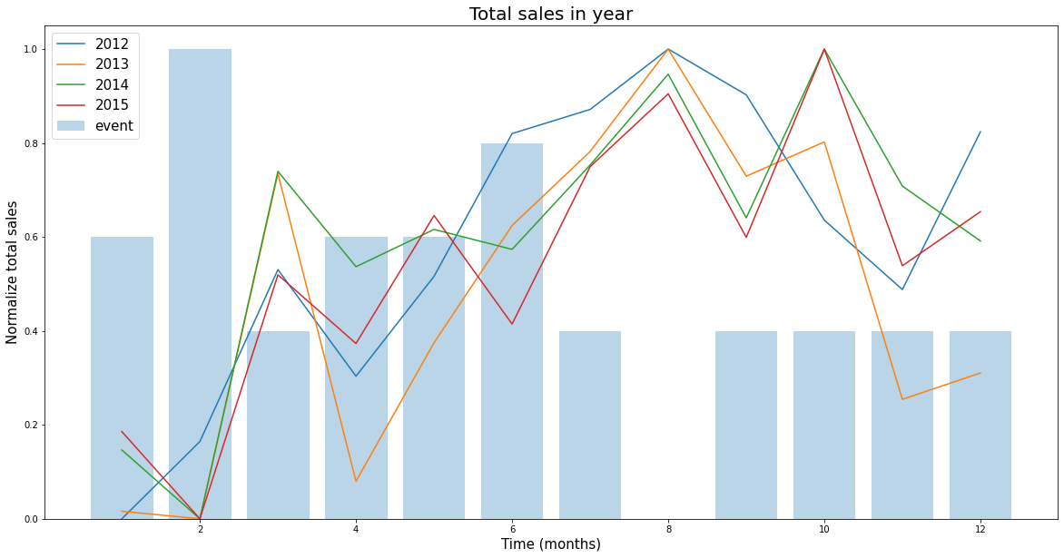
Predictive analysis
There is no correlation between number of event and total sales.

Slide 24
Conclusions

Slide 25
Conclusions
The highest sales are from CA.
The food category has the highest sales, while hobbies and household items rank second and third, respectively.
Total sales in each state depend on population density.
Total sales increase every year.
Total sales do not show a clear periodic function.
Total sales do not depend on events.
Total sales can be accurately predicted using our decision tree regression model

Slide 26
For the full report in Jupyter notebook
https://github.com/pipitton-s/Coraline_assignment

