Slide 1
Loan prediction project
PIPITTON SANSEEHA
28/10/2022
1

Slide 2
Agenda
Project Overview​
Data & Analysis
Modeling & Model Evaluation
Recommendations
2

Slide 3
Project Overview​
Business Problem:
The home loans department wants to use machine learning to recommend if clients will be granted loans.
Business Objective:
Use machine learning to predict the clients’ loan status.
3

Slide 4
Project Overview​
Hypothesis:
Are applicants with a credit history more likely to default than those who do not have one?
Quick answer: Yes.
Is there a correlation between the applicant's income and the loan amount they applied for?
Quick answer: Yes.
4

Slide 5
Project Overview​
Collect Data
EDA
Clean, Transform
Modeling
Predict
Evaluate
EDA = Exploratory data analysis
5

Slide 6
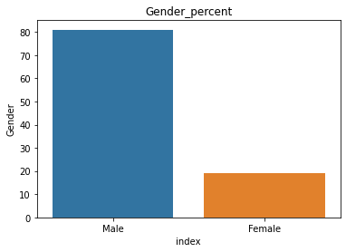
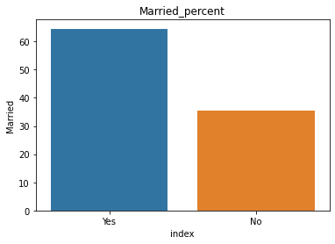
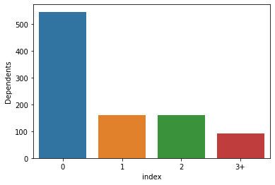
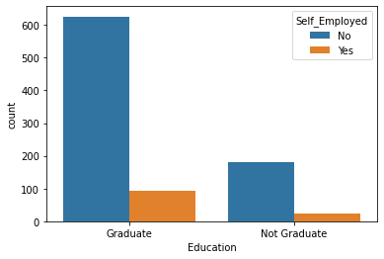
Data & Analysis
6

Slide 7
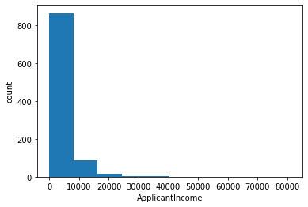
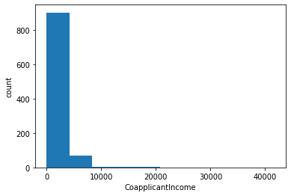
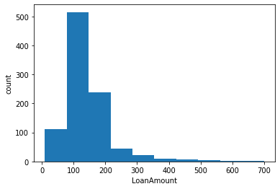
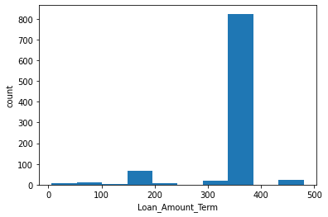
Data & Analysis
7

Slide 8
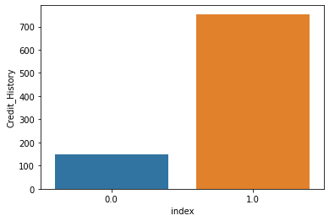
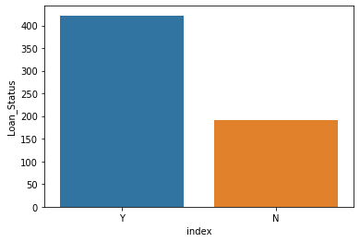
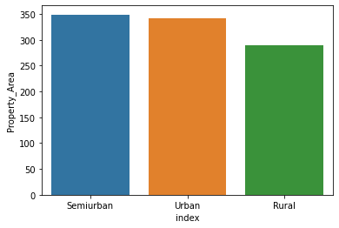
Data & Analysis
8

Slide 9
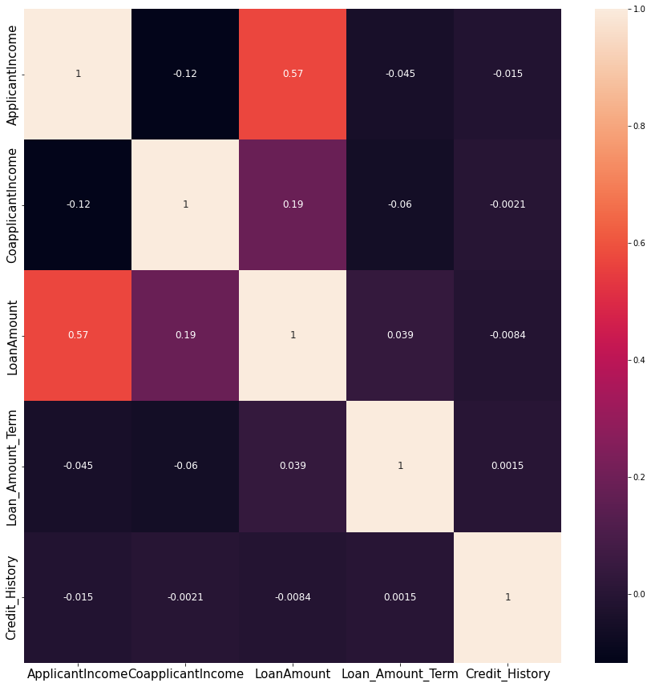
Data & Analysis
Applicant's income and the loan amount have a correlation.
8

Slide 10
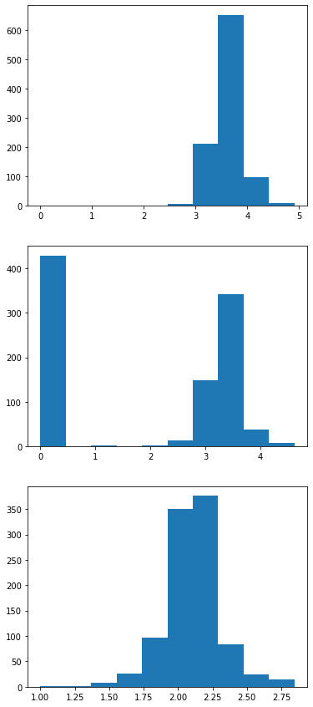
Transform data
Applicant Income
Transform numerical data
Co-Applicant Income
Loan amount
9

Slide 11
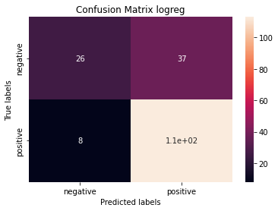
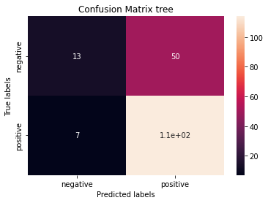


Modeling & Model Evaluation
Logistic regression (logreg): acc 0.834
support vector machine (svm): acc 0.832
decision tree (tree): acc 0.806
k nearest neighbors (knn): acc 0.744
10

Slide 12
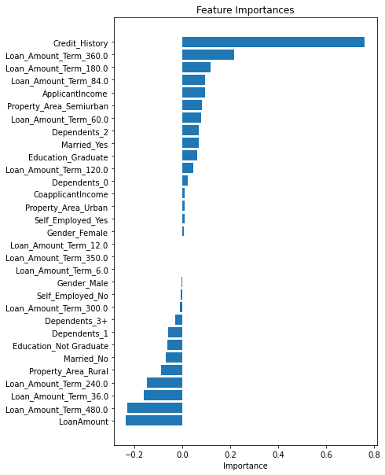
Modeling & Model Evaluation
Credit history is the most important feature.
11

Slide 13
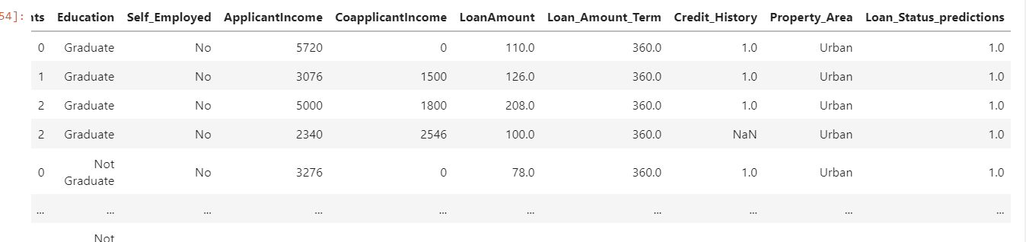

Recommendations
Results (excel)
12

