Slide 1

HOUSING PRICE PREDICTION MODEL
Submitted by: BHAVNA PIPLANI

Slide 2
INTRODUCTION
Business Problem Framing
Houses are one of the necessary need of each and every person around the globe and therefore housing and real estate market is one of the markets which is one of the major contributors in the world’s economy. It is a very large market and there are various companies working in the domain.
Data science comes as a very important tool to solve problems in the domain to help the companies increase their overall revenue, profits, improving their marketing strategies and focusing on changing trends in house sales and purchases.
Predictive modelling, Market mix modelling, recommendation systems are some of the machine learning techniques used for achieving the business goals for housing companies. Our problem is related to one such housing company.

Slide 3
A US-based housing company named Surprise Housing has decided to enter the Australian market. The company uses data analytics to purchase houses at a price below their actual values and flip them at a higher price. For the same purpose, the company has collected a data set from the sale of houses in Australia.

Slide 4
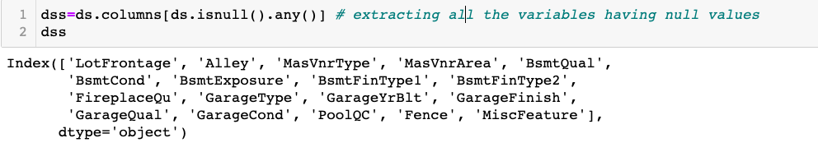
B. Explanatory Data Analysis
The dataset is not clean. Data is missing in many of the features . There are missing or null values in the dataset. Nan values will be replaced by values mentioned in data description provided.

Slide 5
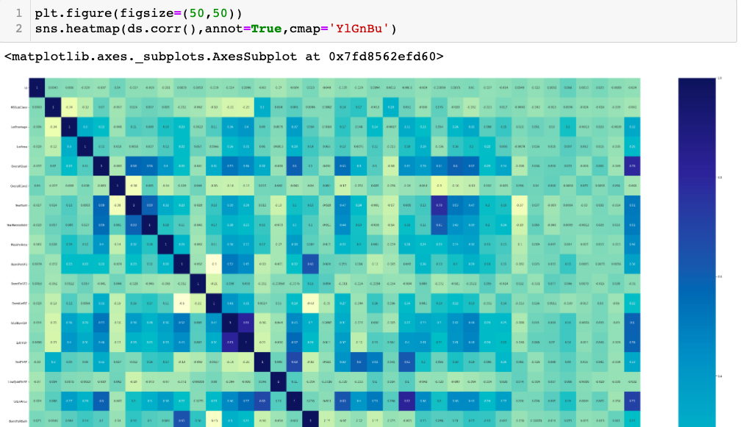
Checking the correlation
1. OverallQual is highly correlated with target variable ActualPrice.
2. Garagecars,GarageArea are highly correlated with each other.
3. GarageCars,garagearea,TotalBsmtSF, 1FirSF are highly correlated with target variable ActualPrice.

Slide 6
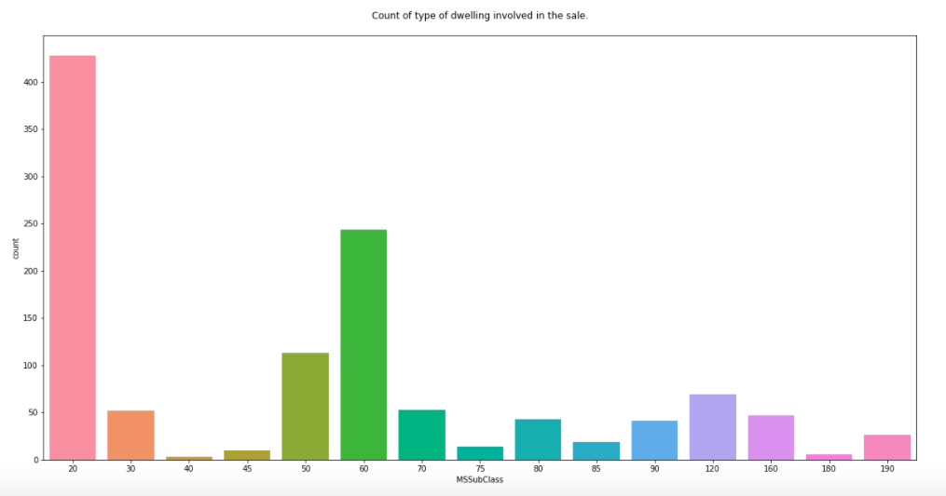
Dwelling involved in the sale
Above countplot shows that
1. 1-STORY 1946 & NEWER ALL STYLES are maximum which are in sale.
2. 1-STORY W/FINISHED ATTIC ALL AGES is least one which is in sale.

Slide 7
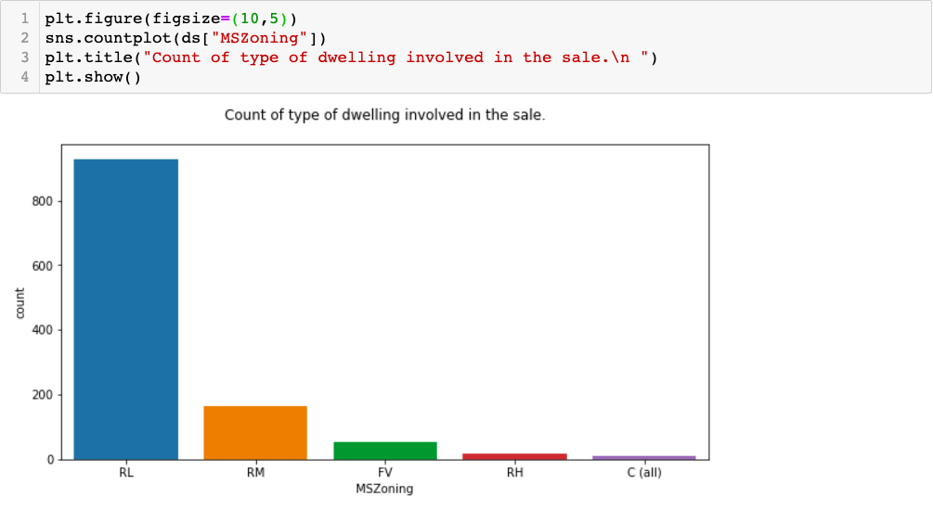
Zoning Classification of dwelling in the sale
Above countplot shows that Residential Low Density property is maximum on sale.
and Commercial is least on sale.

Slide 8
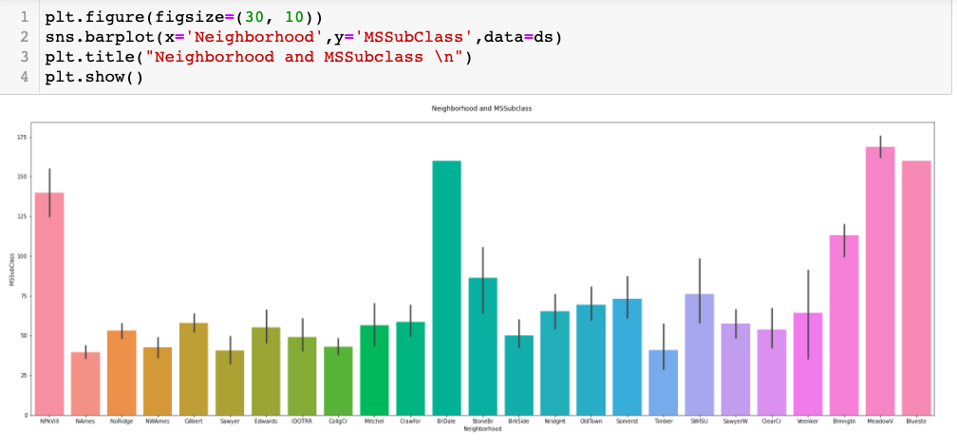
Neighborhood of the dwelling involved in the sale
Above barplot shows the neighbourhood of all MSSubclass dwelling involved in sale. like "Meadow Village" is in neighbourhood of "2-STORY PUD - 1946 & NEWER”

Slide 9
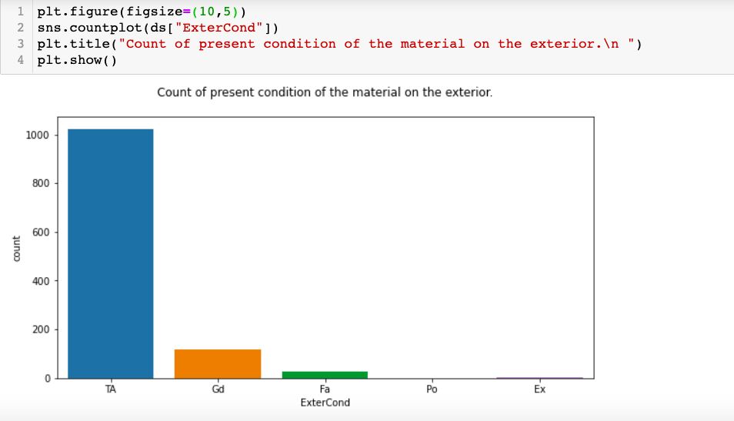
Condition of material on the exterior
Above countplot Evaluates the present condition of the material on the exterior is Average/Typical

Slide 10
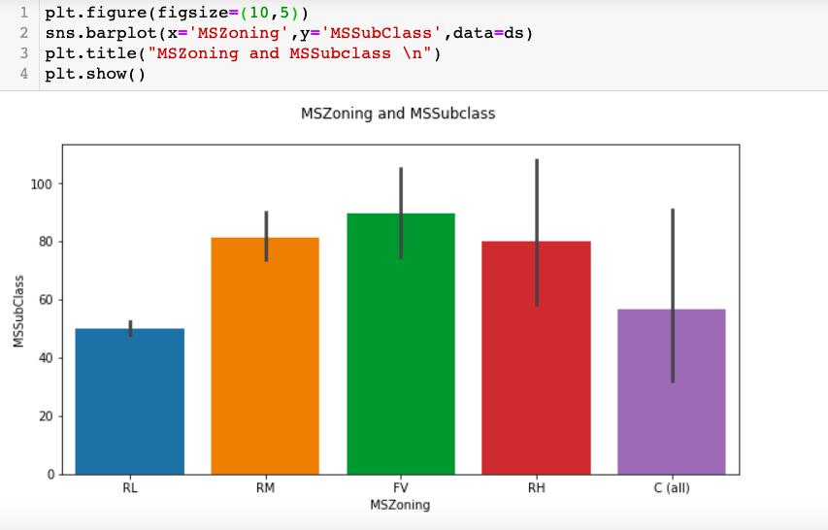
MSZoning and MSSubclass
Above countplot shows Maximum dwelling involved in sale are "DUPLEX - ALL STYLES AND AGES" having general zoning classification as "Floating Village Residential"

Slide 11
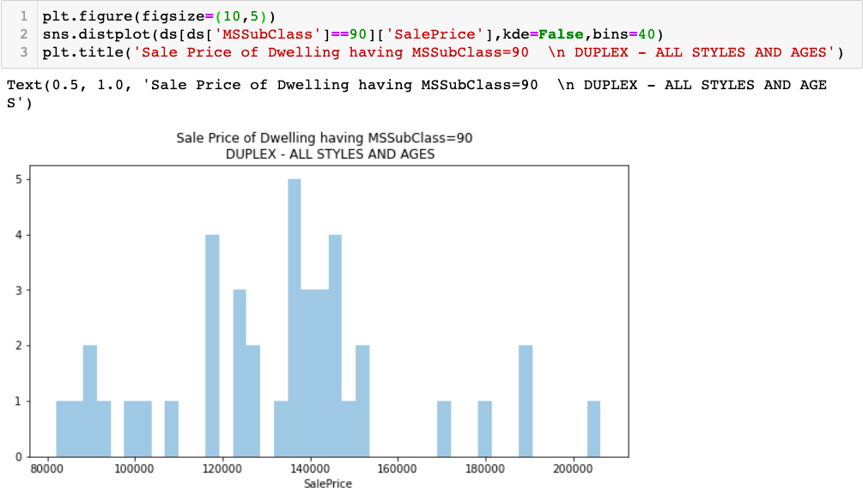
SalePrice of particular dwelling
Above distplot shows the saleprice of dwelling where MSSubClass=90 i.e DUPLEX - ALL STYLES AND AGES

Slide 12
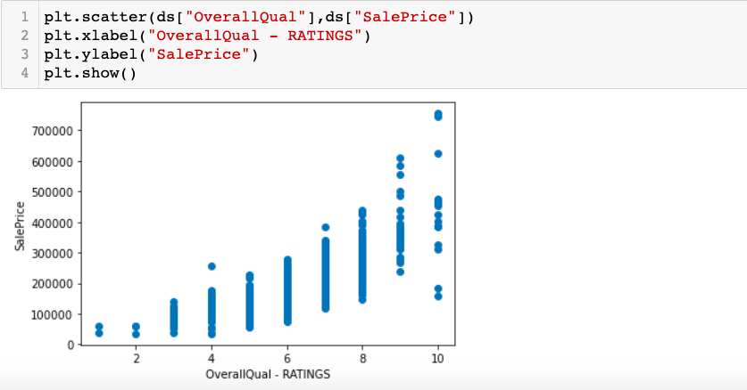
Correlation of SalePrice and Ratings
Above scatterplot shows that Highest rating have highest prices.

Slide 13
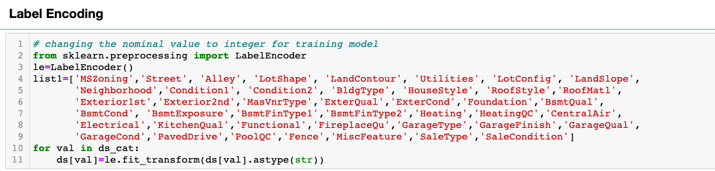
Preprocessing pipeline
Maximum columns have the numerical values other than 18 features. For moving further for model training, we need to transform these nominal values into numerical values by encoding the data.

Slide 14
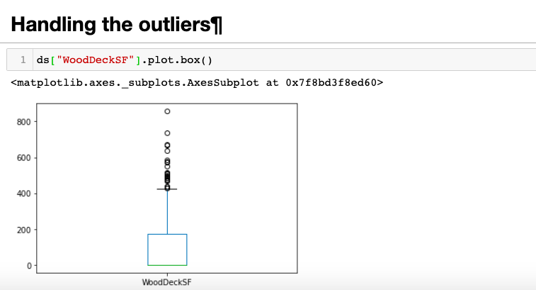
Handling of Outliers
Removing outliers will affect the saleprice prediction. So not removing the outliers

Slide 15
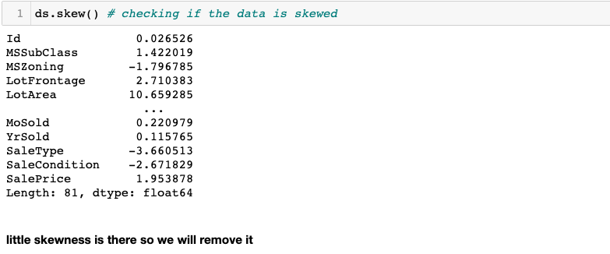
Checking skewness in dataset
Skewness is there , So , we will remove it.

Slide 16
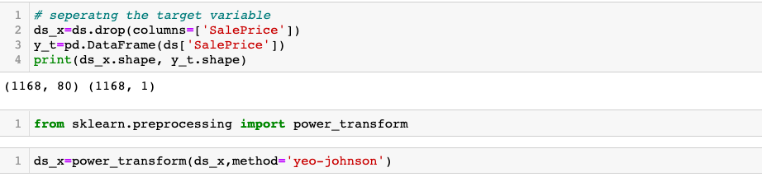
Removing the skewness

Slide 17
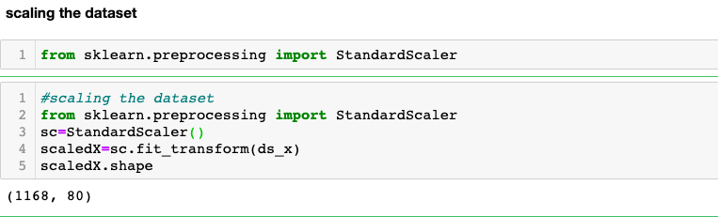
Scaling the dataset

Slide 18
C. Model Development and Evaluation
Most common techniques will fall into the following two groups:
Supervised learning, including regression and classification models.
Unsupervised learning, including clustering algorithms and association rules.
For this dataset, I will be using regression model because the output variable is continuous.

Slide 19
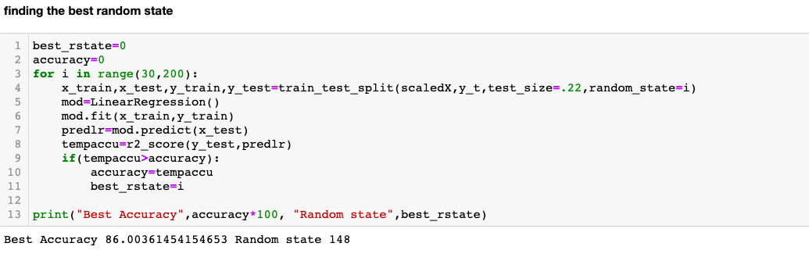
Finding the best random state

Slide 20
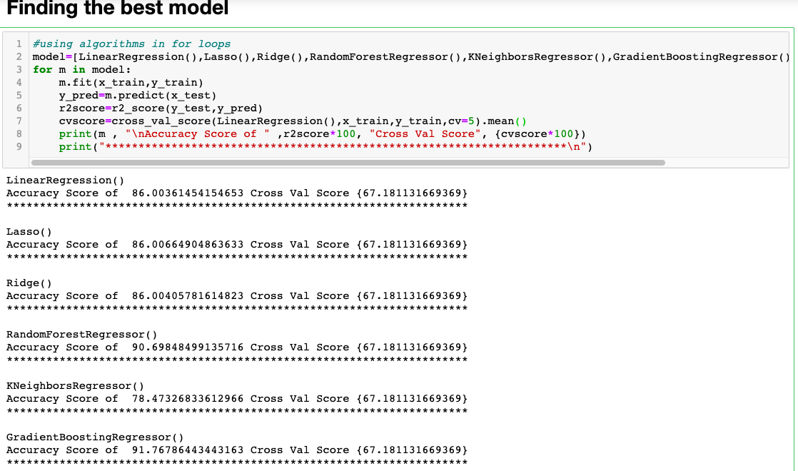
Finding the best model
Here, GradientBoostingRegressor has performed the best with accuracy score round(2) is 0.91

Slide 21
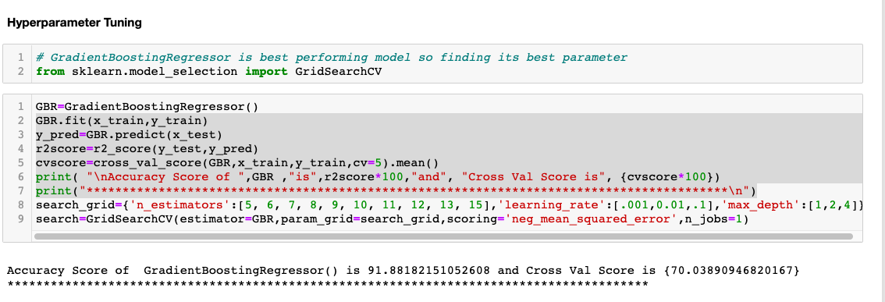
D. Hyper parameter Tuning

Slide 22
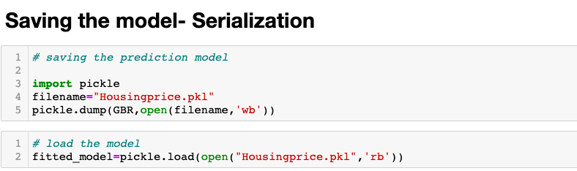
Saving the model--- Serialization
Now, as the model is performing good with the score of 91% , we will save the predicted_model .

Slide 23
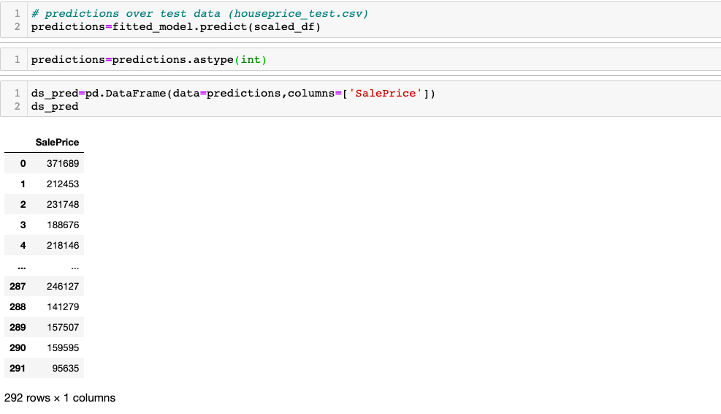
Predicting SalePrice of test dataset
Using best fit model on test data to predict SalePrice of dwelling involved in the sale.

Slide 24
CONCLUSION
Key Findings and Conclusions of the Study
1.OverallQual is highly correlated with target variable SalePrice.
2.Garagecars,GarageArea are highly correlated with each other.
3.GarageCars, garagearea, TotalBsmtSF, 1FirSF are highly correlated with target variable SalePrice.
4.It was found that removing outliers will be loss of more of the data. So, I decided not to remove them.
5.GradientBoostingRegressor was the best fit model.

