Slide 1

Customer Retention EDA
Submitted by: BHAVNA PIPLANI

Slide 2
INTRODUCTION
Business Problem Framing
Customer satisfaction has emerged as one of the most important factors that guarantee the success of online store; it has been posited as a key stimulant of purchase, repurchase intentions and customer loyalty. A comprehensive review of the literature, theories and models have been carried out to propose the models for customer activation and customer retention.
Five major factors that contributed to the success of an e-commerce store have been identified as: service quality, system quality, information quality, trust and net benefit. The research furthermore investigated the factors that influence the online customers repeat purchase intention.
The combination of both utilitarian value and hedonistic values are needed to affect the repeat purchase intention (loyalty) positively

Slide 3
The data is collected from the Indian online shoppers. Results indicate the e-retail success factors, which are very much critical for customer satisfaction.

Slide 4
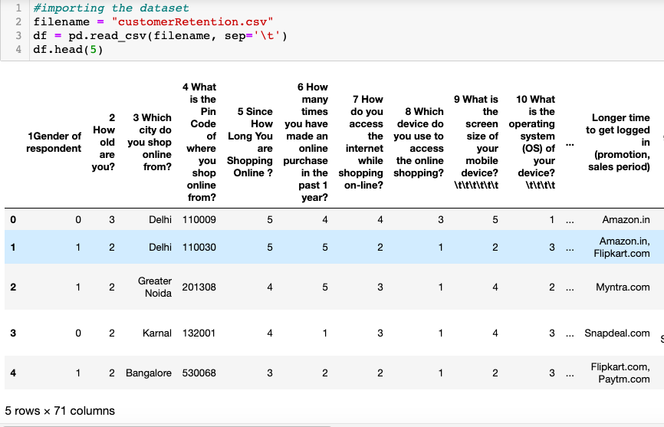
B. Explanatory Data Analysis
Importing the dataset from the source file provided .

Slide 5
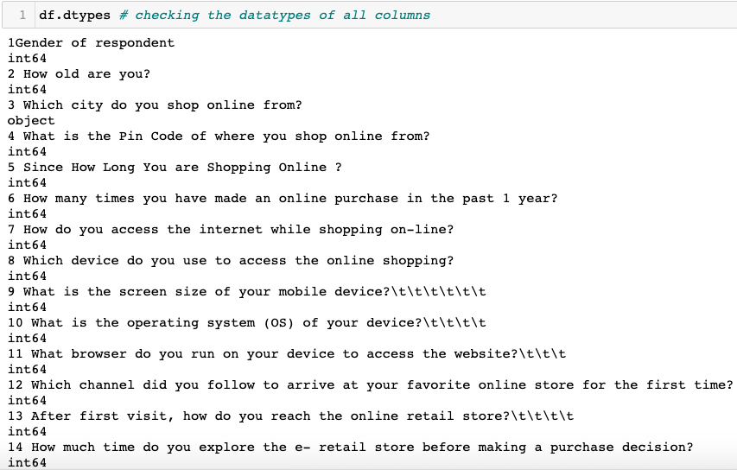
Dataset Datatypes
Above image displays the datatypes of various columns.

Slide 6

Dataset Shape
The dataset has 269 rows and 71 columns.

Slide 7
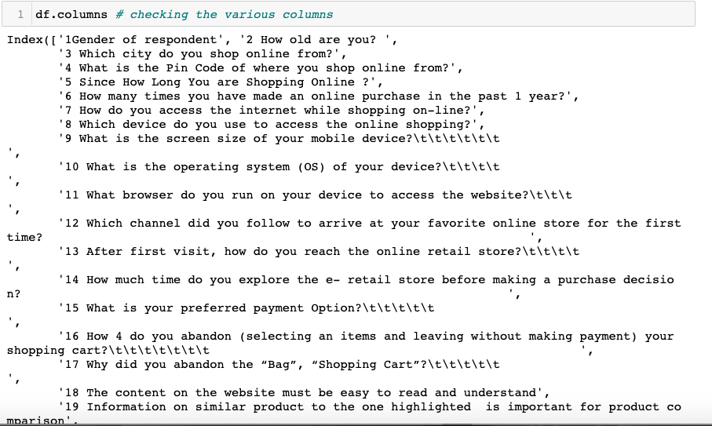
Dataset Columns
The above image shows the various columns of the dataset

Slide 8
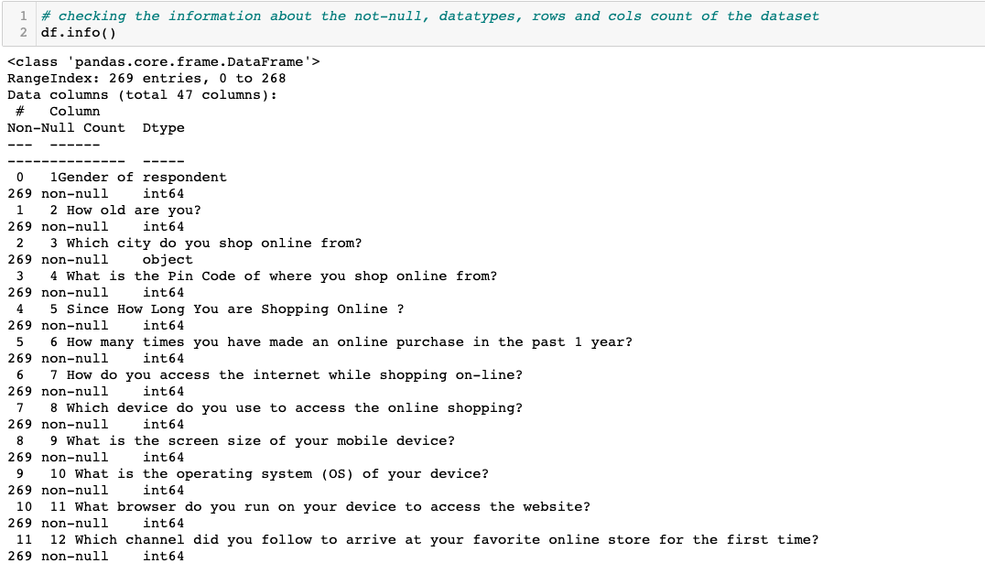
Dataset Information
Above image shows the datatypes , not-null values ,rows and column count of the dataset

Slide 9
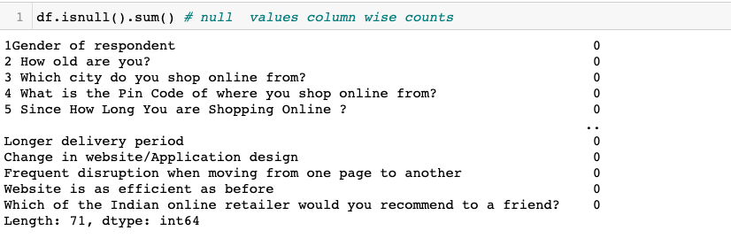
Dataset Null values
The dataset is looking pretty clean. No data is missing in any of the features as the count for all of them is same and same as number of rows too. There are no missing or null values in the dataset.

Slide 10
C. Data Visualization

Slide 11
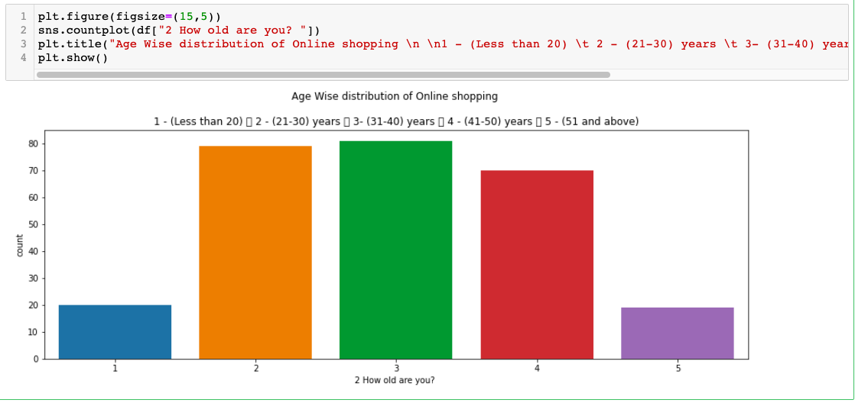
Univariate and Bivariate Analysis
Above countplot shows people of age between 31-40 Shoppe more than others

Slide 12
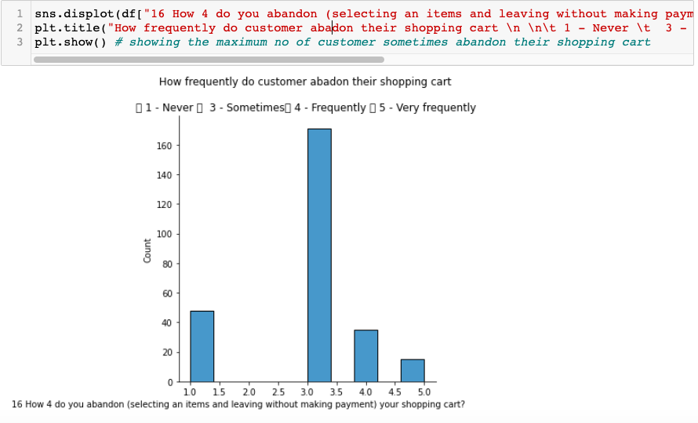
Displot representation
Above displot shows the majority of people abandon their shopping cart sometimes

Slide 13
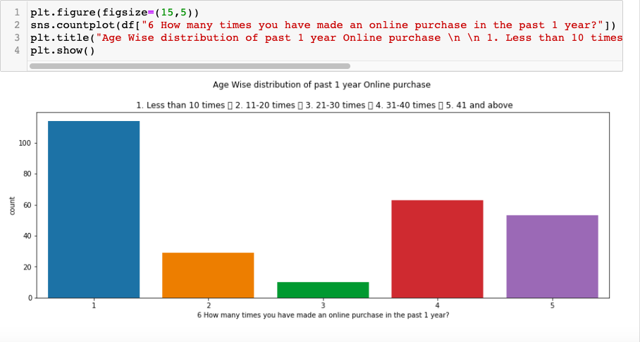
Countplot Representation
Above countplot shows the maximum customers have done online purchase less than 10 times in a year

Slide 14
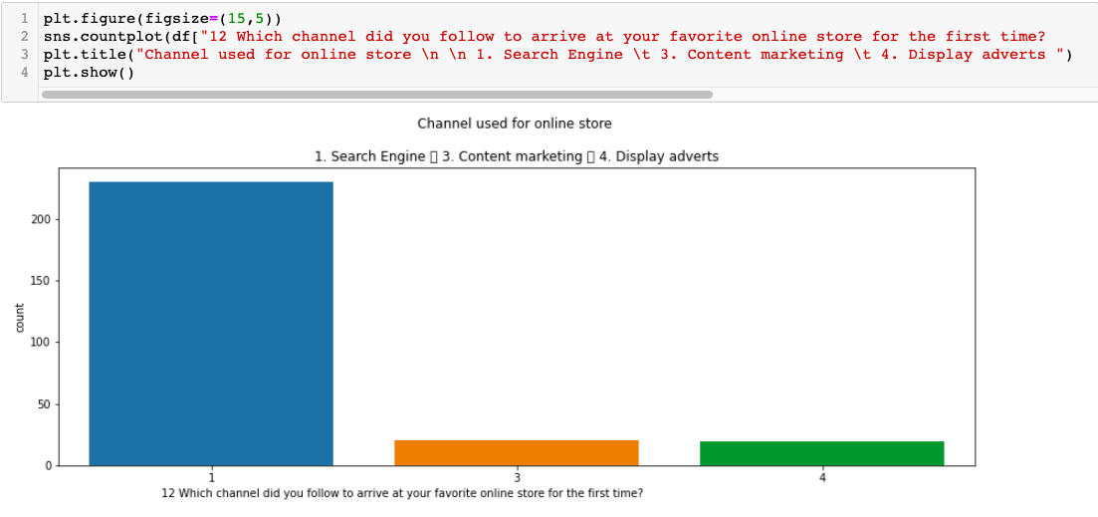
Countplot representation
Above countplot shows majority of customer follow search engine to arrive at your favourite online store

Slide 15
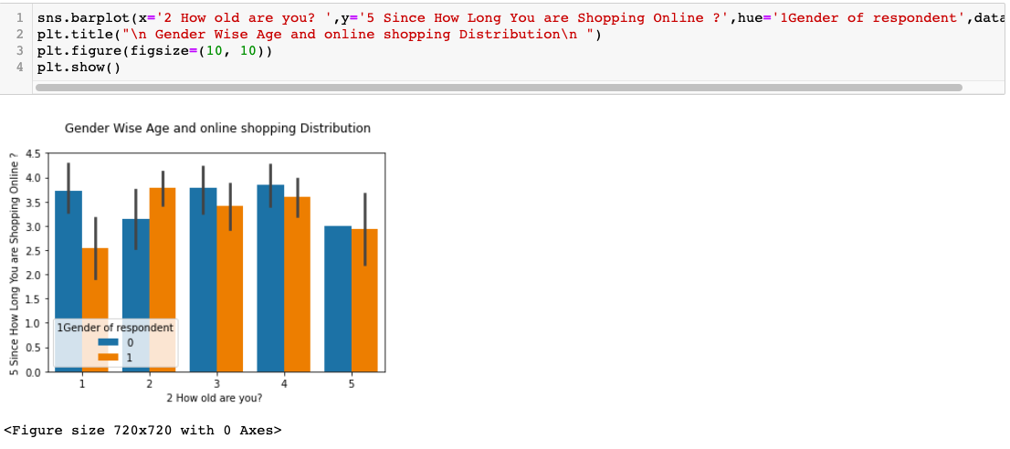
Barplot representation
Above barplot shows male of age between 31-40 years have maximum no of years of shopping online

Slide 16
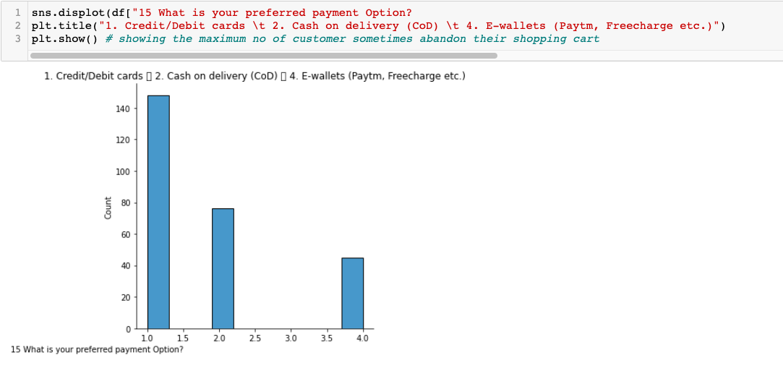
Displot Representation
Above displot shows that majority of customer prefer credit/debit cards for payment options

Slide 17
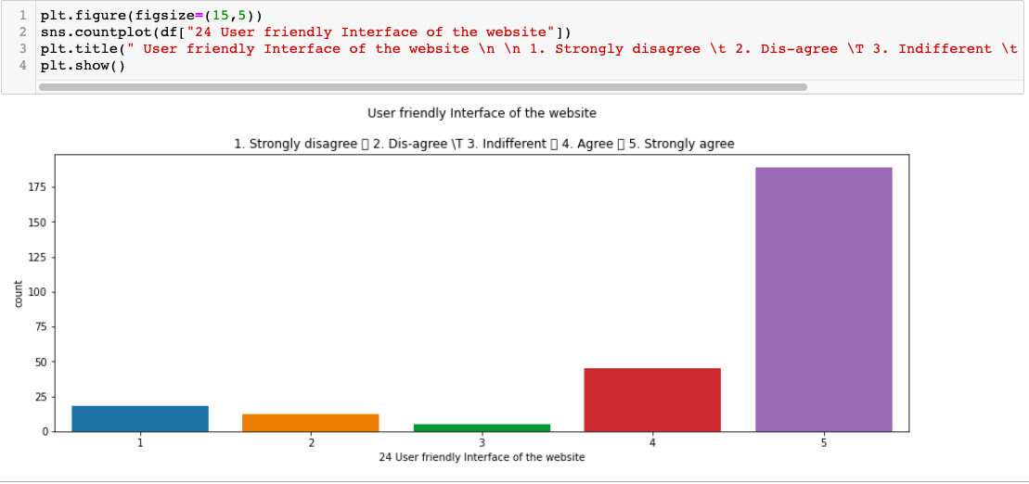
Countplot representation
Above countplot shows that mostly customer strongly agree with the user friendly interface of the website

Slide 18
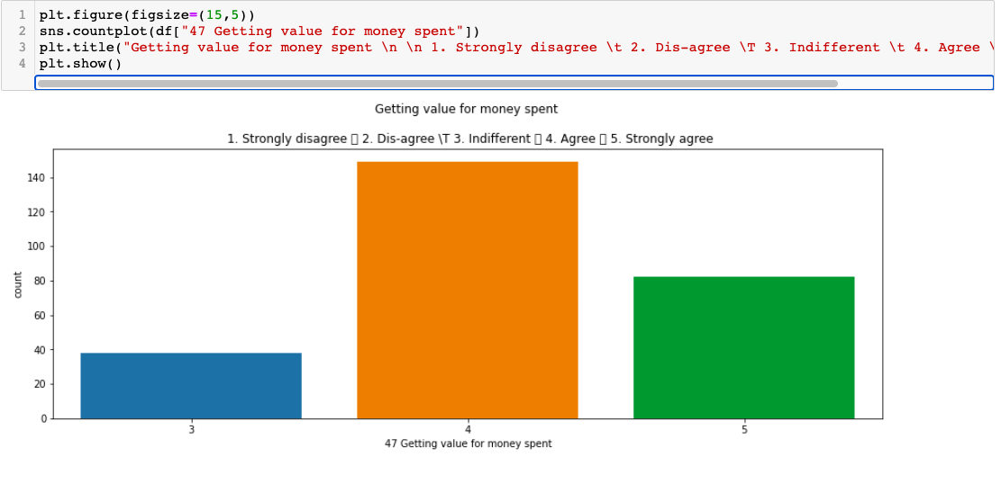
Countplot representation
Above countplot shows that majority of customer agree on getting value for money spent

Slide 19
CONCLUSION
Key Findings and Conclusions of the EDA
people of age between 31-40 Shoppe more than others .
majority of people abandon their shopping cart sometimes .
majority of customer follow search engine to arrive at your favorite online store.
majority of customer prefer credit/debit cards for payment options .
majority of customer agree on getting value for money spent.

Slide 20
END OF PRESENTATION

