Slide 1

RATINGS PREDICTION MODEL
Submitted by: BHAVNA PIPLANI

Slide 2
INTRODUCTION
Business Problem Framing
We have a client who has a website where people write different reviews for technical products. Now they are adding a new feature to their website i.e.
The reviewer will have to add stars(rating) as well with the review. The rating is out 5 stars and it only has 5 options available 1 star, 2 stars, 3 stars, 4 stars, 5 stars.
Now they want to predict ratings for the reviews which were written in the past and they don’t have a rating. So, we have to build an application which can predict the rating by seeing the review.

Slide 3
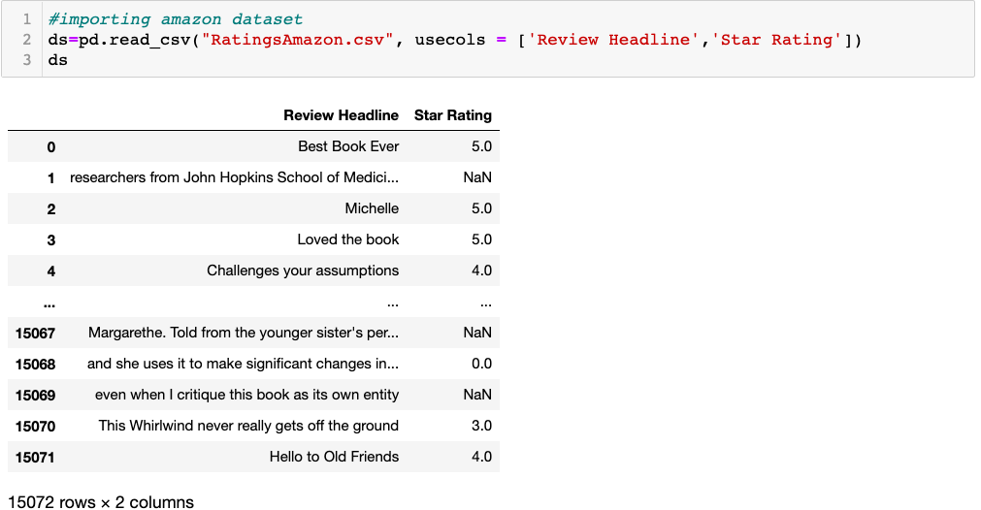
Explanatory Data Analysis
Importing the dataset from the csv file scraped from amazon.in.
.

Slide 4
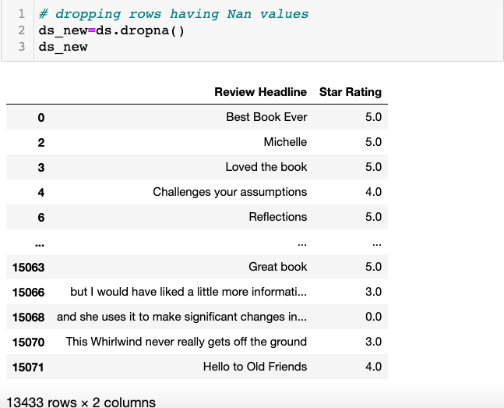
Data Cleaning
Dropping the rows having null values.

Slide 5
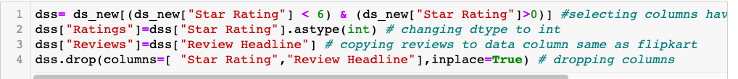
Remove Nan Values
Removing the rows with ratings having less than 1 and greater than 5.

Slide 6
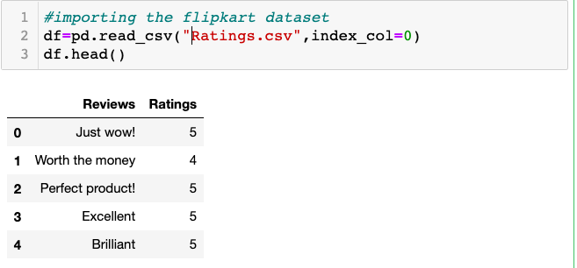
Importing Dataset
Importing other dataset to concatenate with this one.

Slide 7

Train Dataset shape
After concatenating the datasets ,
Train dataset has now 20258 rows and 2 columns

Slide 8
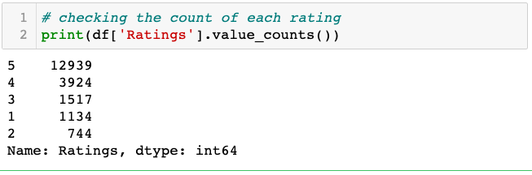
Checking Value count for Ratings
Data is not balanced . Rows count for all the ratings are not same.
Data balancing techniques like oversampling will be used for data balancing.

Slide 9
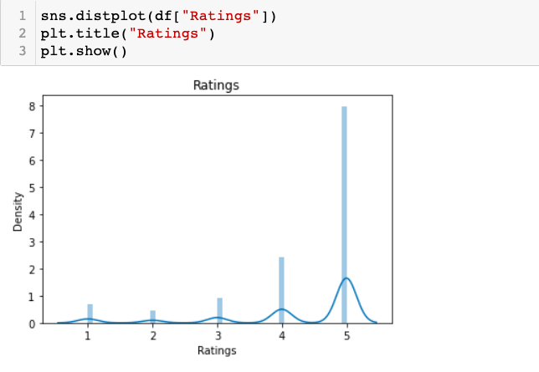
Data Visualization
Above distplot shows the max data is concentrated in 5 star rating

Slide 10
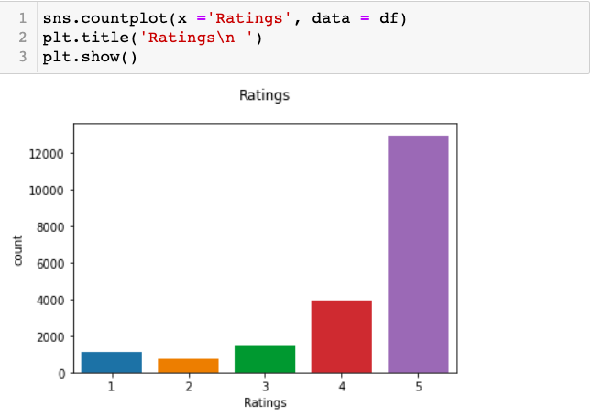
Countplot for Ratings
More than 12000 of records are concentrated in 5 star ratings which shows data is imbalanced.

Slide 11
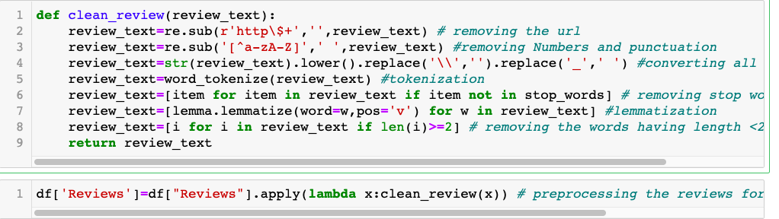
Pre-Processing Pipeline
Data cleaning like removing everything from the text other than alphabets , tokenization , lemmatization .

Slide 12
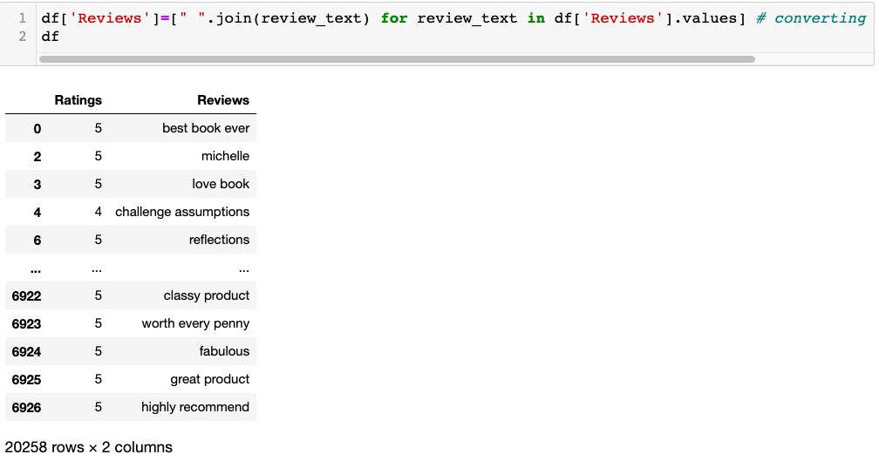
Processed Dataset
Representation of cleaned dataset for model training.

Slide 13
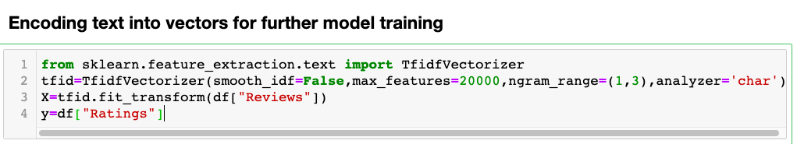
TfidfVectorizer
Encoding text into vectors using TfidfVectorizer

Slide 14
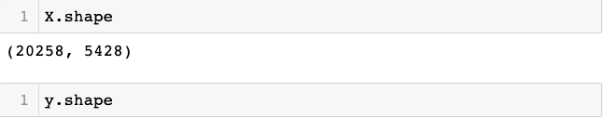
X and y variables shape
After all the data cleaning and data processing, X and y variables are processed for training the model.

Slide 15
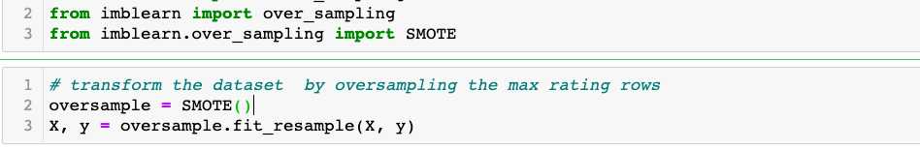
Data Balancing
We will do oversampling using SMOTE to balance the data for data modelling.

Slide 16
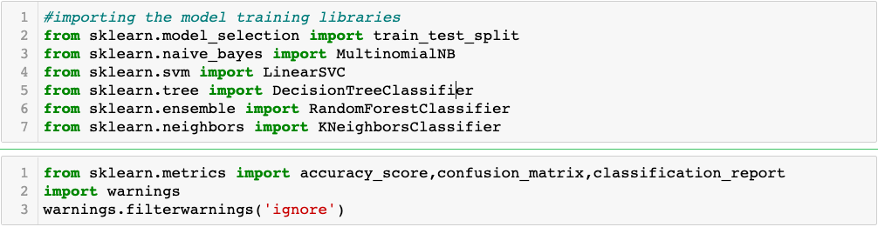
Importing Libraries
Libraries and packages used for model training are listed below

Slide 17
Model Development and Evaluation
Most common techniques will fall into the following two groups:
Supervised learning, including regression and classification models.
Unsupervised learning, including clustering algorithms and association rules.
In this project I will be using MultinomialNB(), LinearSVC(), DecisionTreeClassifier(), RandomForestClassifier(), KNeighborsClassifier() algorithms

Slide 18
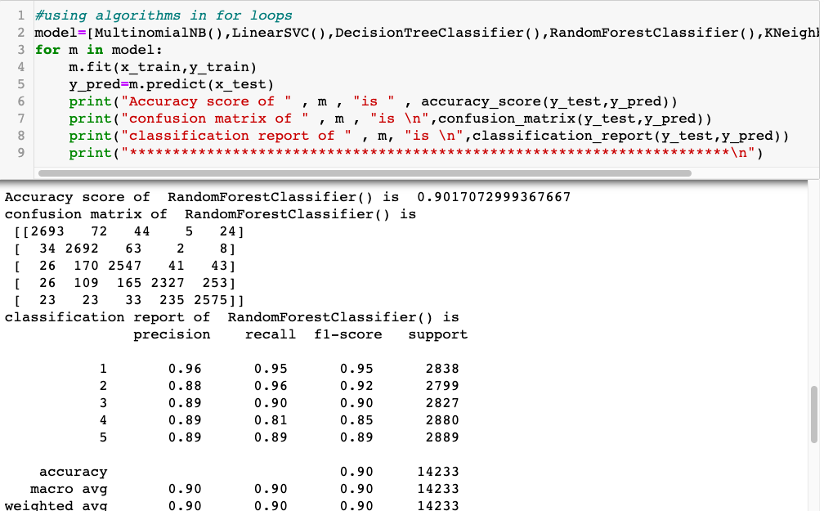
Finding the best model
The best performing model was RandomForestClassifier with more than 90% of accuracy. Also, precision and F1 score for all the ratings was pretty good.

Slide 19
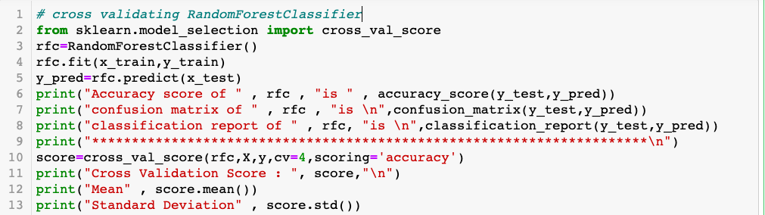
Cross Validating the model
Cross validating the best performing model: RandomForestClassifier model.

Slide 20
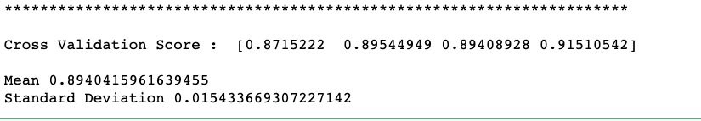
Cross validation score
Accuracy for validation was also proved good. Mean was around .894. And Standard Deviation was very less.

Slide 21
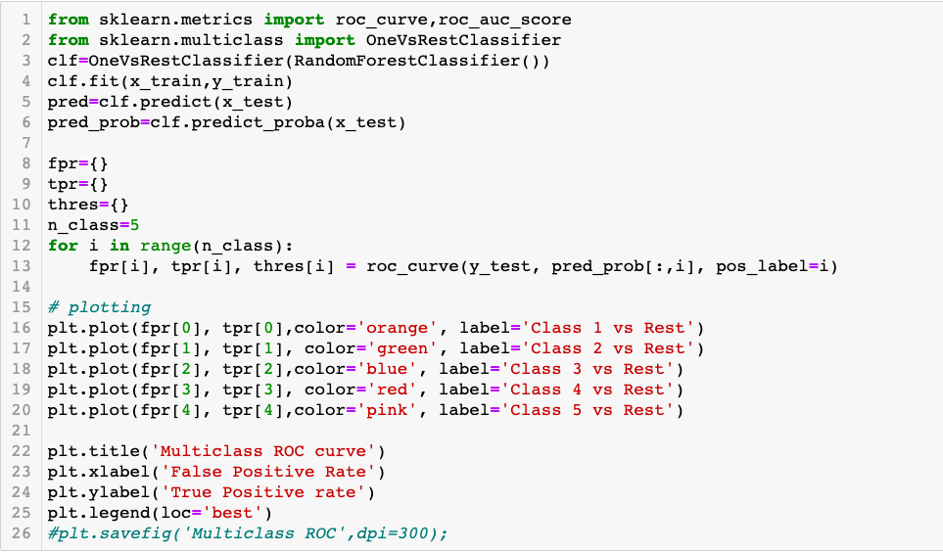
OneVsRestClassifier
OneVsRestClassifier used for representing the accuracy by auc_roc curve in multiclass classification .

Slide 22
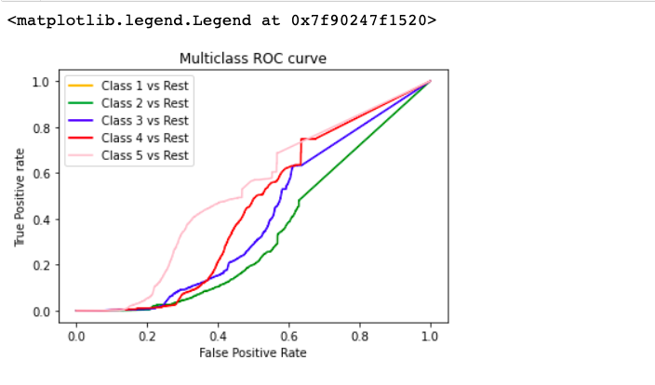
Representation of AUC_ROC

Slide 23
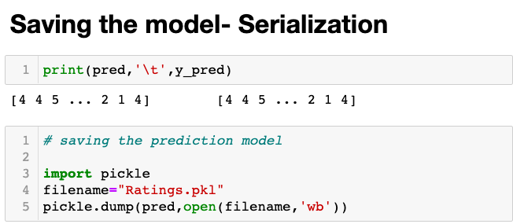
Saving the model--- Serialization
Now, as the model is performing good with the score of 90% , we will save the predicted_model .

Slide 24
CONCLUSION
Key Findings and Conclusions of the Study:
Data scraped from different e-commerce websites was uncleaned.
Data Preprocessing using NLP was done including tokenization, lemmatization, data cleaning by removing every symbol, special characters etc other than alphabets.
Data was imbalanced as the star ratings scraped from different websites were not same for 1 – 5 stars.
SMOTE over_sampling was used to balance the class data
RandomForestClassifer was the best performing and fit model.

