Slide 1

FAKE NEWS DETECTION MODEL
Submitted by: BHAVNA PIPLANI

Slide 2
INTRODUCTION
Business Problem Framing
The authenticity of Information has become a longstanding issue affecting businesses and society, both for printed and digital media.
On social networks, the reach and effects of information spread occur at such a fast pace and so amplified that distorted, inaccurate, or false information acquires a tremendous potential to cause real-world impacts, within minutes, for millions of users.
Recently, several public concerns about this problem and some approaches to mitigate the problem were expressed.

Slide 3
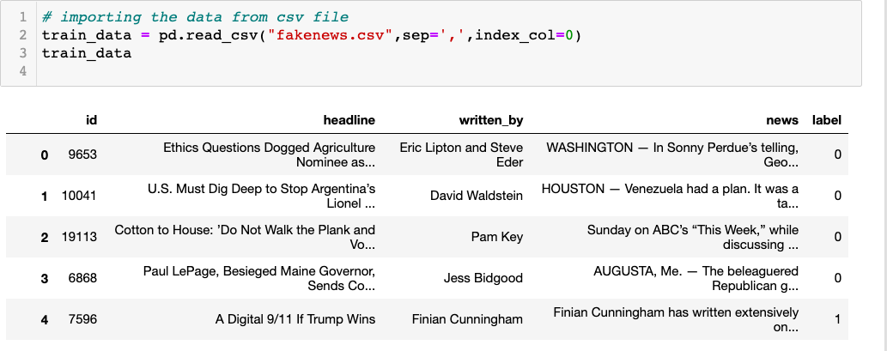
Explanatory Data Analysis
Importing the dataset from the file provided in csv format.
.

Slide 4
Train Dataset shape
Train dataset has 20800 rows and 5 columns

Slide 5
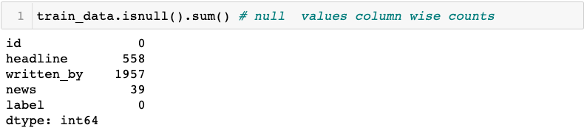
Data Cleaning
Few rows are having null values .

Slide 6
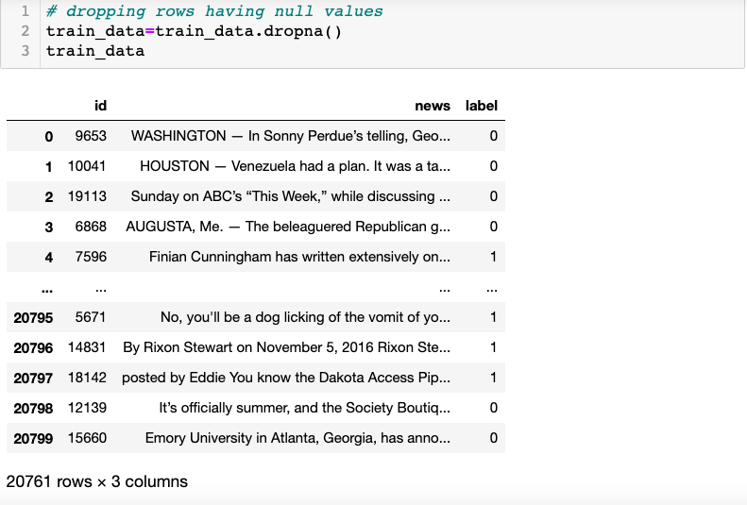
Dropping the null values
Dropping the rows having null values.

Slide 7
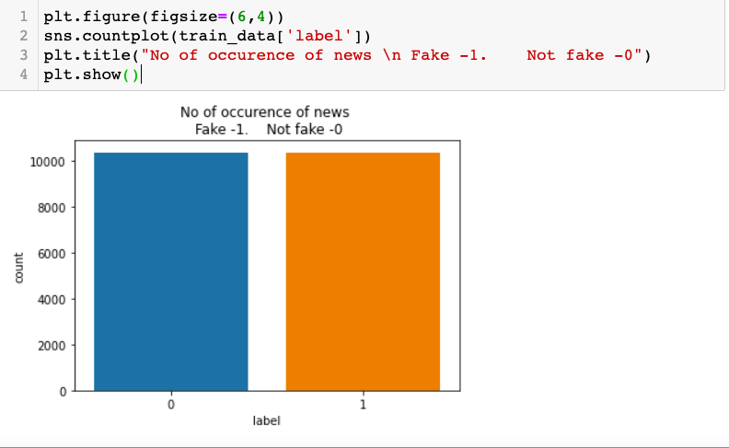
Data Visualization
Above countplot shows the number of occurrence of news in both values i.e for 0 and 1

Slide 8
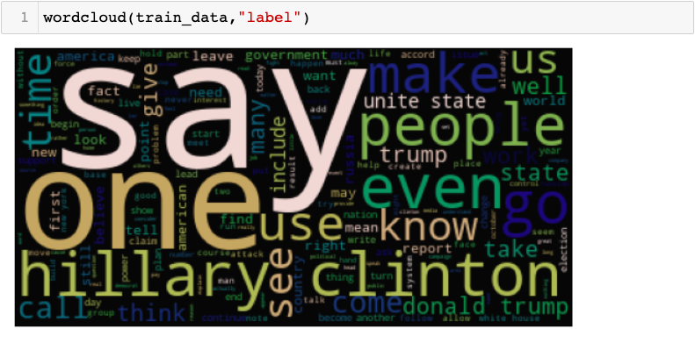
WordCloud to display words
Above wordclous displays few words used in the news feature.

Slide 9
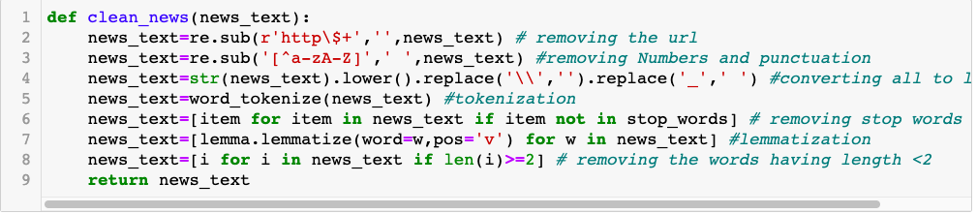
Pre-Processing Pipeline
Data cleaning like removing everything from the text other than alphabets , tokenization , lemmatization .

Slide 10
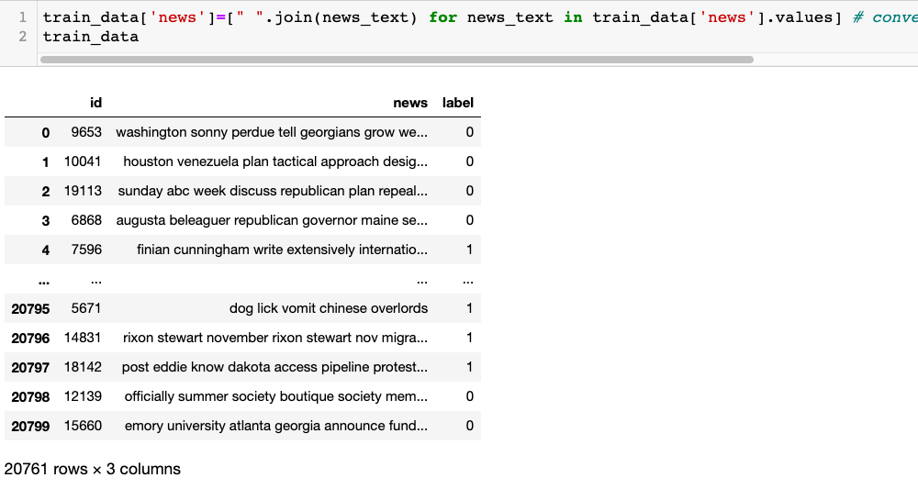
Processed Dataset
Representation of cleaned dataset for model training.

Slide 11
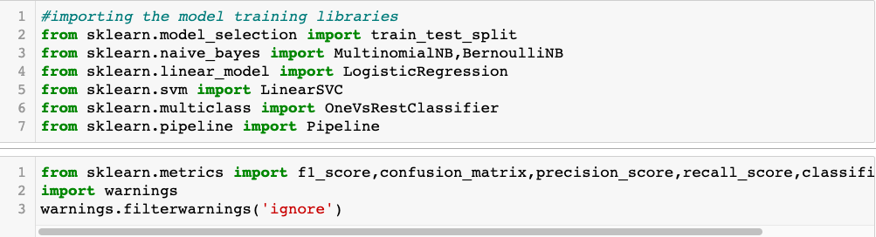
Importing Model building Libraries
Libraries and packages used for vectorization and model training

Slide 12
Model Development and Evaluation
Most common techniques will fall into the following two groups:
Supervised learning, including regression and classification models.
Unsupervised learning, including clustering algorithms and association rules.
In this project I will be using LogisticRegression(), MultinomialNB(), LinearSVC(), DecisionTreeClassifier(), RandomForestClassifier(),KNeighborsClassifier() algorithms

Slide 13
Steps followed for Model building
(TDidF Vectorizer) Encoding text into vectors for further model training
2. Model Training and metrics representation

Slide 14
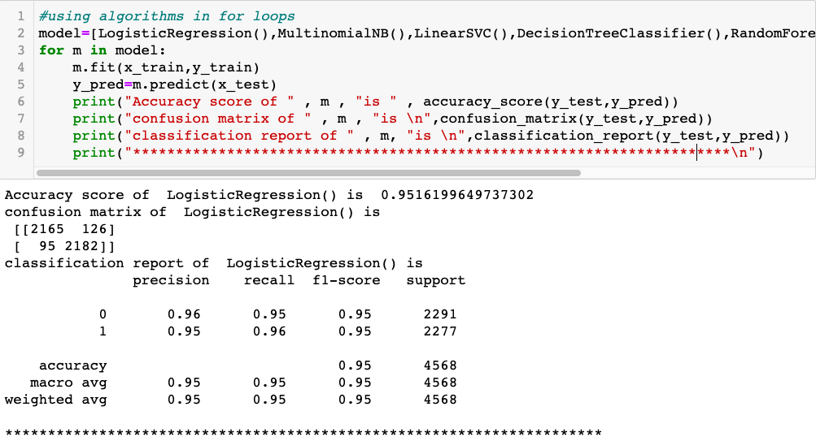
Various Models Training
Using the various models in loop

Slide 15
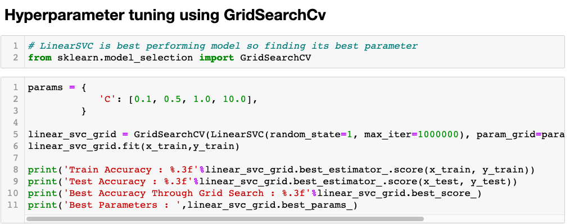
Hyperparameter Tuning
Finding the best accuracy and best parameters .

Slide 16
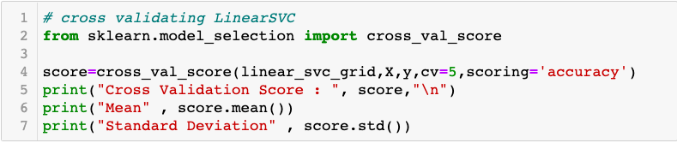
Cross Validating the model
Cross validating the best performing model: LinearSVC model.

Slide 17
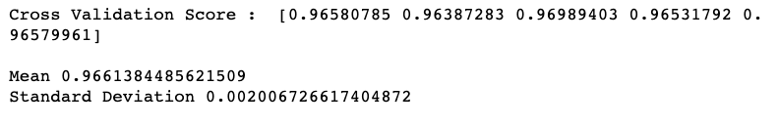
Cross validation score
Accuracy for validation was also proved good . Mean was around .966. And Standard Deviation was very less.

Slide 18
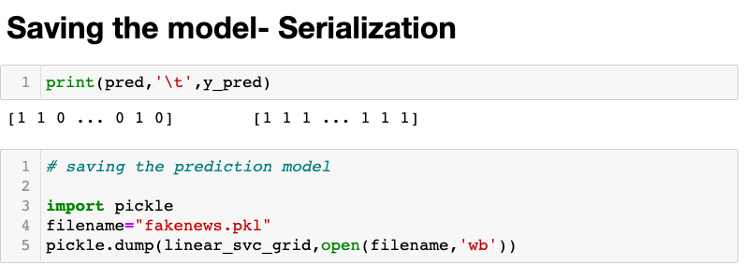
Saving the model--- Serialization
Now, as the model is performing good with the score of 97% , we will save the predicted_model .

Slide 19
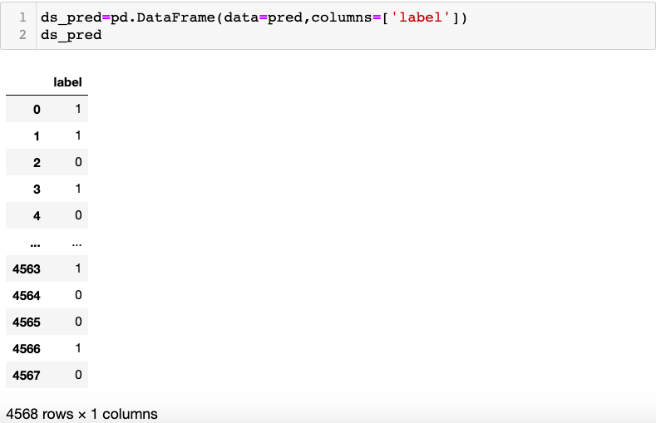
Prediction for the test data

Slide 20
CONCLUSION
Key Findings and Conclusions of the Study:
Data received from csv file was quite clean other than few null values were seen.
Data Preprocessing using NLP was done including tokenization, lemmatization, data cleaning by removing every symbol, special characters etc other than alphabets.
Data was balanced as the fake news and not fake news count was almost equal.
LinearSVC was the best performing and fit model

