Slide 1

MALIGNANT COMMENT CLASSIFIER
Submitted by: BHAVNA PIPLANI

Slide 2
INTRODUCTION
Business Problem Framing
Online hate, described as abusive language, aggression, cyberbullying, hatefulness and many others has been identified as a major threat on online social media platforms. Social media platforms are the most prominent grounds for such toxic behavior.
Internet comments are bastions of hatred and vitriol. While online anonymity has provided a new outlet for aggression and hate speech, machine learning can be used to fight it.

Slide 3
Our goal is to build a prototype of online hate and abuse comment classifier which can used to classify hate and offensive comments so that it can be controlled and restricted from spreading hatred and cyberbullying.
The problem we sought to solve was the tagging of internet comments that are aggressive towards other users. This means that insults to third parties such as celebrities will be tagged as inoffensive, but “u are an idiot” is clearly offensive.

Slide 4
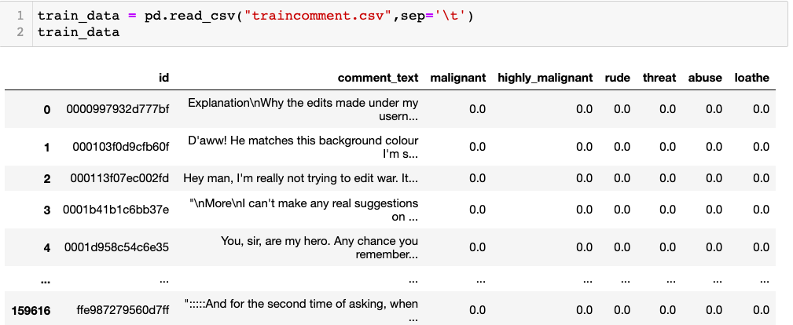
Explanatory Data Analysis
Importing the dataset from the file provided in csv format.
.

Slide 5

Train Dataset shape
Train dataset has 159621 rows and 8 columns

Slide 6
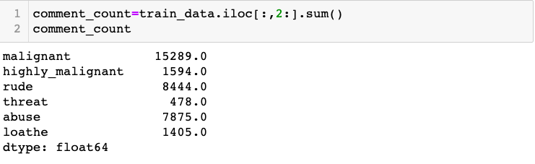
Checking count for Comments in each class
Data is not balanced . Rows count for all the comments are not same.
Data balancing techniques like SMOTE oversampling will be used for data balancing.

Slide 7
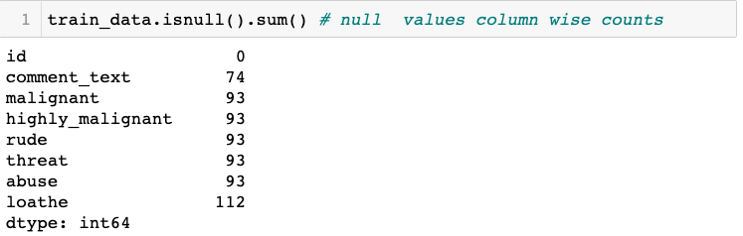

Data Cleaning
Few rows are having null values . Dropping the rows having null values.

Slide 8
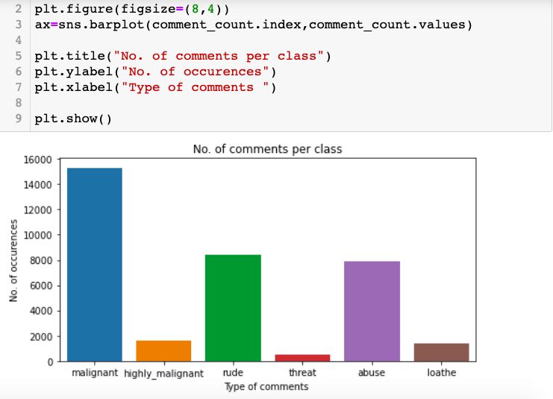
Data Visualization
Above countplot shows that no of comments per class. As it shows a very high range in malignant class and very low comments in threat class.

Slide 9
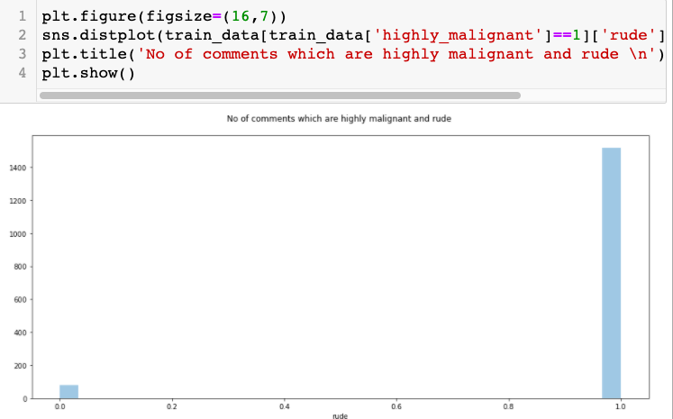
distplot for comments
Above distplot shows around 90 comments are highly malignant and rude too.

Slide 10
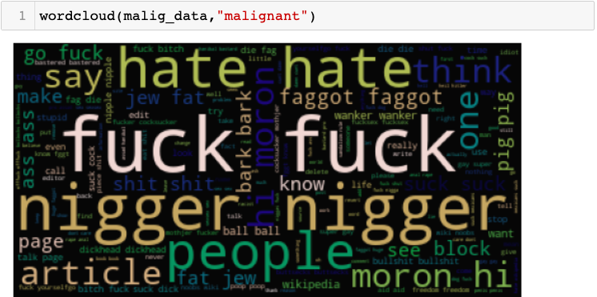
Wordcloud to show words used in comments

Slide 11
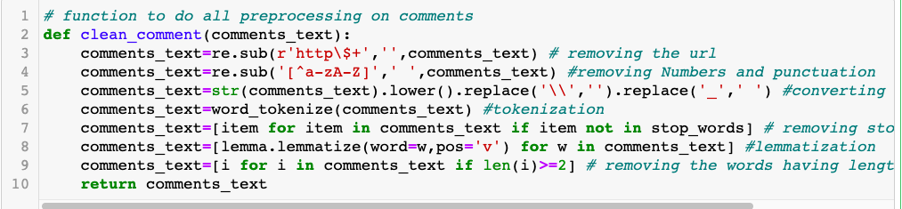
Pre-Processing Pipeline
Data cleaning like removing everything from the text other than alphabets , tokenization , lemmatization .

Slide 12
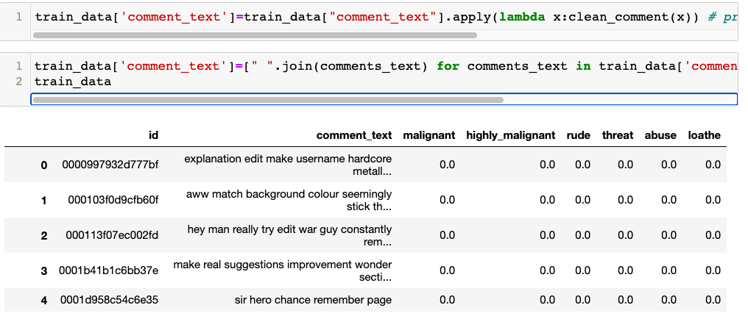
Processed Dataset
Representation of cleaned dataset for model training.

Slide 13
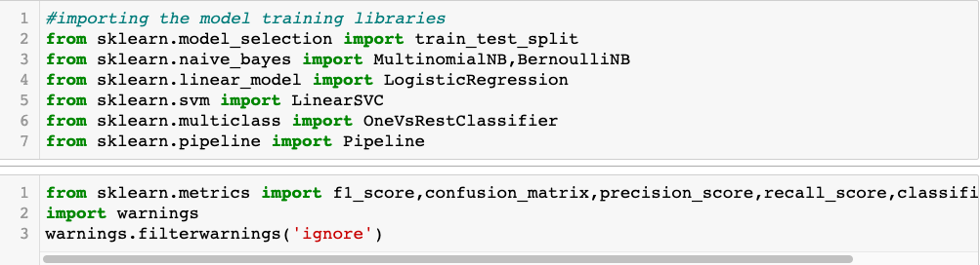
Importing Model building Libraries
Libraries and packages used for vectorization ,Pipelining and model training

Slide 14
Model Development and Evaluation
Most common techniques will fall into the following two groups:
Supervised learning, including regression and classification models.
Unsupervised learning, including clustering algorithms and association rules.
In this project I will be using LogisticRegression(), BernoulliNB(), MultinomialNB(), LinearSVC() algorithms

Slide 15
Steps followed for Model building
(TDidF Vectorizer) Encoding text into vectors for further model training
2. Pipeline the models with TDidF Vectorizer and OneVsrestClassifier for solving multiclass classification model
3. Model Training and metrics representation

Slide 16
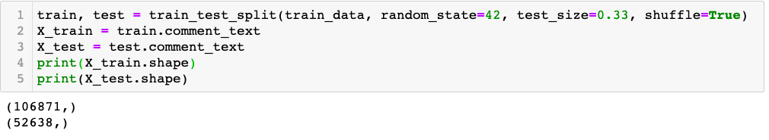
Train_test_split

Slide 17
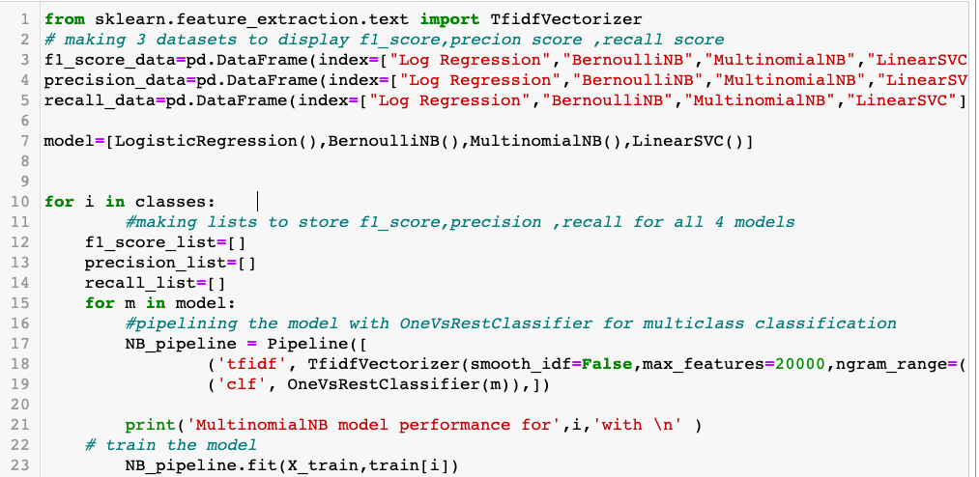
Step 1,2 followed

Slide 18
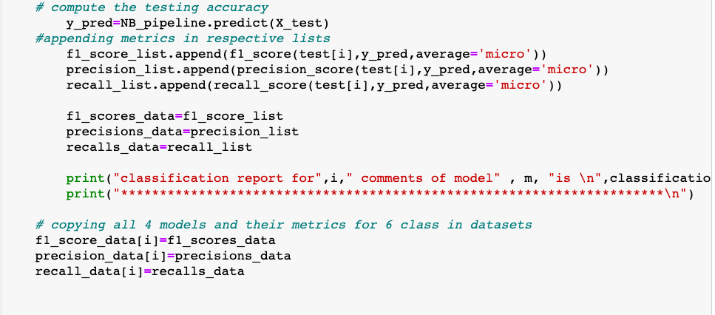
Step 3

Slide 19
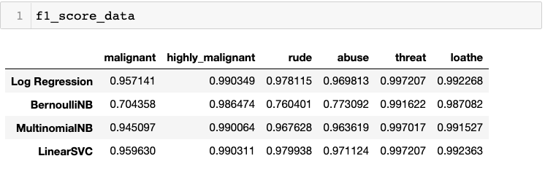
F1_score

Slide 20
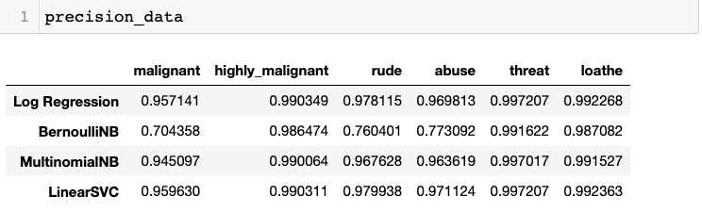
Precision_score

Slide 21
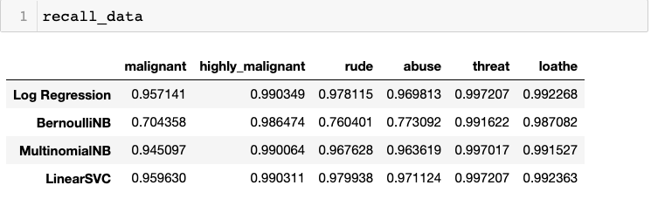
Recall_score

Slide 22
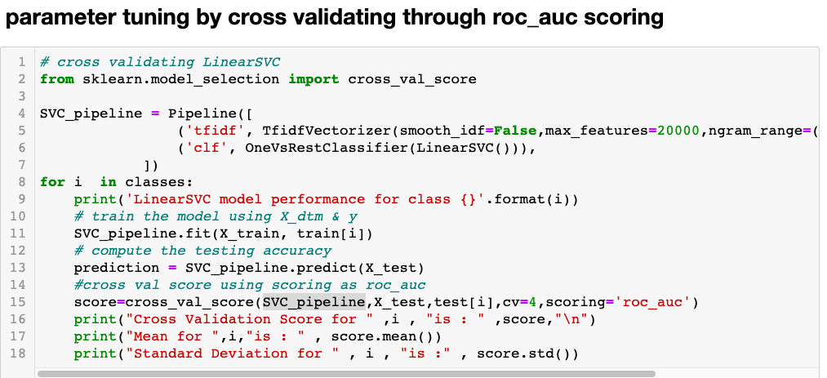
Cross Validating the model
Cross validating the best performing model: LinearSVC model.

Slide 23
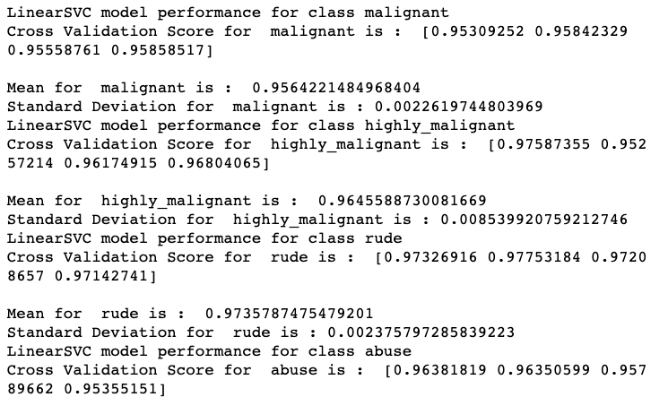
Cross validation score
Accuracy for validation was also proved good . Mean was around .98. And Standard Deviation was very less.

Slide 24
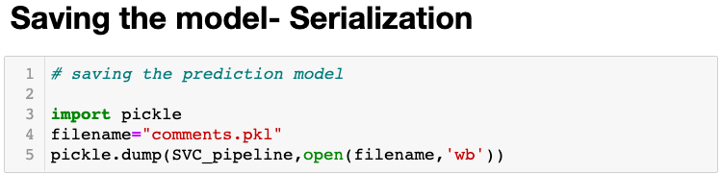
Saving the model--- Serialization
Now, as the model is performing good with the score of 98% , we will save the predicted_model .

Slide 25
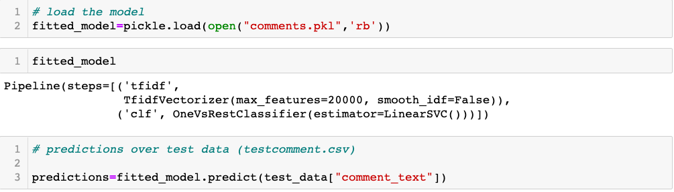
Prediction over test_data

Slide 26
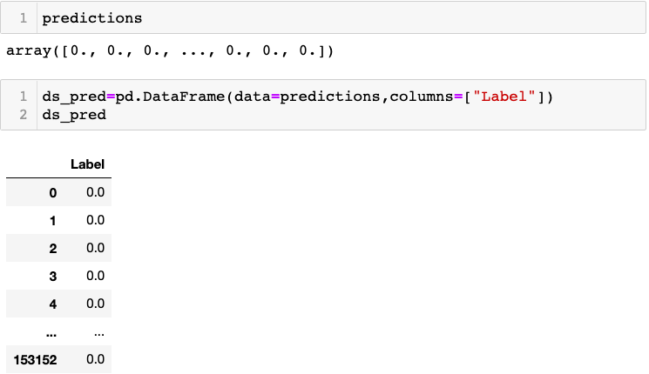
Prediction for the test data of 153157 rows

Slide 27
CONCLUSION
Key Findings and Conclusions of the Study:
Dataset was very huge requiring lot of data cleaning.
OneVsRestClassifier was used for multiclass classification.
F1 score and Recall metrics was used to see how well the positive class was predicted and is the same calculation as sensitivity.
Precision was used to see the fraction of examples assigned the positive class that belong to the positive class.
LinearSVC was the best fit model.

