Slide 1
Shopping Car
Ariel Gonzales
Franz Vidangoz
Vivian Zamorano
Kattya Espinoza
Trainer: Paolo Sandoval
Notes:
Hemos diseñado esta plantilla para que cada miembro del equipo del proyecto tenga un conjunto de diapositivas con su propio tema. De esta manera, los miembros agregan una nueva diapositiva al conjunto:
Marque el lugar donde desea agregar la diapositiva: seleccione una existente en el panel de miniaturas, haga clic en el botón Nueva diapositiva y luego elija un diseño.
La nueva diapositiva tiene el mismo tema que la anterior que seleccionó.
Tenga cuidado. No moleste a los demás moderadores al cambiar accidentalmente sus temas. Eso puede suceder si elige un tema Variante de la pestaña Diseño, que aplica esa apariencia a todas las diapositivas de la presentación.

Slide 2
Schedule / Themes
Project description
Methodology of the project
Obtaining details of the investigation
Conclusion

Slide 3
Project description
Objective
Results
Develop an application that allows a client to perform a purchase order which can include one or several items available through the virtual store.
It offers the buyer the convenience of acquiring all types of products from anywhere, through an online connection and with a simple click. Something that turns out to be quite convenient nowadays and that also starts to be one of the most common ways of doing business.

Slide 4
Procedure / methodology
The design pattern (Design Pattern) Model-View-Controller (MVC)
The database that was used is SQLite 3

Slide 5
Model-View-Controller Design Pattern with Python
The MVC is nothing more than the application of the principle of "Separation of Concerns" (Separation of Concern) to the design of applications, where each of the components of the pattern has a well-defined and unique responsibility.
The Model contains and manages the business logic, data, status and other fundamental rules of the application. The data can be stored in the Model itself or in a database, in the latter case only the Model can access this database.

Slide 6
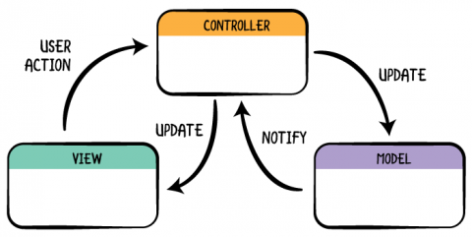
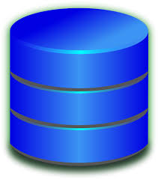
Model-View-Controller Design Pattern with Python
cart_controller
DB
main_view
item
model
shopping_car
store
product_insert_view
product_show_view

Slide 7
Model-View-Controller Design Pattern with Python
tables
Items
Records
database_connection
DB
methods
Insert
Delete
Update
Select
database_manager

Slide 8
Development procedure
The Model contains and manages the business logic, data, status and other fundamental rules of the application. The data can be stored in the Model itself or in a database, in the latter case only the Model can access this database.
The View is the visual component, that is, a visual representation of the Model that the user can usually see on the screen, such as: Graphical User Interfaces (GUI).
Controller is nothing more than the link or means of communication between the Model and the View. All communication flow between the Model and the View is managed through the Controller, therefore, there will be no direct communication between these

Slide 9
Conclusion
In general, the MVC pattern requires the implementation of three classes. The Controller class initializes the instances of the Model and the View; The Vista must receive a reference from the Controller in order to communicate with him and send him the user's requests; The Controller, on the other hand, can freely access all the attributes and methods of the public interface of the Model and of the View. Finally, a fourth element will be defined, the so-called "client code", which will define an instance of the Controller and execute it.

Slide 10
References
https://www.programcreek.com/python/example/106684/PyQt5.QtGui.QIntValidator
http://www.pythondiario.com/2018/07/base-de-datos-sqlite-con-pyqt5.html
https://www.instintoprogramador.com.mx/2018/05/conceptos-sobre-el-patron-mvc.html

