Slide 1




Presentation intro
Project seminar – Object-Oriented Programming - Group 7
22127196 - Lê Ngọc Anh Khoa
22127264 - Hoàng Tuý Minh
22127415 - Nguyễn Đức Tín
22127464 - Võ Thịnh Vượng
14/12/2023

Slide 2
Outline
Game concepts
Technical implementations
Demo video

Slide 3
Game concepts
I
Objective
Gameplay
Scoring
Designs
Other features

Slide 4
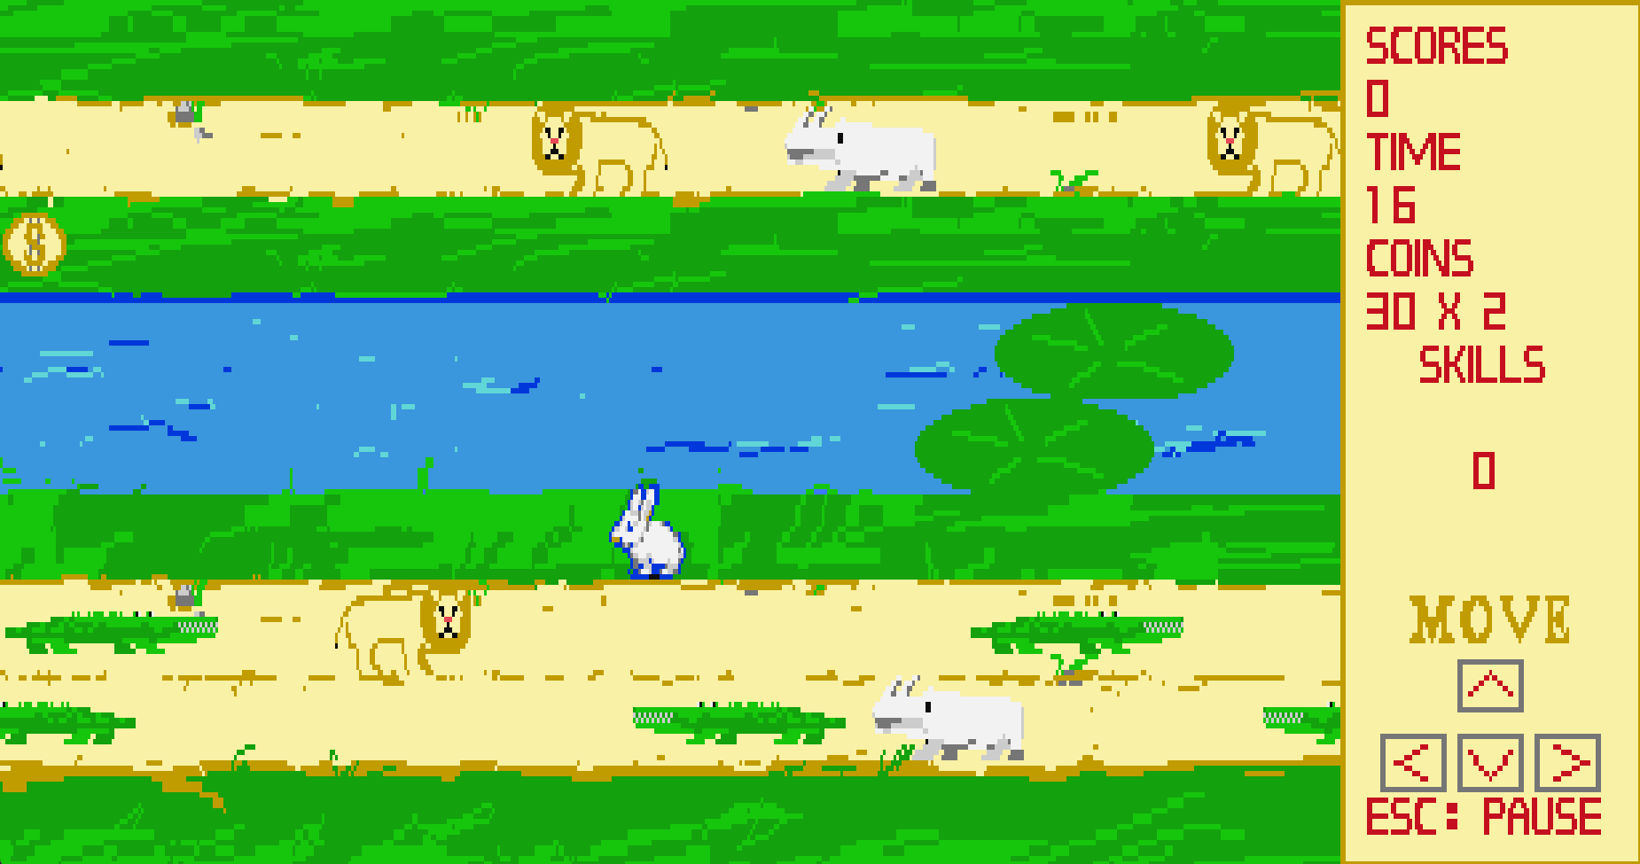
1. Objective
I. Game concepts
Help the character get to the other side!
Dodge moving obstacles to reach the goal.

Slide 5
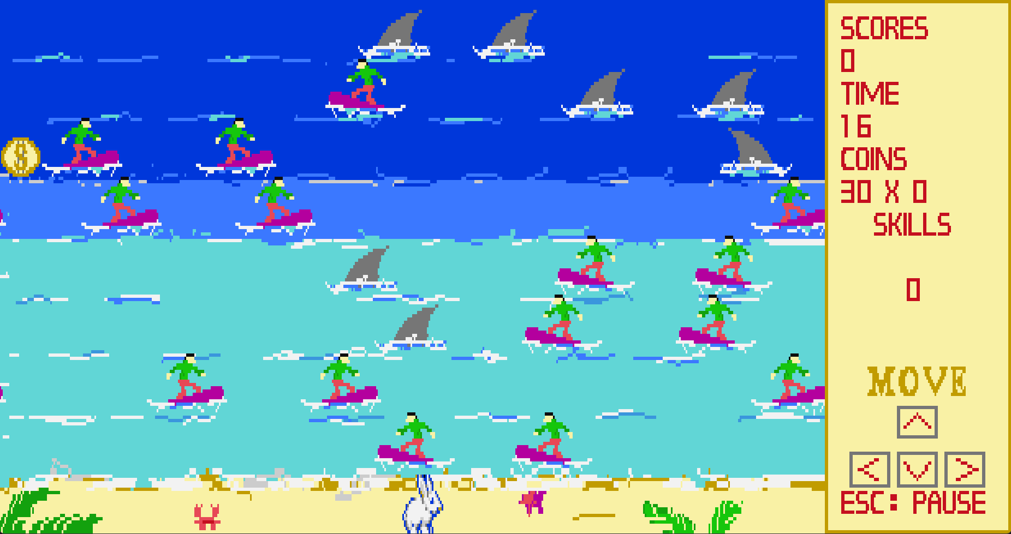

1. Objective
I. Game concepts
Endless mode
Score as many points as possible!
The game gradually gets more difficult

Slide 6


1. Objective
I. Game concepts
Complete a level every time you make it to the other side.
Go through all the levels to complete the game!
Each level gets more difficult.
LV UP!

Slide 7
2. Gameplay
I. Game concepts
Each level has a set obstacle layout.
Obstacles move horizontally with gaps between them.
Obstacle density and speed increases on later levels.

Slide 8
2. Gameplay
I. Game concepts
Obstacles can sometimes stop. Players need to adapt accordingly.
Different kinds of obstacles provide variety.
A lane currently stopped, as shown by the red light

Slide 9
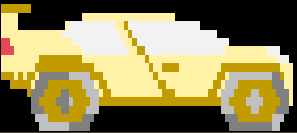
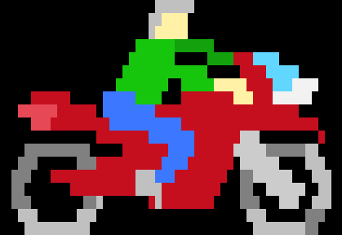
2. Gameplay
I. Game concepts
Players can activate skills. Skills trigger varying effects that can aid players.
Each skill has a cooldown.

Slide 10




3. Scoring
I. Game concepts
Complete a level to earn points.
Going faster earn you more points.

Slide 11
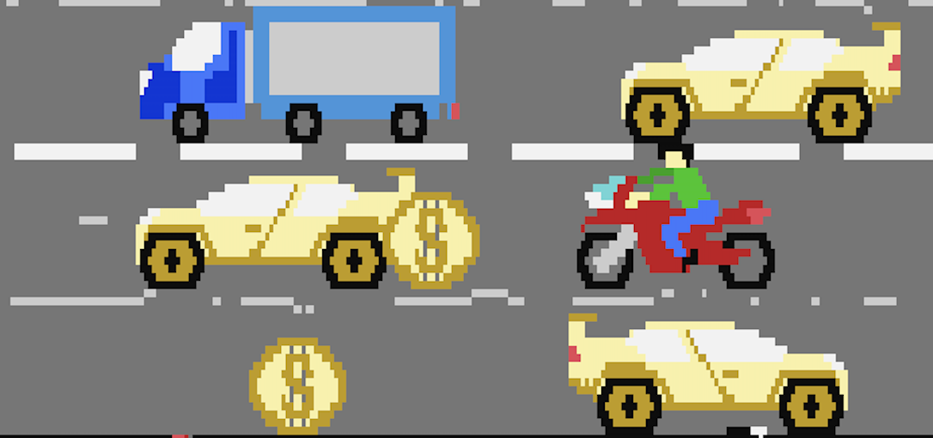
3. Scoring
I. Game concepts
Coins appear randomly on the map.
Collecting coins is risky but grants bonus points.

Slide 12
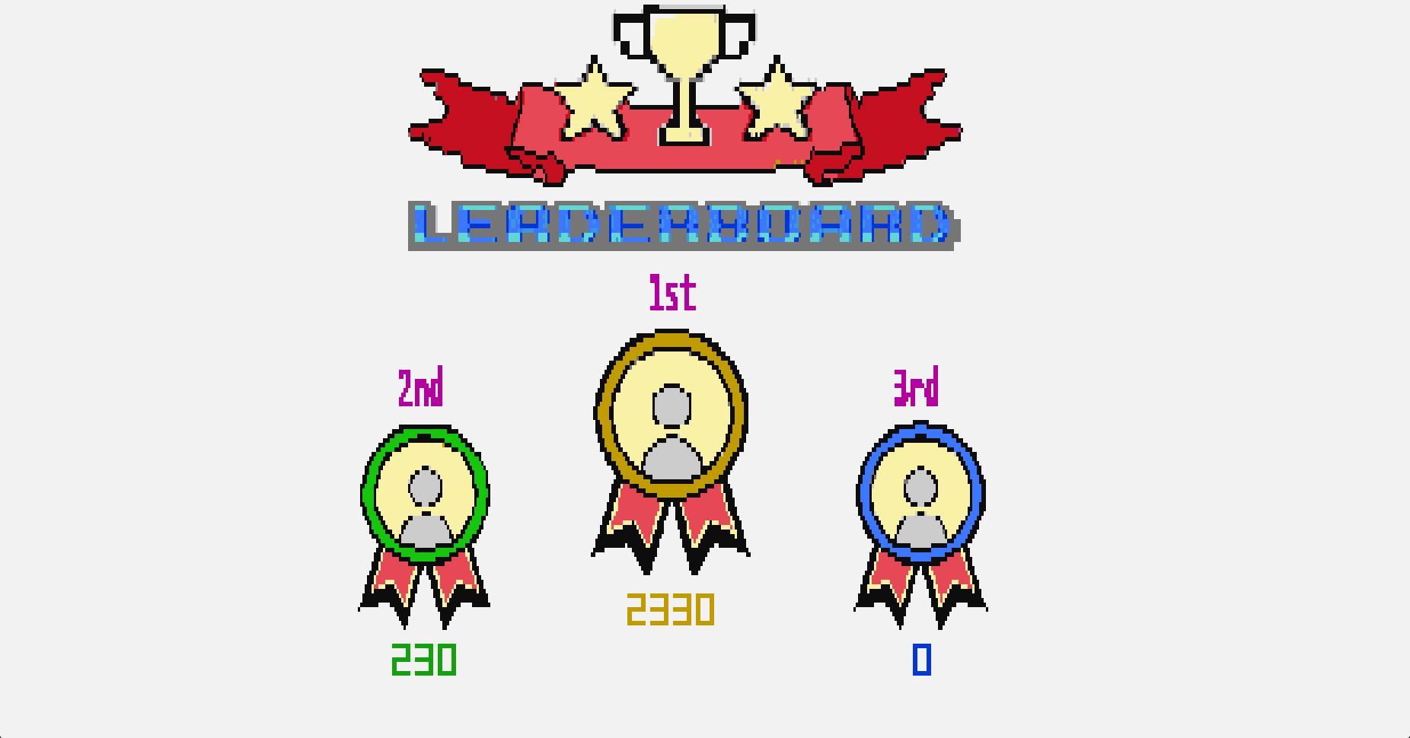
3. Scoring
I. Game concepts
Compete with friends on the leaderboard.
Leaderboard stores local scores.

Slide 13

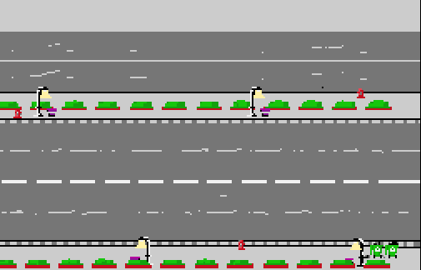
4. Designs
I. Game concepts
Themes

Slide 14


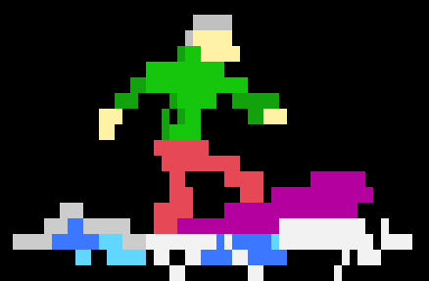
4. Designs
I. Game concepts
Obstacles

Slide 15
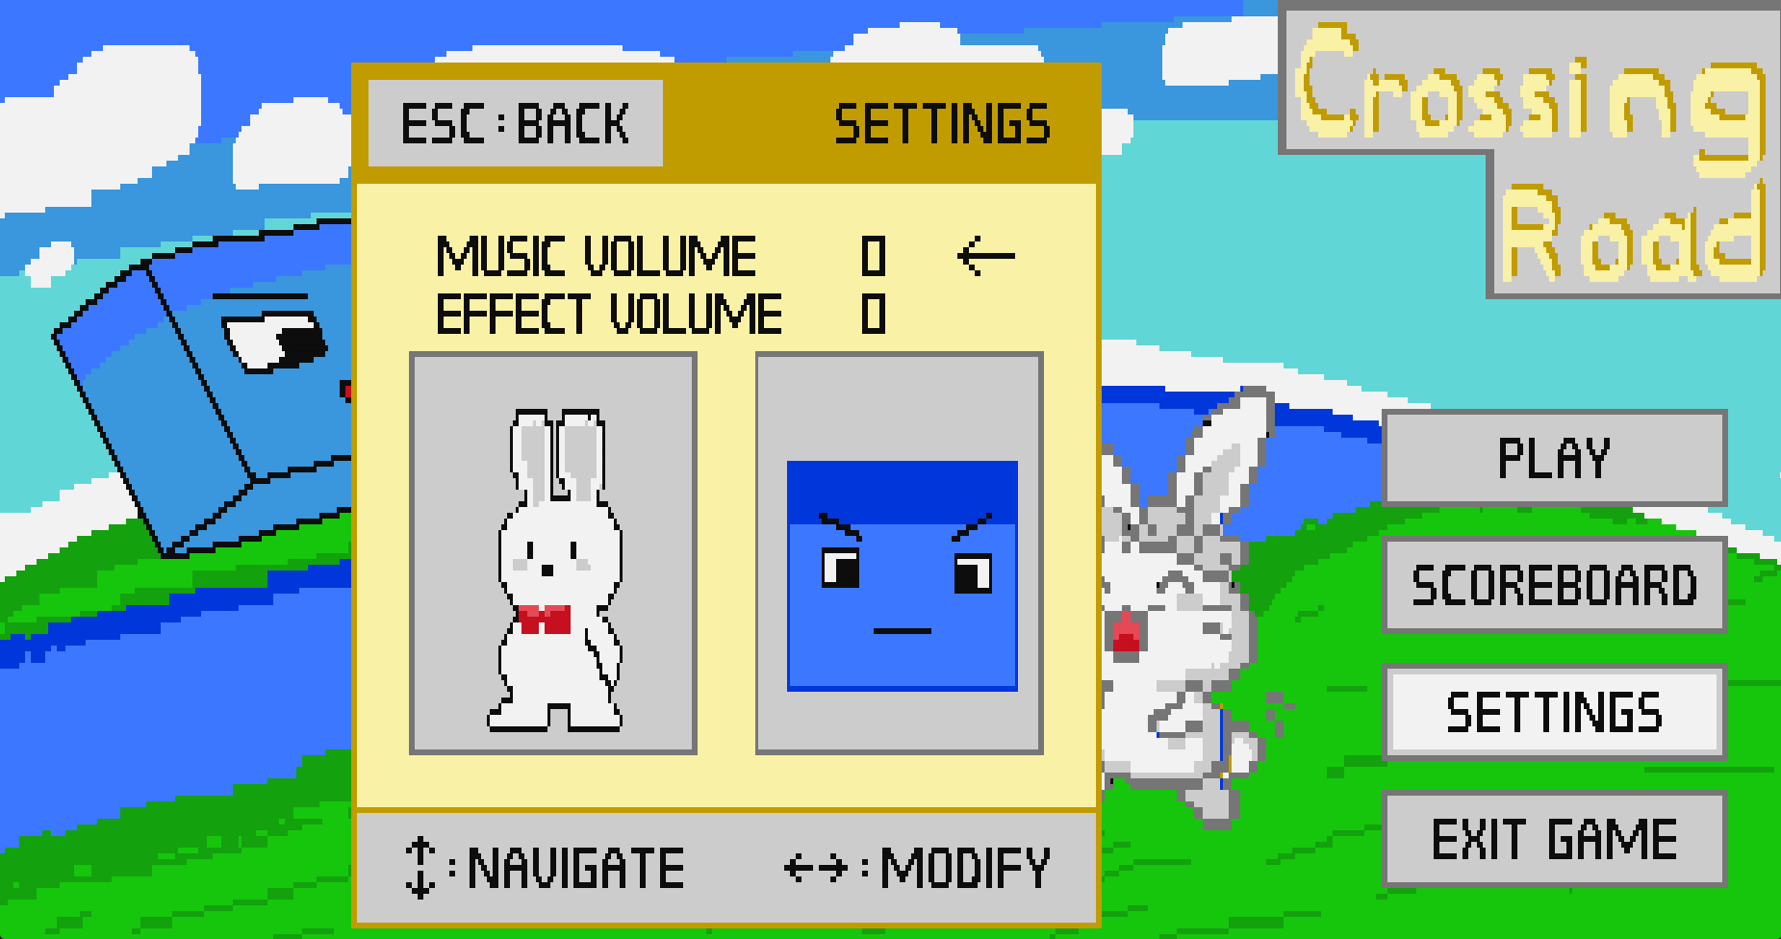
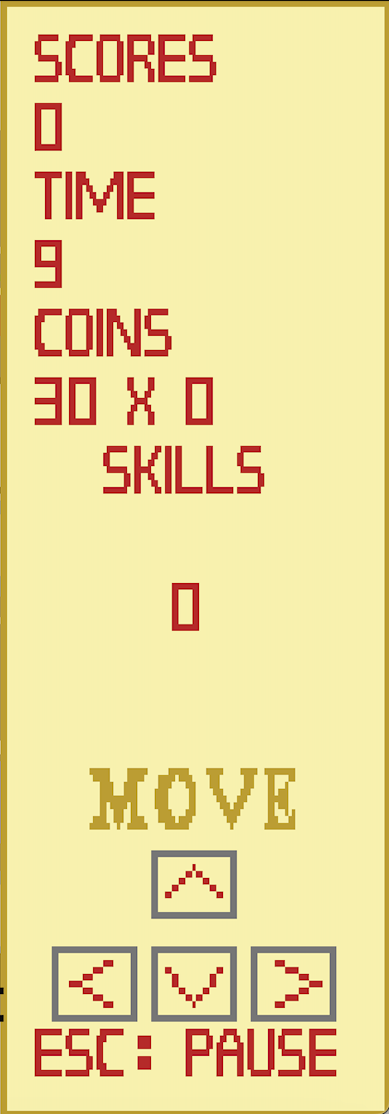
4. Designs
I. Game concepts
UI

Slide 16
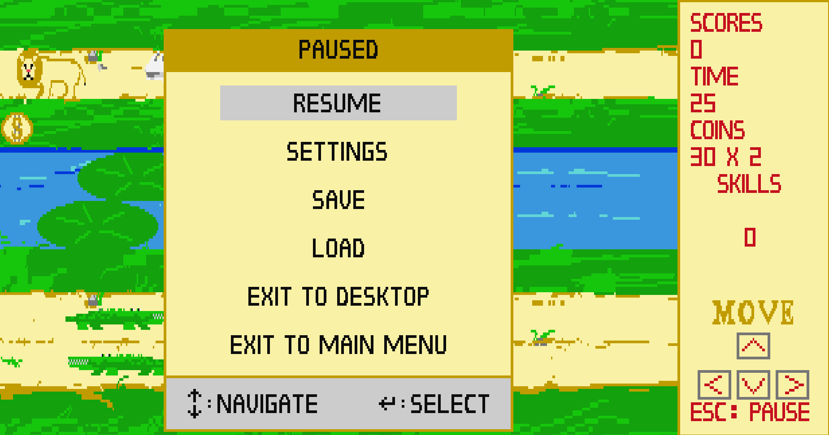
5. Other features
I. Game concepts
Pause
The game can be paused at any time. A pause screen will appear, and all objects are stopped.

Slide 17
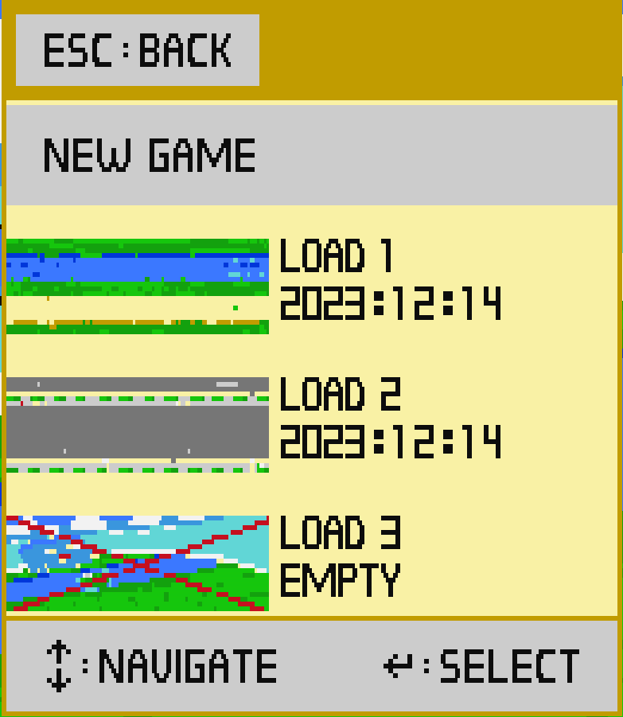
5. Other features
I. Game concepts
Save and load
Players can choose to save their game from the pause screen.
The save can be accessed at any time and persists between game boots.

Slide 18
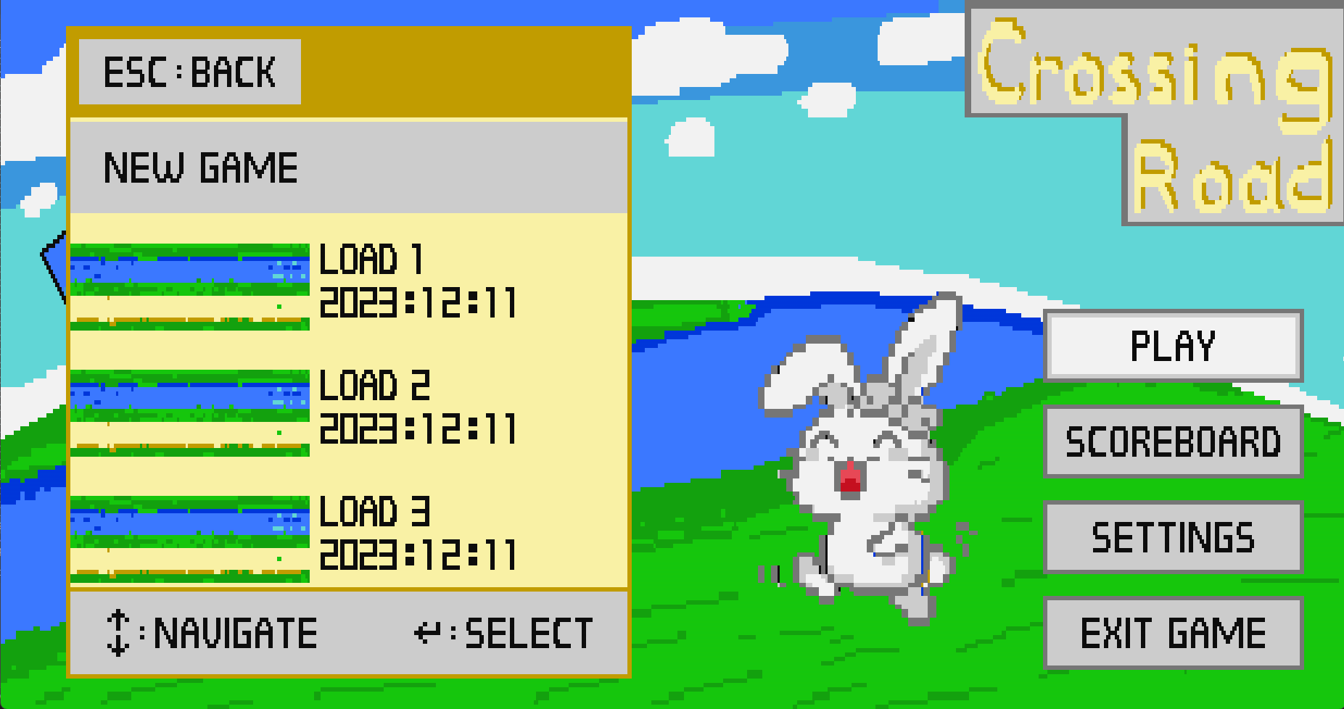
5. Other features
I. Game concepts
Save and load
Players can load save files to continue their game.
Save files can also be accessed through the in-game pause menu.

Slide 19
Technical implementations
II
Class relationships
Mechanics explanation

Slide 20
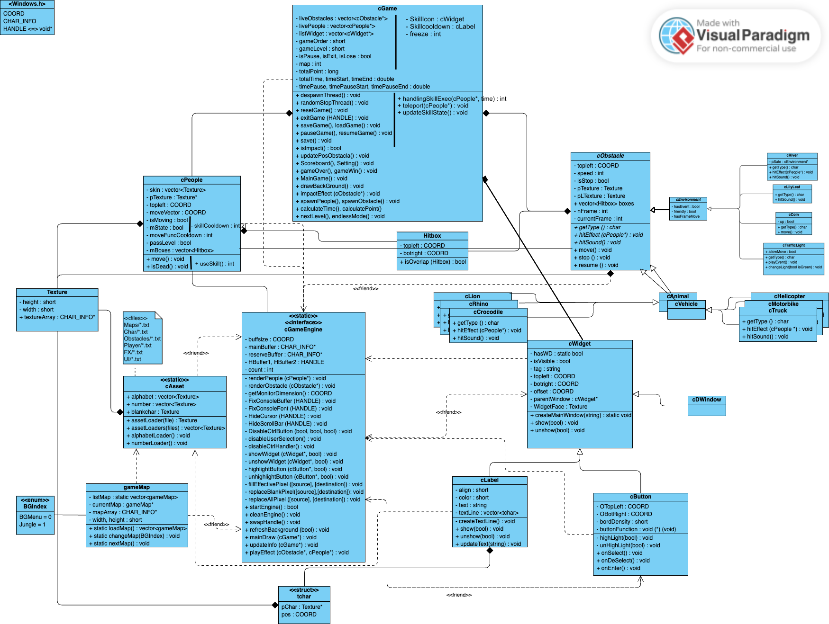
UML class diagram for the project

Slide 21
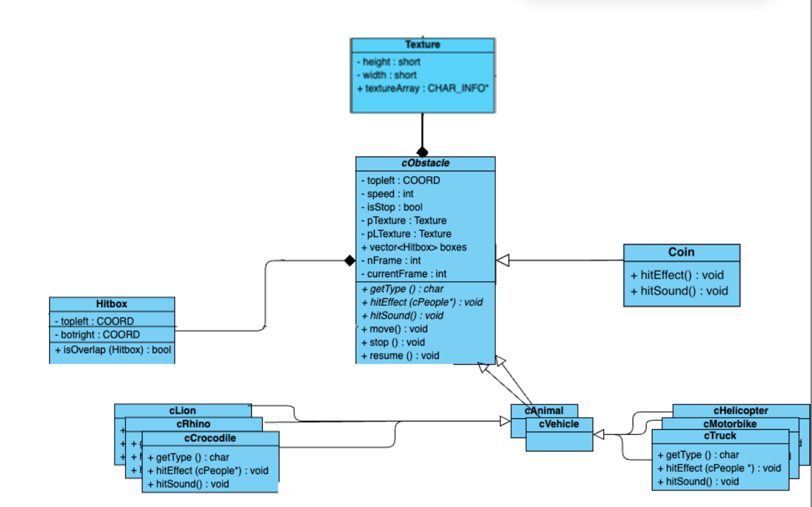
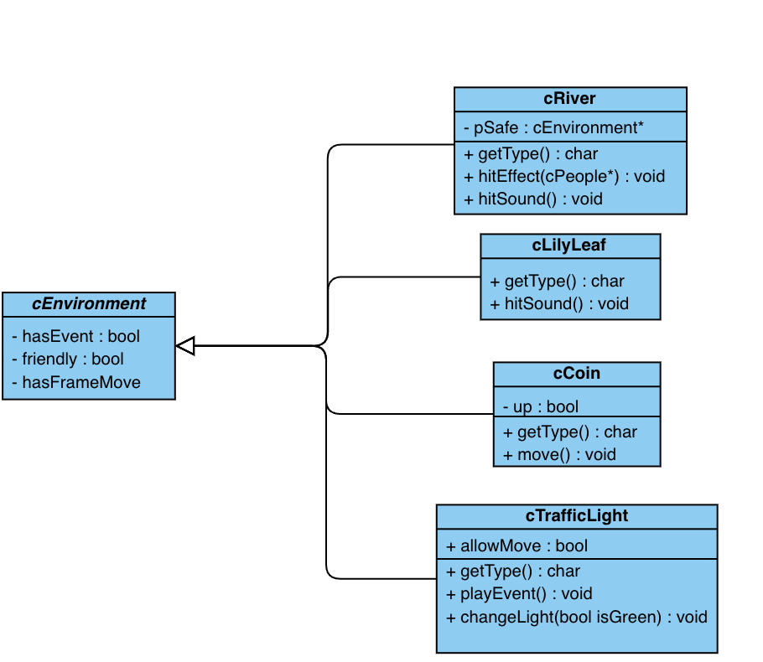
1. Class relationships
II. Technical implementations
Obstacle classes

Slide 22
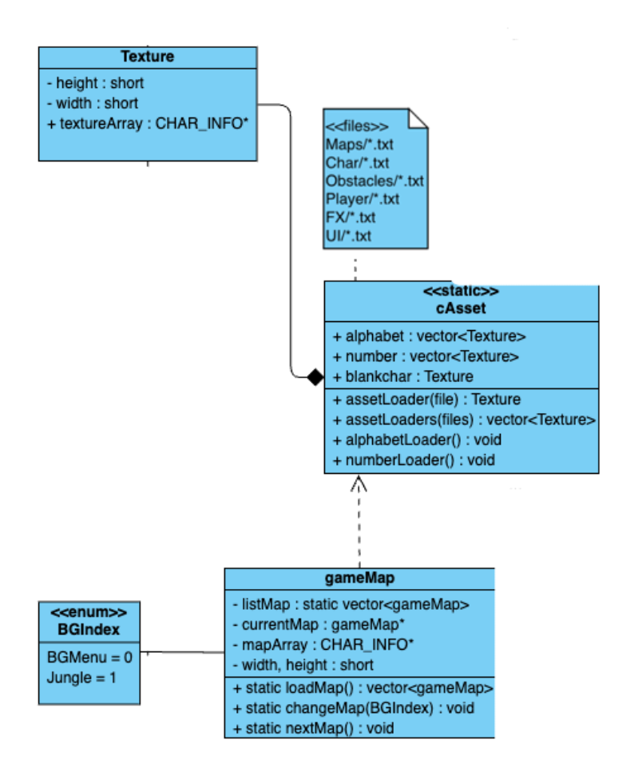
1. Class relationships
II. Technical implementations
Texture classes

Slide 23
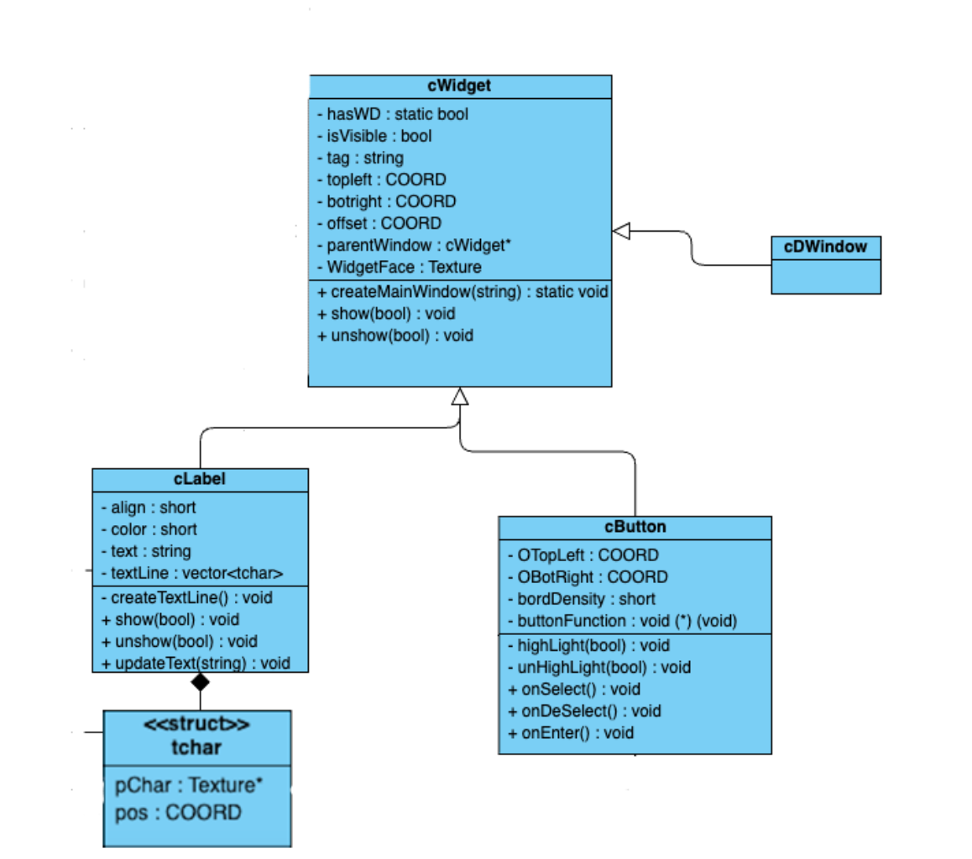
1. Class relationships
II. Technical implementations
Widget classes

Slide 24
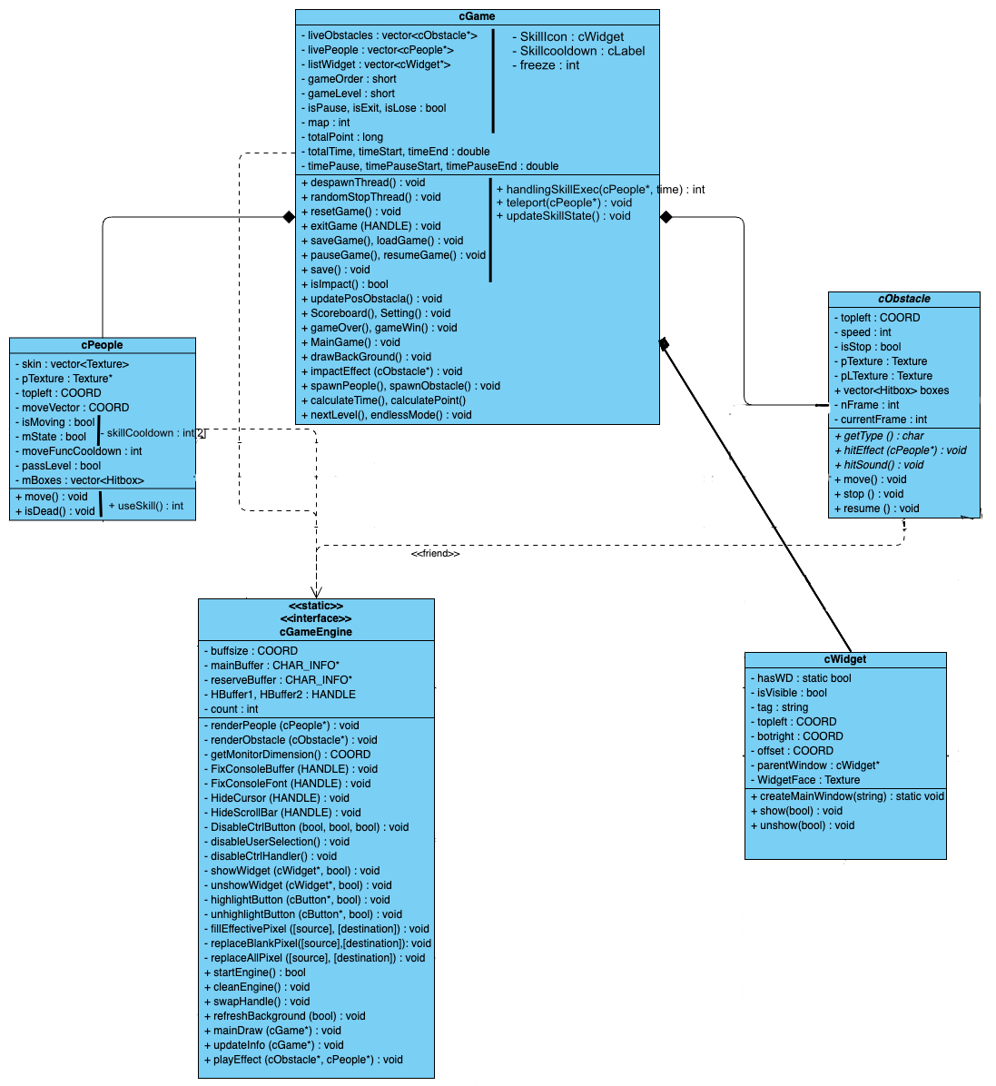
1. Class relationships
II. Technical implementations
Main game classes

Slide 25
Collisions
2. Mechanics explanation
II. Technical implementations
Each object on screen has a hitbox.
An object's hitbox determines its true position in game.
The hitbox may not fully overlap with the sprite.
The rectangle outline shows an example of the lion's hitbox. The sprite of the lion is smaller than its hitbox.

Slide 26

Collisions
2. Mechanics explanation
II. Technical implementations
2 objects collide if their hitboxes overlap.

Slide 27



Collisions
2. Mechanics explanation
II. Technical implementations
Colliding with an obstacle kills the player.
Some objects only prevents movement.
Some objects do not affect the player.

Slide 28
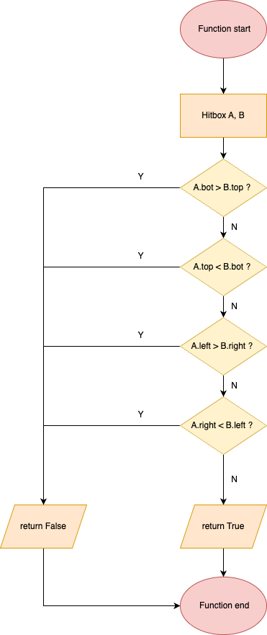
Collisions
2. Mechanics explanation
II. Technical implementations

Slide 29
Collisions
2. Mechanics explanation
II. Technical implementations
Pseudocode:
Function isOverlap(Hitbox B) if bottom A is above top B or top A is below bottom B then
return false
end if
if left A is right of right B or right A is left of left B then
return false else return true end if end function

Slide 30
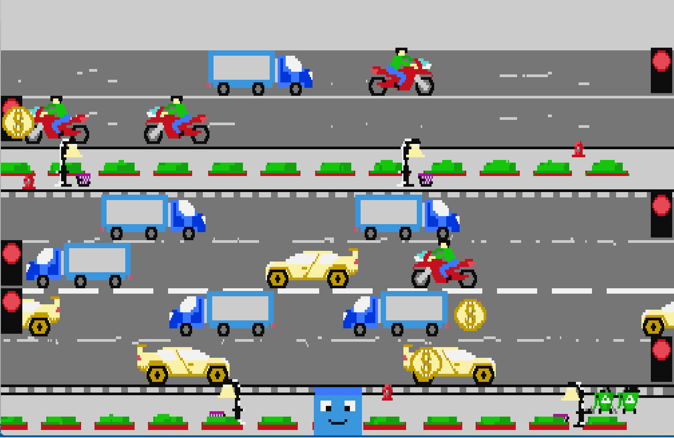
Random Stop
2. Mechanics explanation
II. Technical implementations
Random stop and continue moving by using rand() and chrono to determine time.
Each traffic light has a duration to know that this lane is movable or not (range of a duration: -10000 -> 7500)

Slide 31
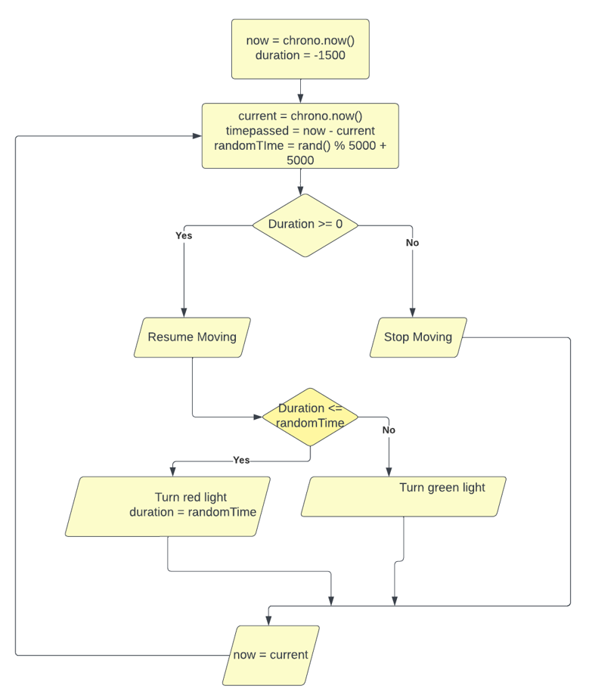
Random Stop
2. Mechanics explanation
II. Technical implementations

Slide 32
Random Stop
2. Mechanics explanation
II. Technical implementations
Pseudo code: procedure randomStop for each lane L in the map do Reduce remaining stop duration duration if duration ≤ 0 then Resume objects in lane L Get random number rand from −10000 → −5000 if duration < rand then Change traffic light in lane L to red Randomly set stop duration from 2500 → 7500(ms) else Change traffic light in lane L to green end if else Stop objects in lane L end if end for end procedure

Slide 33
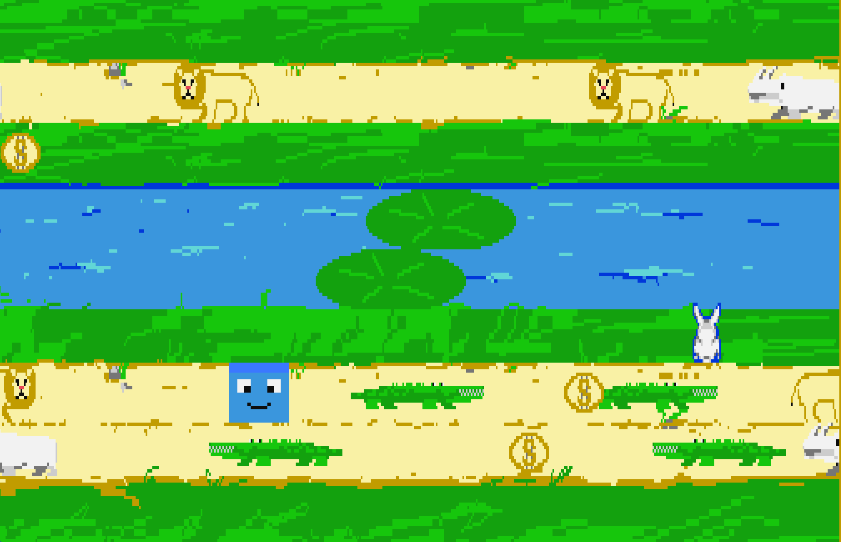
Co-op
2. Mechanics explanation
II. Technical implementations
Use 2 key-set to control the character

Slide 34
Console draw
2. Mechanics explanation
II. Technical implementations
Main buffer
Console drawing uses a double buffer technique.
This ensures all necessary pixel information is loaded before objects are drawn on screen.
Reserved buffer

Slide 35
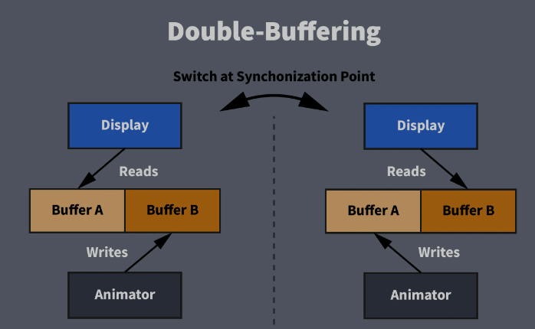
Double buffering
2. Mechanics explanation
II. Technical implementations
Source: https://luckyresistor.me/2019/12/07/how-to-write-custom-snowflake-patterns-1/

Slide 36

2. Mechanics explanation
II. Technical implementations
Thread 1
Update information
Ready to draw
Draw main buffer
game objects
background
effects
Drawing thread
new information
menu pop up
Draw reserved buffer
Thread 2
Update Information
Ready to draw

Slide 37
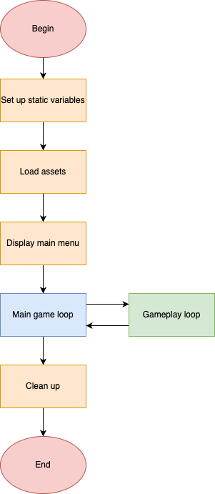
Game loop
2. Mechanics explanation
II. Technical implementations
The program flow

Slide 38
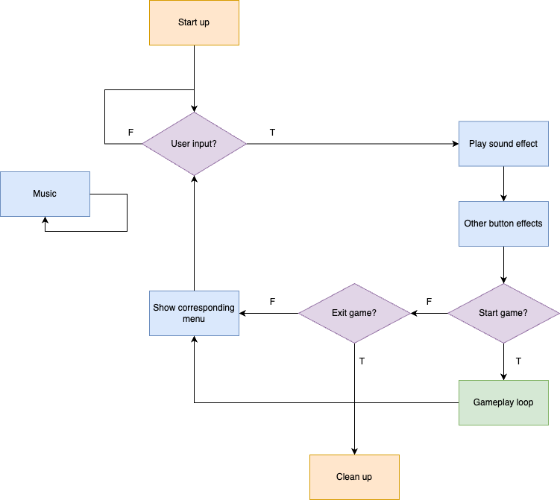
Game loop
2. Mechanics explanation
II. Technical implementations
Main game loop
Music is handled by OS commands and loops in the background.

Slide 39
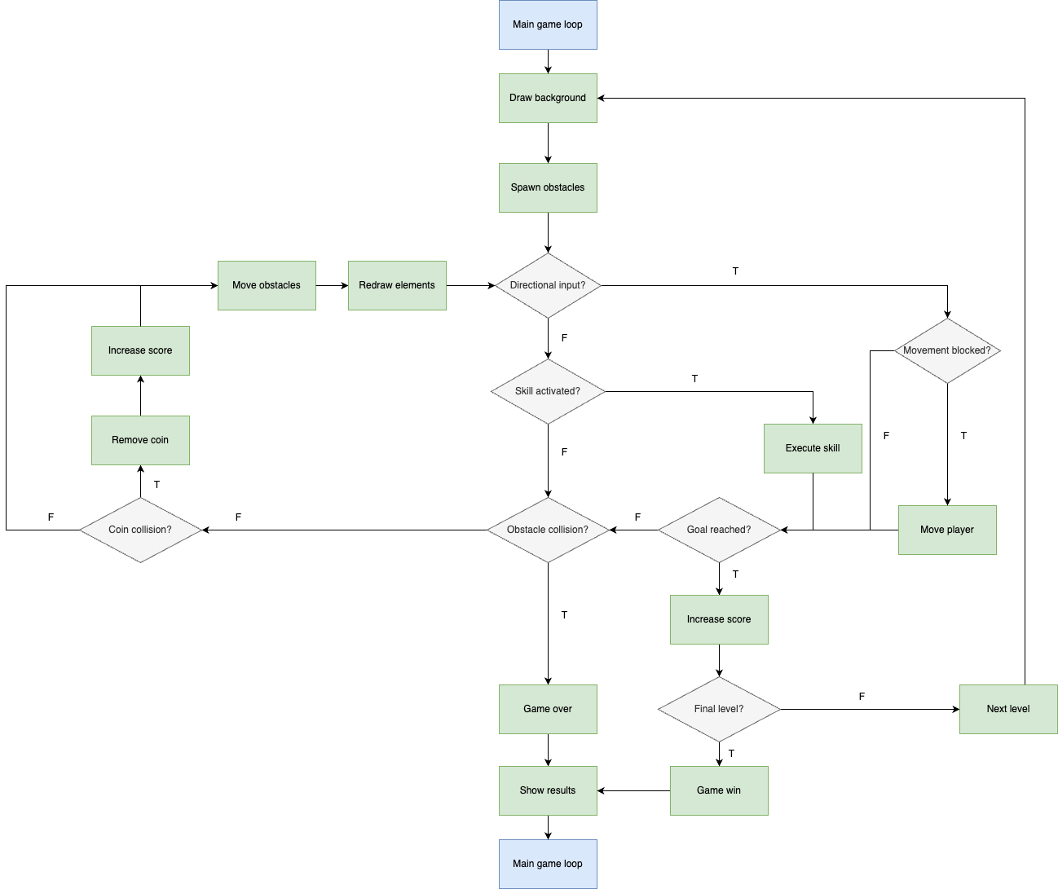
Gameplay loop

Slide 40
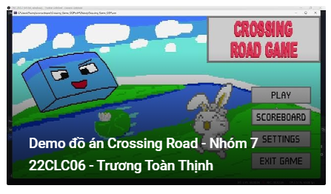
Demo video
III
Demo video

