Slide 1
Test plan for « Snake detection theory experiment »
Group:
LESÉNÉCHAL
Adrien
UJCIC
Hana

Slide 2
Rationale
Context:
Snakes were one of the earliest predators of primates
According to the snake detection hypothesis, the predatory pressure of these reptiles on primates may have caused evolutionarily driven changes in the primate visual system
Goal: Test human awareness to images of snakes compared to other animals
Task: Discrimination
Visual function: Contrast

Slide 3
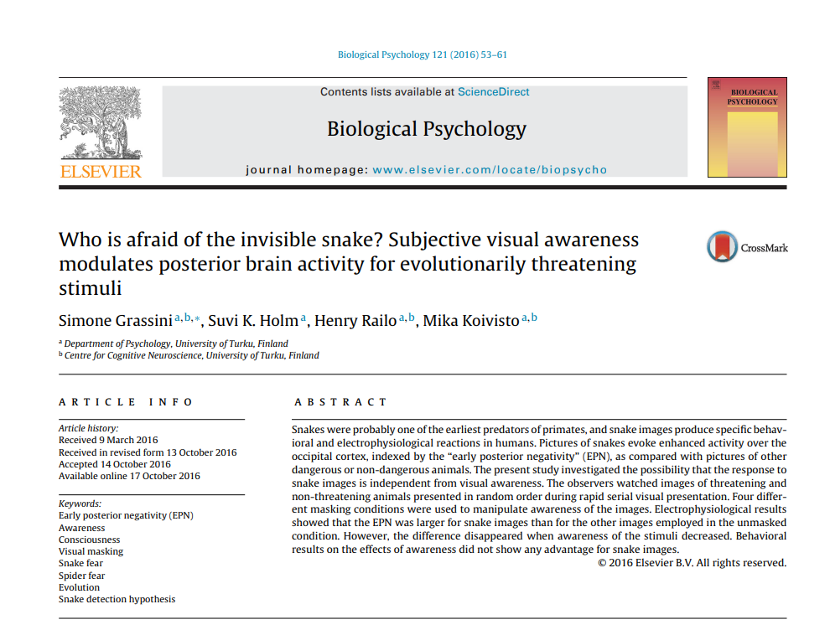

Slide 4
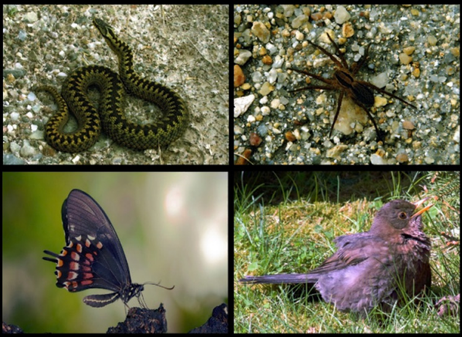
Example of Stimuli
Fixed parameters: Images of four different categories of animals
snakes, spiders (threatening)
birds, butterflies (unthreatening)
Variable parameters: Images are shown from 1 to 4 frames, followed by a mask (backward masking)

Slide 5
Protocol
Relative threshold
Method of constant stimuli (1 to 4 frames)
Forced choice: participant has to choose between 4 categories
Extra question: subjective awareness of the stimulus (did they see stimulus clearly, were they guessing)

Slide 6
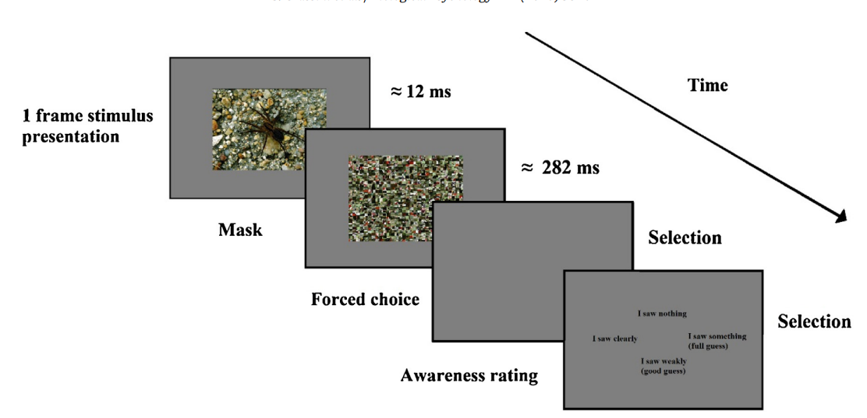

Slide 7
How? (tools)
Series of images of same size, luminance and contrast in succession
Choice between categories: click on category on screen
Choice of awareness: 4 choices, click on screen

Slide 8
Extra questions
Ask every participant if they have a fear of any of the animals
Ask every participant how often they see the animal in real life (test for habituation)

