Slide 1

Note: The data and information in this document is reflective of a hypothetical situation and client. This document is to be used for KPMG Virtual Internship purposes only.
Sprocket Central Pty Ltd
Data analytics approach
Lingyi Zhang

Slide 2
Note: The data and information in this document is reflective of a hypothetical situation and client. This document is to be used for KPMG Virtual Internship purposes only.
Agenda
Introduction
Data Exploration
Model Development
Interpretation

Slide 3
Note: The data and information in this document is reflective of a hypothetical situation and client. This document is to be used for KPMG Virtual Internship purposes only.
Introduction
Target:
Map the demographic features of current customers
Identify the 1000 top customers based on RFM model
Problem:
Sprocket Central Pty would like to get high value customers from the potential customers.
The new list of 1000 potential customer has no transaction record, just demographic features and attribute.
There is a larger dataset pf existing customers with transaction records and features.
Method:
Give a detailed analysis/comparison on the demographic features of existing customers/new customers.
Based on 1, develop a model of RFM to predict the value of new customers.

Slide 4
Note: The data and information in this document is reflective of a hypothetical situation and client. This document is to be used for KPMG Virtual Internship purposes only.
Data Exploration
Data cleaning
Consistency | Inconsistent values for the same attribute Inconsistent data type for the same attribute | In CustomerDemographic, gender have 6 unique values : F & Femal was converted Female, M was converted to Male. In CustomerAddress, state has different rules, with full spelling and abbrev. All of them were converted to abbrev [NSW], [VIC], [QLD]. Converted columns with wrong data types, eg. [product_first_sold_date](to date time) and [list_price] (to float) Garbled data columns were removed.
Completeness | Missing values | If only a small number of rows are empty, we will filter out the record entirely from the training set for prediction, like less 1% transactions have missing fields. But if it is core field or the missing rate is high (like 12.5% missing rate of job_title in CustomerDemographic, we will impute the missing fields based on distribution in the training dataset.
Currency | The maximal of customer_id in CustomerDemographic is 4000, while the values of customer_id in Transactions is 5034 | It would be ensured that all tables are from the same period. Only customers in CustomerDemographic will be used as a training set for our model. Common key columns would be used to merge dataset. Data with obvious low validity (eg. DOB[1843-12-21]) was removed.

Slide 5
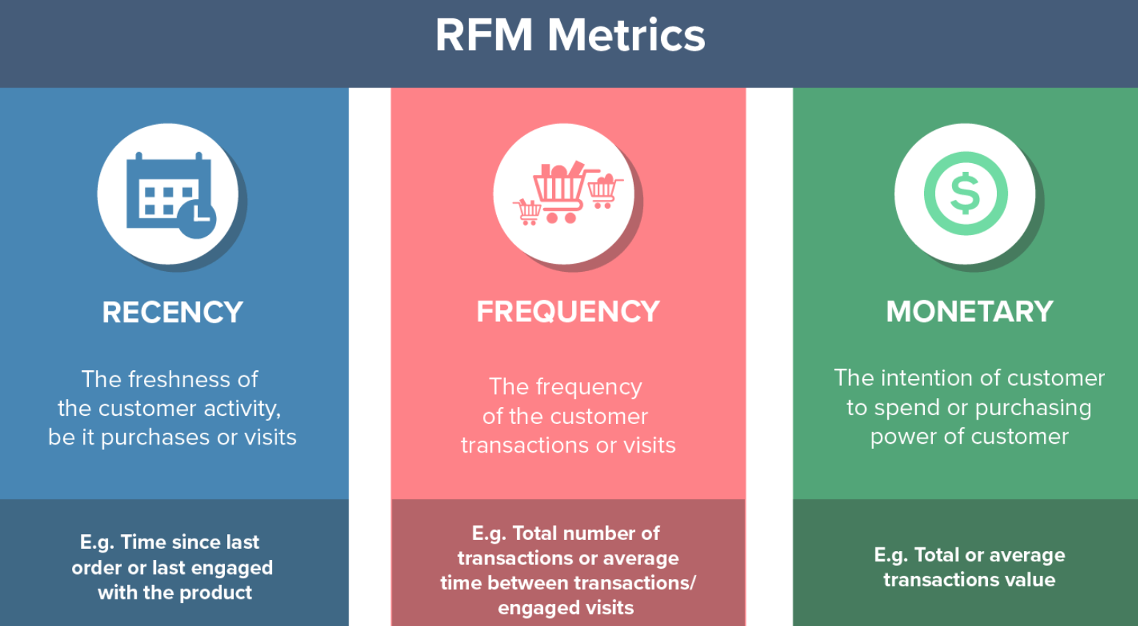
Note: The data and information in this document is reflective of a hypothetical situation and client. This document is to be used for KPMG Virtual Internship purposes only.
Model Development
RFM analysis & Customer Segment
R – Recency
F – Frequency
M – Monetary
RFM metrics are important indicators of a customer’s behavior.
Place any supporting images, graphs, data or extra text here.

Slide 6
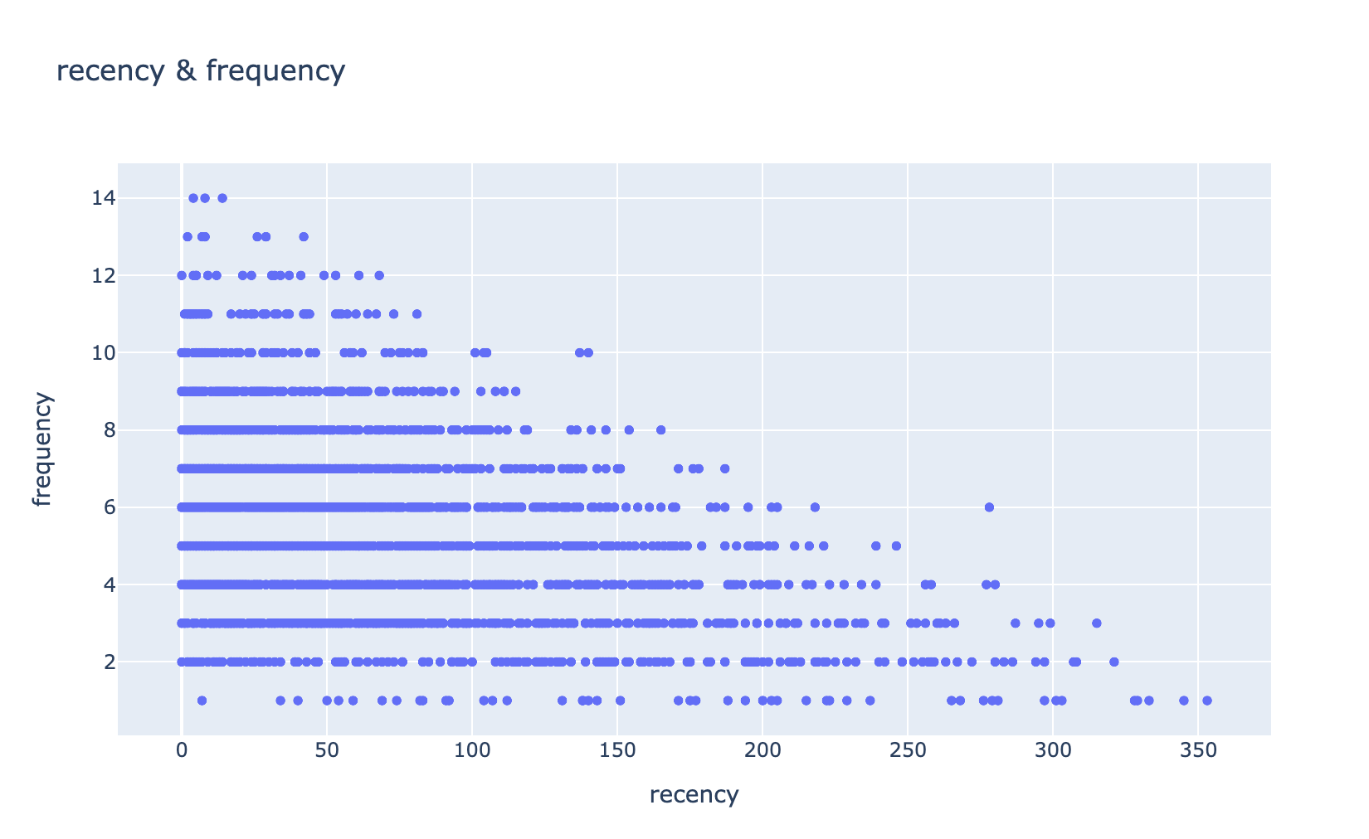
Note: The data and information in this document is reflective of a hypothetical situation and client. This document is to be used for KPMG Virtual Internship purposes only.
Interpretation
Recency & Frequency

Slide 7
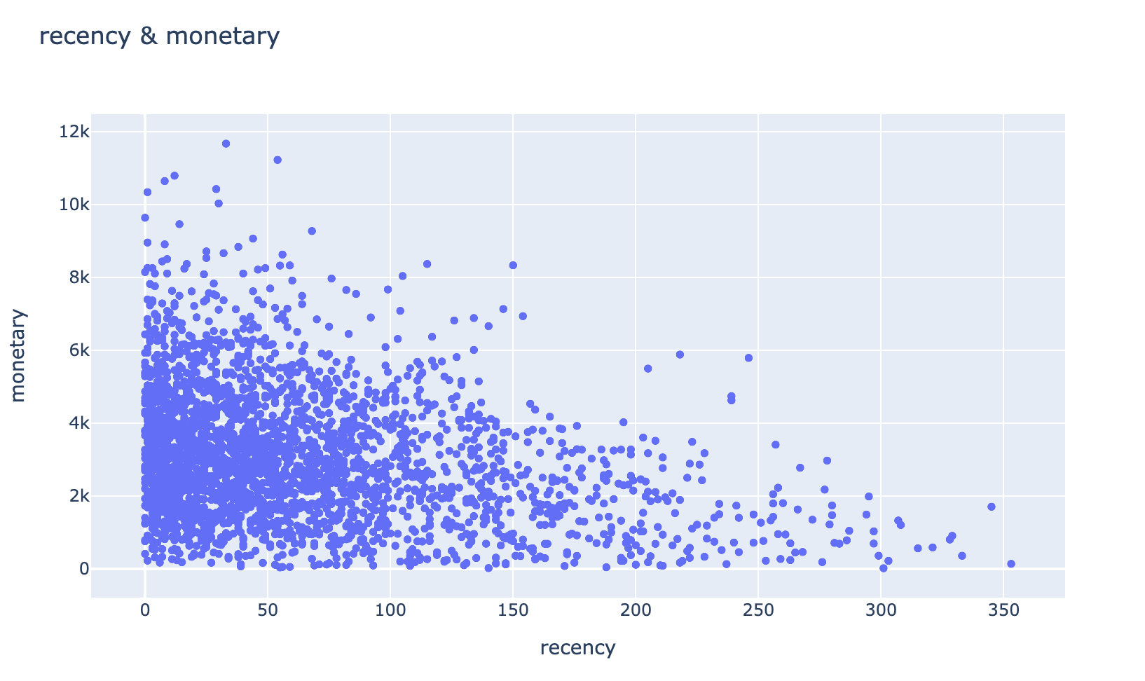
Note: The data and information in this document is reflective of a hypothetical situation and client. This document is to be used for KPMG Virtual Internship purposes only.
Interpretation
Recency & Monetary

Slide 8
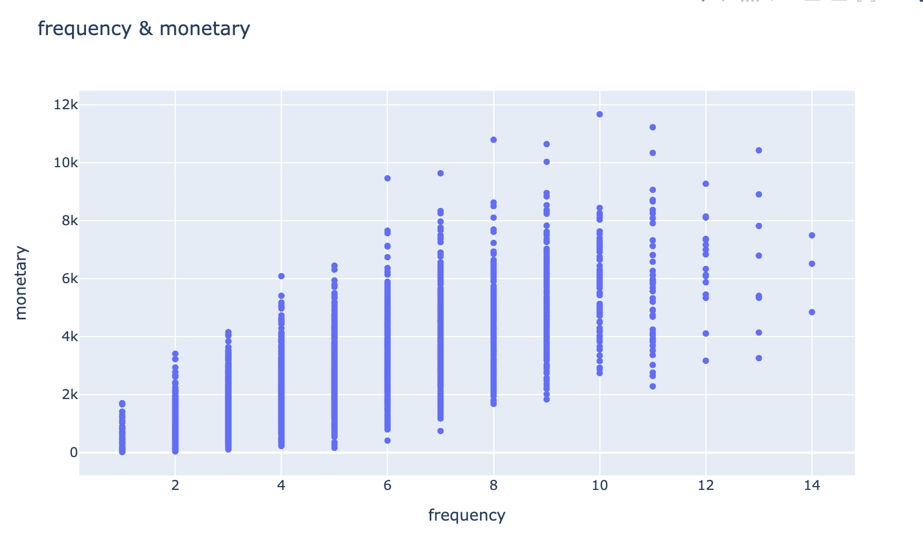
Note: The data and information in this document is reflective of a hypothetical situation and client. This document is to be used for KPMG Virtual Internship purposes only.
Interpretation
Frequency & Monetary

Slide 9
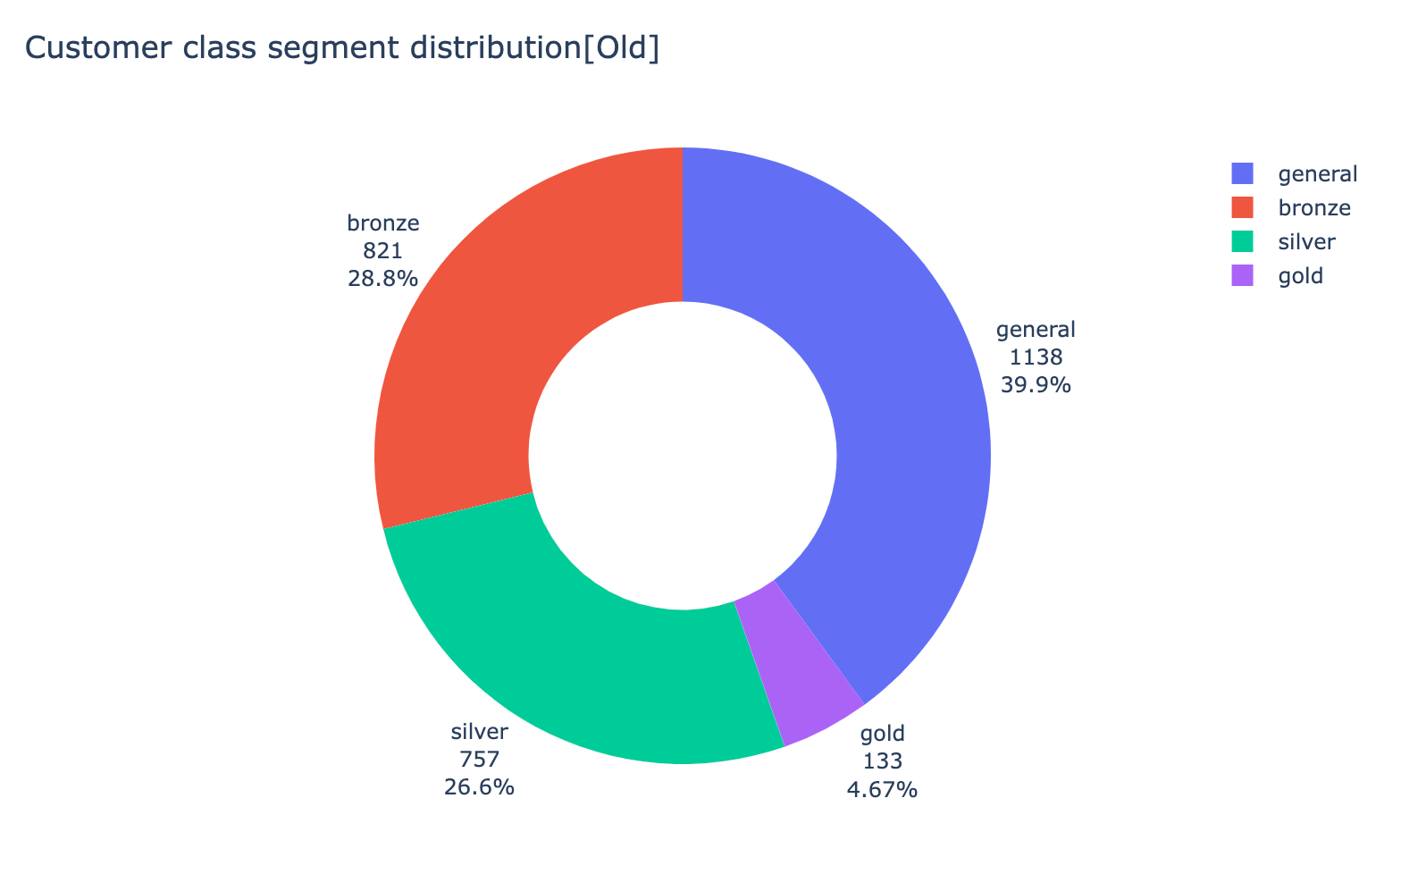
Note: The data and information in this document is reflective of a hypothetical situation and client. This document is to be used for KPMG Virtual Internship purposes only.
Interpretation
The class segment distribution of existing customers
The more recent the last transaction happens
&
The higher the profit
&
The more purchases happens,
The higher score this customer indicates.
Gold: total score <= 3,
Silver: total score <= 6, 25%
Bronze: total score <= 8, 50%
Basic: total score > 8

Slide 10
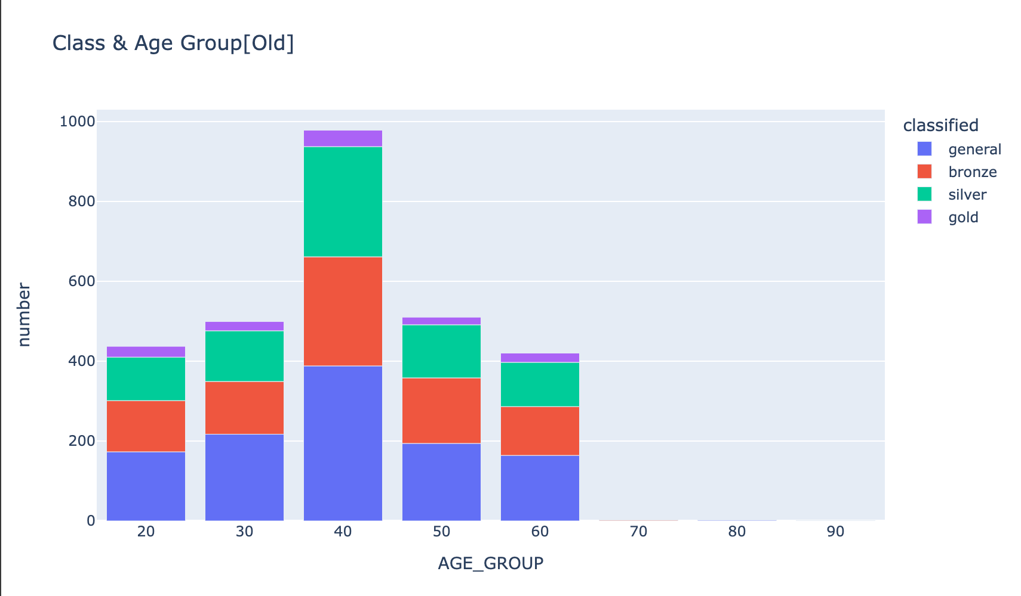
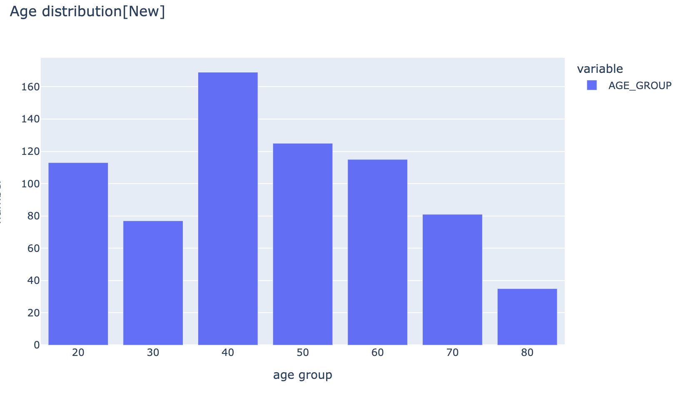
Note: The data and information in this document is reflective of a hypothetical situation and client. This document is to be used for KPMG Virtual Internship purposes only.
Interpretation
Age Distribution

Slide 11
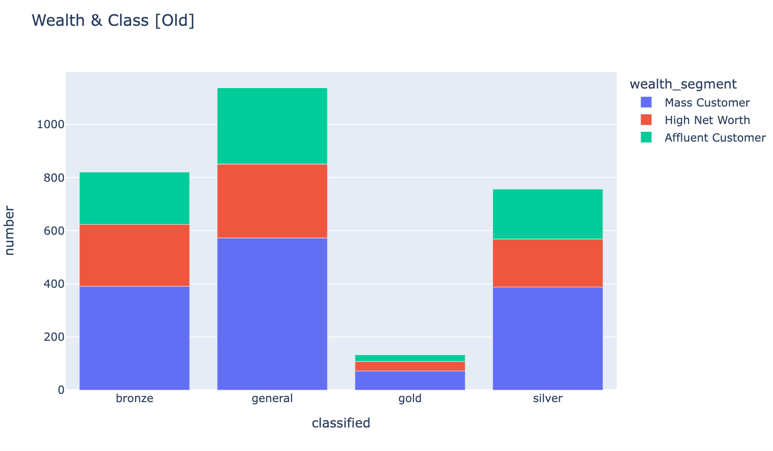
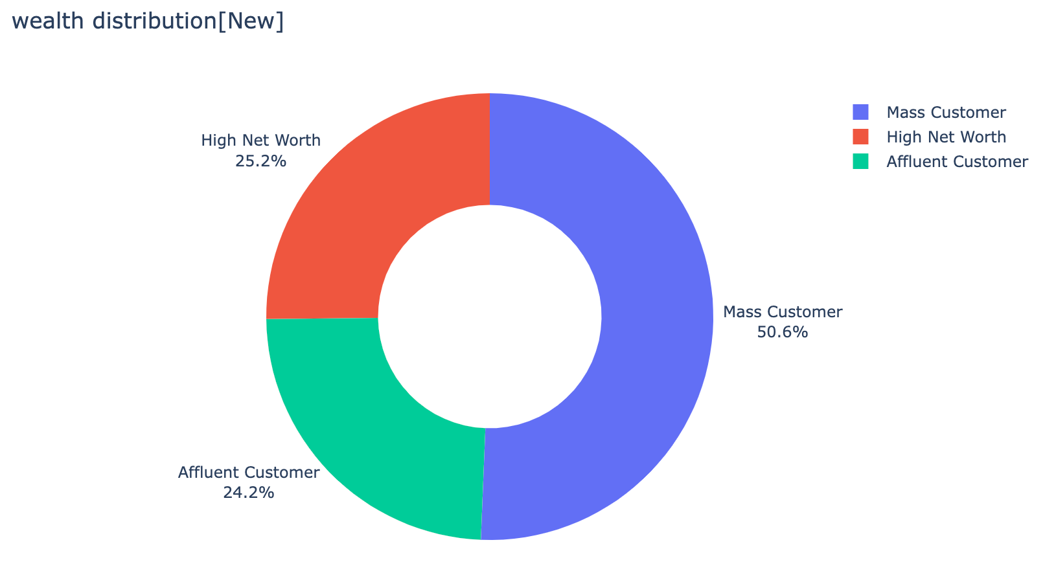
Note: The data and information in this document is reflective of a hypothetical situation and client. This document is to be used for KPMG Virtual Internship purposes only.
Interpretation
Wealth Segment Distribution

Slide 12
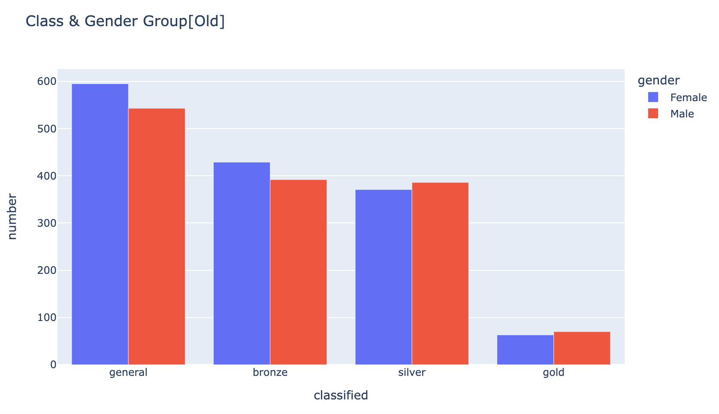
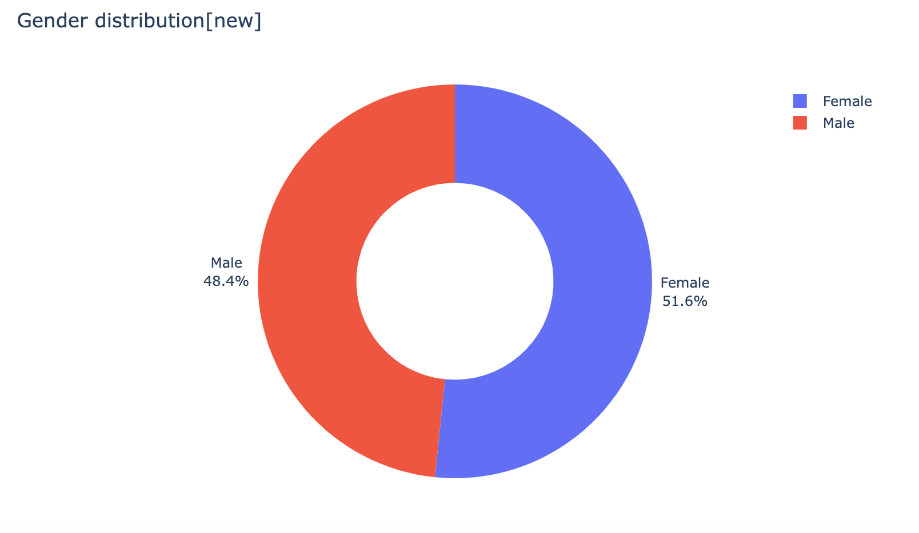
Note: The data and information in this document is reflective of a hypothetical situation and client. This document is to be used for KPMG Virtual Internship purposes only.
Interpretation
Gender Distribution

Slide 13
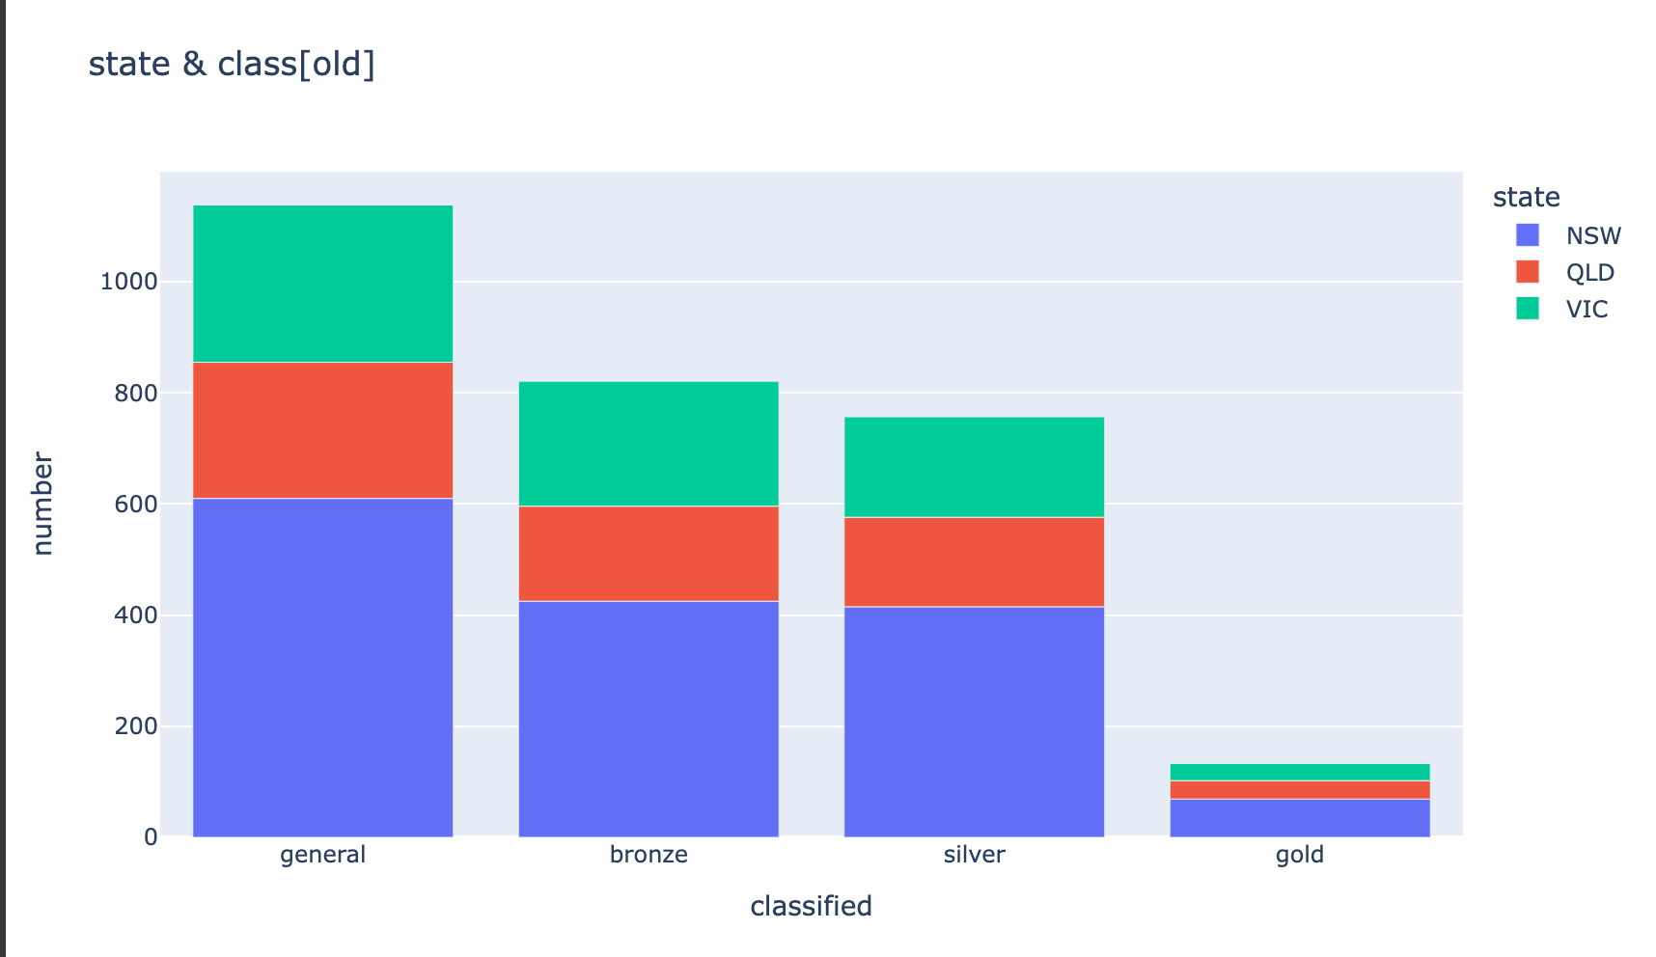
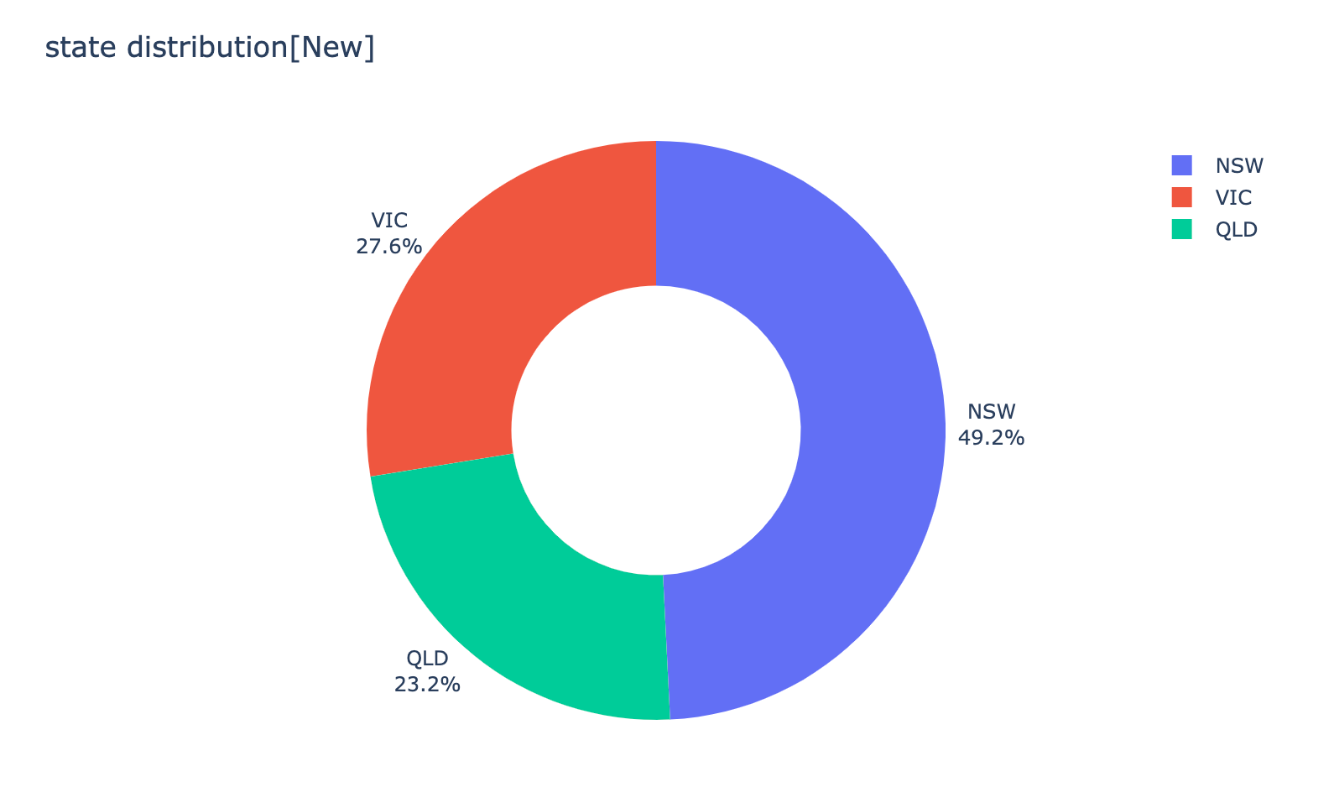
Note: The data and information in this document is reflective of a hypothetical situation and client. This document is to be used for KPMG Virtual Internship purposes only.
Interpretation
State Distribution

Slide 14
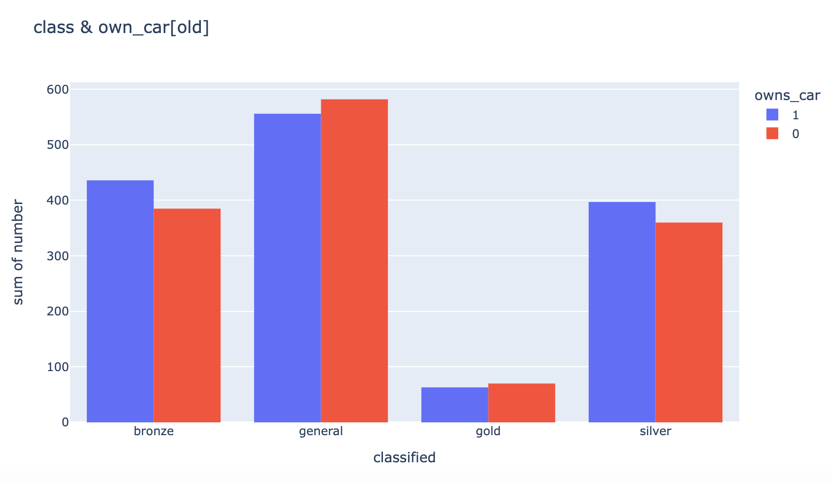
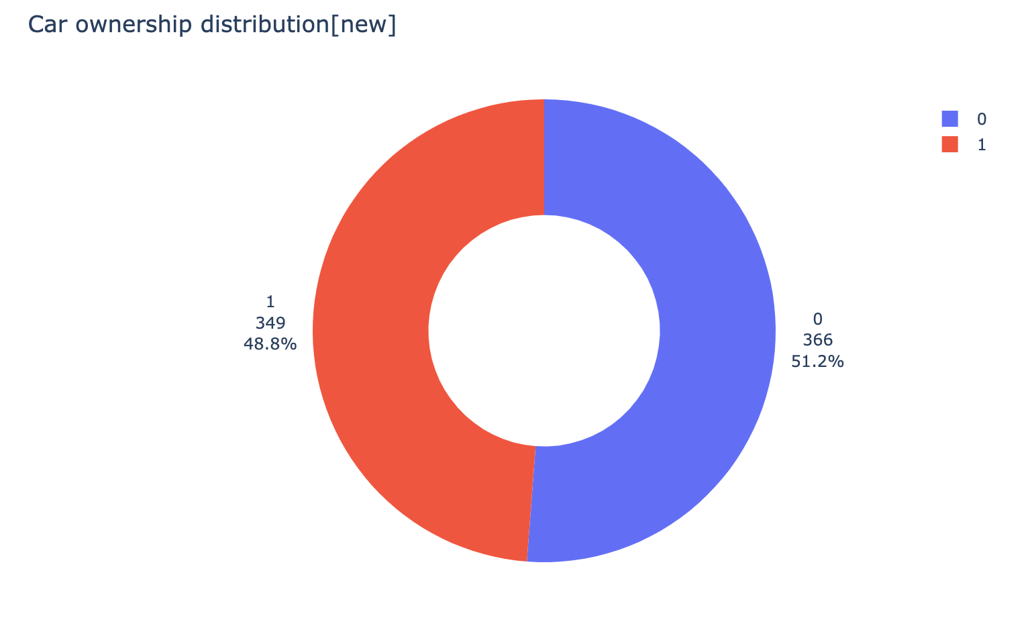
Note: The data and information in this document is reflective of a hypothetical situation and client. This document is to be used for KPMG Virtual Internship purposes only.
Interpretation
Car Ownership Distribution

Slide 15
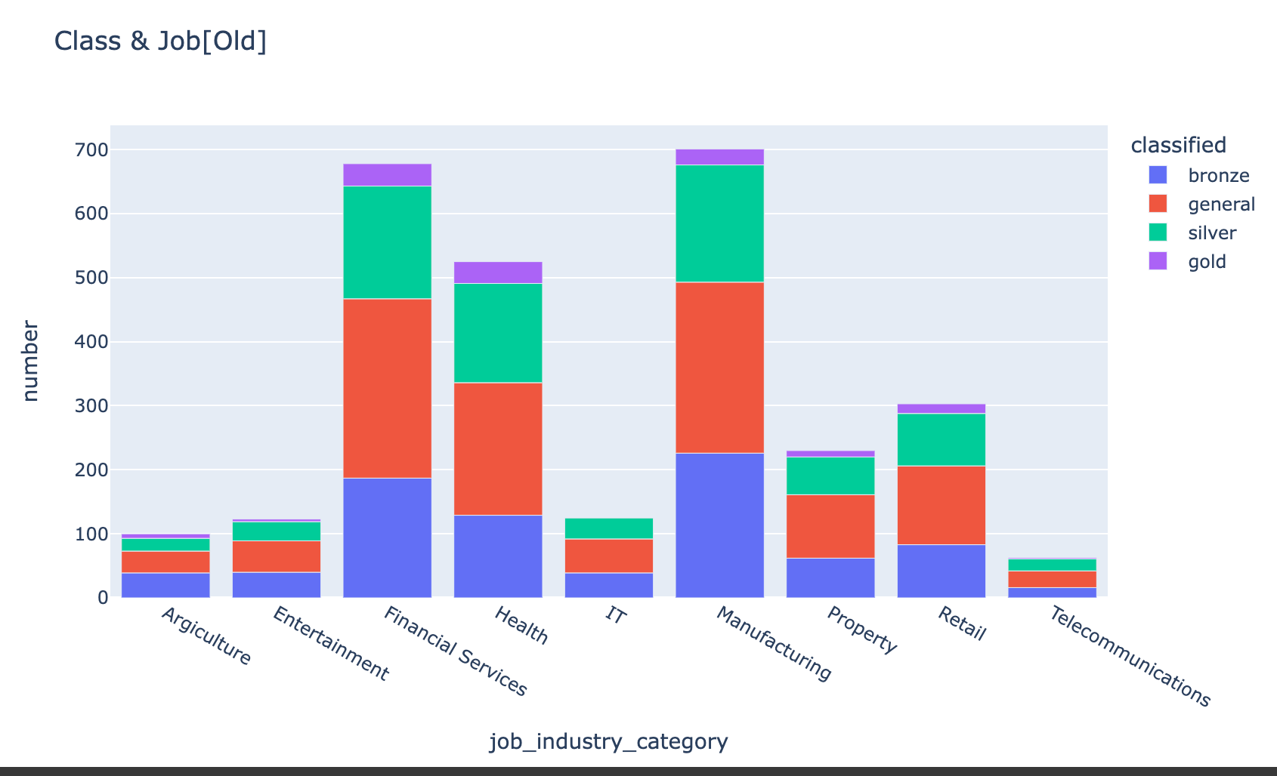
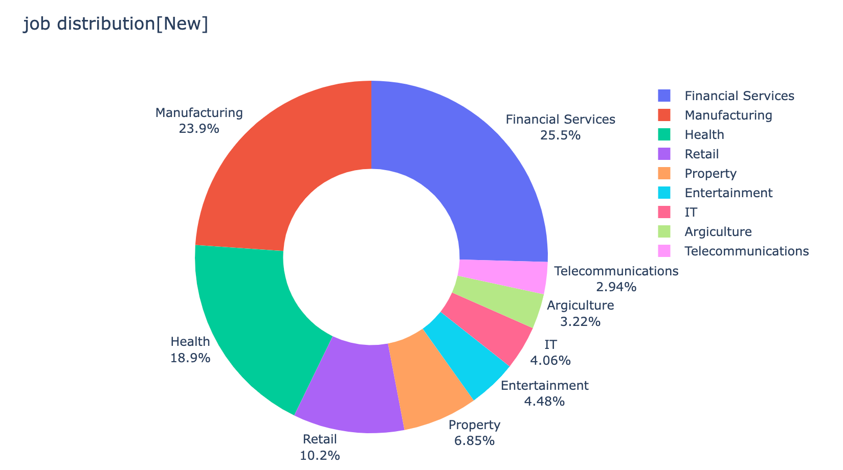
Note: The data and information in this document is reflective of a hypothetical situation and client. This document is to be used for KPMG Virtual Internship purposes only.
Interpretation
Job Category Distribution

Slide 16
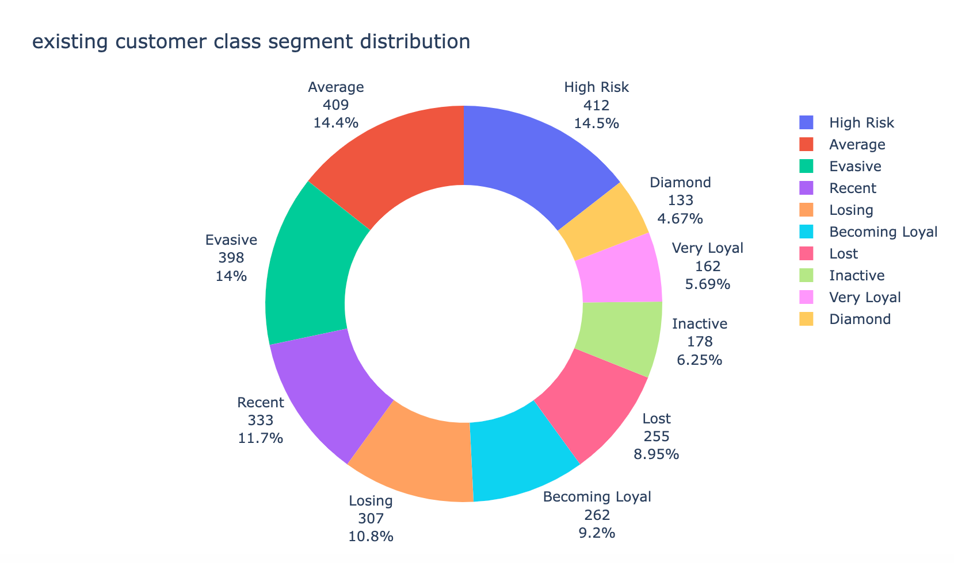
Note: The data and information in this document is reflective of a hypothetical situation and client. This document is to be used for KPMG Virtual Internship purposes only.
Interpretation
Customer Class Segment
Total Score | Segment | Total Score | Segment
3 | Diamond | 8 | High Risk
4 | Very Loyal | 9 | Evasive
5 | Becoming Loyal | 10 | Losing
6 | Recent | 11 | Inactive
7 | Average | 12 | Lost

Slide 17
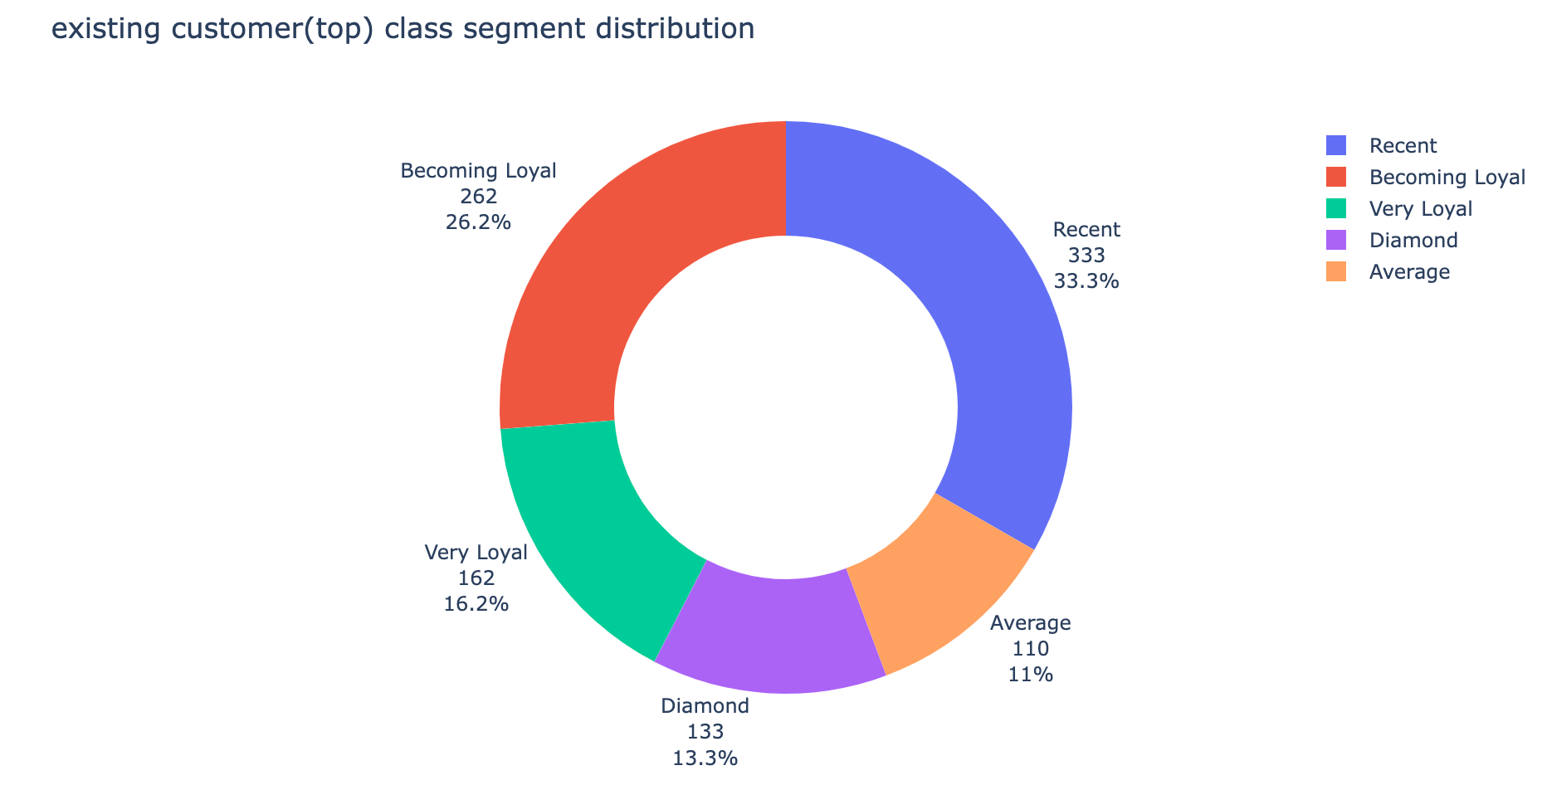
Note: The data and information in this document is reflective of a hypothetical situation and client. This document is to be used for KPMG Virtual Internship purposes only.
Interpretation
Top 1000 Customers
Total Score | Segment | Rank | Counts
3 | Diamond | 1 | 133
4 | Very Loyal | 2 | 162
5 | Becoming Loyal | 3 | 262
6 | Recent | 4 | 333
7 | Average | 5 | 110

Slide 18
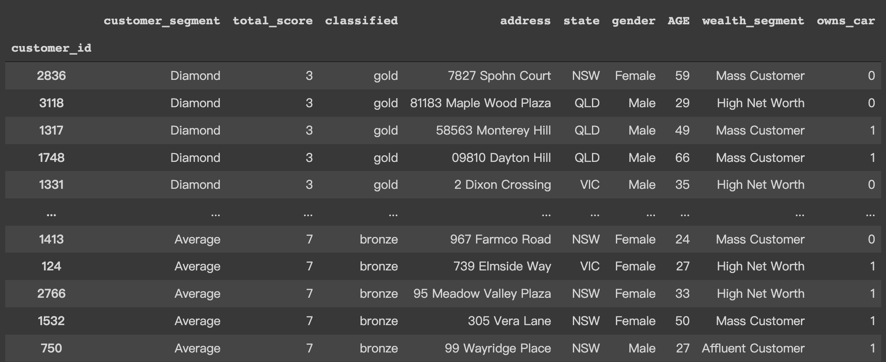
Note: The data and information in this document is reflective of a hypothetical situation and client. This document is to be used for KPMG Virtual Internship purposes only.
Interpretation
Top 1000 Customers

Slide 19
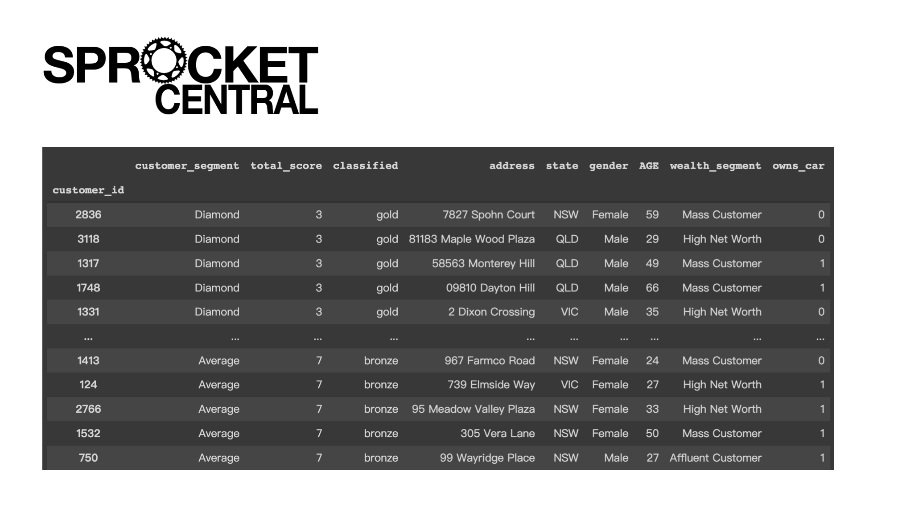
Note: The data and information in this document is reflective of a hypothetical situation and client. This document is to be used for KPMG Virtual Internship purposes only.
Dashboard

Slide 20
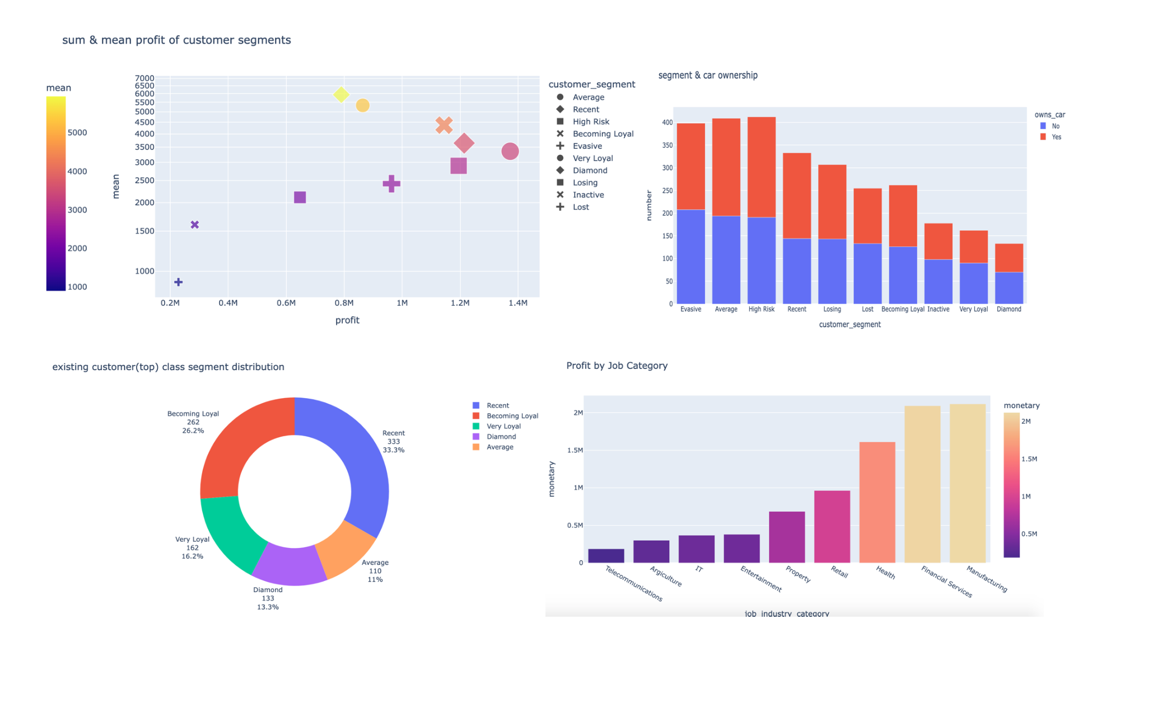
Note: The data and information in this document is reflective of a hypothetical situation and client. This document is to be used for KPMG Virtual Internship purposes only.
Dashboard

Slide 21
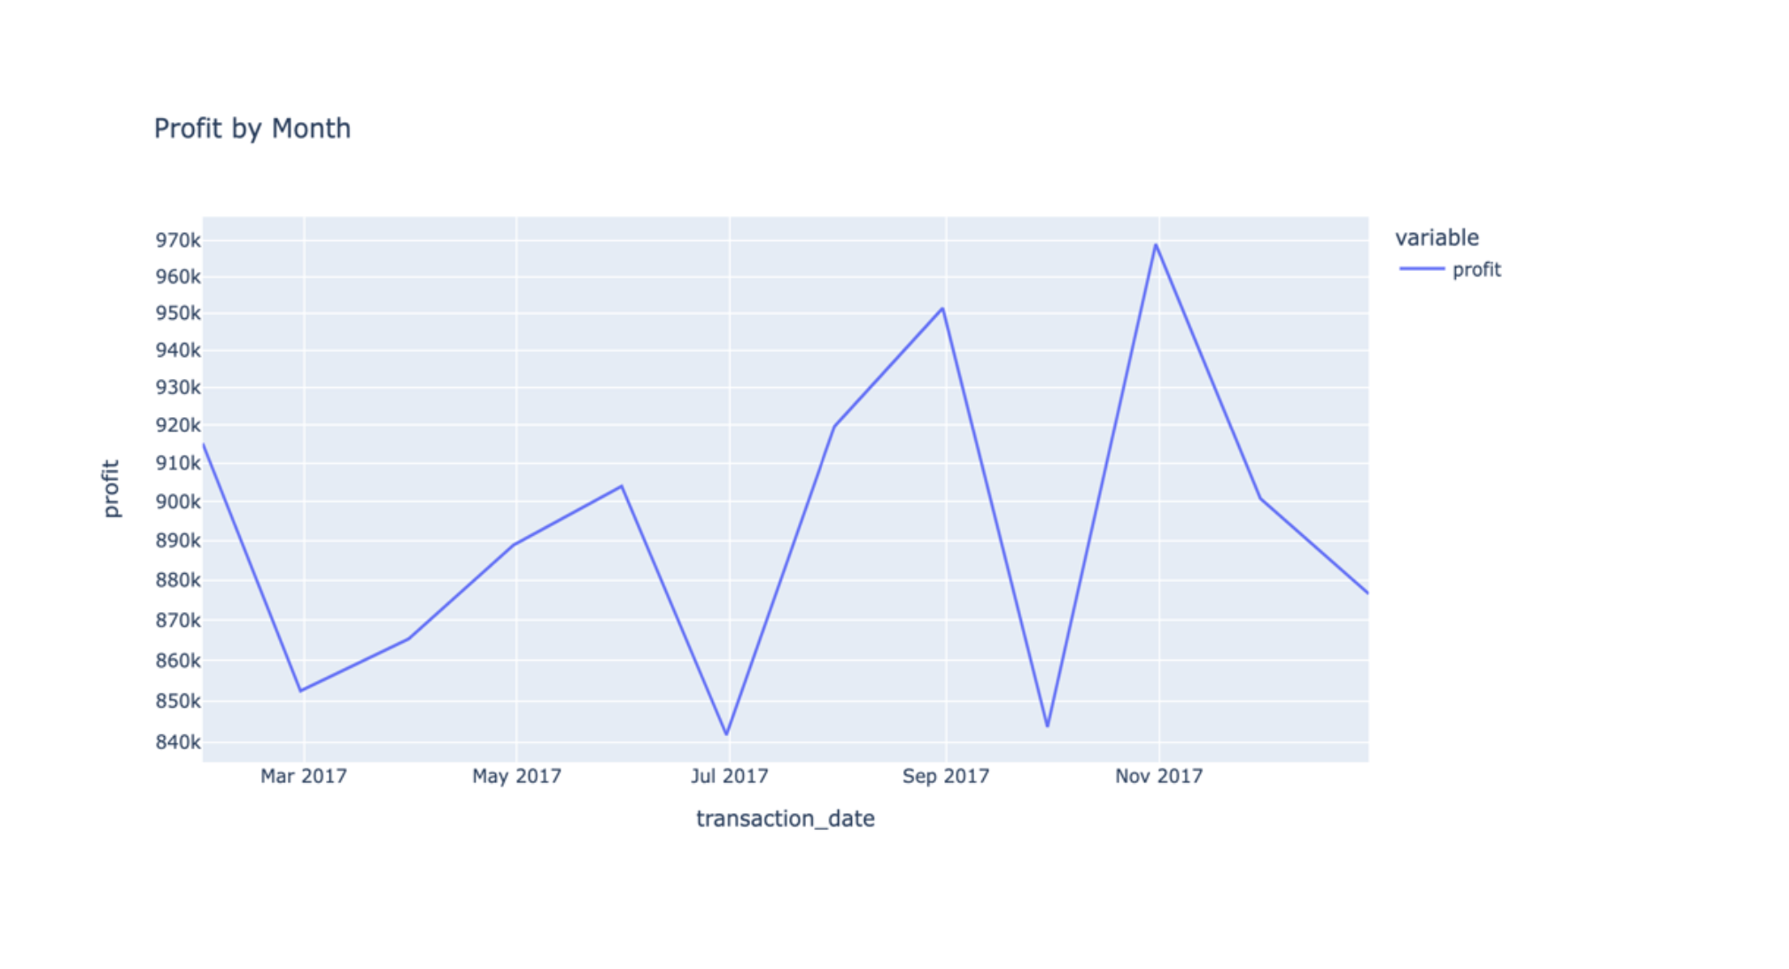
Note: The data and information in this document is reflective of a hypothetical situation and client. This document is to be used for KPMG Virtual Internship purposes only.
Dashboard

Slide 22
Note: The data and information in this document is reflective of a hypothetical situation and client. This document is to be used for KPMG Virtual Internship purposes only.
Appendix

Slide 23
Note: The data and information in this document is reflective of a hypothetical situation and client. This document is to be used for KPMG Virtual Internship purposes only.
Appendix
Python code and other graphs:
https://colab.research.google.com/drive/1sH7Vs4goNzqYV5FzVxlwUirrPbI_9sHY#scrollTo=59dqcSzh4Twm

