Slide 1
SET CONFERENCE
A CNN Based Approach to Detect Deepfake
Team Pritam Mondal [22MCA0129] Arya Panja [22MCA0355]
Guide Prof. Nivedhitha M

Slide 2
Problem Statement:
Deepfake images are created using AI techniques, where a person's face or body is replaced with someone else’s.
2. Deepfake images can be created with malicious intent, such as spreading false information, blackmailing, or defaming individuals.
3. Deepfake images are difficult to identify as they look realistic, making it challenging to differentiate between real and fake images.
4. The spread of deepfake images can cause significant harm to individuals or organizations, leading to reputational damage, financial loss, or even physical harm.

Slide 3
Objective:
Deepfakes pose a threat to society by manipulating and deceiving people with false information.
Deepfake detection is challenging, and traditional methods are limited in effectiveness.
A deep learning-based approach using convolutional neural networks (CNN) is proposed for deepfake prediction.
Transfer learning is performed with Xception on a Kaggle dataset of real and fake images.
The CNN model learns to distinguish between real and fake images by identifying unique patterns and features.
The proposed CNN-based approach shows decent performance in predicting fake images. We are aiming forward in achieving better results.

Slide 4
Literature Survey

Slide 5
Architecture | Pre-Trained Model Used | Classification Types | Dataset Used | Accuracy
13 volume layers, 3 completely linked layers, and 5 pool layers | VGG16 network based on noise and image augmentation (NA-VGG) by adding an SRM filter layer | Fake/Real | 12416 training set images. 1376 verification set images. 1376 test set images. | 85.7 %
CNN architecture is fed with optical flows | VGG-16/ResNet50 | Fake/Real | FaceForensics + dataset | 81.61% with VGG16 and 75.46% with ResNet50

Slide 6
Architecture | Pre-Trained Model Used | Classification Types | Dataset Used | Accuracy
3 layered groups (convolutional layer fitted with LReLu and a max pooling layer) |  | Fake/Real | CELEBAHQ dataset | 92%
CNN(for frame feature extraction) LSTM(for temporal sequence analysis) |  | Fake/Real | 300 deepfake videos and HOHA dataset | 97.1% with 80 frames

Slide 7
Architecture | Pre-Trained Model Used | Classification Types | Dataset Used | Accuracy
CFFN(three dense units that include two, four, and three dense blocks) |  | Fake/Real | CelebA | Recall- 0.9
layers for pooling and fully connected layers | DenseNet and ResNet | Fake/Real | Flickr dataset(1 million fake and 70000 real image) | 81.6%

Slide 8
Features to distinguish real and deepfake image
Facial landmarks
Skin texture
Lighting and shadows
Depth and perspective
Hair Pattern

Slide 9
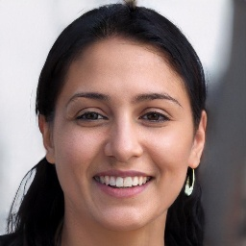
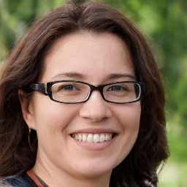
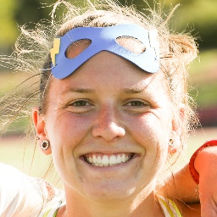
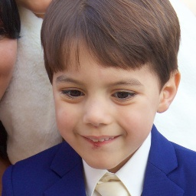
Dataset The goal is to create a dataset-independent model.
Dataset was downloaded from https://www.kaggle.com/ to train the model.
The dataset consists of 70,000 real images and 70,000 fake images.
All data in dataset is labeled, providing ground truth information.
To train our model we took randomly 20000 image from the dataset.
Fake Image Real Image

Slide 10
Data Pre-processing
Data cleaning
Resizing data
Data augmentation
rescale.
rotation_range
3. width_shift_range
4. height_shift_range
5. shear_range
6. zoom_range
7. horizontal_flip
8. fill_mode

Slide 11
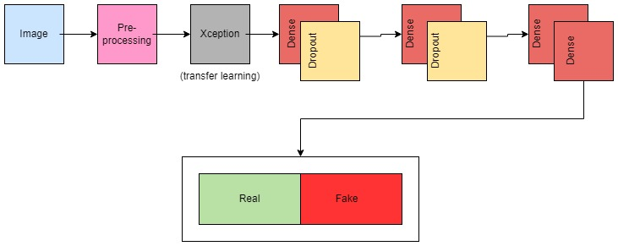
CNN Architecture:
Transfer is implemented using Xception Model
Pre-processed image is fed into 6-layered CNN architecture(Dropout-Dense x 2; Dense-Dense).

Slide 12
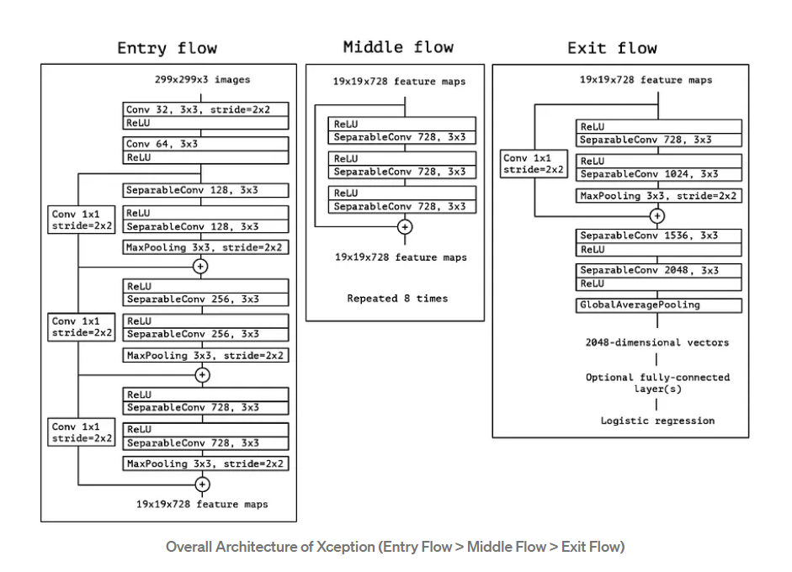
Xception Model Architecture

Slide 13
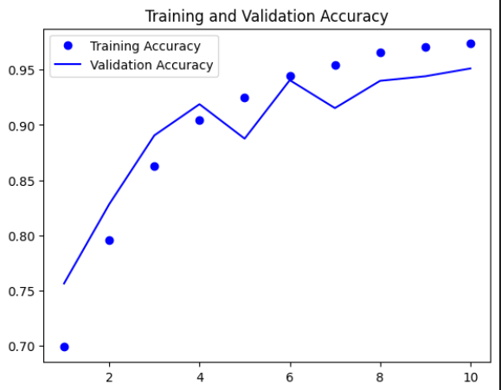
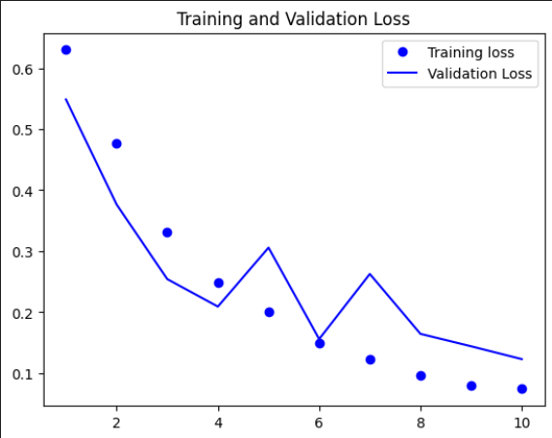
Experimental Result:
Train generator : loss: 0.0458 - accuracy: 0.9856
Validator generator: loss: 0.1232 - accuracy: 0.9512

Slide 14
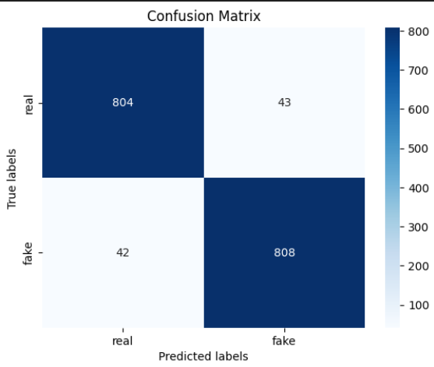
Confusion Matrix:

Slide 15
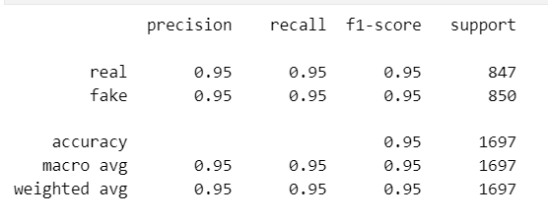
Classification Report:

Slide 16
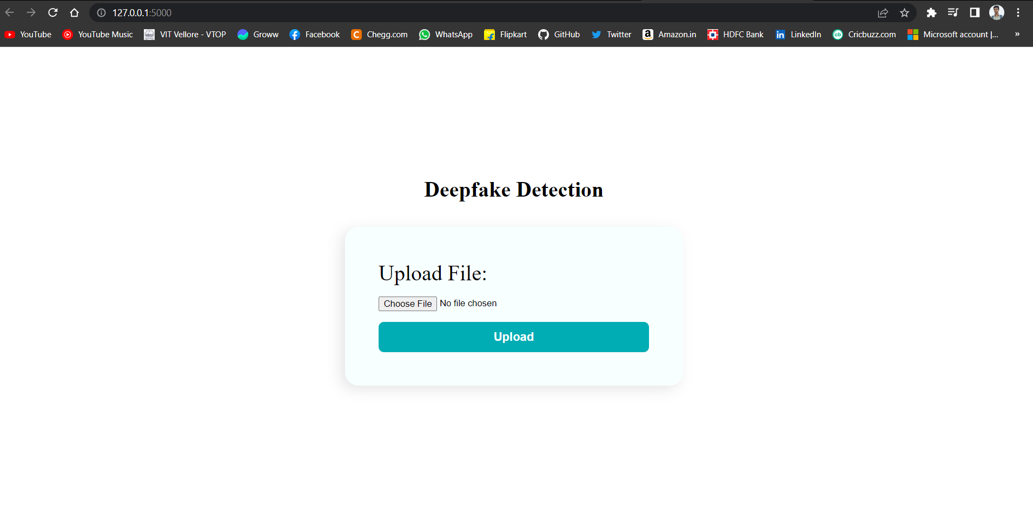
User Interface

Slide 17
Thank You

