Slide 1
Best location to open a restaurant in Helsinki

Slide 2
Introduction
Over 50 percent of new restaurants goes out of business in their first three years period
Having a good location and concept can help the restaurant to succeed
In this project we tried to find out the best location and type to open up a restaurant in Helsinki

Slide 3
Data
Data is acquired from Foursquare’s explore and venues API
Explore API columns:
Name, id, coordinates, postal code, categorie
Venues API columns:
Tip count, likes, rating, price tier

Slide 4
Methodology
K-means algorithm to cluster restaurants in 10 clusters
Four top clusters and top 10 restarants choosed for futher analysis and visualization
Exploratory analysis based on the results and visualizations of the results.

Slide 5
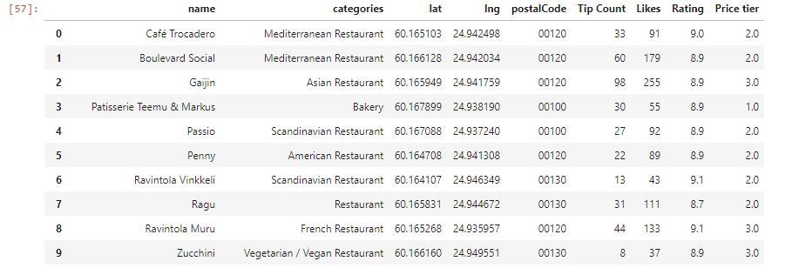
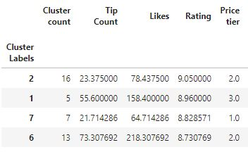
Results 1/2

Slide 6
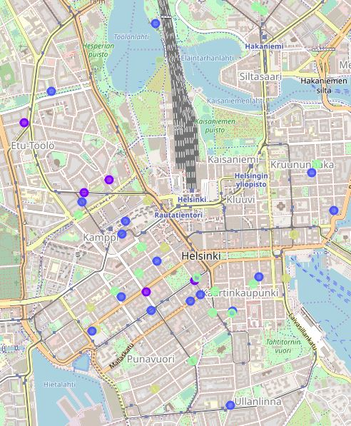
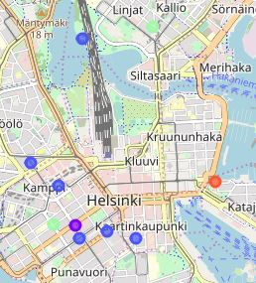
Results 2/2

Slide 7
Conclussion
Kamppi is the best location to open a Restaurant in Helsinki
Moderate priced Scandinavian restaurant would be the best type of the restaurant based on the data
Restaurant can still be popular in spite of the location and the type

