Slide 1
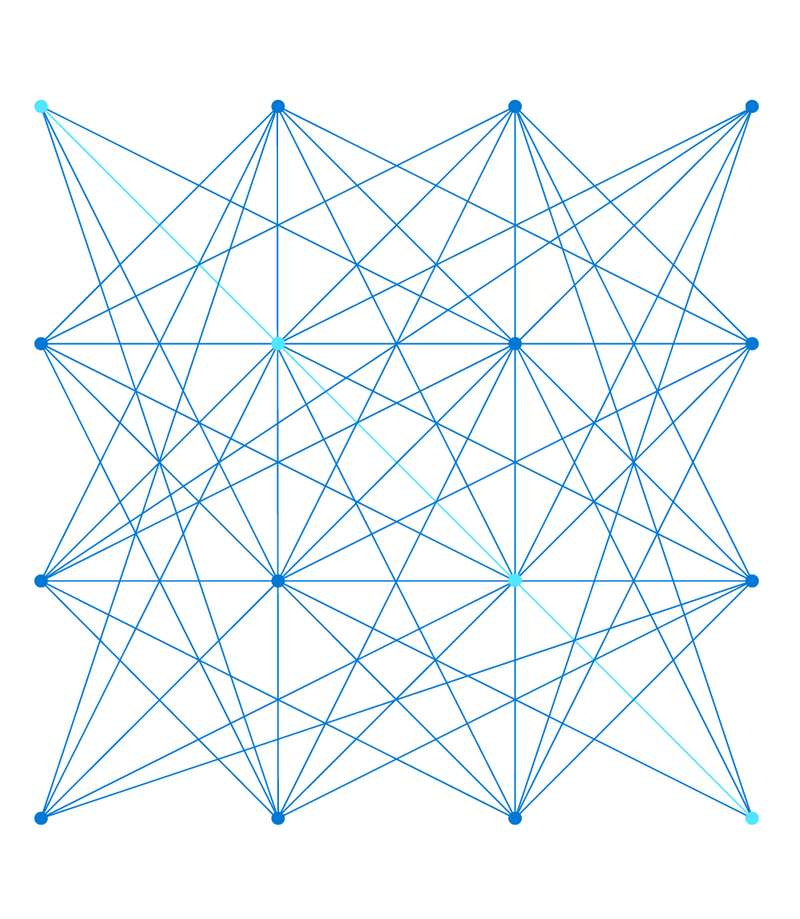
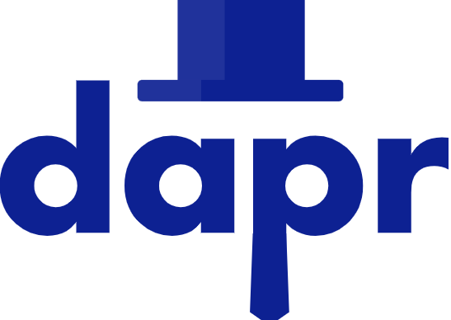
Building Distributed applications with
Piran Tata
Senior Consultant – Modern Apps

Slide 2

Provision a world-leading supercomputer dedicated to weather and climate.
Will be in the top 25 supercomputers in the world - twice as powerful as any other in the UK.

Slide 3
What is Dapr?

Slide 4
Distributed Application Runtime
Dapr was created as a portable, event-driven runtime, aiming for an easy developer experience when building resilient, stateful and stateless applications that run on the cloud.

Slide 5
Distributed Application Runtime
Dapr, as a framework, codifies the best practices for building microservice applications into open, independent APIs called “Building Blocks”.
Dapr’s Building Blocks will
Enable you to build applications using the language and framework of your choice.
Are completely independent.
Have no limit to how many building blocks you use in your application.

Slide 6
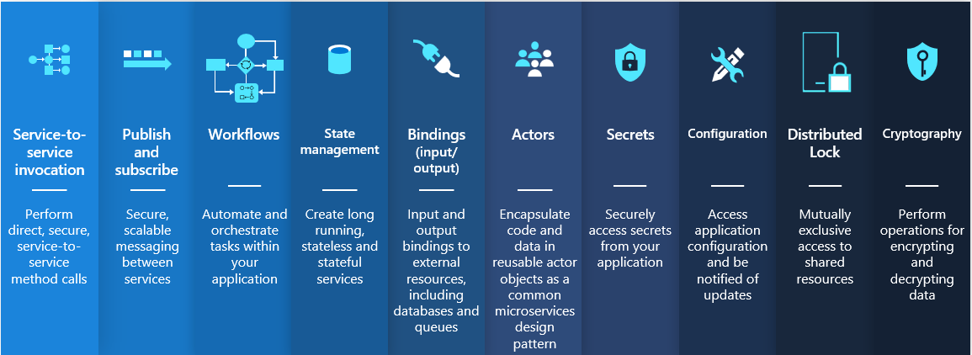
Distributed Application Runtime
Dapr, as a framework, codifies the best practices for building microservice applications into open, independent APIs called “Building Blocks”.

Slide 7
Distributed Application Runtime
Dapr is platform agnostic
You can run Dapr applications:
Locally
On any Kubernetes cluster
On virtual or physical machines
In other hosting environments that Dapr integrates with - Azure Container Apps

Slide 8
What are the main concepts of a Dapr Application?

Slide 9
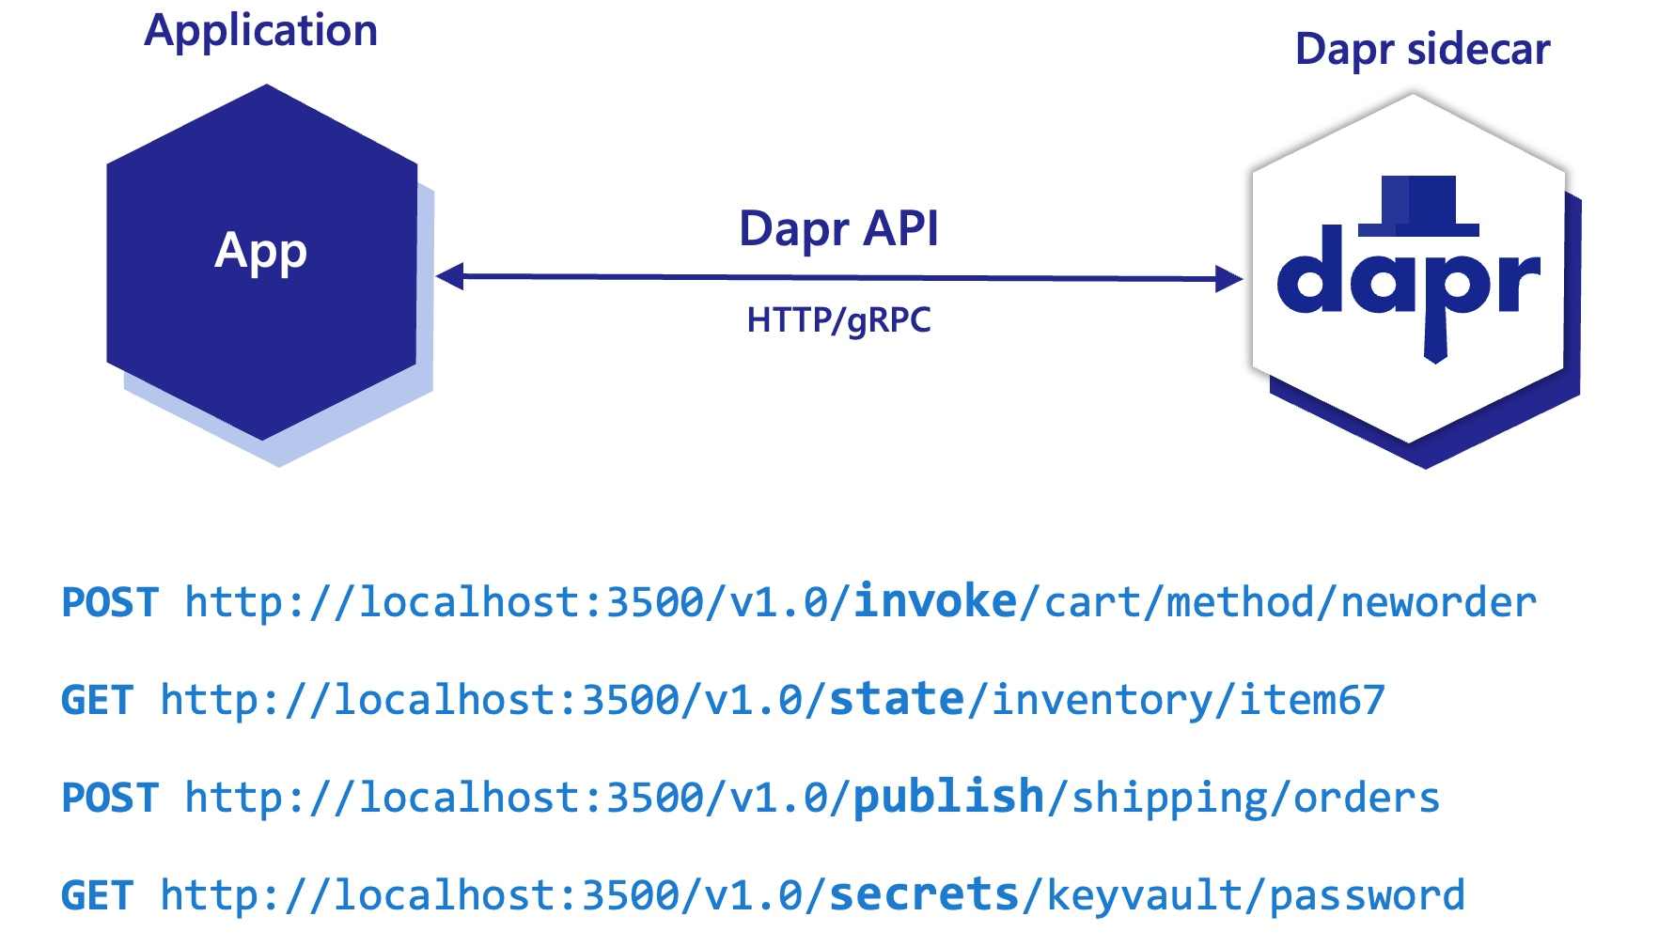
Dapr - Application concepts
Sidecar architecture
All Dapr building block APIs are hosted using a sidecar architecture:
Sidecars run as either as a container or as a process.
The Dapr runtime is injected into the sidecar.
Your application will invoke Dapr Building-Block API’s using HTTP or gRPC.

Slide 10
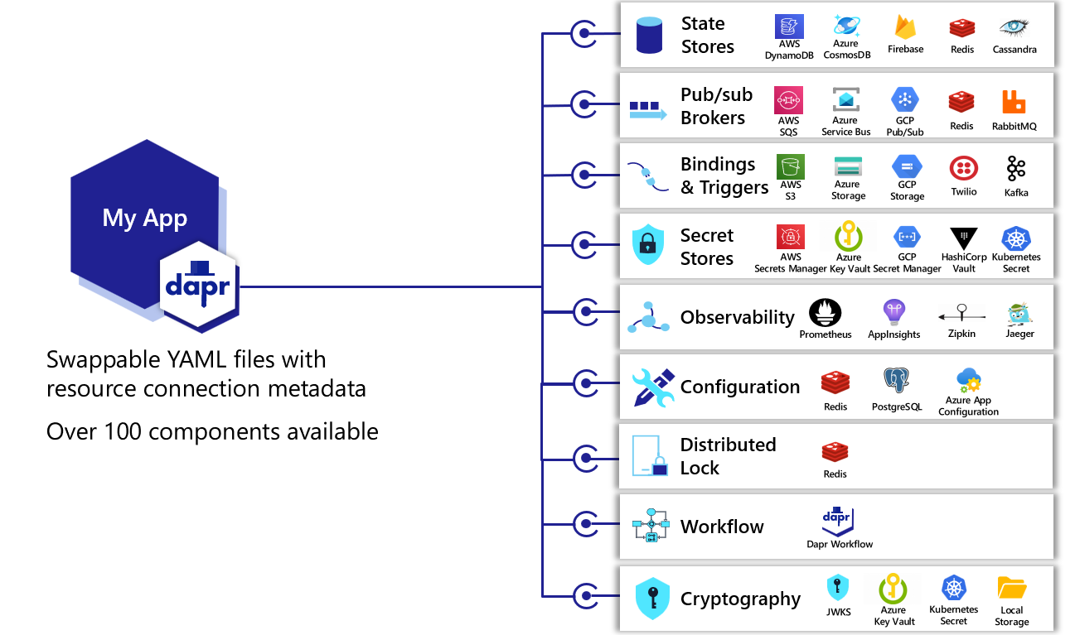
Dapr - Application concepts
Components
Components are modular pieces of functionality that are in turn used by a Dapr building block API.
Components deliver the required functionality by using a backing component platform technology.
A building block API can use any combination of components.
Example: the actors and the state management building block API’s both use state-store components.
Design time configuration via YAML.
Built in and Pluggable components (Define your own).
Large library of Public Components – Can contribute your own.

Slide 11
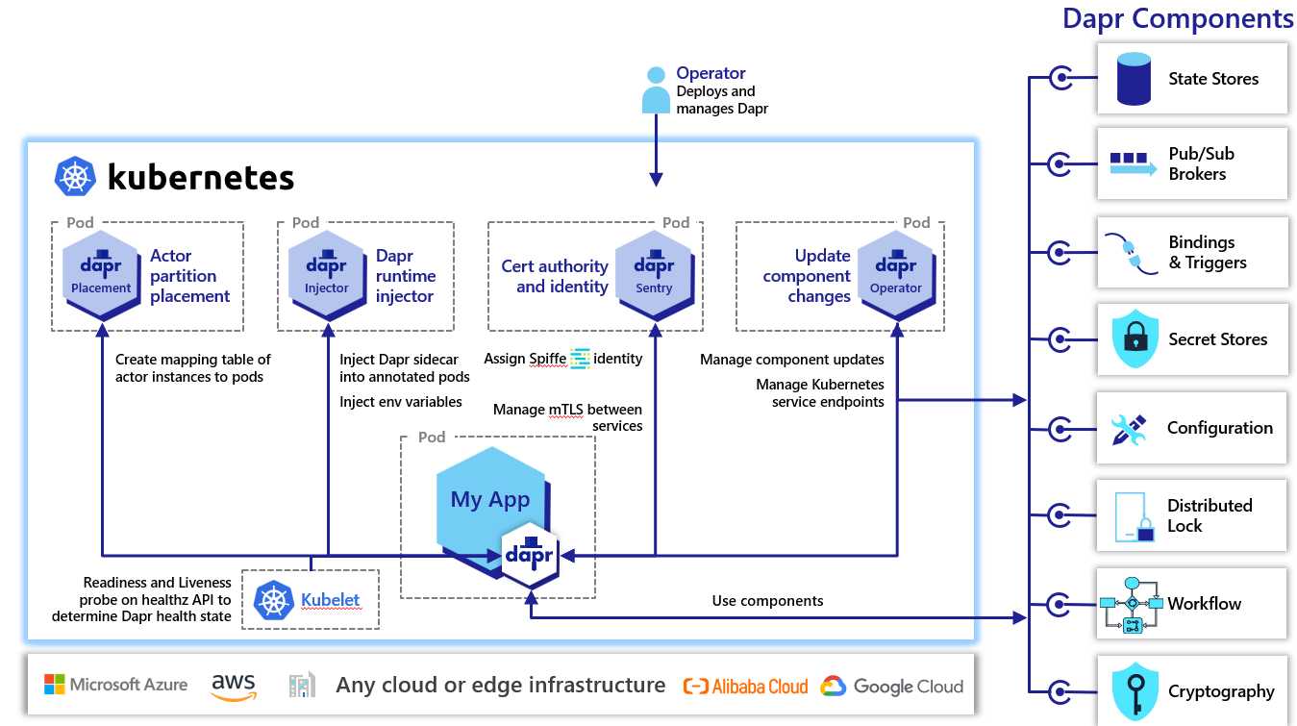
Dapr - Application concepts
Dapr Control Plane
A collection of services that are part of a Dapr installation on a hosting platform
Allows Dapr-enabled applications to run on the platform and handles Dapr capabilities such as actor placement, Dapr sidecar injection, or certificate issuance/rollover.

Slide 12
Demo – Part 1: Dapr Publish and subscribe

Slide 13
Demo – Dapr Publish and subscribe
Demonstrate the Dapr pub/sub API building block.
Hosted via Azure Container Apps
First class support for integrating with Dapr: Component + Sidecar registrations etc, as part of the deployment.
Configuring a “Dapr Sidecar” on your container app, creates a secondary process alongside your application code, that simplifies application intercommunication with the Dapr runtime via HTTP or gRPC.
Demo – Simple Chat Application, using Publish-Subscribe semantics
Client application posts messages via Dapr Sidecar (Client): POST /dapr.proto.runtime.v1.Dapr/PublishEvent
Server application endpoint notified of incoming chat message by Dapr Sidecar (Server).
A dapr “pubsub” Component is configured to interact with an Azure Service Bus Topic: pubsub.azure.servicebus
All application code is unaware that the pub/sub functionality is being fulfilled by an Azure Service Bus Topic.

Slide 14
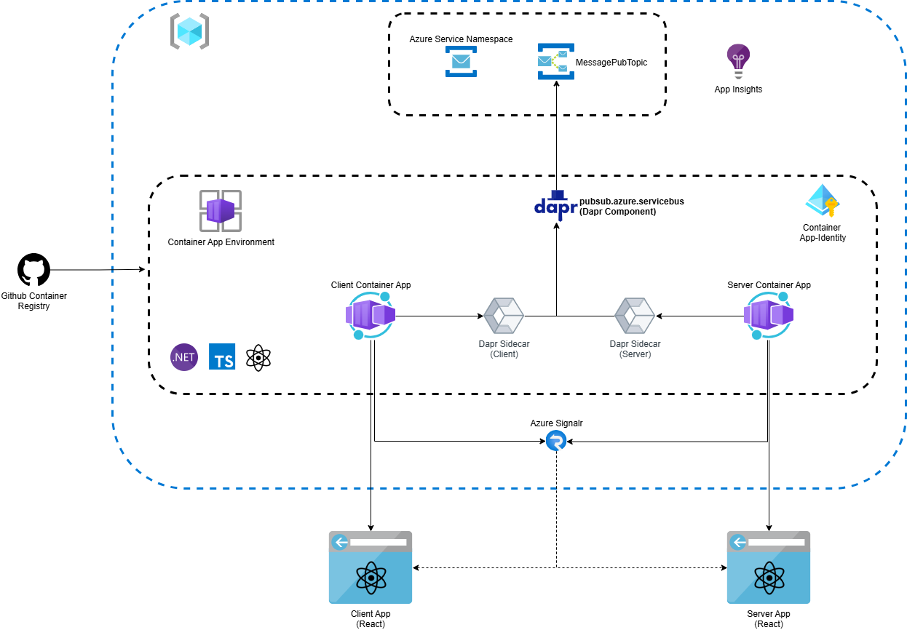

Slide 15
Demo – Dapr Publish and subscribe
Demo…..

Slide 16
Demo – Part 2: Actors in Dapr

Slide 17
Demo – Actors in Dapr
Demonstrate the Dapr Actor API building block.
Dapr includes a runtime that specifically implements the Virtual Actor pattern.
Code is written in a self-contained unit (called an Actor) that receives messages and processes them “one-at-a-time”, without any kind of concurrency or threading.
Every actor is defined as an instance of an actor “type” (identical to the way an object is an instance of a class).
Every actor instance is uniquely identified by an “Actor ID”.
Actors of the same “type” can be distributed on various nodes across a cluster.

Slide 18
Demo – Actors in Dapr
Demo – Bank Account Actor that can process Transactions
Dapr “state” Component used to persist Actor-State in Azure Cosmos DB: state.azure.cosmosdb
Server application registered to host instances of a “BankAccountActor” actor type.
Client application (using a Dapr “actor proxy”), will post transaction messages to an instance of a “BankAccountActor” actor : PUT /v1.0/actors/BankAccountActor/BA123/method/AddTransactionAsync
Dapr (via server sidecar) invokes a BankAccountActor instance on the Server application (with an Actor ID BA123).
The actor implementation logic, stores the transaction to the “actor state” (representing the ledger): PUT /v1.0/actors/BankAccountActor/BA123/state
An actor Timer used to periodically process “pending” transactions.
All application code is unaware that Azure Cosmos DB is being used to store Actor State.

Slide 19
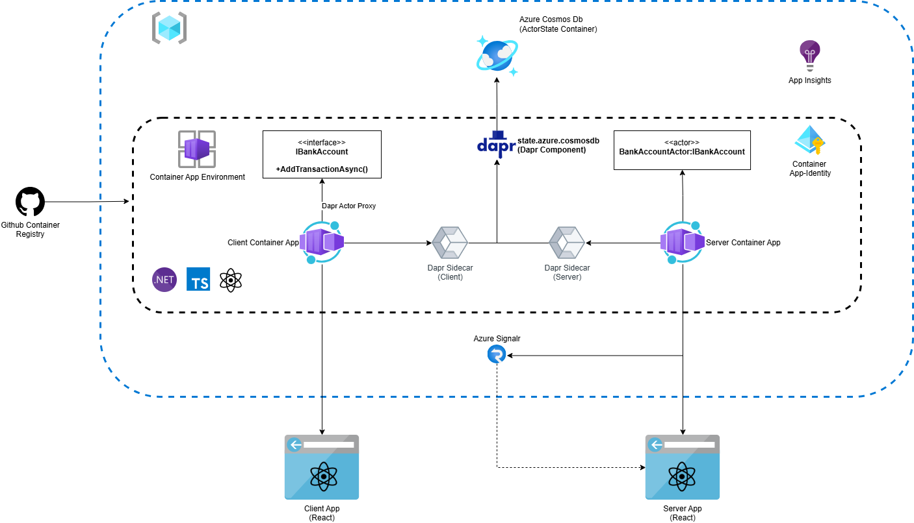

Slide 20
Demo – Actors in Dapr
Demo…..

Slide 21
Where would Dapr fit into your project/technical roadmap?

Slide 22
Dapr – The case for using Dapr
Proven Industry Adoption:
Used to build real-time recommendations engine, IoT, Banking https://dapr.io/
Microsoft ISD+ Met Office Supercomputer – Dapr Actor framework is central to the development of all File-System workflows.
Rich third-party Dapr component support for various Azure services:
https://docs.dapr.io/reference/components-reference/supported-state-stores/
Platform-agnostic integration using the Dapr framework.
Tech roadmap for onboarding an existing Application Surface onto Azure – Potential to mix with other existing cloud providers?
Benefits for Application Development:
Building Block API’s, Security, Observability, Resiliency etc.
https://www.diagrid.io/blog/dapr-as-a-10x-platform

Slide 23
Dapr – Honest view of draw-backs from experience
Learning Curve required – Dapr paradigms (Sidecar, components etc). Documentation “can” be a little lacking.
Can add complexity to the LED testing effort.
Some Building-Blocks/Components are still in Beta phase – Workflows (BYO).
Component implementations can be opinionated e.g. Actor State keys/Reminders in Cosmos DB
Requires pre-testing to gauge if the chosen component/building blocks meet NF requirements.
Only a subset of components are supported in Azure Container Apps – Tier1 VS Tier 2 components (Tier 2 less stable, less priority in critical security/regression scenarios).

Slide 24
Kudos Code: https://github.com/pirahawk/az-isd-dapr-talk

Slide 25
Thank you.

