Slide 1
Big Data challenges for e-Mobility- infra operator
Team members:
1.Roshini S [711715104050]
2.Vrinda raj.V.P [711715104075]
Faculty Guide : Mrs.Jayashree.R [AP/CSE]
Industry Guide : Mrs.Yukthika
Department of CSE, KGiSL Institute of Technology, Coimbatore

Slide 2
Abstract
The E-Charging Operators (equivalent of today's petrol pump operators) need a prediction to ensure their customers (end-users) satisfaction and optimum utilization of the e-Charging stations.
The operator may have fast or slow charging infrastructure with their own payment terms and timings.
With the help of machine learning algorithms the operator can offer dynamic pricing at stipulated times and manage the peak demand accordingly.
Department of CSE, KGiSL Institute of Technology, Coimbatore

Slide 3
Area Introduction-Existing system
With the rapid increase in the penetration level of electric vehicles (EVs), accurate modelling of the impacts of EVs on the electricity grid in cities is of important value to grid operators.
Then a spatial model is developed and validated using the previously analysed data. The results show that there is a big difference in the occupancy rate of stations. Some stations are more frequently used than others.
The price prediction was done only based on a survey with the society and not with any predictions.
Department of CSE, KGiSL Institute of Technology, Coimbatore

Slide 4
Proposed System
A battery swapping (or switching) station is a place at which a vehicle's discharged battery or battery pack can be immediately swapped for a fully charged one, eliminating the delay involved in waiting for the vehicle's battery to charge.
In this system, Using the Machine learning algorithms like K-means, Linear Regression and decision tree algorithms the pricing structure according to the demand and the infrastructure is predicted.
It was done by finding the prediction score and accuracy for each algorithms and selecting an algorithm which has the high accuracy rate compared to the other two.
Department of CSE, KGiSL Institute of Technology, Coimbatore

Slide 5
Advantages over existing methods
Easy to predict.
Accuracy is obtainted
easy to fullfil a demand.
Future Enhancement
Will also create a web page or an android application where many operators can easily find their pricing structure.

Slide 6
Literature Review
Drawbacks:
The number of electrical vehicles continues to increase but EV charging infrastructure remains underdeveloped and insufficient.
This is beacuse of the some people who are afraid to build an echarging station as they think they may suffer loss due to improper pricing structure.
Most of the operators does not have an idea how to place an pricing structure for fast and slow charging infrastructure.
Department of CSE, KGiSL Institute of Technology, Coimbatore

Slide 7
References
https://www.nttdata.com/global/en/success-stories/2018/february/open-charging-station-controller-for-future-mobility-society#
https://wise-paas.advantech.com/en-us/embedded/resource-library/4cc199e6-0d4c-4d53-b0f5-5243b096f94a
https://en.wikipedia.org/wiki/Charging_station#Overview
https://www.researchgate.net/publication/320663372_Data_from_electric_vehicle_charging_stations_Analysis_and_model_development

Slide 8
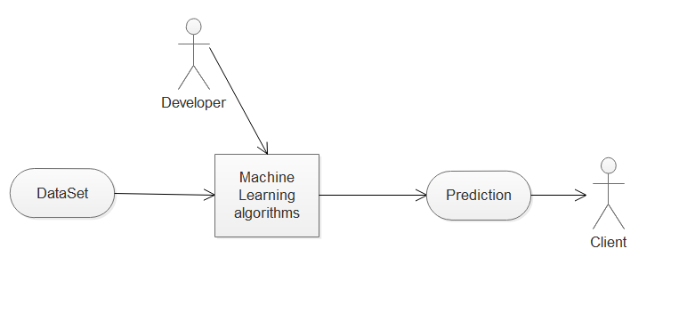
Use case diagram

Slide 9
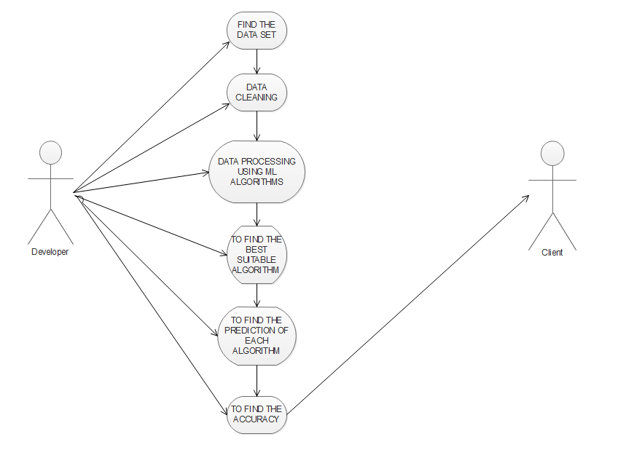
Use case diagram

Slide 10
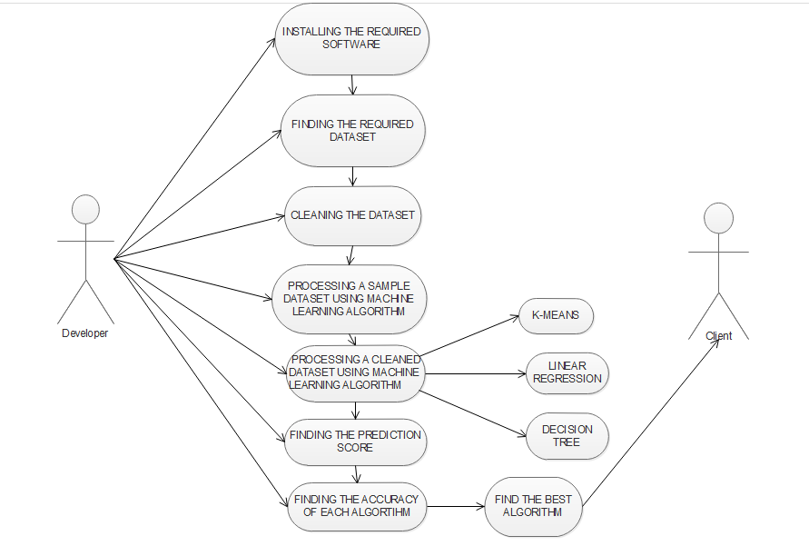
Use case diagram

Slide 11
Module Splitup
Module 1:
1.Data set
2.Data cleaning
Module 2:
1.K-means
Module 3:
1.Linear regression
2.Decision tree
Module 4:
1. prediction score and accuracy.

Slide 12
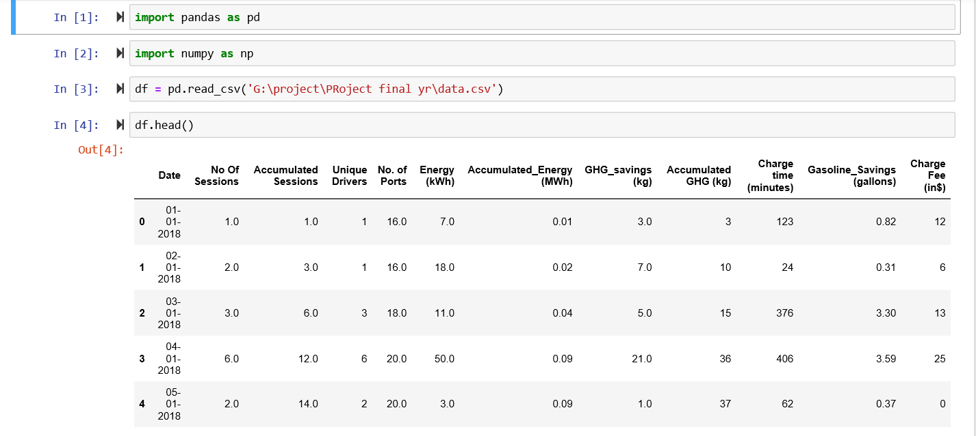
SCREENSHOTS OF DATA EXTRACTION

Slide 13
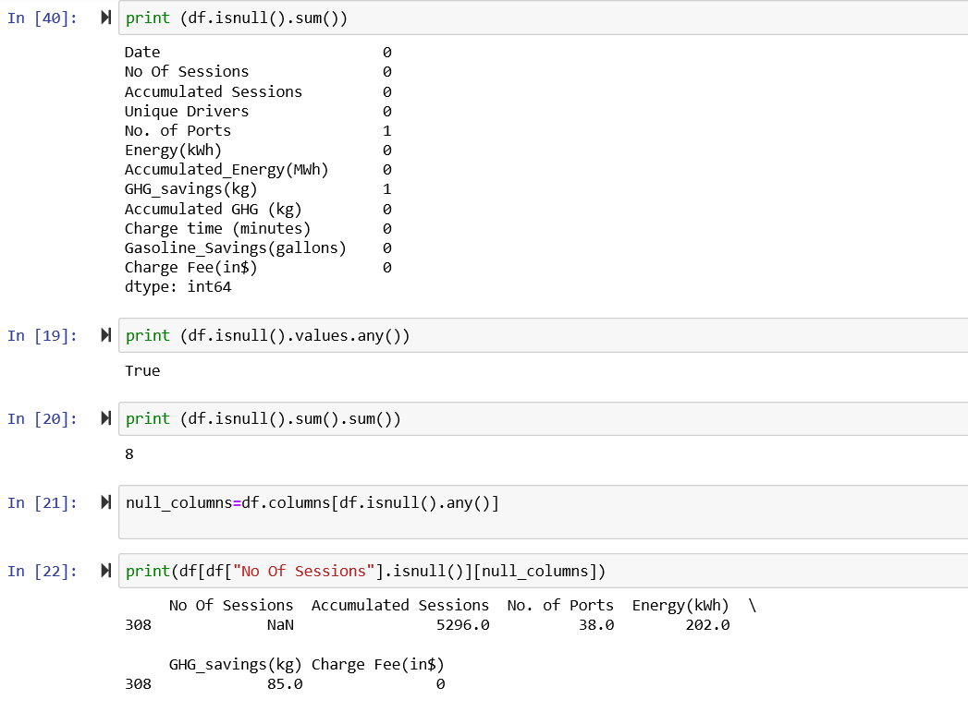
SCREENSHOTS OF DATA CLEANING

Slide 14
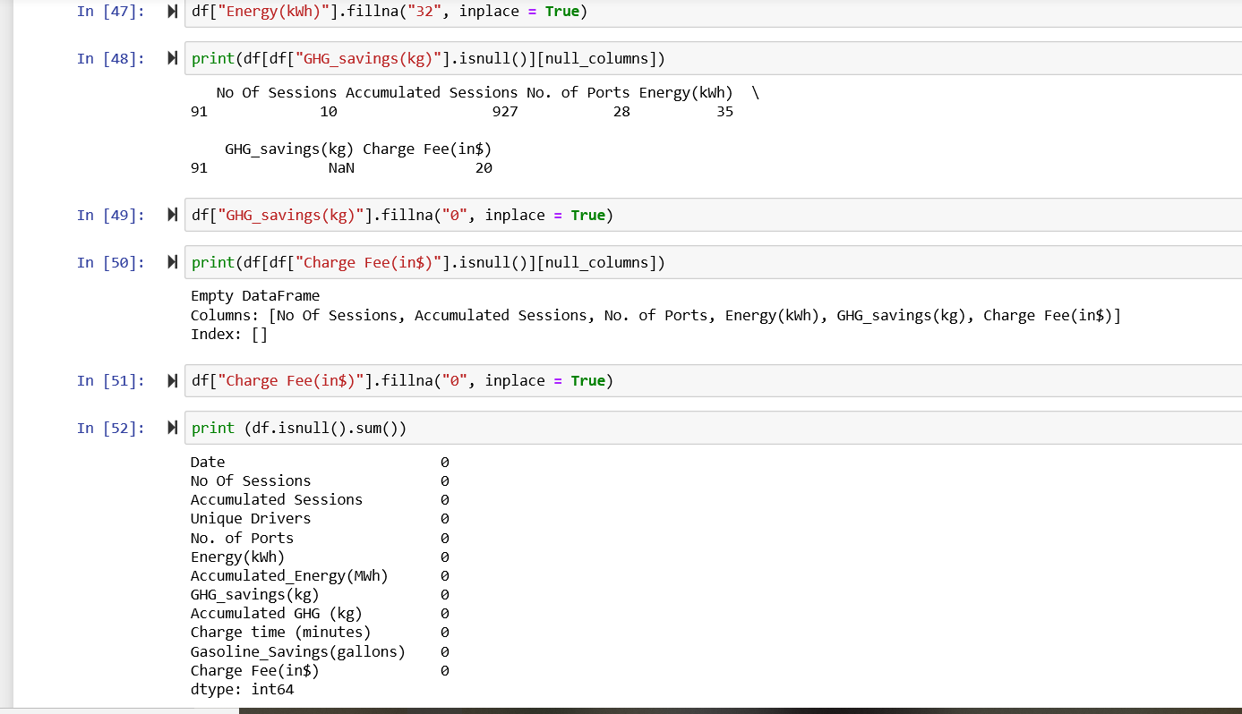
SCREENSHOTS OF DATA CLEANING

Slide 15
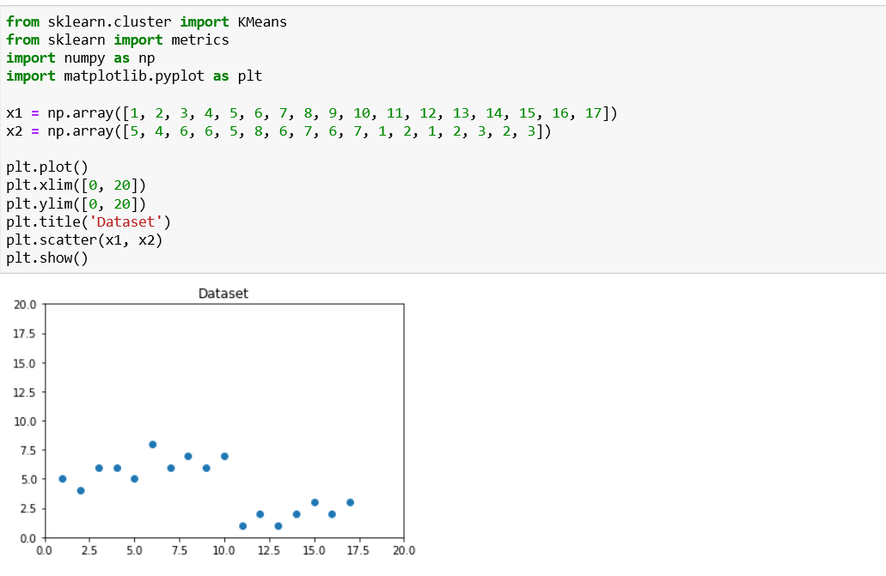
SCREENSHOTS OF SAMPLE KMEANS

Slide 16
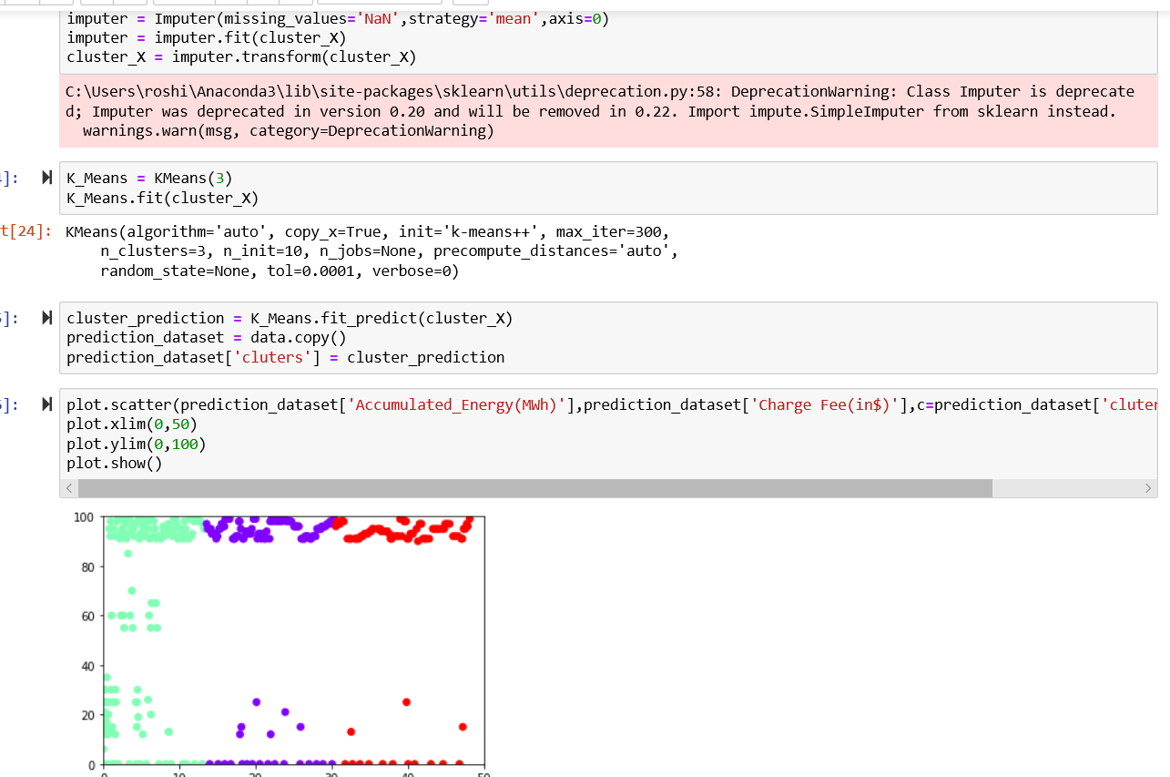
SCREENSHOTS OF KMEANS CLUSTERING

Slide 17
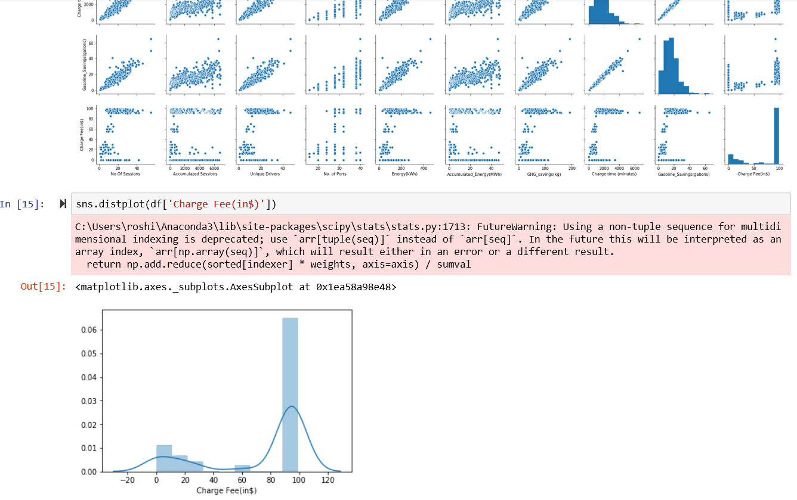
SCREENSHOTS OF LINEAR REGRESSION

Slide 18
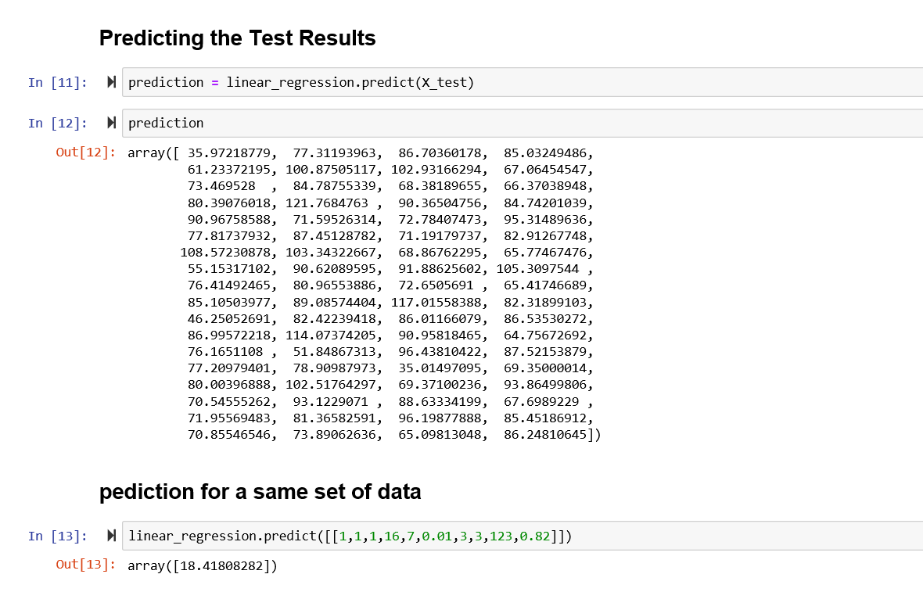
SCREENSHOTS OF LINEAR REGRESSION

Slide 19
Thank You!!! BY Roshini S Vrinda Raj V P
The need for an algorithm that will prove efficient every time is the reason that gave rise to the comparative study of machine learning algorithms in e-charging station.

