Slide 1
PageRank using AWS Elastic MapReduce
Ansha Yu
Gene Shin
Jimmy Feher

Slide 2

Purpose
The goal of this project was to deploy a MapReduce cluster on AWS that can calculate the PageRanks of web pages in a Web graph.
This is achieved primarily by overwriting the map and reduce methods in Apache's Hadoop libraries.

Slide 3

Approach
There are two different approaches we take: Simple PageRank and Blocked PageRank.
Both run through multiple phases of MapReduce to converge on accurate PageRank values.
However, the latter approach is an improvement on the former that gives us faster convergence.

Slide 4

Simple PageRank
We'll start with Simple PageRank, which is a node-by-node approach.
In other words, single nodes are passed through MapReduce phases and PageRanks are calculated individually, node by node.
To gauge how quickly (rather, how slowly) simple PageRank converges, we calculate the average of the residuals for each node for each phase. The residual is defined as:
The residual of a node u is simply the normalized difference between the node's PageRank value from the previous phase and the current phase.
As a measure of convergence, we see how quickly the average residual decreases through phases of MapReduce.

Slide 5
Simple PageRank Implementation
Mappers and reducers both have the following input/output types
Key is the node number of type Text
Value is a string (type Text) containing the node's PageRank value and outgoing nodes, all delimited by "_“.
Map input:
<u;PR(u)_{v | u->v}>
Map outputs/ Reducer input:
<u;PR(u)_{v | u->v}>, <{v;PR(u)/N_-1} | u->v>
Reducer output:
<v;Pr_{new}(v)_{w | v->w}>
To pass values between mappers and reducers, we construct a value string (the node’s PageRank and outgoing nodes) when emitting.
When a mapper or reducer receives it, it can parse them out of the string.
Hadoop Counters approach to accumulate the average residuals.

Slide 6
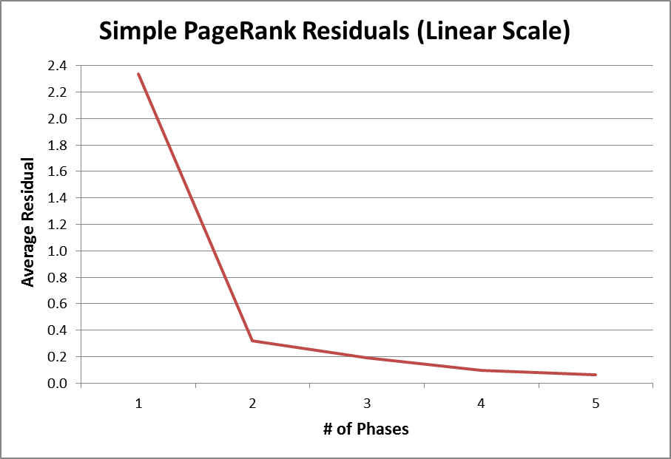
Results
Average residual decreases slowly -> slow convergence
Does not converge to accurate values by 5 iterations

Slide 7
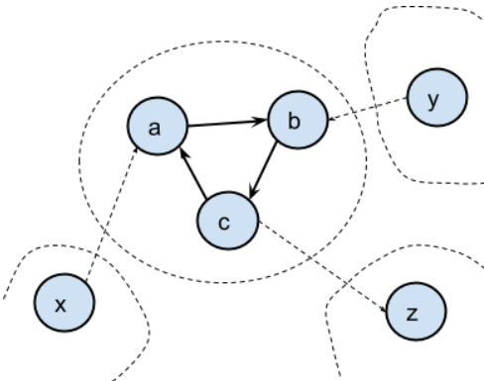
Blocked PageRank
In blocked PageRank, the Web graph is partitioned into blocks of nodes where every node is in a block.
The map function is similar to Simple PageRank with different input/output parameters.
The reduce function performs multiple PageRank iterations for a given block until the residual error falls below a threshold.

Slide 8
Blocked PageRank
The residual for Blocked PageRank is slightly different than that of Simple PageRank:
The residual of a node v is the normalized difference between the node's PageRank value passed from the map stage and the last iteration of a reduce task.
Termination condition: After each MapReduce phase, take the average residual across all the blocks. If the average residual falls below an error bound (0.001 in our case), the PageRanks have converged and MapReduce terminates.

Slide 9
Blocked PageRank Implementation
Mappers and reducers both have the following input/output types
Key is block number of type Text
Value is a string (type Text) containing a node number, which block the node came from (if applicable), the PageRank of the node, and the lists of outlink nodes and their corresponding blocks, all delimited by "_".
Map input:
<b(u);u_-1_PR(u)_{b(v)~v | u->v}>
Map outputs/ Reducer input:
<b(u);u_-1_PR(u)_{b(v)~v | u->v}>, <b(v);v_b(u)_PR(u)/N_-1>
Reducer output:
<b(u);u_-1_PR(u)_{b(v)~v | u->v}>
Parsing and constructing the string value fields is done the same way as in Simple PageRank.
Two Counters: one for the residuals, and another for the number of PageRank iterations per reduce task.

Slide 10
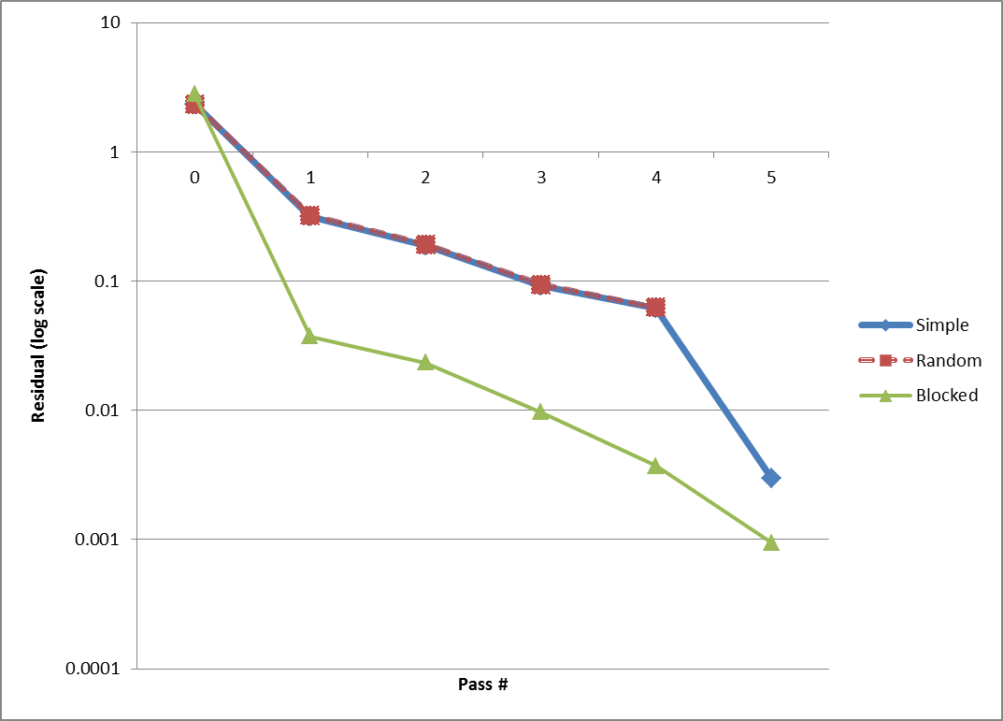
Results - Residuals
Blocked converges faster than Simple PageRank given a good partition.

Slide 11
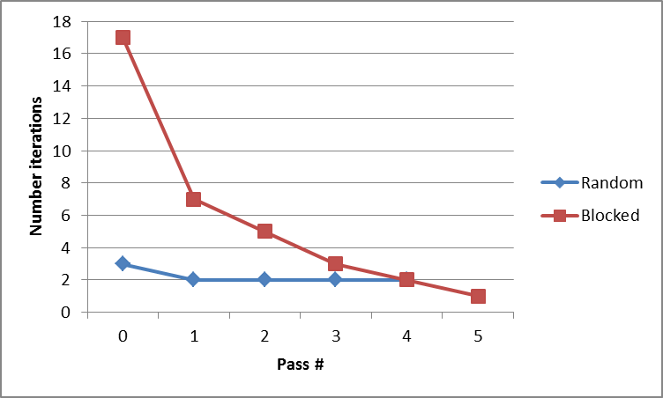
Results - Iterations

Slide 12
Random Partitions
The performance of Blocked PageRank depends heavily on how the nodes are partitioned.
Good partitions in Blocked PageRank converge much faster than Simple PageRank.
But bad partitions in Blocked PageRank offers almost no improvement on Simple PageRank.
To partition our nodes into random blocks, we hash node numbers accordingly:
Block# = (Node# * 13) mod 68, where 68 = # of blocks.

Slide 13
Conclusion
Blocked PageRank converges faster than Simple PageRank
This is only true when the nodes are in good partitions. In general, it’s difficult to achieve good partitions.

