Slide 1
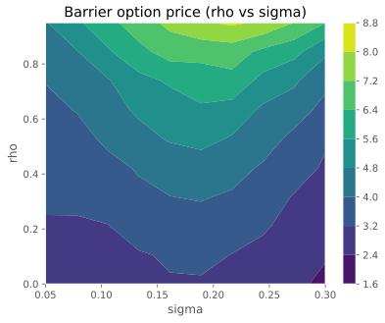
Numerical methods to price multi asset barrier options
Bevan Ramsden

Slide 2
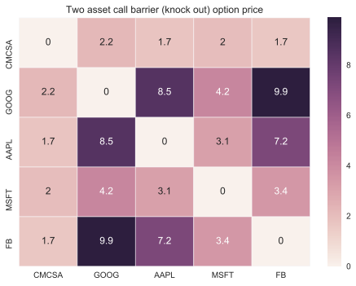
Nasdaq 100
Aim is to price all two asset knock out call barrier options on the Nasdaq 100.

Slide 3
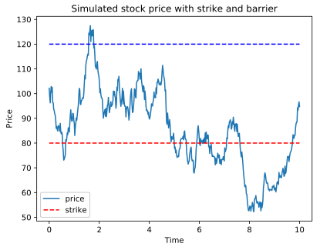
Barrier Option
Focus on call up and out barrier option

Slide 4

Basics of Montecarlo pricing
Any option can be priced as a discounted expectation under it’s risk neutral pricing.
Generate n sample runs and average terminal option value will limit towards option price.
Task is “embarrassingly parallel”.
Assume equities follow Geometric Brownian Motion

Slide 5

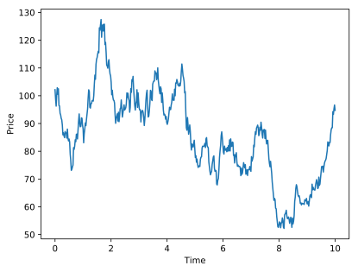
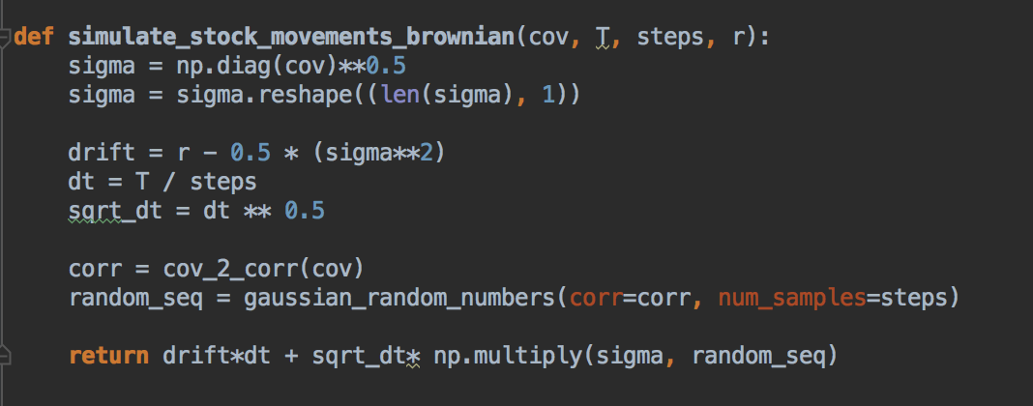
Generating a sample single stock path

Slide 6
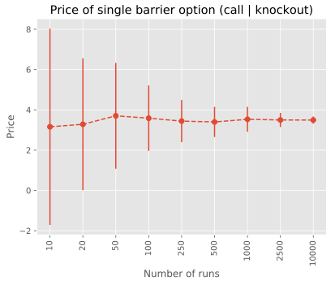
Pricing a knock out call option
r = 0.05; T = 1.0; No dividends; S0 = 100; K = 100;
B = 130; sigma = 0.2
Iterations = 200.0

Slide 7
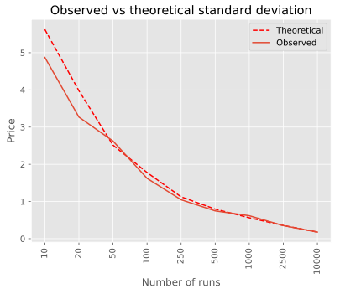
Central limit theorem
More runs result in more accurate answers
Answer related to square root of n

Slide 8


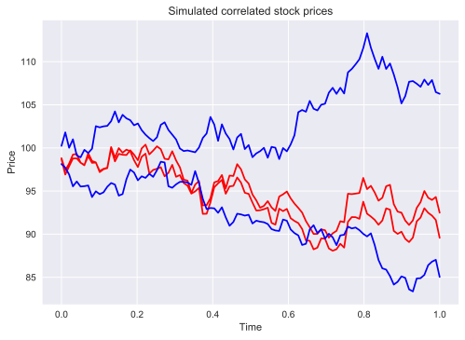
Generate samples from multivariate distribution
Use Cholesky decomposition

Slide 9
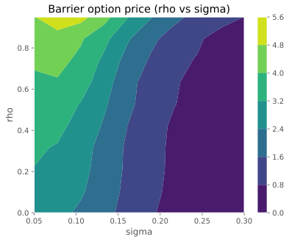
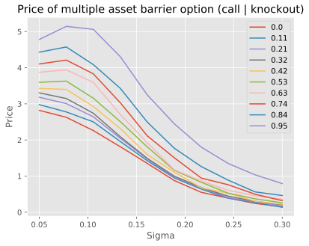
Multi asset barrier sensitivities
Multi asset barrier is the minimum of each barrier option.
r = 0.05; T = 1; K = 100; B = 130; No dividends; S0 = 100

Slide 10
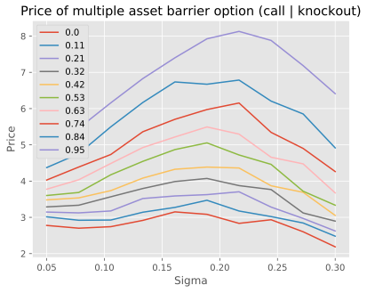
Multi asset barrier sensitivities
Multi asset barrier is the minimum of each barrier option.
r = 0.05; T = 1; K = 100; B = 170; No dividends; S0 = 100

Slide 11
Pricing barrier options on Nasdaq
r = 0.05; T = 1.0; B* = 1.3
Covariance configured from last 30 business days. EOD pricing from google

Slide 12
Thank you
Further topics include:
Variance reduction in Montecarlo techniques.
Other stochastic models apart from GBM.
All code can be found at github.com/pirateb

Slide 13
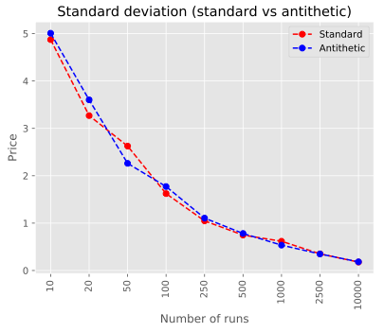
Variance Reduction
Antithetic variables

