Slide 1
IBM Coursera - Advanced Data Science Capstone
Sentiment analysis for financial news
By Rico Pircklen
27.7.2020

Slide 2
Use case
Sentiment analysis for financial news’ headlines.
Overview of the market sentiment, or the sentiment of a specific company to help decision making in stock trading.
Better understanding on how a company is presented in media.

Slide 3
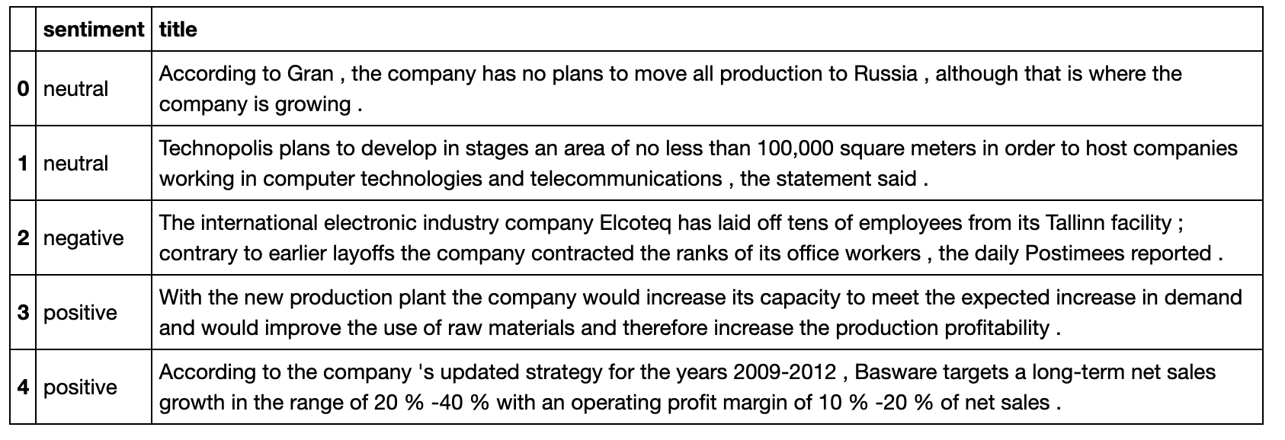
Data Set
Kaggle - “Sentiment Analysis for Financial News” -dataset
Available at: https://www.kaggle.com/ankurzing/sentiment-analysis-for-financial-news/metadata
Labelled text data
Only 4837 samples

Slide 4
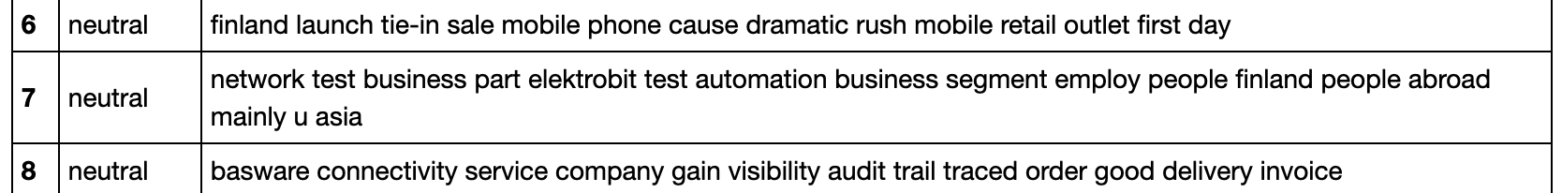
Data Quality Assessment
Amount of missing values: 0
Manual reviewing of random data samples: 13 % mislabelled

Slide 5
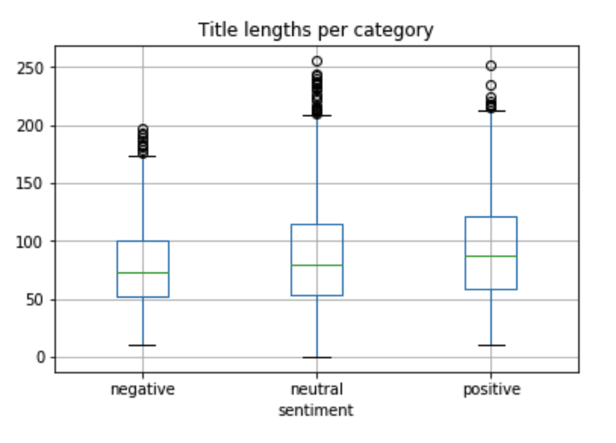
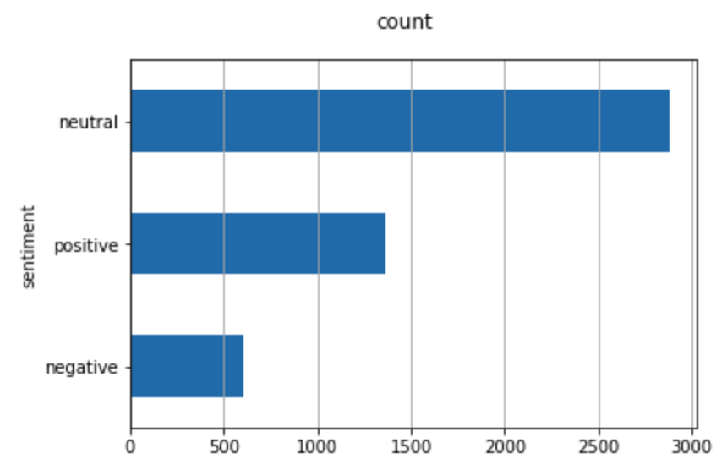
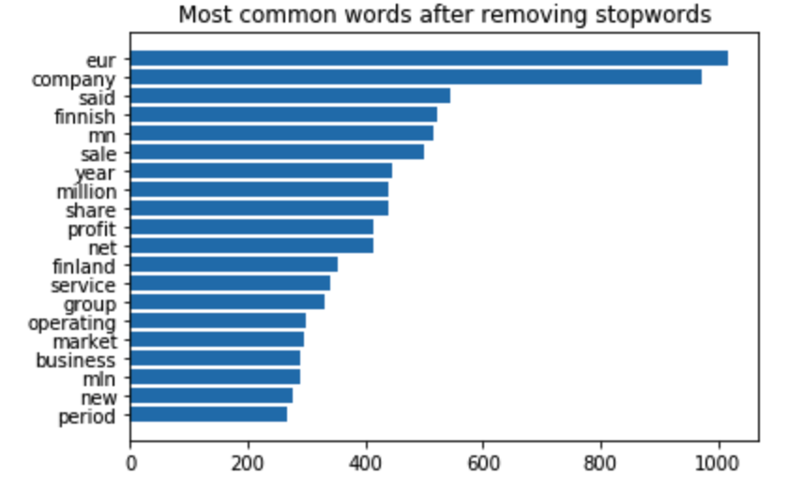
Data Exploration

Slide 6
Data Processing
Data cleansing
Removal of numbers, stop words, and punctuation
Lemmatizing
Lowercasing
Normalizing the sample count between different categories
Feature engineering
Tf-idf vectorization
GloVe embeddings

Slide 7
Solution Algorithm
Linear SVM with SGD training
Scikit learn
Tf-idf vectorization
Optimization using gridsearch
LSTM
pyTorch
GloVe

Slide 8
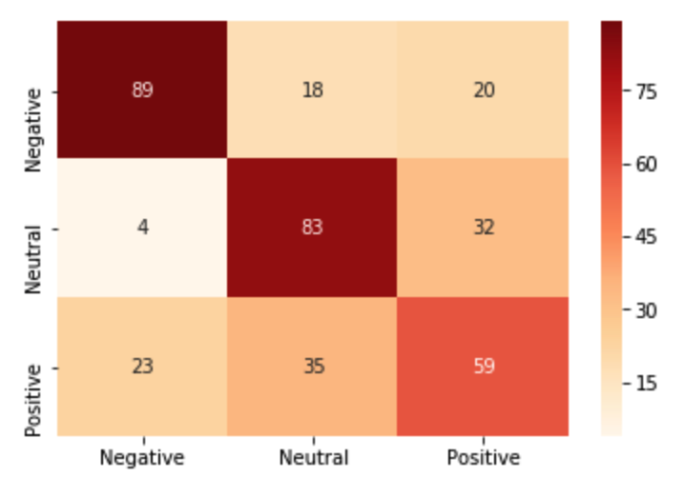
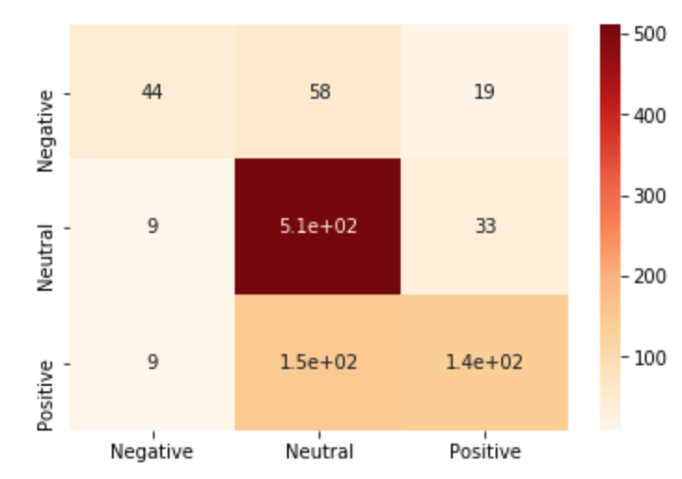
Performance
Accuracy, F1-score, and confusion matrix
Linear SVM with SGD
Accuracy 65 % (74 %)
F1-score 64 %
LSTM
Accuracy 63 %
Normalized dataset
Complete dataset

Slide 9
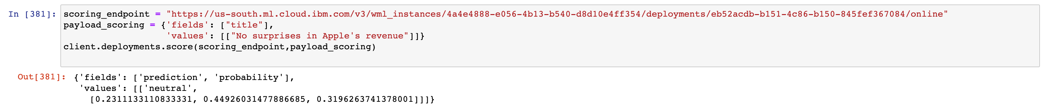
Deployment And Conclusion
Selected model: Linear SVM with SGD, hyperparameters optimized with gridsearch
No Apache Spark
IBM Data Storage for storing data
IBM Watson Machine Learning for deployment

