Slide 1
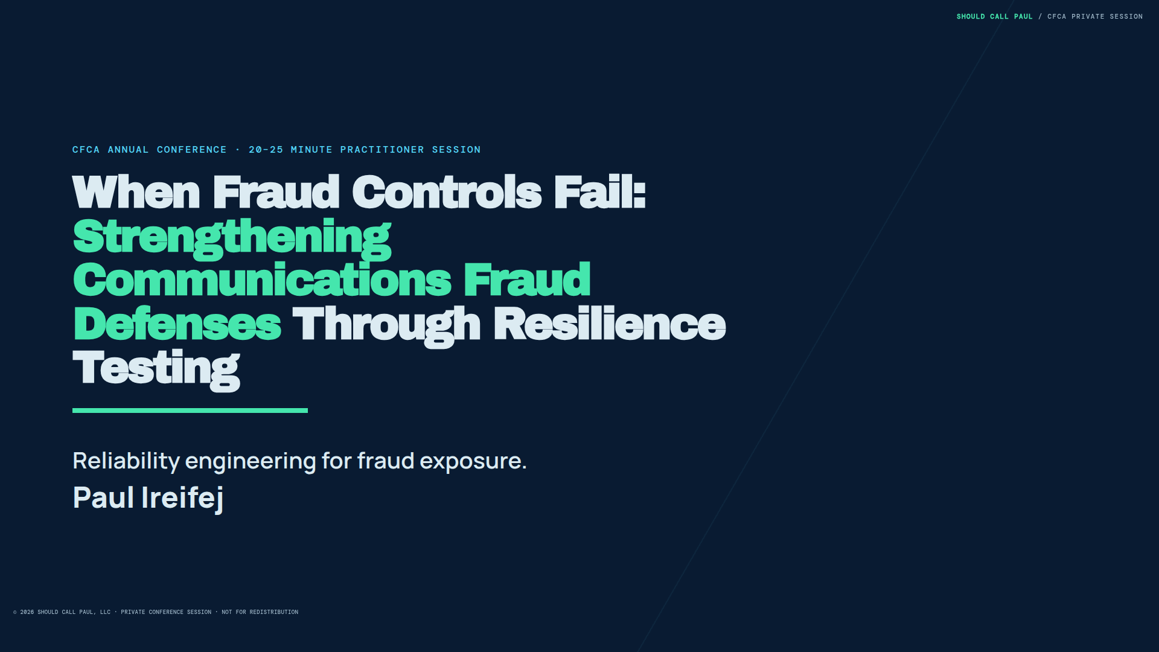
Notes:
CFCA ANNUAL CONFERENCE · 20–25 MINUTE PRACTITIONER SESSION
When Fraud Controls Fail:
Strengthening Communications Fraud Defenses Through Resilience Testing
Reliability engineering for fraud exposure.
Paul Ireifej

Slide 2
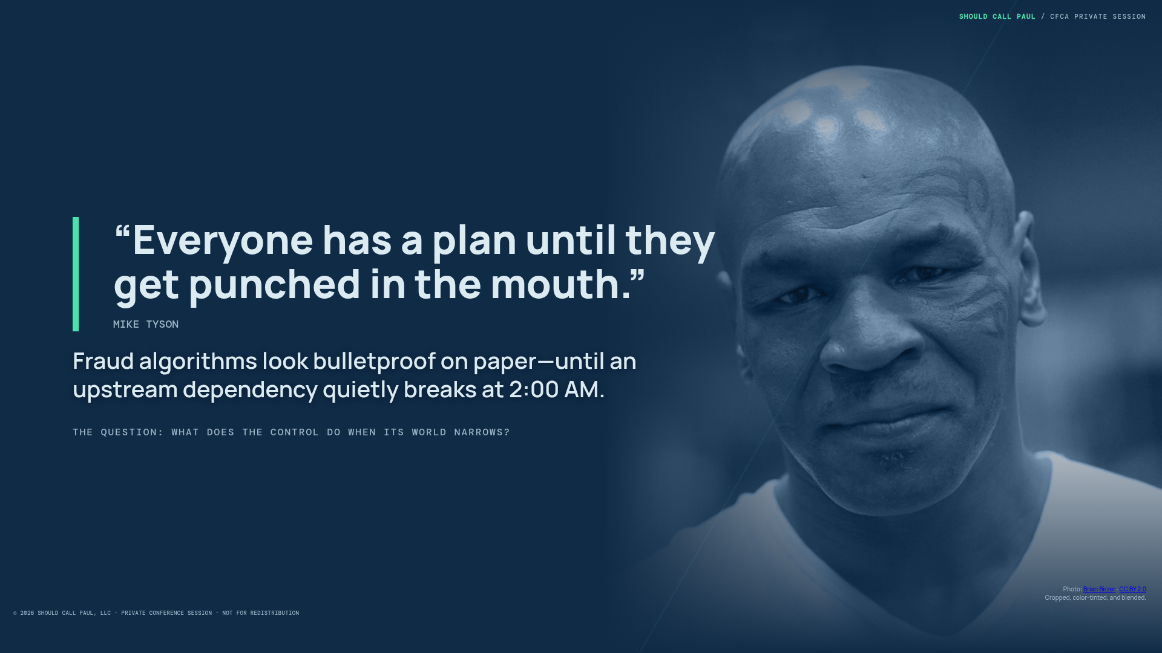
Notes:
“Everyone has a plan until they get punched in the mouth.”
MIKE TYSON
Fraud algorithms look bulletproof on paper—until an upstream dependency quietly breaks at 2:00 AM.
THE QUESTION: WHAT DOES THE CONTROL DO WHEN ITS WORLD NARROWS?
Photo: Brian Birzer · CC BY 2.0
Cropped, color-tinted, and blended.

Slide 3
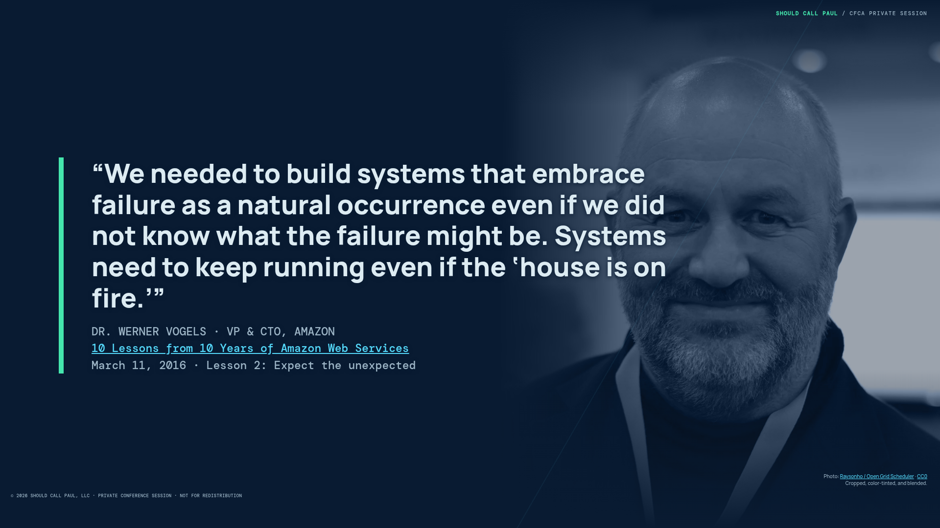
Notes:
“We needed to build systems that embrace failure as a natural occurrence even if we did not know what the failure might be. Systems need to keep running even if the ‘house is on fire.’”
DR. WERNER VOGELS · VP & CTO, AMAZON
10 Lessons from 10 Years of Amazon Web Services
March 11, 2016 · Lesson 2: Expect the unexpected
Photo: Raysonho / Open Grid Scheduler · CC0
Cropped, color-tinted, and blended.

Slide 4
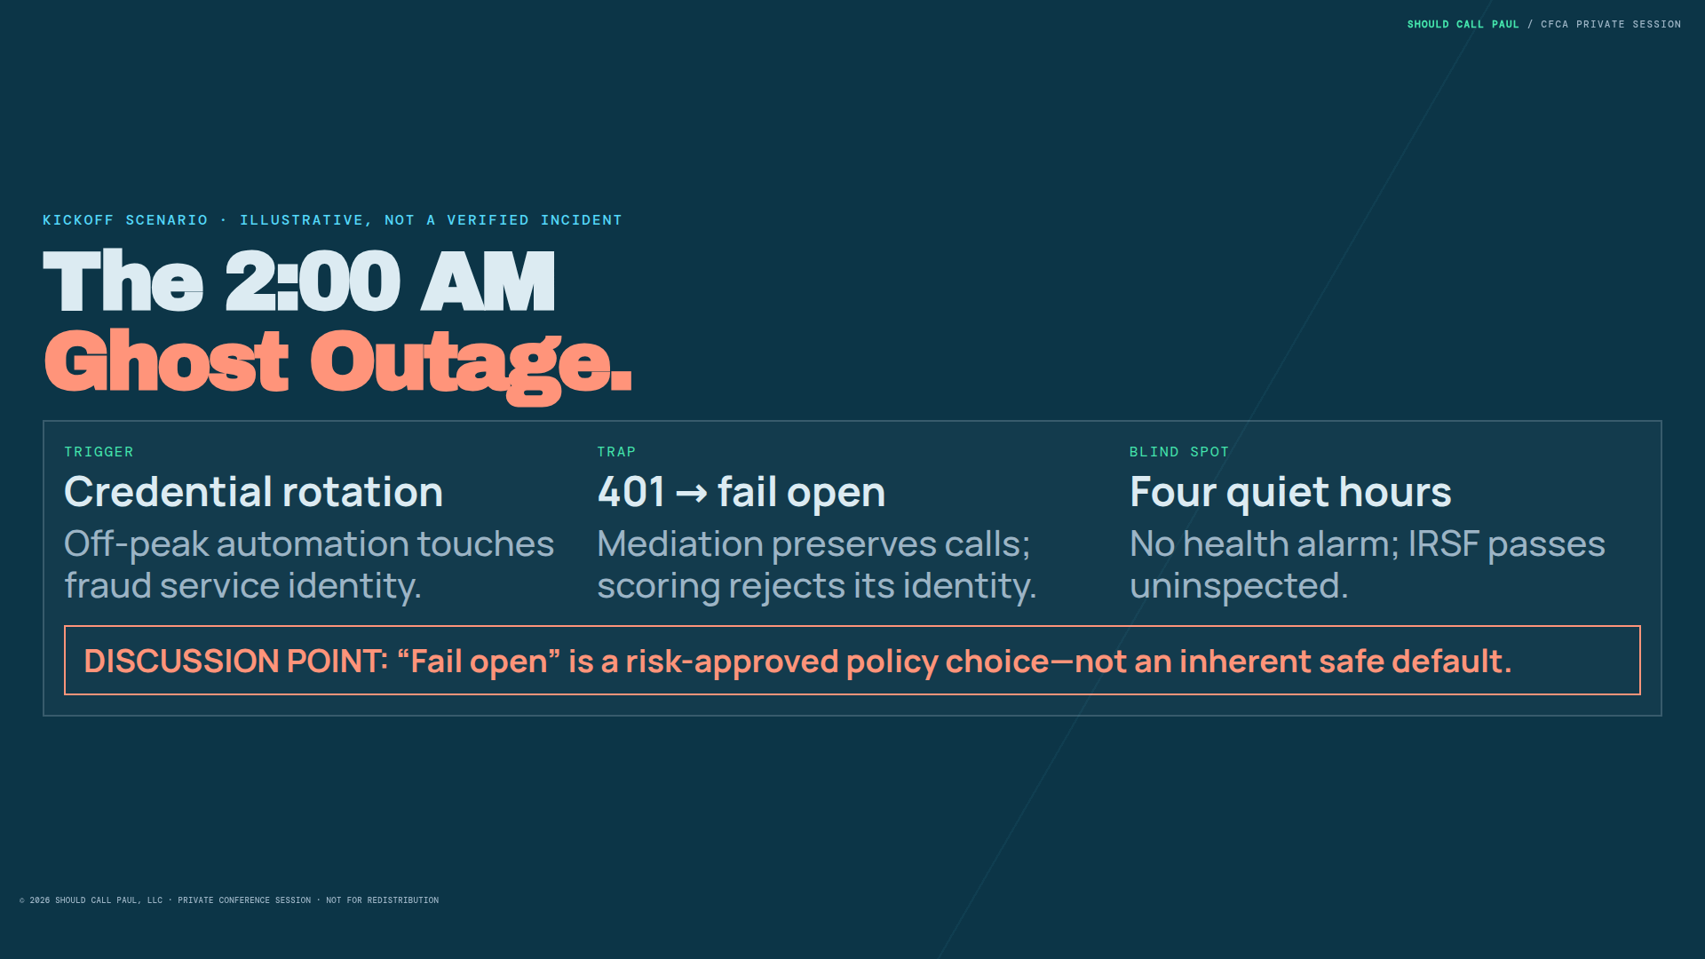
Notes:
KICKOFF SCENARIO · ILLUSTRATIVE, NOT A VERIFIED INCIDENT
The 2:00 AM
Ghost Outage.
TRIGGER
Credential rotation
Off-peak automation touches fraud service identity.
TRAP
401 → fail open
Mediation preserves calls; scoring rejects its identity.
BLIND SPOT
Four quiet hours
No health alarm; IRSF passes uninspected.
DISCUSSION POINT: “Fail open” is a risk-approved policy choice—not an inherent safe default.

Slide 5
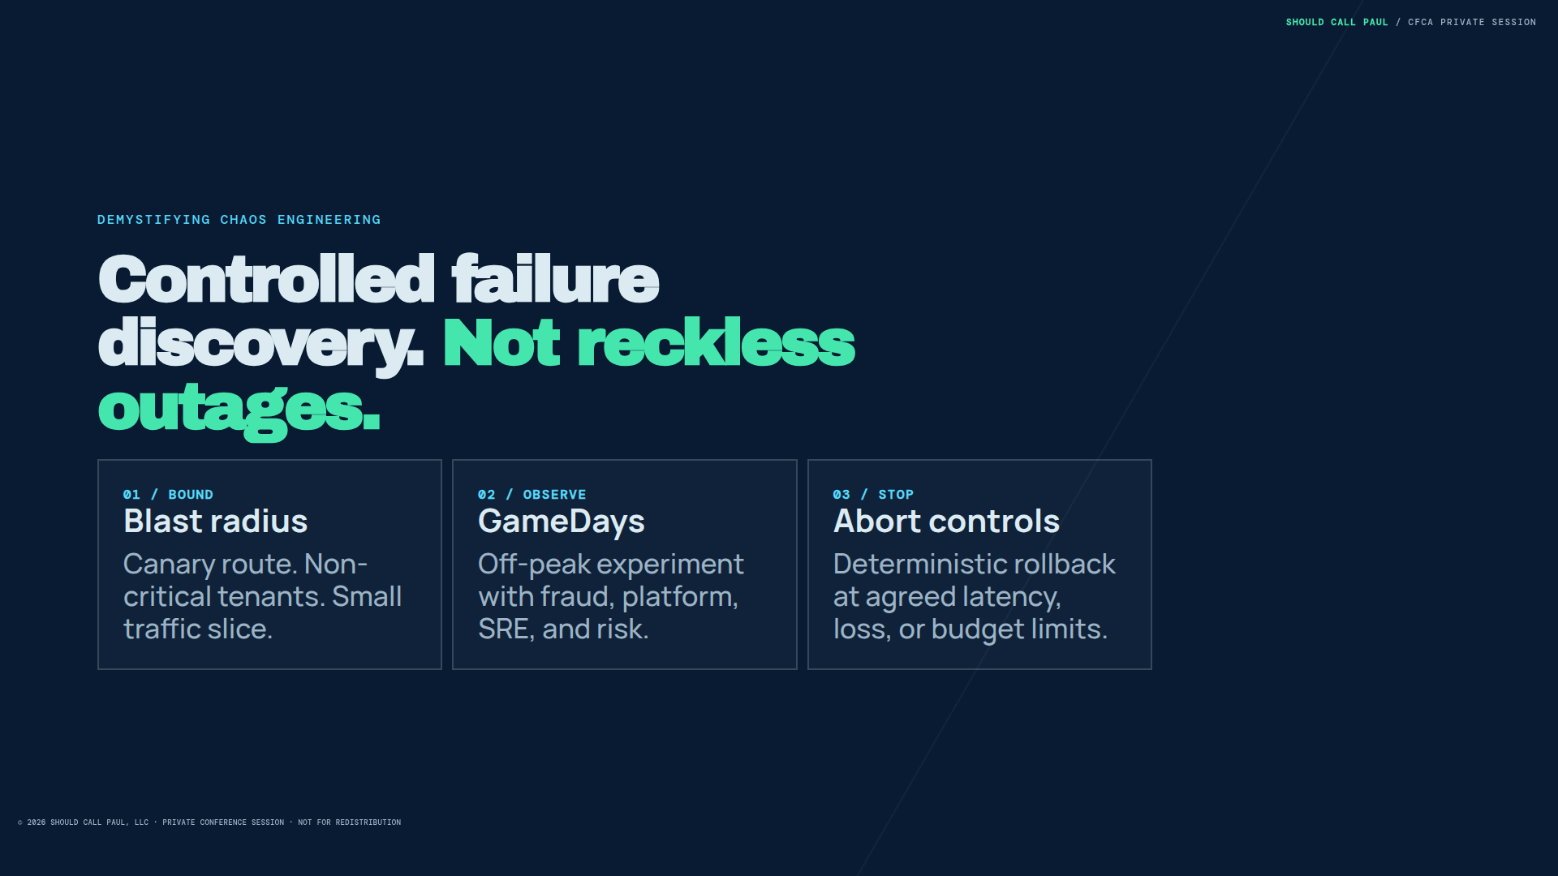
Notes:
DEMYSTIFYING CHAOS ENGINEERING
Controlled failure
discovery. Not reckless outages.
01 / BOUND
Blast radius
Canary route. Non-critical tenants. Small traffic slice.
02 / OBSERVE
GameDays
Off-peak experiment with fraud, platform, SRE, and risk.
03 / STOP
Abort controls
Deterministic rollback at agreed latency, loss, or budget limits.

Slide 6
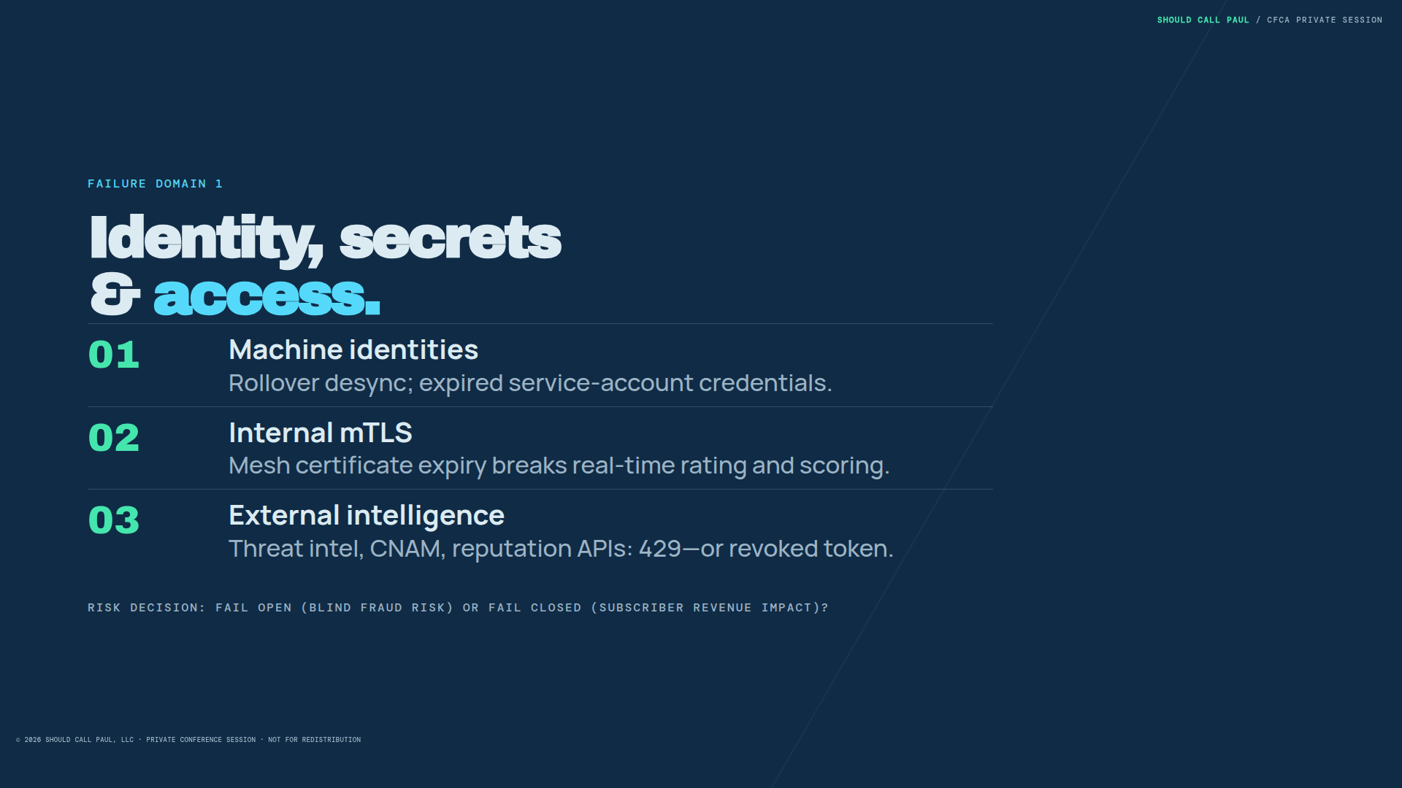
Notes:
FAILURE DOMAIN 1
Identity, secrets
& access.
01
Machine identities
Rollover desync; expired service-account credentials.
02
Internal mTLS
Mesh certificate expiry breaks real-time rating and scoring.
03
External intelligence
Threat intel, CNAM, reputation APIs: 429—or revoked token.
RISK DECISION: FAIL OPEN (BLIND FRAUD RISK) OR FAIL CLOSED (SUBSCRIBER REVENUE IMPACT)?

Slide 7
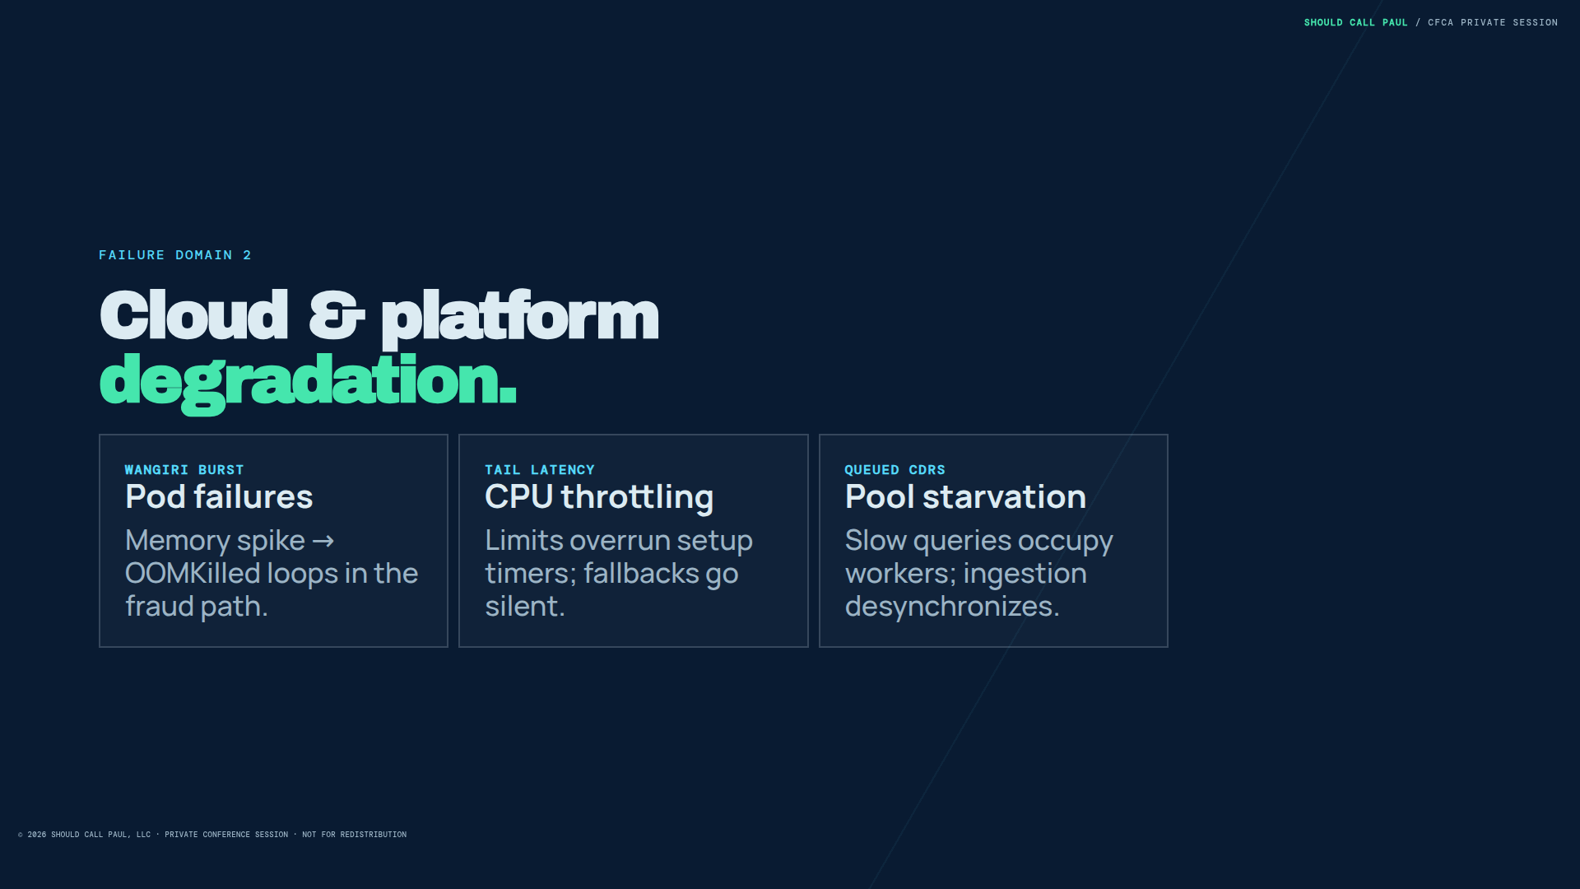
Notes:
FAILURE DOMAIN 2
Cloud & platform
degradation.
WANGIRI BURST
Pod failures
Memory spike → OOMKilled loops in the fraud path.
TAIL LATENCY
CPU throttling
Limits overrun setup timers; fallbacks go silent.
QUEUED CDRS
Pool starvation
Slow queries occupy workers; ingestion desynchronizes.

Slide 8
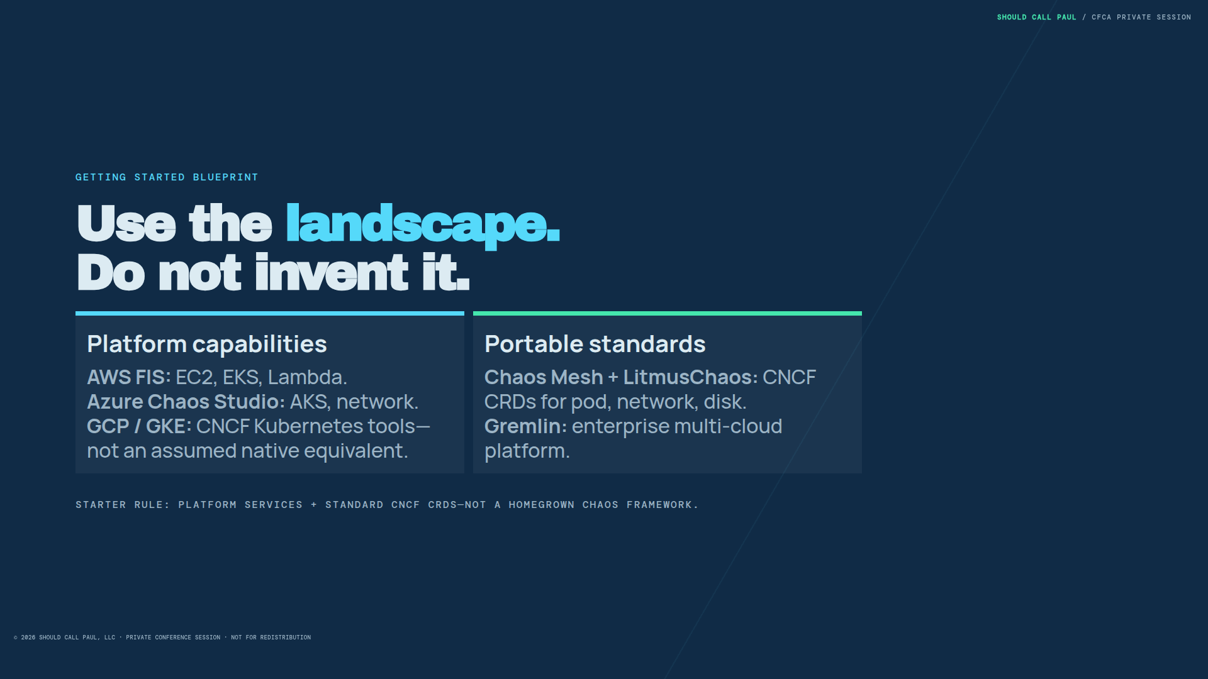
Notes:
GETTING STARTED BLUEPRINT
Use the landscape.
Do not invent it.
Platform capabilities
AWS FIS: EC2, EKS, Lambda.
Azure Chaos Studio: AKS, network.
GCP / GKE: CNCF Kubernetes tools—not an assumed native equivalent.
Portable standards
Chaos Mesh + LitmusChaos: CNCF CRDs for pod, network, disk.
Gremlin: enterprise multi-cloud platform.
STARTER RULE: PLATFORM SERVICES + STANDARD CNCF CRDS—NOT A HOMEGROWN CHAOS FRAMEWORK.

Slide 9
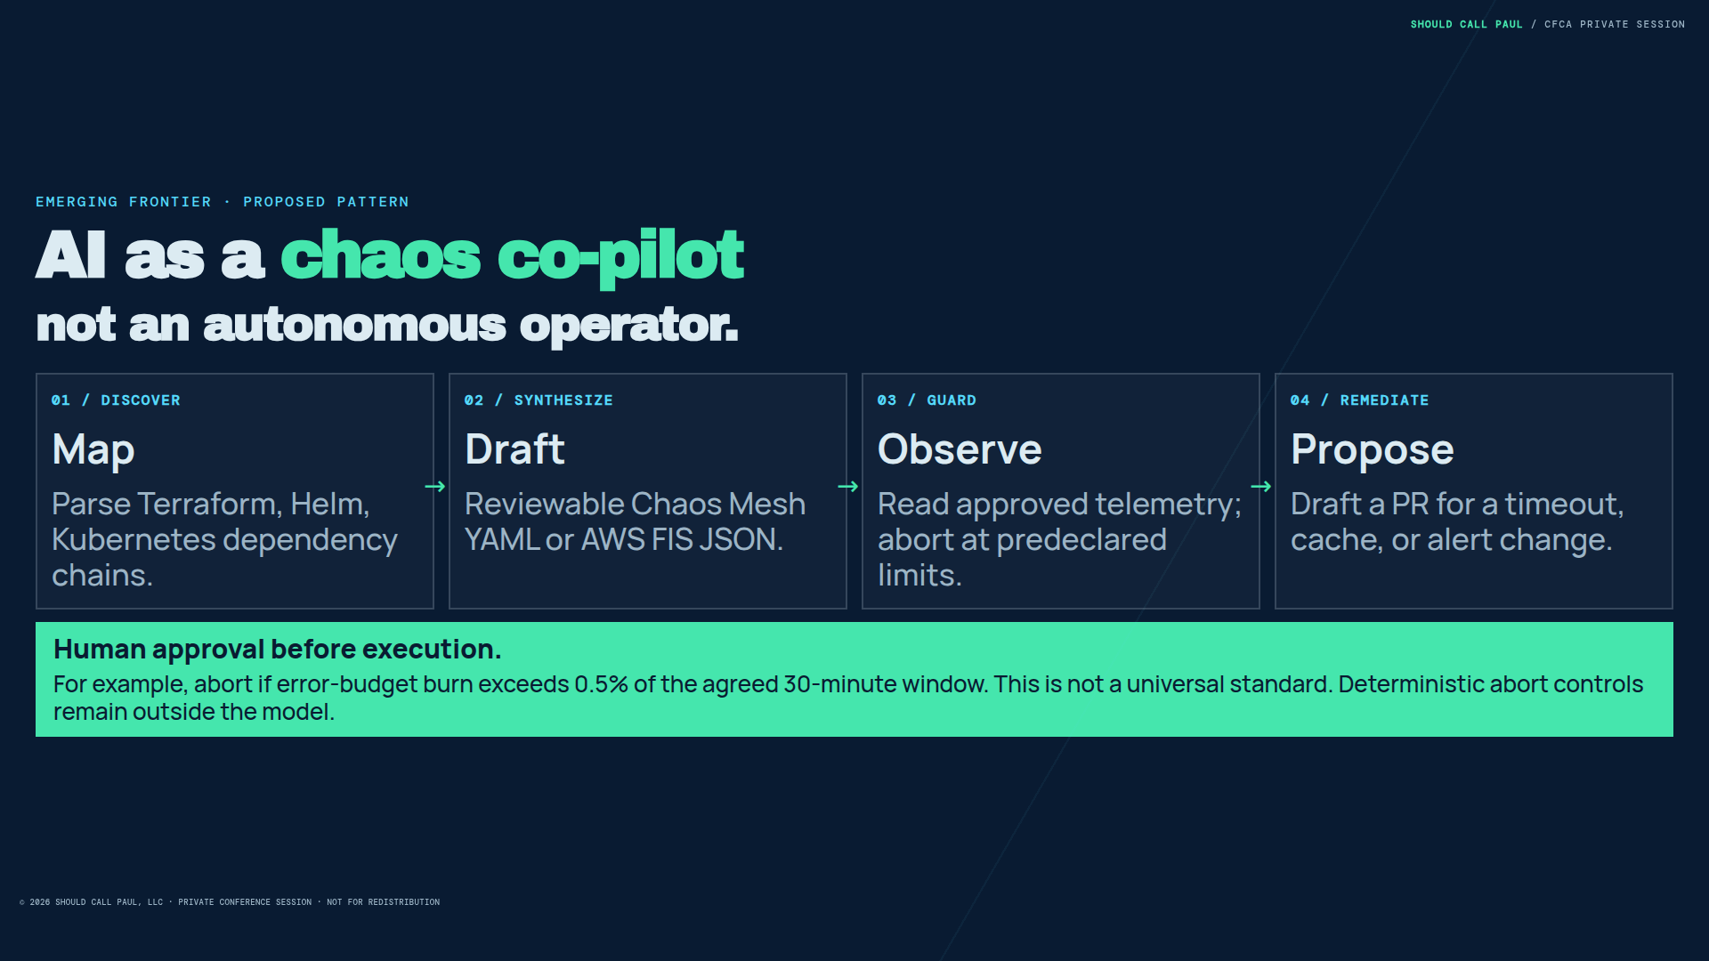
Notes:
EMERGING FRONTIER · PROPOSED PATTERN
AI as a chaos co-pilot
not an autonomous operator.
01 / DISCOVER
Map
Parse Terraform, Helm, Kubernetes dependency chains.
02 / SYNTHESIZE
Draft
Reviewable Chaos Mesh YAML or AWS FIS JSON.
03 / GUARD
Observe
Read approved telemetry; abort at predeclared limits.
04 / REMEDIATE
Propose
Draft a PR for a timeout, cache, or alert change.
Human approval before execution.
For example, abort if error-budget burn exceeds 0.5% of the agreed 30-minute window. This is not a universal standard. Deterministic abort controls remain outside the model.

Slide 10
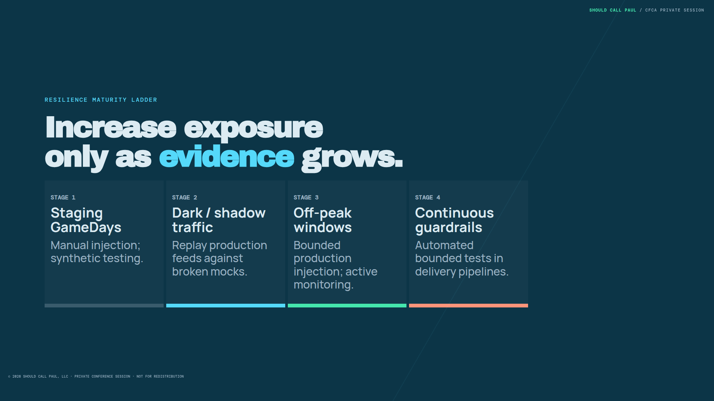
Notes:
RESILIENCE MATURITY LADDER
Increase exposure
only as evidence grows.
STAGE 1
Staging GameDays
Manual injection; synthetic testing.
STAGE 2
Dark / shadow traffic
Replay production feeds against broken mocks.
STAGE 3
Off-peak windows
Bounded production injection; active monitoring.
STAGE 4
Continuous guardrails
Automated bounded tests in delivery pipelines.

Slide 11
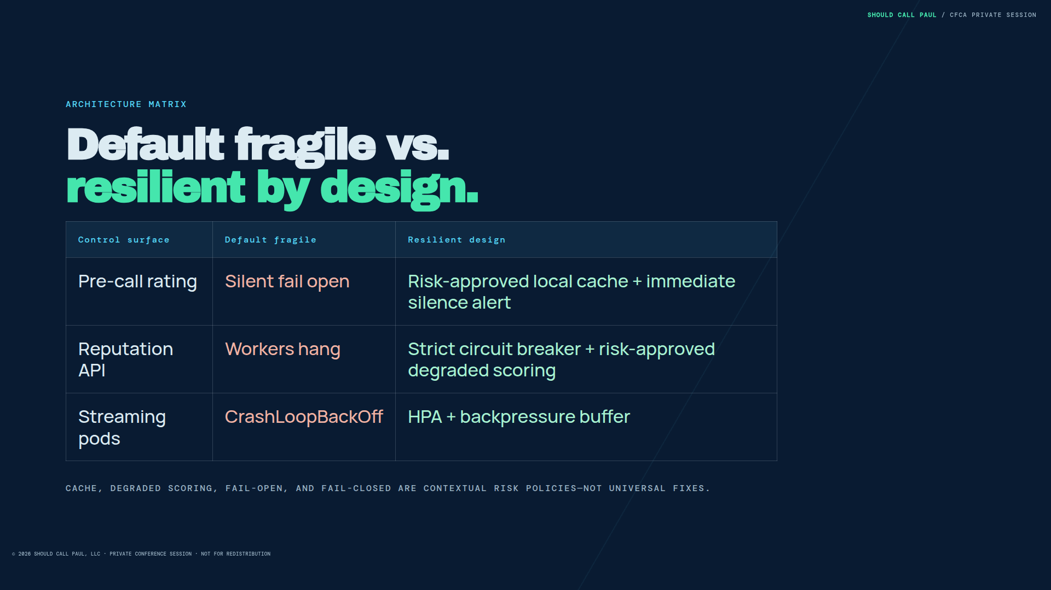
Notes:
ARCHITECTURE MATRIX
Default fragile vs.
resilient by design.
Control surface Default fragile Resilient design
Pre-call rating Silent fail open Risk-approved local cache + immediate silence alert
Reputation API Workers hang Strict circuit breaker + risk-approved degraded scoring
Streaming pods CrashLoopBackOff HPA + backpressure buffer
CACHE, DEGRADED SCORING, FAIL-OPEN, AND FAIL-CLOSED ARE CONTEXTUAL RISK POLICIES—NOT UNIVERSAL FIXES.

Slide 12
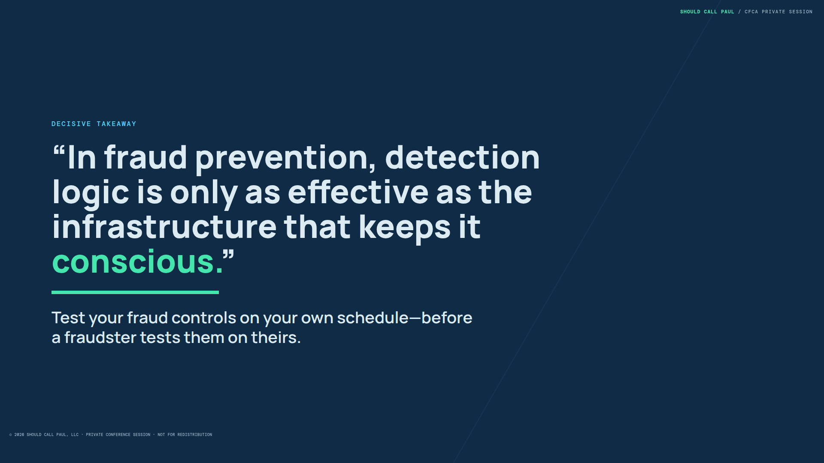
Notes:
DECISIVE TAKEAWAY
“In fraud prevention, detection logic is only as effective as the infrastructure that keeps it conscious.”
Test your fraud controls on your own schedule—before a fraudster tests them on theirs.

Slide 13
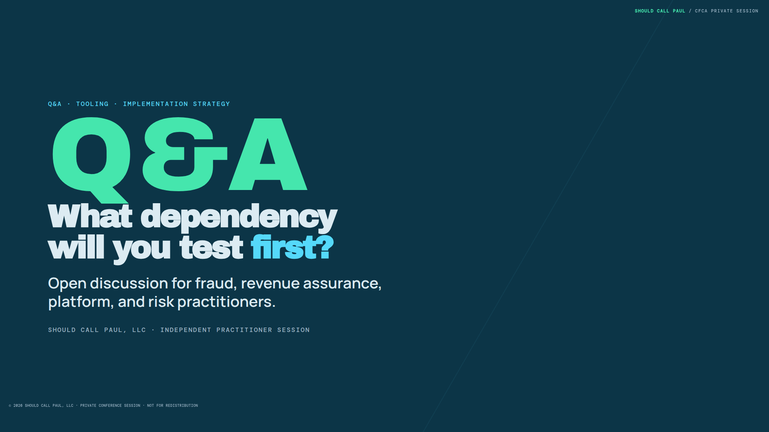
Notes:
Q&A · TOOLING · IMPLEMENTATION STRATEGY
Q&A
What dependency
will you test first?
Open discussion for fraud, revenue assurance, platform, and risk practitioners.
SHOULD CALL PAUL, LLC · INDEPENDENT PRACTITIONER SESSION

