Slide 1
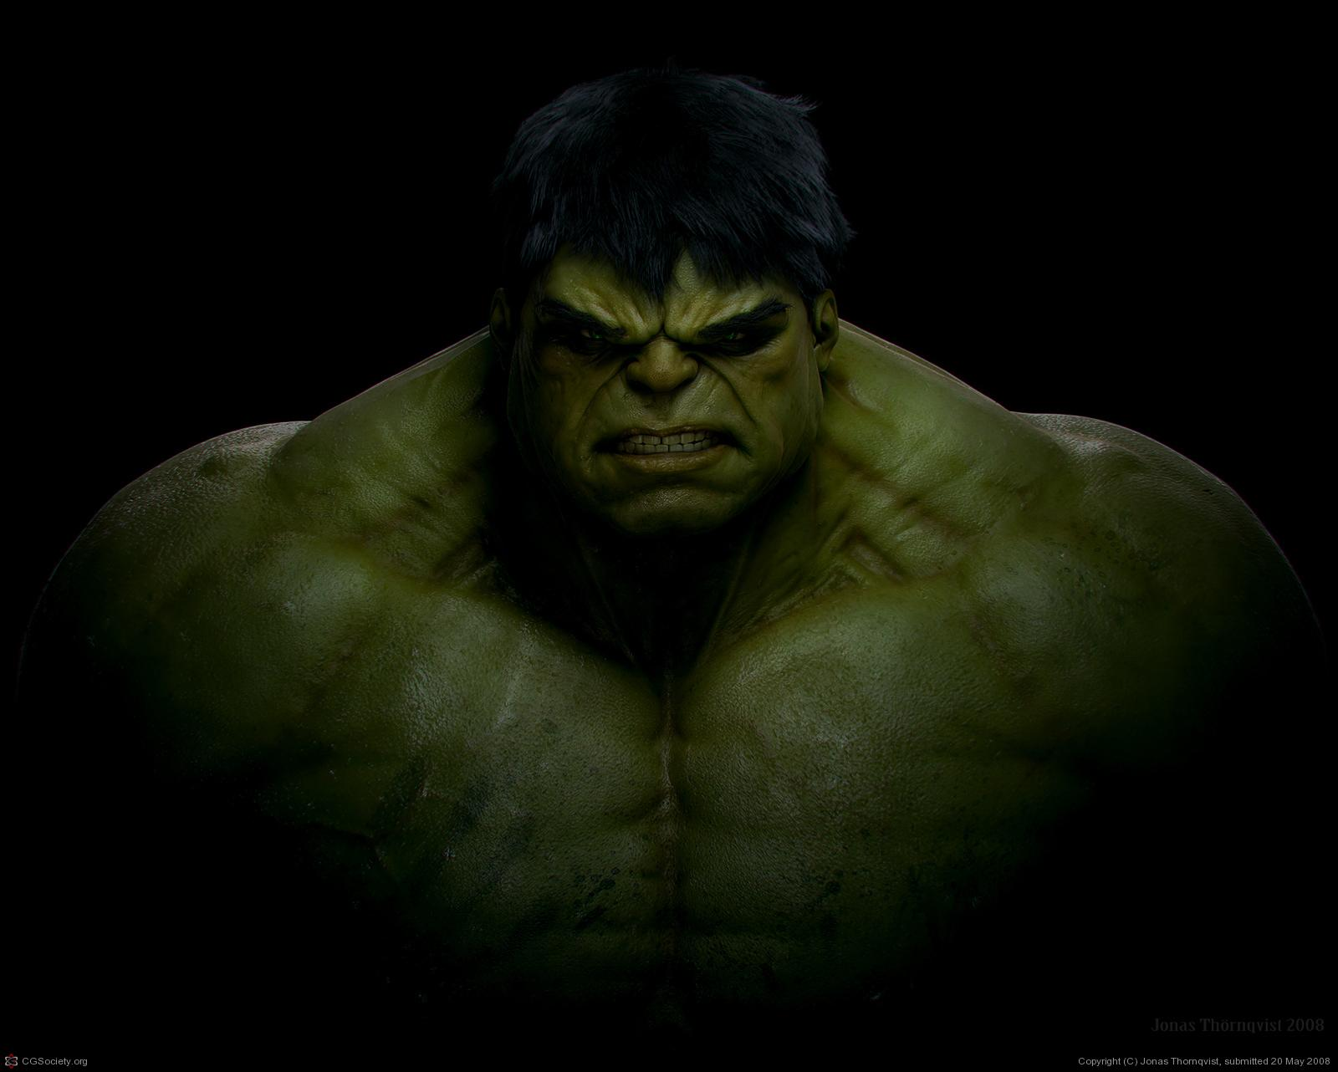

Team Hulk OOP TeamWork
Team members:
Georgi Ivanov (georgi.ivanov)
Kalojan Atanasov (Kalojanatanasov)
Pirin Karabenchev (pirin)
Project URL: https://georgiivanov.visualstudio.com/

Slide 2
Team Hulk OOP TeamWork
Tetris

Slide 3
Team Hulk OOP TeamWork
Project goal:
To implement a Tetris clone. We base our solution on Windows Forms technology, aiming better user experience and studying something new during development.

Slide 4
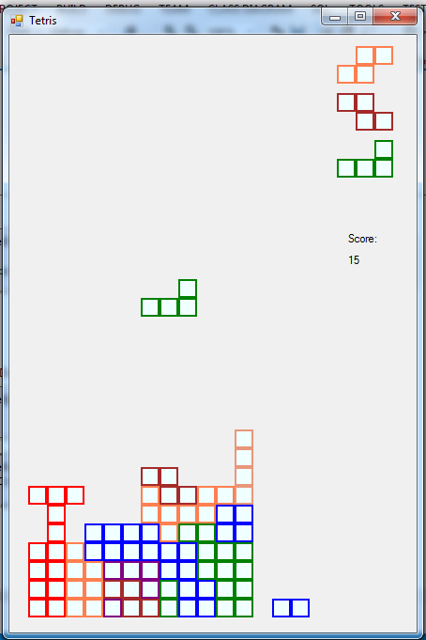
Team Hulk OOP TeamWork
Game field
Shapes queue
Score
Active shape
Static blokcs

Slide 5
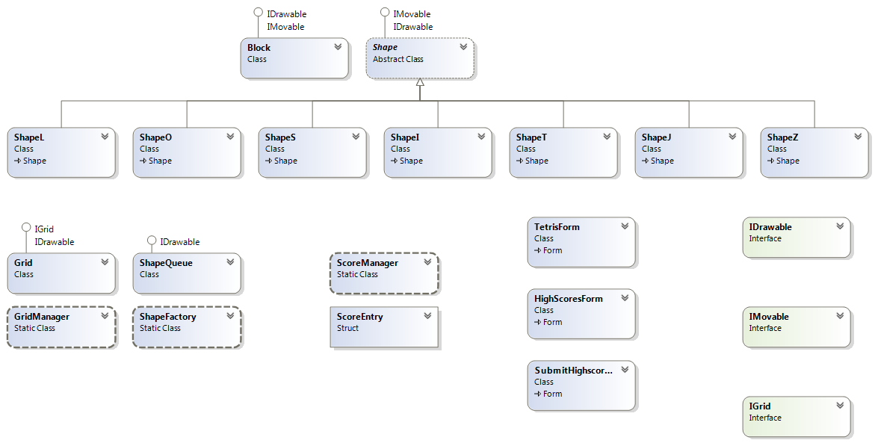
Team Hulk OOP TeamWork

Slide 6
Team Hulk OOP TeamWork
Questions?

Slide 7
Team Hulk OOP TeamWork
Thank you!

